Slide 1
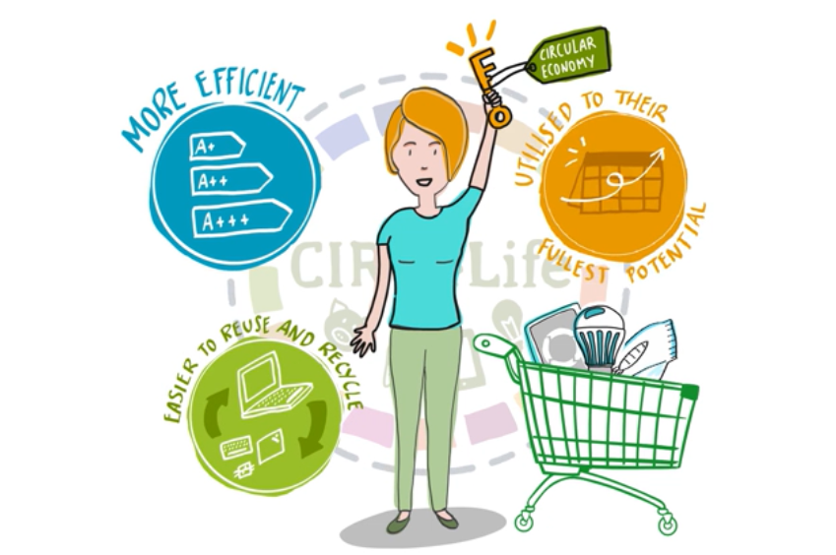
Bottom up approaches in the circular economy
How average people as citizens, entrepreneurs, and consumers are helping make a more circular world.
Timothy Marcroft & Dikshya Regmi
Sogndal 6. February 2022

Slide 2
Roadmap of this lecture
What do we mean by a bottom-up approach and why does it matter?
ReSOLVE: a general framework for increasing circularity.
Consumer behavior and its importance to the circular economy.
Breaking down the process of consumption and circular behaviors within it.
Slow fashion: a circular clothing movement.
Examples from other bottom-up initiatives.
Other readings, resources, and references

Slide 3
A collaborative, bottom-up approach to the
circular economy
Circular Economy from a bottom-up perspective pays attention to the mobilization and work of citizens and social innovators in their efforts to bring new solutions and business models into circularity.
Bottom-up activities belong to individuals, communities and by individual companies.
The bottom-up approach aims to encourage sustainability practices by all actors in society through innovative forms of consumption and production, implementing actions at all stages of value chains.
Top-down
Bottom-up
(PDF) Social-Ecological-Technical systems in urban planning for a circular economy: an opportunity for horizontal integration (researchgate.net)

Slide 4
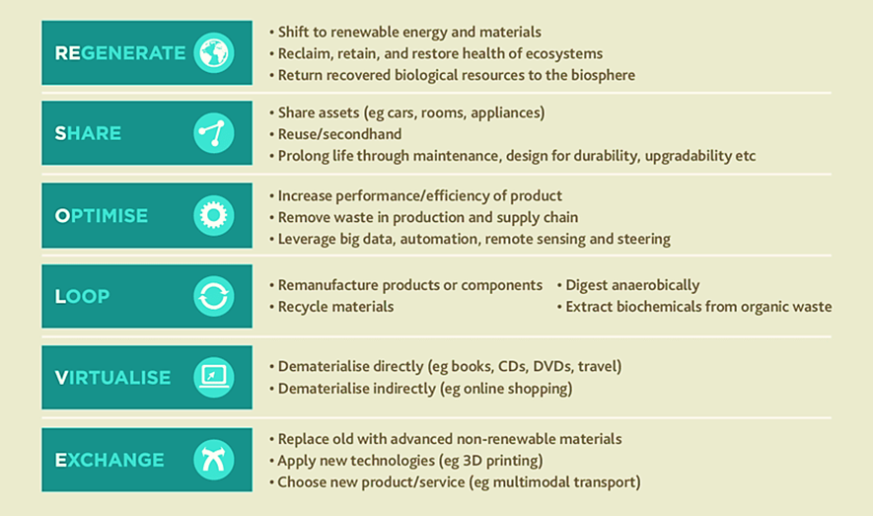
The ReSOLVE framework for circularity
ReSOLVE framework developed by Arup and the Ellen MacArthur Foundation provides a roadmap for organisations to become more circular.
https://iopscience.iop.org/article/10.1088/1755-1315/294/1/012002/meta
Source of graphic:
https://earthbound.report/2016/09/12/the-resolve-framework-for-a-circular-economy/

Slide 5
Consumers and circularity

Slide 6
Factors affecting consumer behavior
Economic factors
Information used for choices
Price and associated costs
Income
Valuation of future costs and benefits
Perception of risks and uncertainties
Circular solutions more expensive than linear solutions
Availability and comprehension of inputs for consumer decision making
Understanding distinctive characteristics of circular solutions
Information on availability and likely impact
Avoiding greenwashing to distort consumer understanding
European Environment Agency: Enabling Consumer Choices for a Circular Economy

Slide 7
Factors affecting consumer behavior (continued)
Fit between need and offerings
Preferences and Beliefs
Extent of products and services meeting consumer needs
Availability
Quality and Performance
Characteristics
Analysis of consumer needs and preferences
Limited supply and availability of circular solutions
Comfort (convenience)
Prestige
Value assigned to environmental characteristics
Brand loyalty
Other personal values
Changing cultural norms
Social Factors
Respect the social norms of the community
Follow common practices
Look for examples from role models
Follow advice from reference groups
European Environment Agency: Enabling Consumer Choices for a Circular Economy

Slide 8
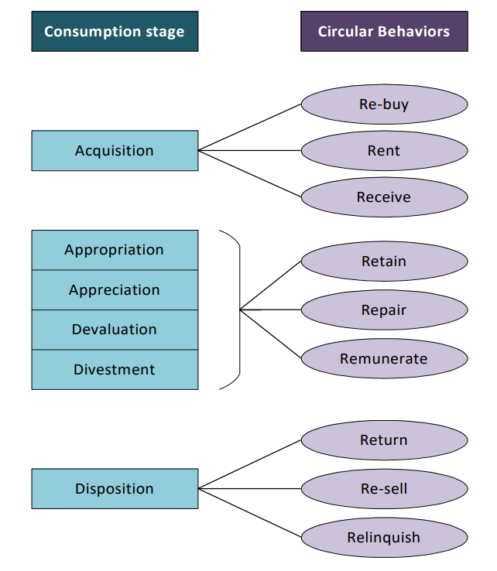
Circular economy and consumption
6 stages of Consumption & associated circular behaviors.
Acquisition: Purchasing circulated products or access to the product's function
Appropriation: Creation of meaning and enclose use of product in everyday life
Appreciation: Valuing the product in the domestic environment
Devaluation: Losing meaning and importance for the consumer
Divestment: Exiling from the domestic realm
Disposal: Allowing the product to re-enter the system
Camacho-Otero, Juana & Tunn, Vivian & Chamberlin, Lucy & Boks, Casper. (2019). Consumers in the circular economy.

Slide 9
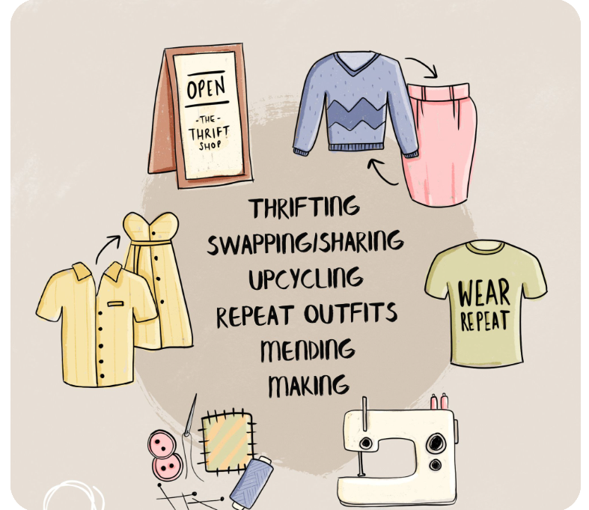
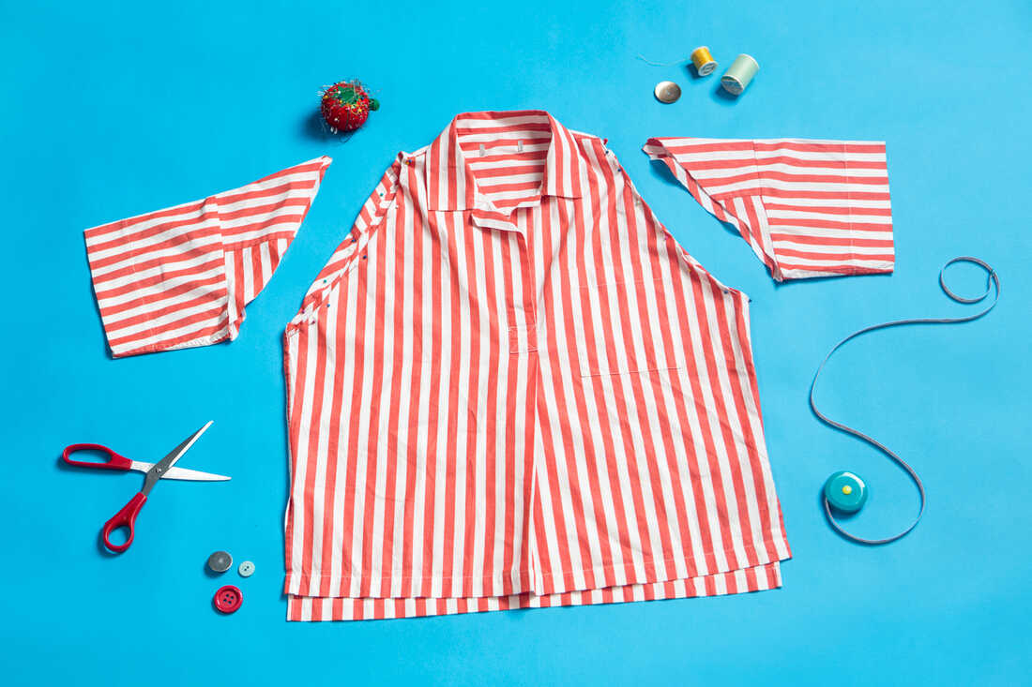
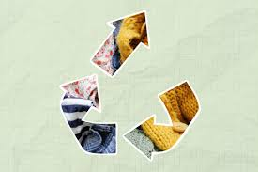
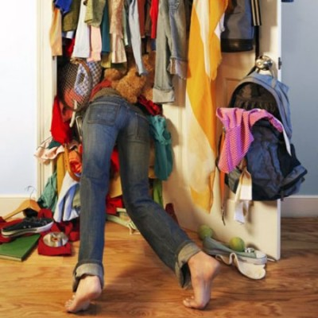
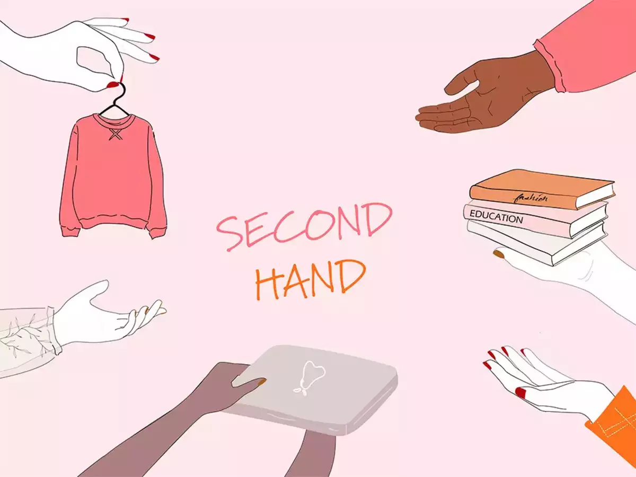
Slow fashion : a consumer trend towards circularity
Slow fashion towards clothing circularity
But how can we achieve this?
Making stations
Upcycling
Wardrobe audits
Clothing swaps
Matušovičová, Monika (2020) Sustainable fashion as a part of the circular economy concept
The Circular Project, Slow Fashion World
Charlie Steer-Stephenson (2022), The end of fast fashion and emergence of a circular economy

Slide 10
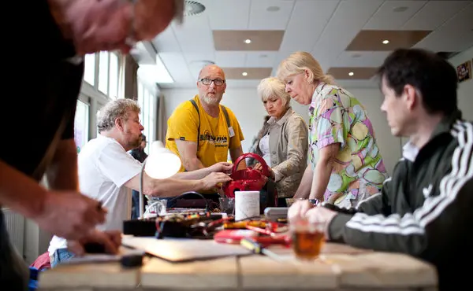
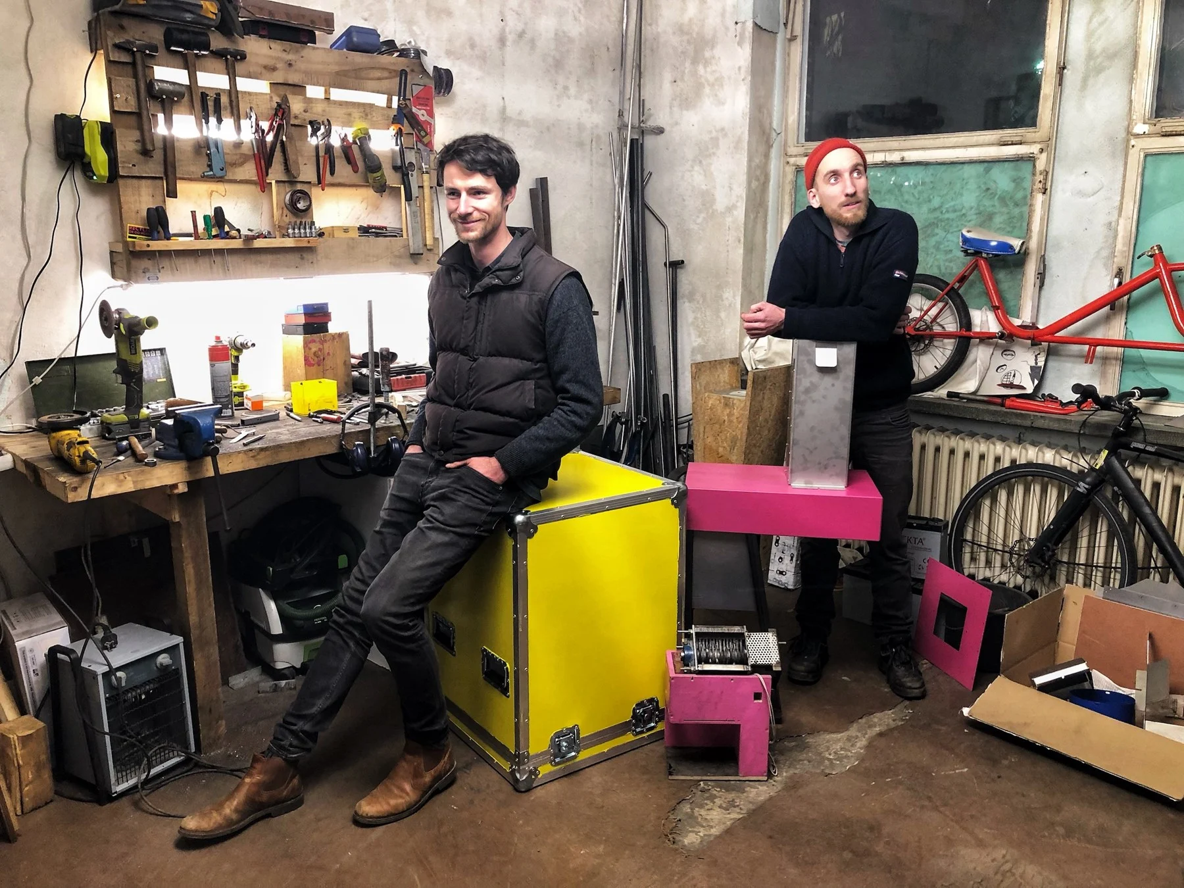
Repair & reuse: An equitable bottom-up dynamic in the circular economy
Repair cafe, Amsterdam
Recycle on the spot, Berlin
7 Great Examples of Bottom-up Circularity, Valtech

Slide 11
Opportunities for further reading
Enabling consumer choices for a circular economy, European Environment Agency briefing, 2022: https://www.eea.europa.eu/publications/influencing-consumer-choices-towards-circularity/enabling-consumer-choices-towards-a
Consumers in the circular economy, in Handbook of the Circular Economy, 2022: https://www.researchgate.net/publication/337085214_Consumers_in_the_circular_economy
The Ellen MacArthur Foundation website: https://ellenmacarthurfoundation.org/
Getting the ball rolling: an exploration of the drivers and barriers towards the implementation of bottom-up circular economy initiatives in Amsterdam and Rotterdam: https://ideas.repec.org/a/taf/jenpmg/v63y2020i11p1903-1926.html

