Slide 1
Digital technologies for the circular economy in the solar industry
Ässia Boukhatmi, Bern University of Applied Sciences, December 5th 2024

Slide 2
Ässia Boukhatmi
M.Sc. Industrial Engineering – Renewable energies & environmental resources (Berlin)
Research associate
Doctoral researcher
Lecturer
«Investigating potentials of digital technologies to foster the CE transition in the European solar industry»
Digital platforms and databases
Digital Product Passports
Machine Learning
Contact: aessia.boukhatmi@bfh.ch

Slide 3
Digital technologies for the circular economy (Kristoffersen et al. (2020)
“Digital platforms provide the technological infrastructure to connect different DTs, thus facilitating collaboration and innovation between the participating entities [1-3].”
Data analysis
Machine Learning algorithms
Data integration
Relational databases
Data collection
RFID chips & IoT sensors
Notes:
[1] Autio, E. (2022). Orchestrating ecosystems: A multi-layered framework. Innovation, 24(1), 96–109. https://doi.org/10.1080/14479338.2021.1919120
[2] Bonina, C., Koskinen, K., Eaton, B., & Gawer, A. (2021). Digital platforms for development: Foundations and research agenda. Information Systems Journal, 31(6), 869–902. https://doi.org/10.1111/isj.1232
[3] Zeng, J., Mahdi Tavalaei, M., & Khan, Z. (2021). Sharing economy platform firms and their resource orchestration approaches. Journal of Business Research, 136, 451–465. https://doi.org/10.1016/j.jbusres.2021.07.054

Slide 4
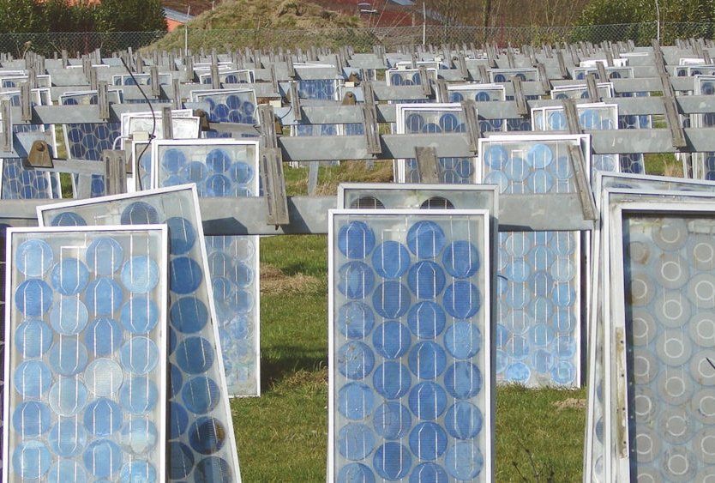
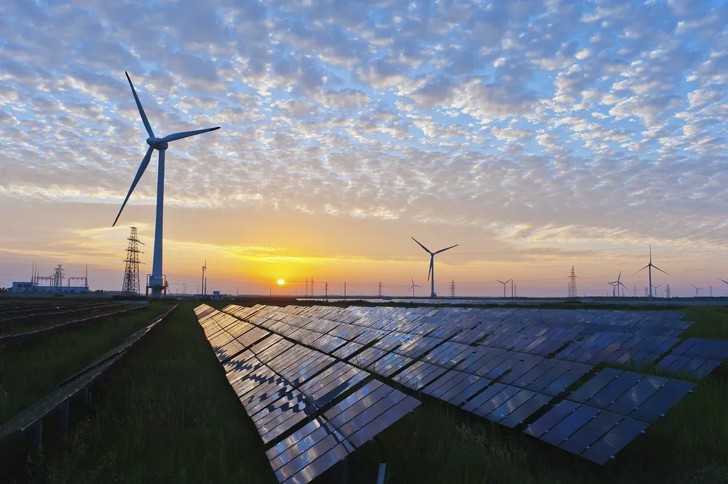
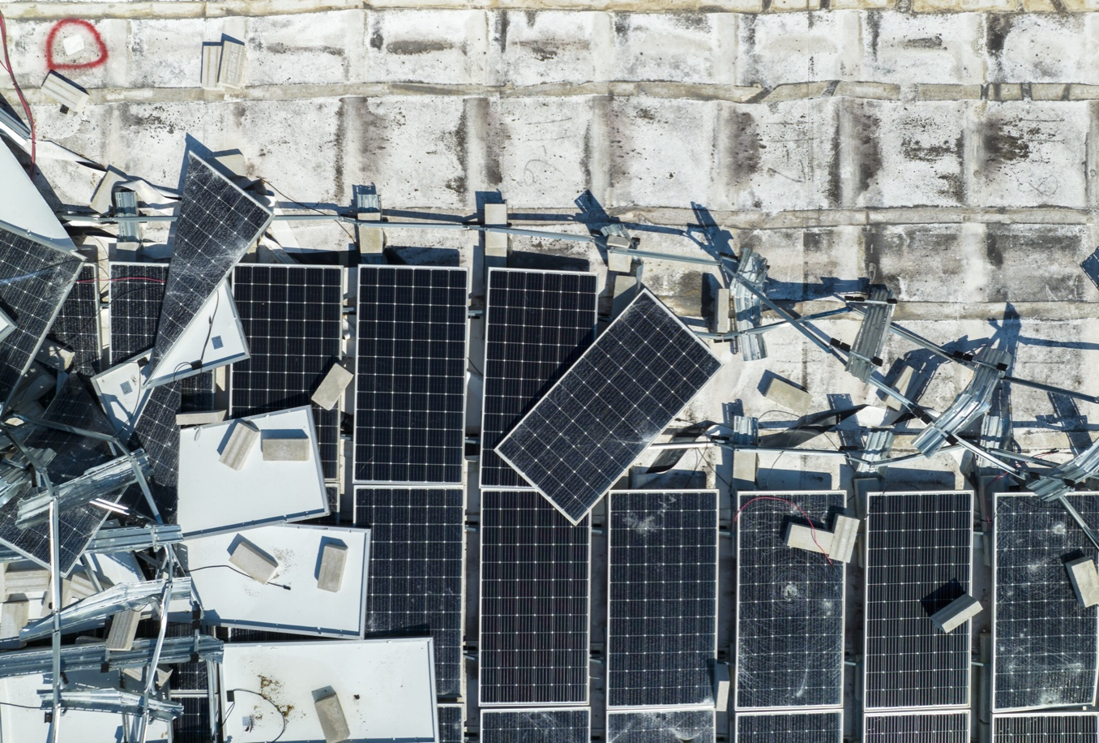
The European solar industry – Vision
vs. reality
Sources: EU news
Pv magazine
Notes:
Disposal of solar panels to be borne by manufacturers
Recycling PV panels: Why can’t we hit 100%? – pv magazine International

Slide 5
Increasig global PV waste amounts
140’000 tons in France until 2040?
Source: Soren (2023)
Notes:
An overview of solar photovoltaic panels’ end-of-life material recycling - ScienceDirect Germany 81,739 MW installiert in 2023 (8.3%)
Andere Quellen (Czajkowski et al. (2023)): ca. 12 Millionen Tonnen 2023

Slide 6
Resource depletion
The production of 1TWp of PV systems requires…
42 Mio. tons glass
20%
29’000 tons silver
12.5 Mio tons aluminium
56 Mio tons steel
2.3 Mio tons silicon
7 Mio tons cupper
Source: Soren (2023)
Notes:
2023 wurden ca 400 GW installiert. Das heisst 1TW ist etwa die Leistung, die in den nächsten zwei Jahren installiert wird
Silber Annahme: Reserven 530’000 t

Slide 7
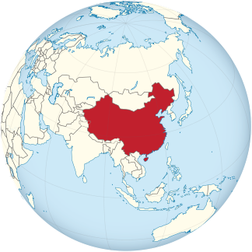
Geopolitical dependency
China produces currently more than 80% of the global PV capacity
Notes:
In der Schweiz: 1. Trina Solar, 2. JA Solar, 4. Longi Solar, 5. Jinko Solar

Slide 8
The circular economy– A paradigm shift for the European solar industry?
Narrow resource flows
Reduce waste
Slow resource flows
Reuse PV modules
Close resource flows
Recycle PV modules
Digitalization
Digital Product Passport

Slide 9
Digital platform and DPP – what is the overlap?
Digital platform
Digital product passport
“Digital platforms provide the technological infrastructure to facilitate innovation and collaboration between previously unconnected ecosystem actors.” [1-3]
“Services connect the platform architecture and its users through collaborative activities.” [4-6]
“Digital product passports are the underlying technology for developing new services.” [7]
“The DPP is a data set that summarizes the components, materials, and chemical substances in a product, and information on reparability, spare parts, and proper disposal instructions.” [8-9]
Platforms provide infrastructure for DPP development
DPP features shape platform design
(e.g., Modularity, access rights, APIs) [10]
Notes:
[1] Autio, E. (2022). Orchestrating ecosystems: A multi-layered framework. Innovation, 24(1), 96–109. https://doi.org/10.1080/14479338.2021.1919120
[2] Bonina, C., Koskinen, K., Eaton, B., & Gawer, A. (2021). Digital platforms for development: Foundations and research agenda. Information Systems Journal, 31(6), 869–902. https://doi.org/10.1111/isj.12326
[3] Zeng, J., Mahdi Tavalaei, M., & Khan, Z. (2021). Sharing economy platform firms and their resource orchestration approaches. Journal of Business Research, 136, 451–465. https://doi.org/10.1016/j.jbusres.2021.07.054
[4] Aarikka-Stenroos, L., Ritala, P., & Thomas, L. D. W. (2021). Circular economy ecosystems: A typology, definitions, and implications. In Research Handbook of Sustainability Agency (pp. 260–276). Edward Elgar Publishing. https://www.elgaronline.com/display/edcoll/9781789906028/9781789906028.00024.xml
[5] Adner, R. (2017). Ecosystem as Structure: An Actionable Construct for Strategy. Journal of Management, 43(1), 39–58. https://doi.org/10.1177/0149206316678451
[6] Jacobides, M. G., Cennamo, C., & Gawer, A. (2018). Towards a theory of ecosystems. Strategic Management Journal, 39(8), 2255–2276. https://doi.org/10.1002/smj.2904
[7] van Capelleveen, G., Vegter, D., Olthaar, M., & van Hillegersberg, J. (2023). The anatomy of a passport for the circular economy: A conceptual definition, vision and structured literature review. Resources, Conservation & Recycling Advances, 17, 200131. https://doi.org/10.1016/j.rcradv.2023.200131
[8] T. Götz, T. Adisorn, L. Tholen, L., Der Digitale Produktpass als Politik-Konzept, Wuppertal Report Nr. 20, Wuppertal Institut, 2021.
[9] T. Adisorn, L. Tholen, T. Götz, Energies 2021, 14, 2289. DOI: https://doi.org/10.3390/en14082289
[10] Chen et al. (2022) Governance and Design of Digital Platforms: A Review and Future Research Directions on a Meta-Organization

Slide 10
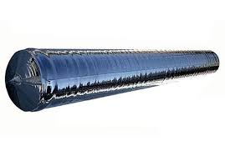
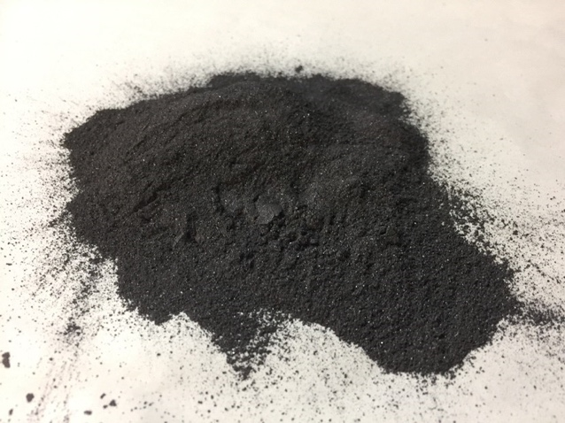
Narrow resource flows – Reduce waste
Increasing efficiency in production
Use of highly efficient PV modules to maximize energy yield
Optimization of production processes
Durable product design
Development of robust PV modules with long life cycles
Material saving
Substitution of rare and toxic resources
Avoidance of overproduction
Demand-oriented production through precise demand forecasts
Promotion of regional production capacities
Notes:
Presentation of the challenges related to the recycling of Silicon Kerf by LuxChemtech - Icarus

Slide 11
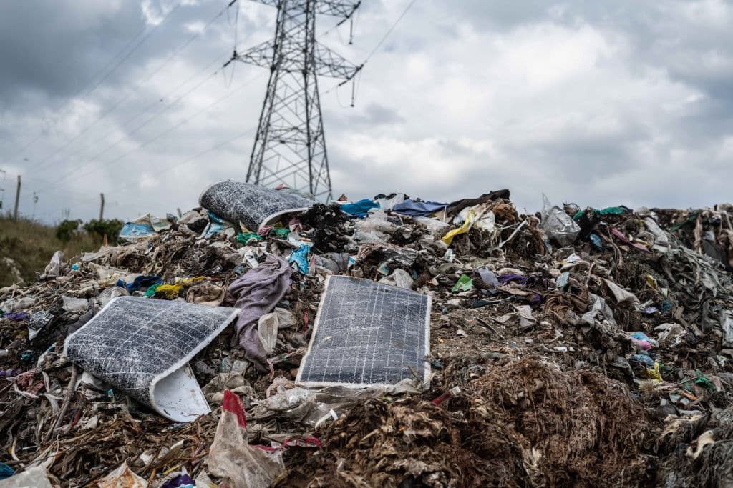
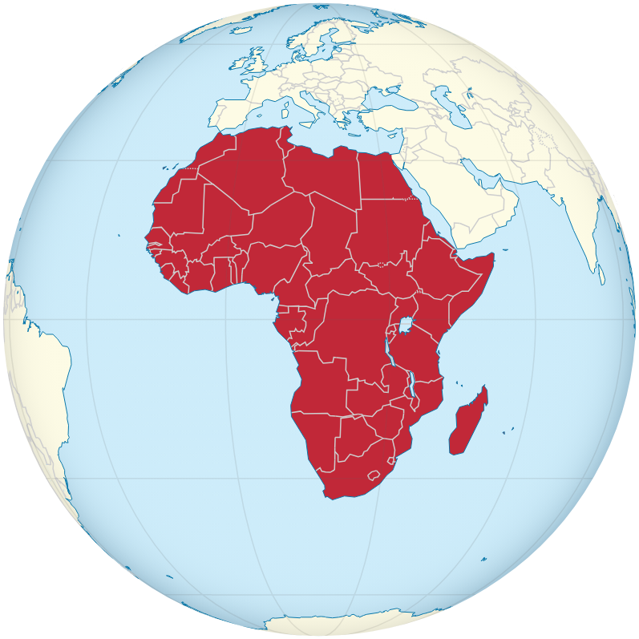
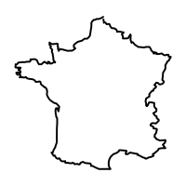
Reuse is already happening
Germany:
50% Export
Waste relocation
France:
30% Export
Italy:
70% Export
Source: Forbes Africa
Source: Soren
Notes:
After Solar, Comes Lead: Why Africa Can’t Afford To Become A Toxic Dumping Ground For E-Waste - Forbes Africa

Slide 12
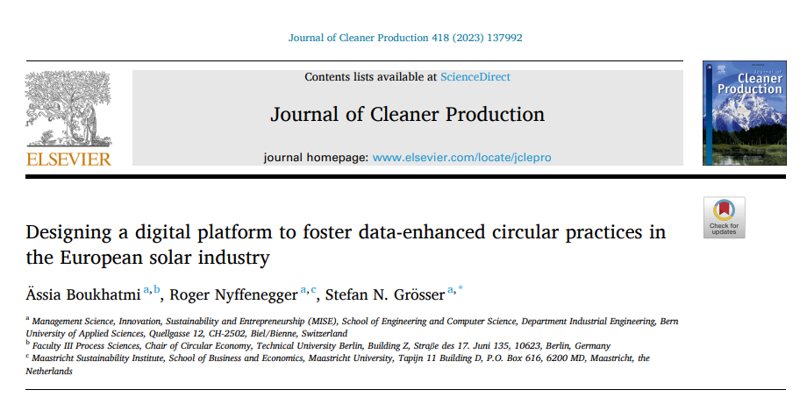
Digital platform prototype

Slide 13
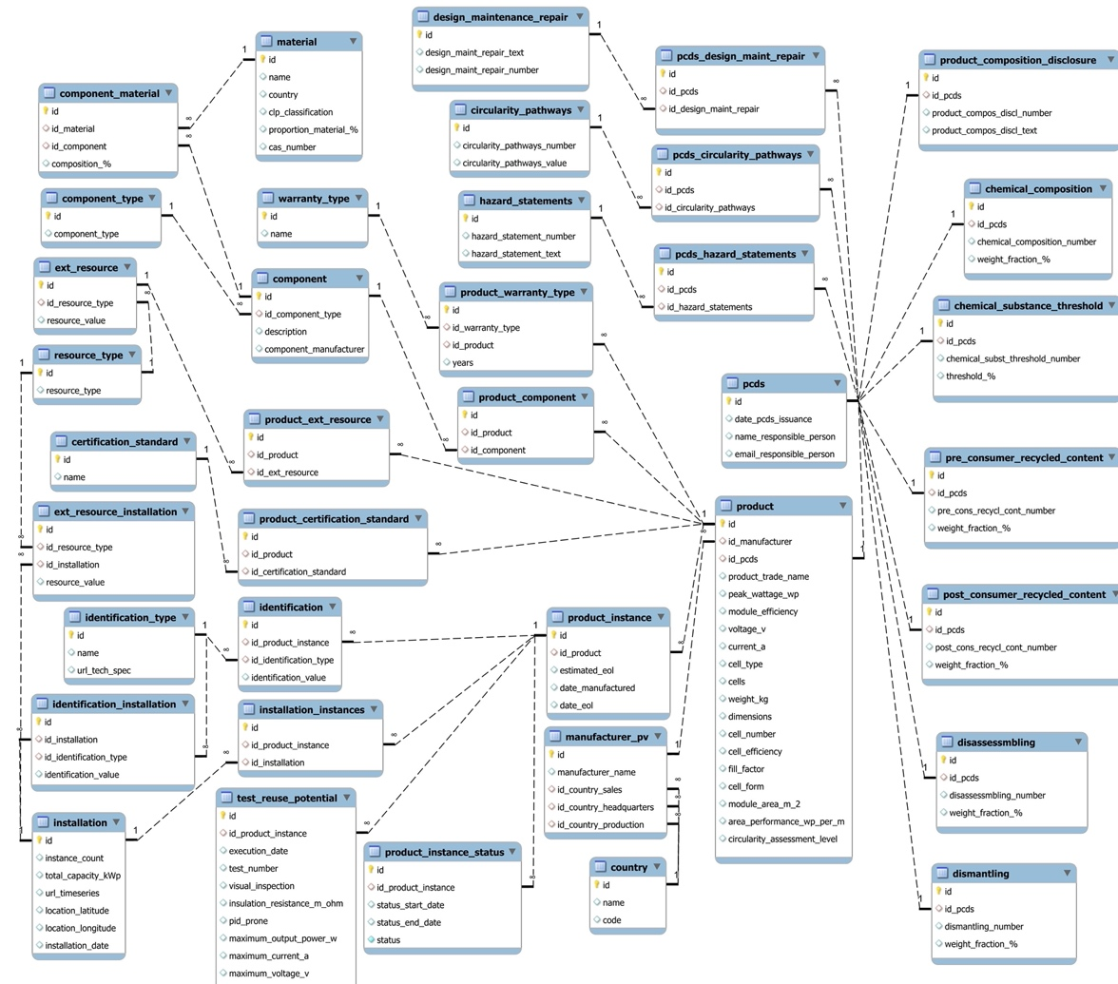
Digital platform prototype – (the vision)

Slide 14
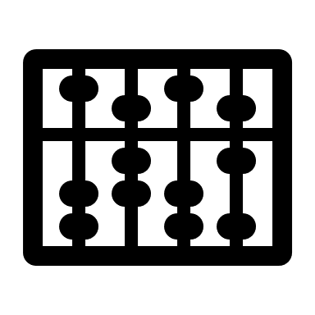
Understanding PV End-of-Life in Switzerland
(1) Data sorting & selection
(2) Data merging
(3) Data formatting & anomaly detection
(4) Pattern identification
→ Data losses ☹
→ Power interruptions ≤ 12 months
Development of sample dataset with 522 potential End-of-Life PV plants (qual. analysis)
Development of master dataset (basis for database & quant. analysis)

Slide 15
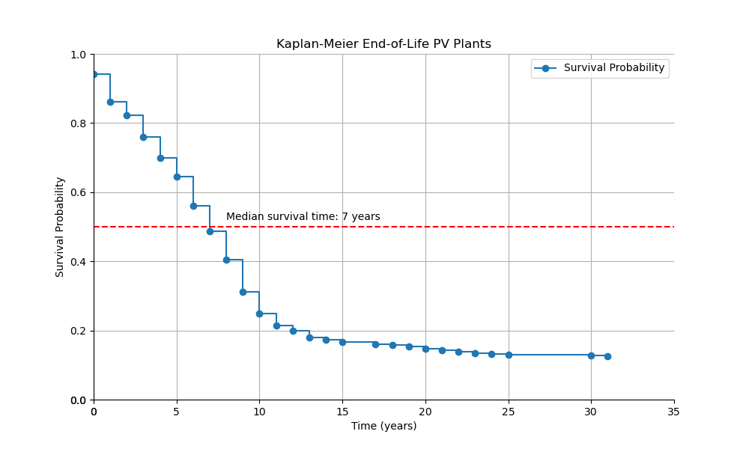
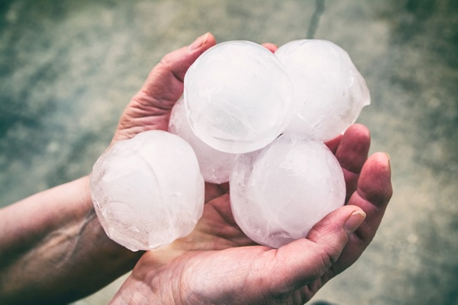
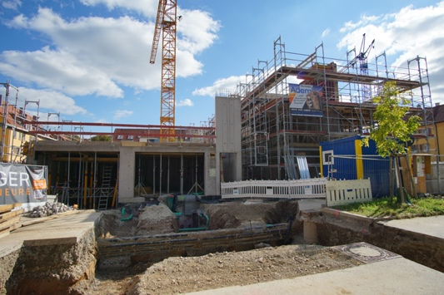
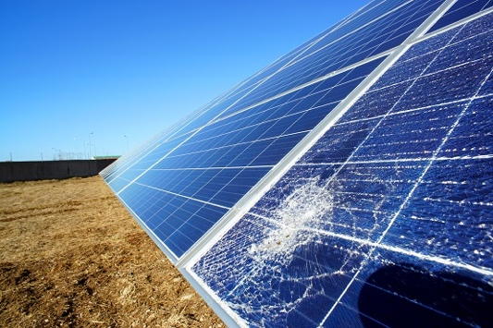
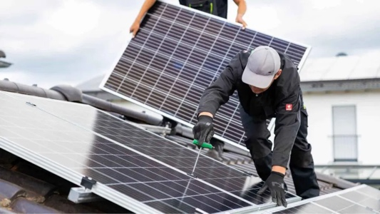
Understanding PV End-of-Life – Quantitative analysis
50% of PV modules currently entering the waste stream are reusable
Hail
Construction work
Material damages
Repowering
Notes:
Wenn der Hagel einschlägt: So schützt du dein Haus
Repowering Photovoltaik: Mehr Energie aus deiner Solaranlage
Wichtig: Im Durchschnitt leben Module sehr lange (>25 – 30 Jahre)

Slide 16
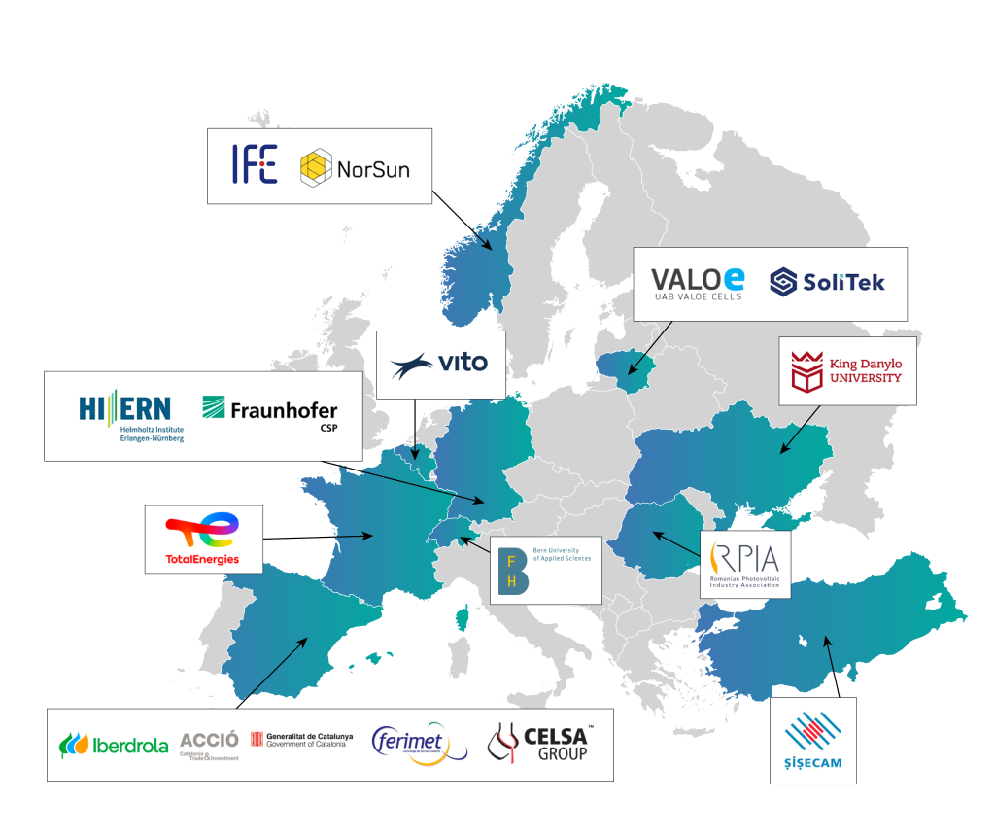
Close resource flows – Recycling
Common technologies:
Mechanical recycling
Thermal recycling
Chemical recycling
Water jet separation
Flash separation
Challenges:
Energy (CO₂)-intensive
Low material quality (i.e. not reusable in PV production)
Recycling not yet established on an industrial scale
Returning waste from PV modules to production as high-quality products
Notes:
How to design a winning business model for a startup using business model canvas

Slide 17
The circular future of the European solar industry
How do we get there?
4. Digitalization of the value chain
5. Regulations
3. Expansion of efficient recycling technologies
2. Reuse before recycling
1. Reuse of recycled materials & production waste

Slide 18
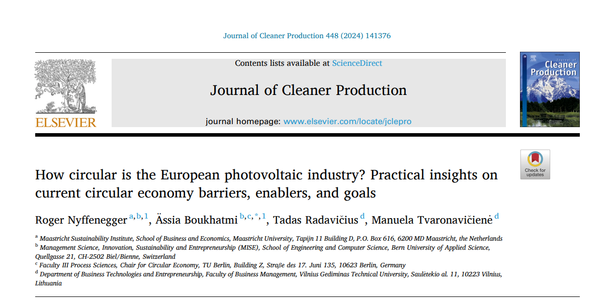
Another paper recommendation

Slide 19
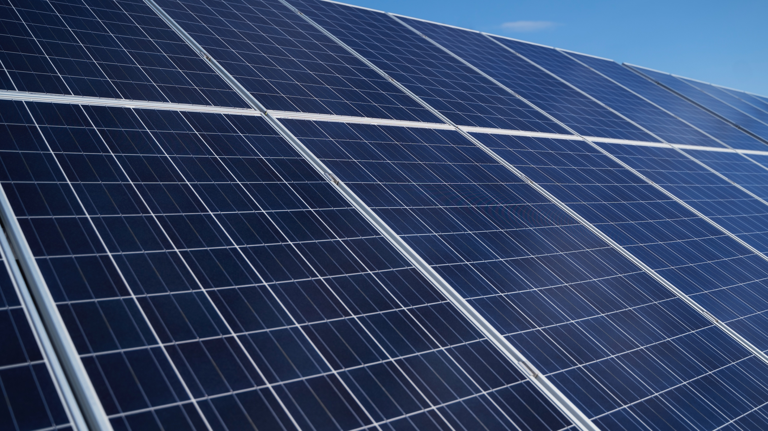
Questions?
aessia.boukhatmi@bfh.ch

