Slide 1
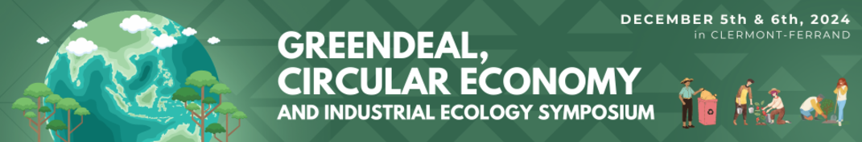


INDUSTRIAL ECOLOGY AND CIRCULAR ECONOMY: PAST, PRESENT AND FUTURE DEVELOPMENTS.
A BIBLIOMETRIC ANALYSIS
Veronica Casolani; Raffaella Taddeo; Valentino Tascione; Alberto Simboli
Email addresses: veronica.casolani@unich.it; r.taddeo@unich.it; v.tascione@unich.it; a.simboli@unich.it
Department of Economic Studies, University “G. d’Annunzio” of Chieti-Pescara, Viale Pindaro 42, Pescara, Italy
Notes:
Good morning everyone. I would like to thank the organizers for the opportunity to present my research. Today, I will be presenting a work on the relationship between Industrial Ecology (IE) and Circular Economy (CE). The research is part of my PhD project, which aims to study the transition of production systems towards the circular economy, using IE approaches and methods. This research aims to analyze the intersection of these fields and explore their common ground.

Slide 2
AGENDA
1. Basic concepts
3. Methodology
4. Results - aspects investigated
Trend
5. Limits and further investigations
Authors
Author’s keywords
Countries
2. Research problem and aim of study
Notes:
The presentation is structured as follows: Initially we will see the definition of the two basic concepts studied, I will present the research problem and the objective of the study, the methodology followed, The results obtained by analysing 4 more important aspects to highlight the relationships between the two areas of study and we will see possible future developments

Slide 3
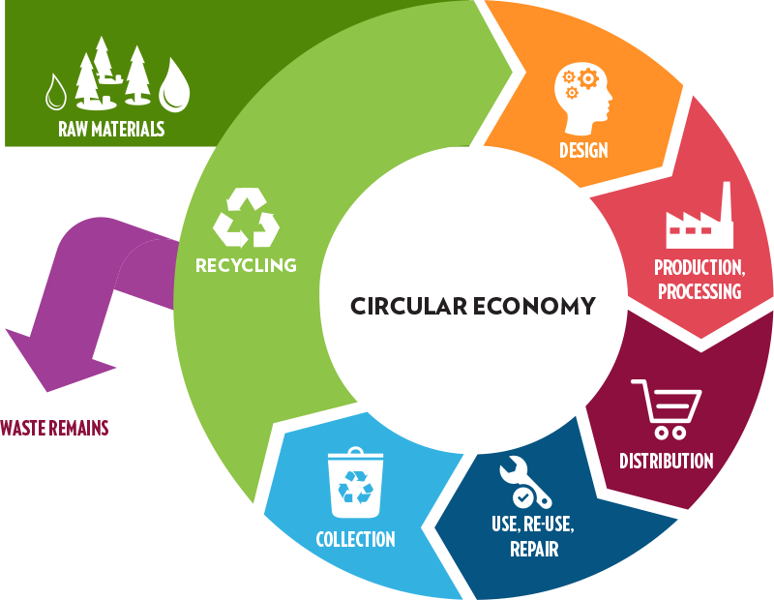
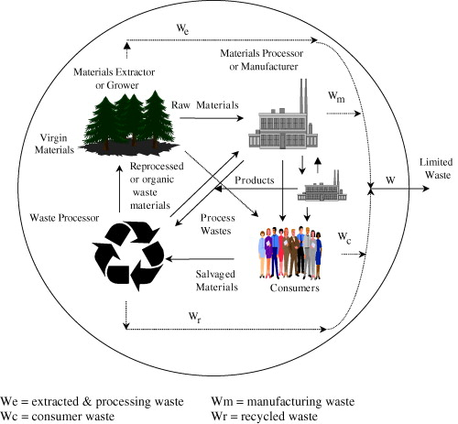
1. BASIC CONCEPTS
Industrial Ecology (IE)
Interdisciplinary approach that studies human systems by analogy with biological systems. IE promotes the development of solutions for designing economic systems so that they evolve in a more sustainable way.
Circular Economy (CE)
Paradigm shift opposite to the so-called ‘take make-dispose’ linear economic model, which has been made possible through the implementation of closed-loop solutions within economic systems.
Notes:
We are familiar with and have learned to deal with Circular Economy (CE), which has become a phenomenon across all sectors, not just in academia. It is widely agreed that CE represents a new paradigm, opposite to the so-called 'take-make-dispose' linear economic model, which has been made possible through the implementation of closed-loop solutions within economic systems.
Less well-known globally, except within scientific area of studies dedicated to the field, is the concept of Industrial Ecology (IE). IE has been an interdisciplinary approach for over 60 years, studying human systems by analogy with biological systems. The goal of both fields is to redesign economic systems so they evolve in a more sustainable way.

Slide 4
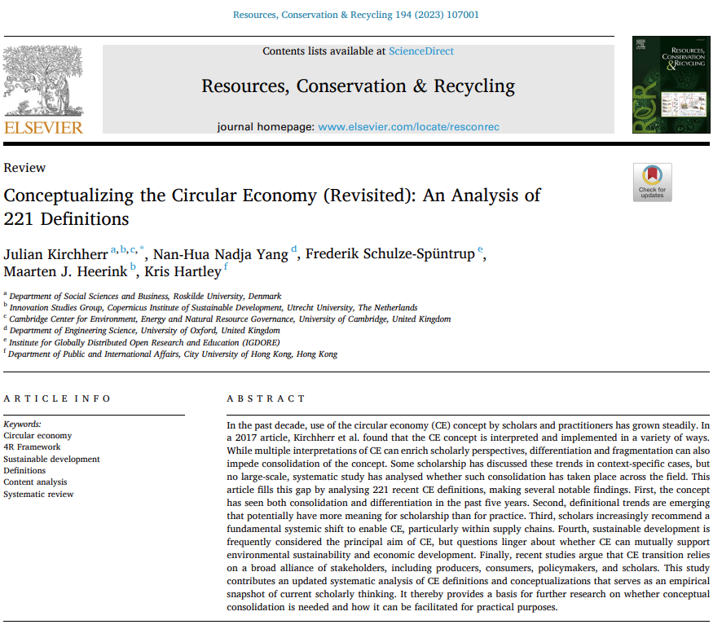
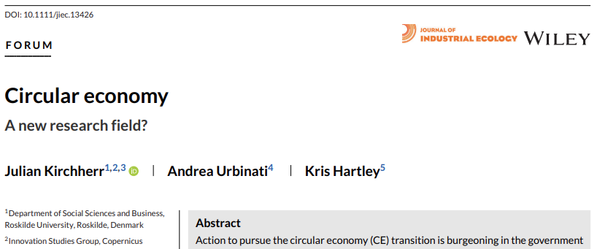
2. Research problem and aim of study
IE
?
CE
AIM OF STUDY
EXAMINE THE SCIENTIFIC DEVELOPMENT OF CIRCULAR ECONOMY AND INDUSTRIAL ECOLOGY, TRYING TO HIGHLIGHT WHAT THEY HAD, OR STILL HAVE, IN COMMON AND UNDERSTAND IF THERE IS STILL SOMETHING THAT THEY CAN SHARE IN THE FUTURE.
Notes:
Maybe it's because the words used are simple, which immediately evoke a sense of balance and regeneration, the term "circular economy" has become increasingly popular in all fields, not just in academia. In the literature, we find more than 200 different definitions, and just five years ago, the same author identified only a little over 100. This shows how much the topic has grown in popularity and been addressed by various researchers from different backgrounds.
Some have even begun to question about a new research field.
we asked ourselves how this concept, so similar to "Industrial Ecology," is actually related to it.

Slide 5
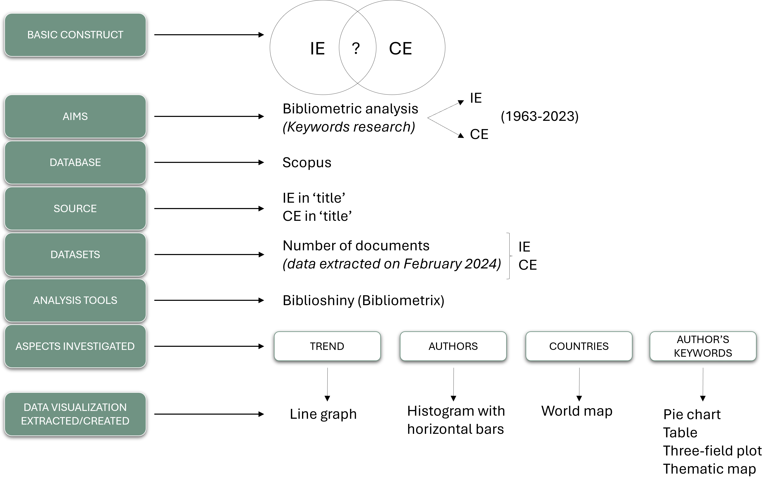
3. Methodology
Quantitative review method that allows scholars to summarize and analyze previous studies in order to investigate research trends in a field, identify knowledge gaps, derive new ideas for research and situate their intended contributions in the field.
Interface obtained using the R bibliometrics package (Aria and Cuccurullo, 2017), which helps scholars to easily use the main basic functions of bibliometrics and supports bibliometric analysis with analytics and plots data.
Notes:
The study followed this design. The core constructs are those of Industrial Ecology (IE) and Circular Economy (CE). Within these two fields, we aim to identify the relationships and commonalities between them. To achieve this, we conducted a bibliometric analysis—a quantitative review method that allows researchers to summarize and analyze previous studies, explore research trends, identify knowledge gaps, generate new research ideas, and position their contributions within the field.
The data for the analysis were extracted from Scopus, one of the most widely used and comprehensive academic databases. From Scopus, we retrieved two datasets:
All articles up to 2023 containing the keyword "Industrial Ecology" (IE) in the title.
All articles up to 2023 containing the keyword "Circular Economy" (CE) in the title.
Given that these are widely researched topics across various disciplines, we chose to focus specifically on the titles to ensure we captured only the most relevant studies. This approach covers a long period—60 years of research.
The articles and their associated metrics were extracted and processed using Biblioshiny, a tool based on the R Bibliometrix package (Aria and Cuccurullo, 2017). Biblioshiny provides an easy-to-use interface for bibliometric analysis, offering various analytical and visualization tools. It is free, capable of handling large datasets (as in our case), and highly efficient for this type of study. The main aspects investigated were: trends, authors, countries of origin of the authors, and the keywords used by the authors. For each of these aspects, graphs were generated to visualize the results.

Slide 6
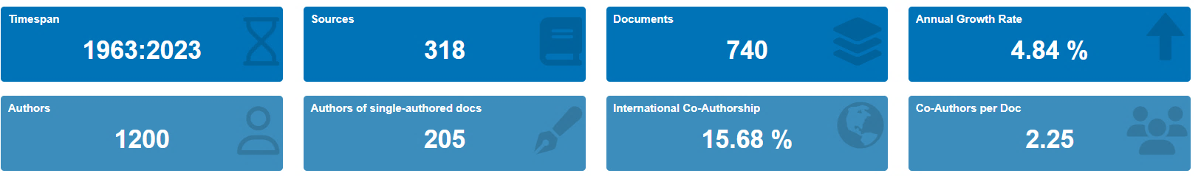
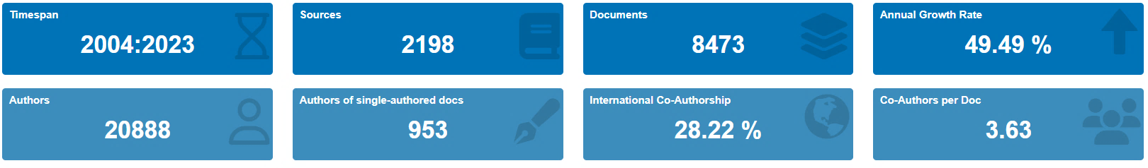
BIBLIOSHINY SUMMARY DATA
Summary of IE results. Source: Biblioshiny
Summary of CE results. Source: Biblioshiny
Notes:
In fact, we worked with two datasets: one for Industrial Ecology (IE) with 740 articles, and another for Circular Economy (CE) with 8,473 articles.
The summary data for these two datasets show a noticeable difference in annual growth trends.
Another interesting finding is the data on international co-authorship, which reveals that the field of Circular Economy has a much higher level of international collaboration compared to Industrial Ecology.

Slide 7
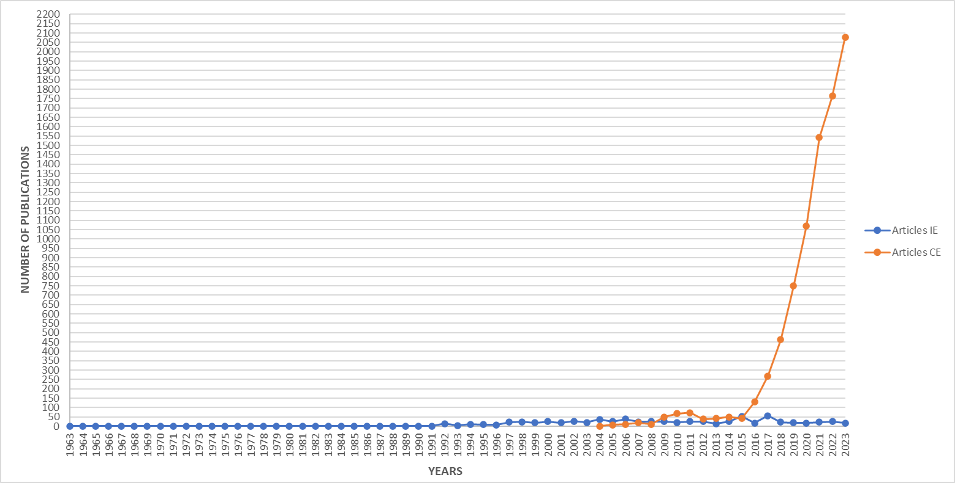
4. Results - aspects investigated
TREND
Period 1
Period 2
Period 3
Notes:
From this point on, I will present the results obtained from the four areas analyzed, starting with the trend. The graph you see in slide, shows the number of documents published over time for Industrial Ecology (blue trend line) and Circular Economy (orange trend line). Based on trends over time, It quickly became clear that the entire period can be divided into three distinct periods: the first 40 years are characterized by the presence of only EI. From 2004 to 2015, both fields follow the same trend. From 2016 to 2023, there a significant shift in trends, with a clear separation between IE and CE. Industrial Ecology continued to evolve steadily, while Circular Economy grew exponentially. Taking into account this time separation, it is useful to make comparisons

Slide 8
4. Results - aspects investigated
Industrial Ecology
AUTHORS
TOP 25 AUTHORS BASED ON THE NUMBER OF PUBLICATIONS
Legend:
in common within the same field (IE/CE)
Horizontal bar chart - IE 1963-2003. Source: Biblioshiny
shared between the fields (IE/CE)
Horizontal bar chart - IE 2004-2013. Source: Biblioshiny
Notes:
The second area of research focused on the authors. For each period, we selected the top 25 authors based on the number of publications. Here, we can see the authors of Industrial Ecology. Highlighted in the rectangle, we see the authors who are common between the first and second periods.

Slide 9
Circular Economy
Horizontal bar chart - CE 2004-2013. Source: Biblioshiny
Horizontal bar chart - IE 2014-2023. Source: Biblioshiny
Horizontal bar chart - CE 2014-2023. Source: Biblioshiny
Notes:
Some of these authors are also present in the third period (as shown on the left). One interesting finding is that, within the field of industrial ecology, there is a certain recurrence and stability among the authors. This is not the case for circular economy, where only 4 of the top 25 authors are common across the two periods we examined. An important point to highlight is that only one author appears in both fields of study (indicated with an oval shape). This suggests that those who publish most frequently on industrial ecology do not also write about circular economy, and vice versa.

Slide 10
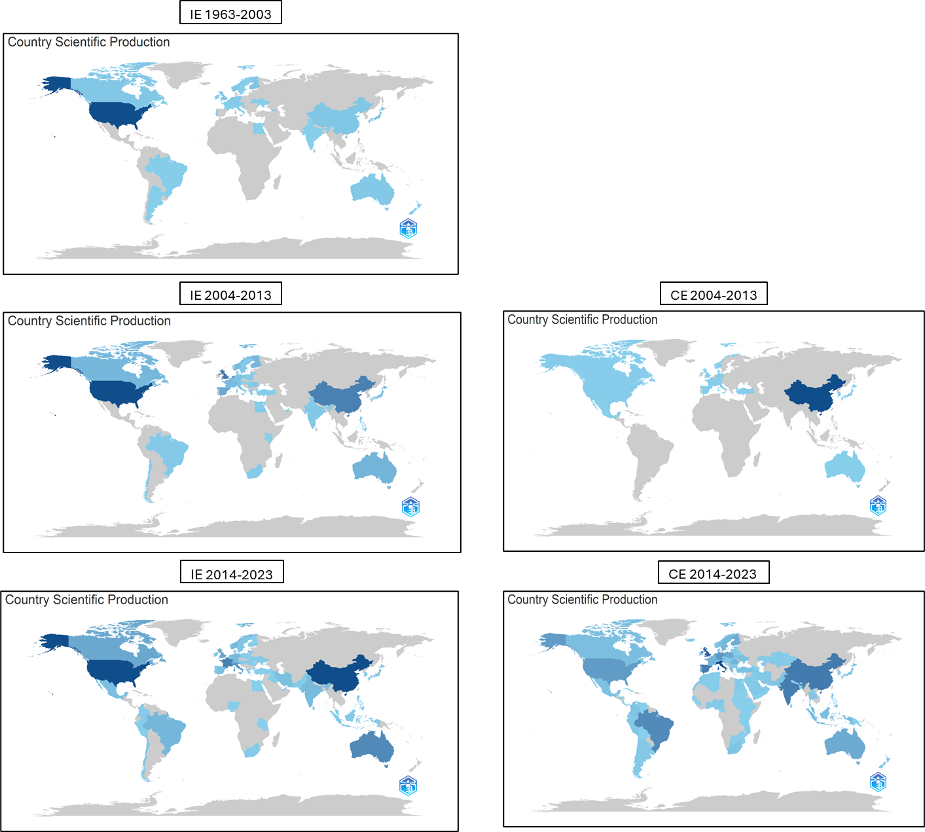
4. Results - aspects investigated
COUNTRIES
World map - scientific production of the countries. Source: Biblioshiny
=
+
=
+
=
=
+
=
-
+
=
+
+
+
+
-
+
+
+
+
+
+
+
+
+
+
+
+
+
=
Notes:
There are also some interesting differences relating to the countries of origin of the authors. The color intensity is proportional to the number of publications.
Studies on industrial ecology primarily come from Western countries, especially North America, and then spread to other parts of the world. On the other hand, research on circular economy mostly started in Eastern countries, particularly China, and has since expanded globally, even more so than industrial ecology. It's also that in more recent years, industrial ecology has gained more attention in China, while circular economy research has become particularly prominent in European countries, such as England, Spain and Italy.

Slide 11
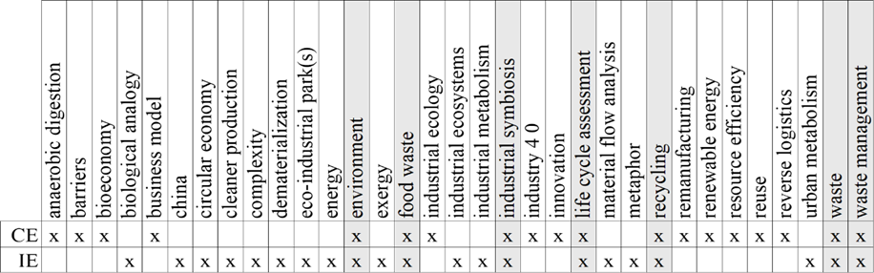
4. Results - aspects investigated
AUTHOR’S KEYWORDS
Summary table (IE and CE) – all periods. Source: authors’ elaboration
Notes:
For the analysis regarding the keywords, all the authors' keywords extracted from Biblioshiny for both the IE and CE datasets were first sorted by their absolute frequency. We decided to exclude the keywords 'industrial ecology' for IE, 'circular economy' for CE, and 'sustainability' (and its synonyms) as they are broadly shared by both fields of study. We then decided to focus on the top 20 keywords for each field. After that, the keywords were grouped together and organized alphabetically. The results of this analysis show that both fields share common themes, such as "environment," as well as some methodological aspects, like industrial symbiosis and life cycle assessment. Additionally, both fields address topics related to waste and its management, including keywords like food waste, recycling, waste, and waste management.

Slide 12
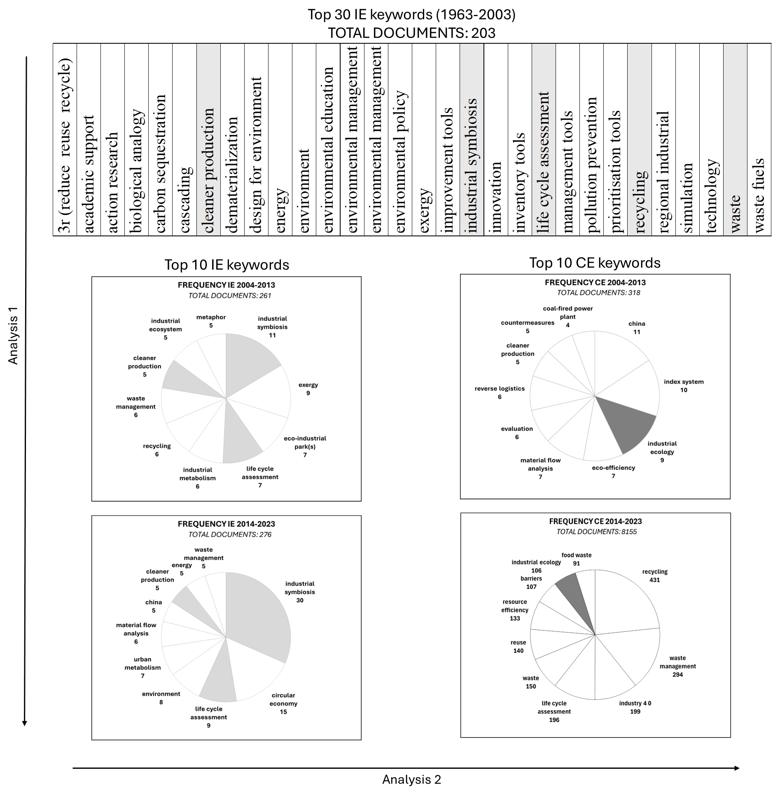
4. Results - aspects investigated
AUTHOR’S KEYWORDS
Pie chart - 3 periods of IE and CE. Source: authors’ elaboration
Notes:
We also conducted a further analysis by examining the top keywords in both fields, broken down by time periods. For the first period of industrial ecology, we decided to include at least 30 keywords to get a more detailed view. The analysis shows that in IE, there is a consistent evolution, with many themes remaining relevant over the years, highlighted in light grey. In contrast, circular economy studies use a smaller number of terms over time, including 'industrial ecology,' which is highlighted in dark grey. Solo 1 termine compare nei 2 periodi
The 'cross-sectional' analysis reveals that many key concepts in CE, such as cleaner production, life cycle assessment, and waste, were already important in IE before 2004 and have remained constant in IE over time. Additionally, recycling has become the most frequently used keyword in CE studies over the past decade. Both fields share the keywords 'industrial ecology' and 'circular economy,' with 'industrial ecology' appearing early in CE, and 'circular economy' becoming more prominent in IE over the last 10 years.

Slide 13
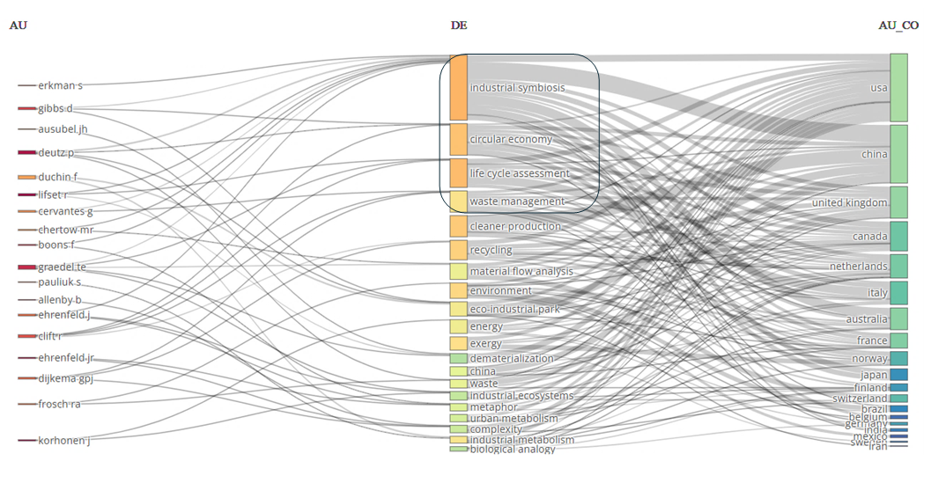
4. Results - aspects investigated
AUTHOR’S KEYWORDS
Three-field plot – IE (1963-2023). Source: Biblioshiny
1. Recycling
2. Waste management
3. Life cycle assessment
4. Industry 4.0
CE
IE
1. Industrial symbiosis
2. Circular economy
3. Life cycle assessment
4. Waste management
Three-field plot – CE (2004-2023). Source: Biblioshiny
Notes:
We used a three-field plot to explore which authors in the two fields are working on which topics and where they are based. it is a Sankey diagram type plot that summarizes the relationship between authors, keywords used and countries. The middle column represents the keywords most frequently used by the authors, the left column represents the author’s name, and the right column represents the authors’ countries. The height of the ‘nodes’ together with the strength of the links corresponds to the number of connections. The figures highlight the keywords with the most connections. When we looked at the first four keywords in detail, we found that two were common to both fields: ‘life cycle assessment’ and ‘waste management’. However, 'circular economy' and 'industrial symbiosis' are more common in industrial ecology studies, while 'recycling' and 'industry 4.0' are more frequently used in circular economy studies. In particular, the term industry 4.0 appears in EC but not in EI.
Additionally, many of the key authors in the CE field are based in Europe, particularly in England, Italy, and Spain, while IE research is more commonly associated with authors from the USA and China.

Slide 14
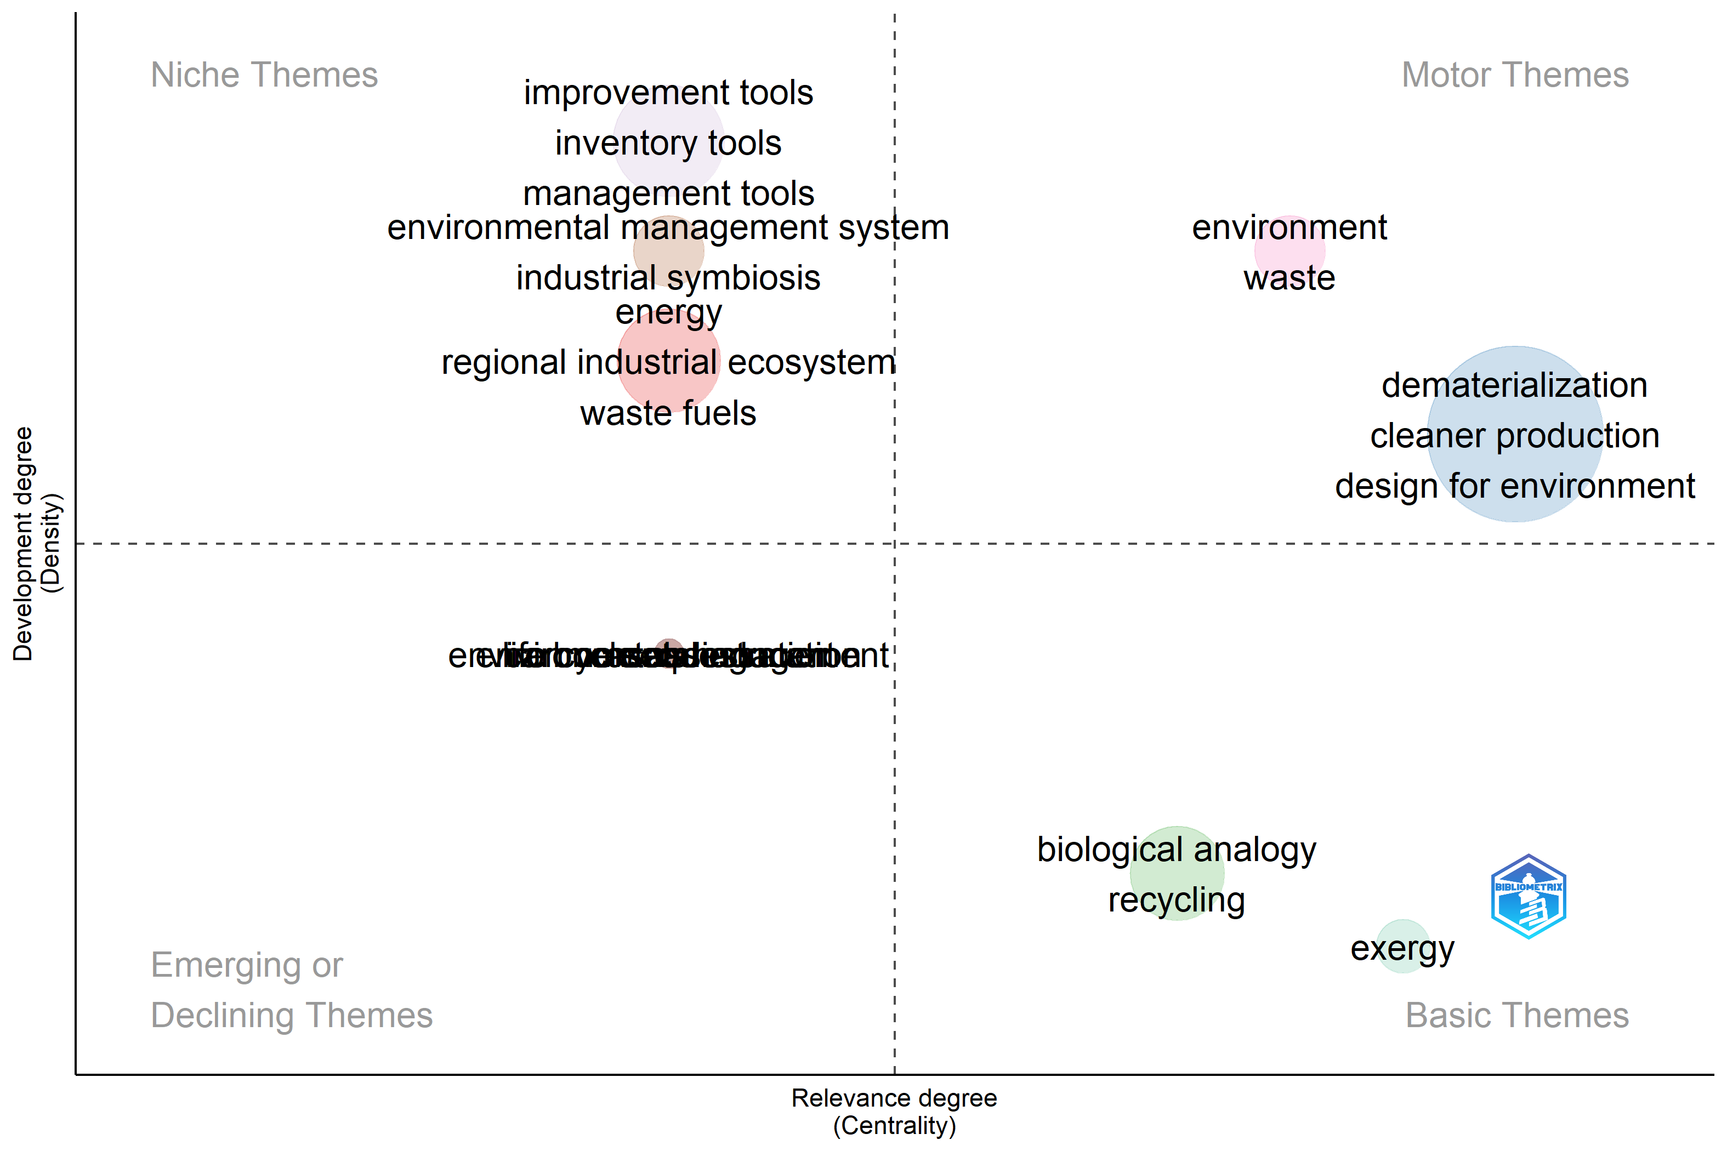
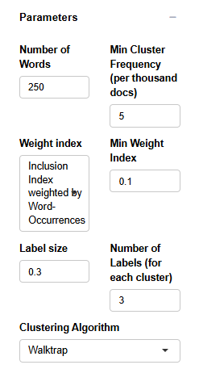
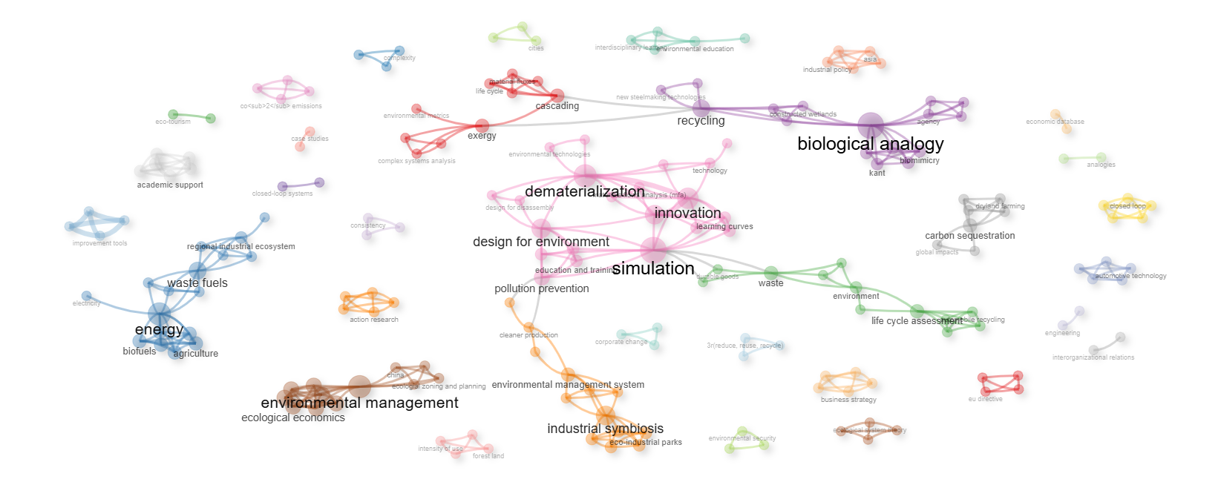
4. Results - aspects investigated
IE 1963-2003
AUTHOR’S KEYWORDS
Thematic Evolution map – IE (1963-2003). Source: Biblioshiny
Closed-loop systems
Closed loop
3r (reduce, reuse, recycle)
Notes:
In the final step of the research, we examined the relative weight of different research topics in the two fields using a thematic map. This map analyzes groups of authors' keywords and their relationships to identify different 'themes'. These themes are characterized by two key properties: density and centrality. Density is shown on the vertical axis, while centrality is on the horizontal axis. These properties help measure the relevance of the themes, allowing us to distinguish between those considered more important and those viewed as less significant. The results were then aggregated across the three periods.
As can be seen in this figure, even before the emergence of the CE (2004), the IE field was already dealing with the concepts of ‘closed loops’, ‘closed-loop systems’ and the 3Rs (reduce, reuse, recycle), which later became the basis of the current CE field.

Slide 15
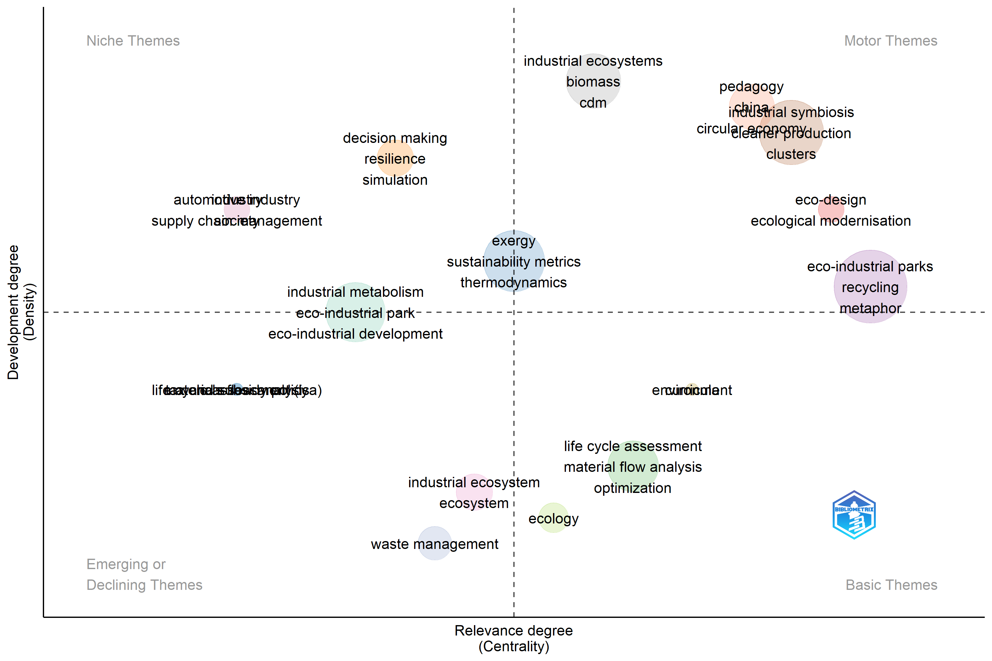
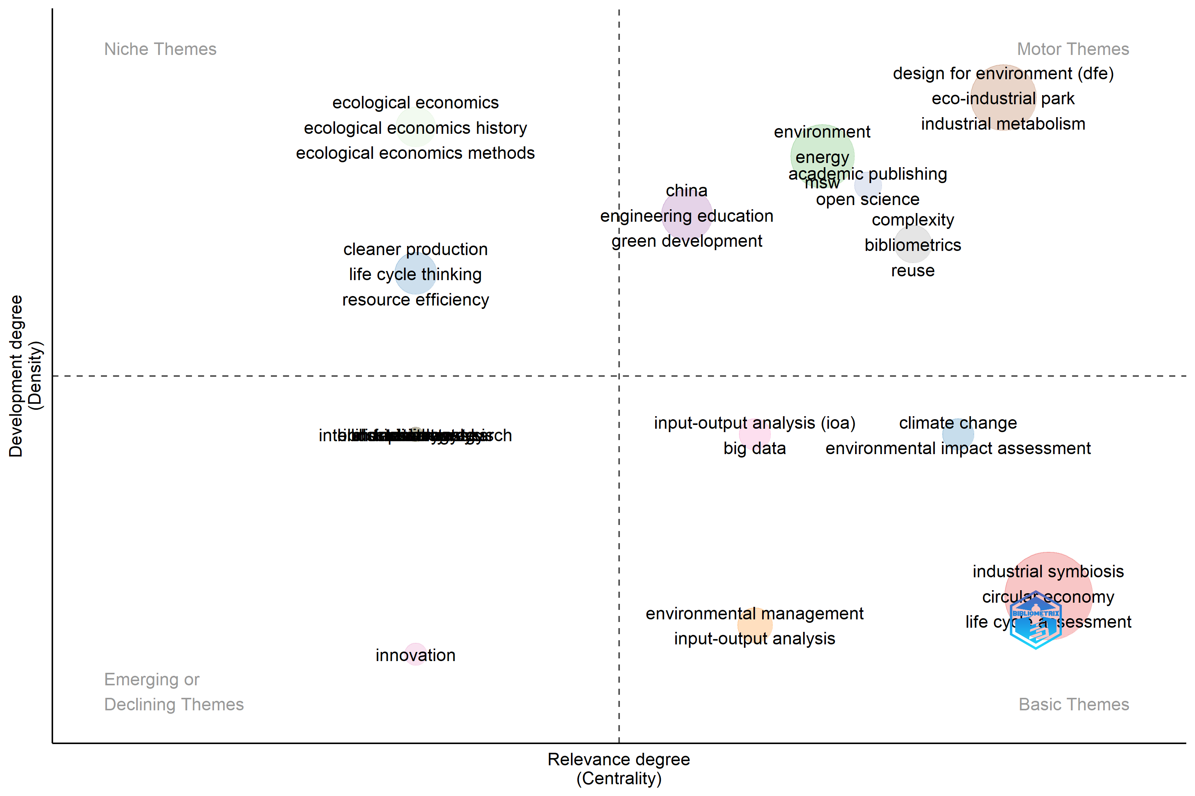
IE 2004-2013
IE 2014-2023
CE
CE
Thematic Evolution map– IE (2004-2023). Source: Biblioshiny
Notes:
In this graph, you can see how the concept of Circular Economy was initially a Motor themes within Industrial Ecology, but it became a 'basic' concept in the following decade. This indicates that EI has immediately integrated the theme of EC

Slide 16
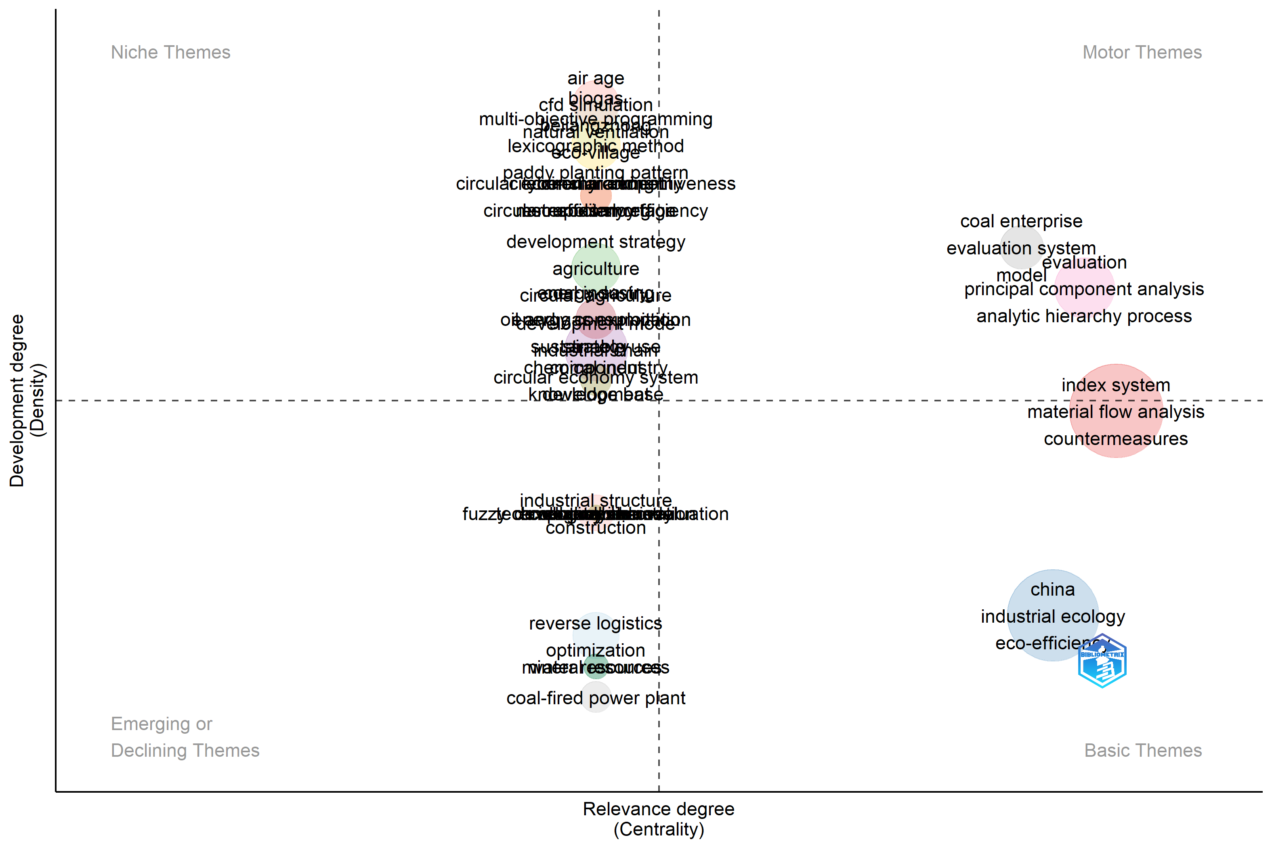
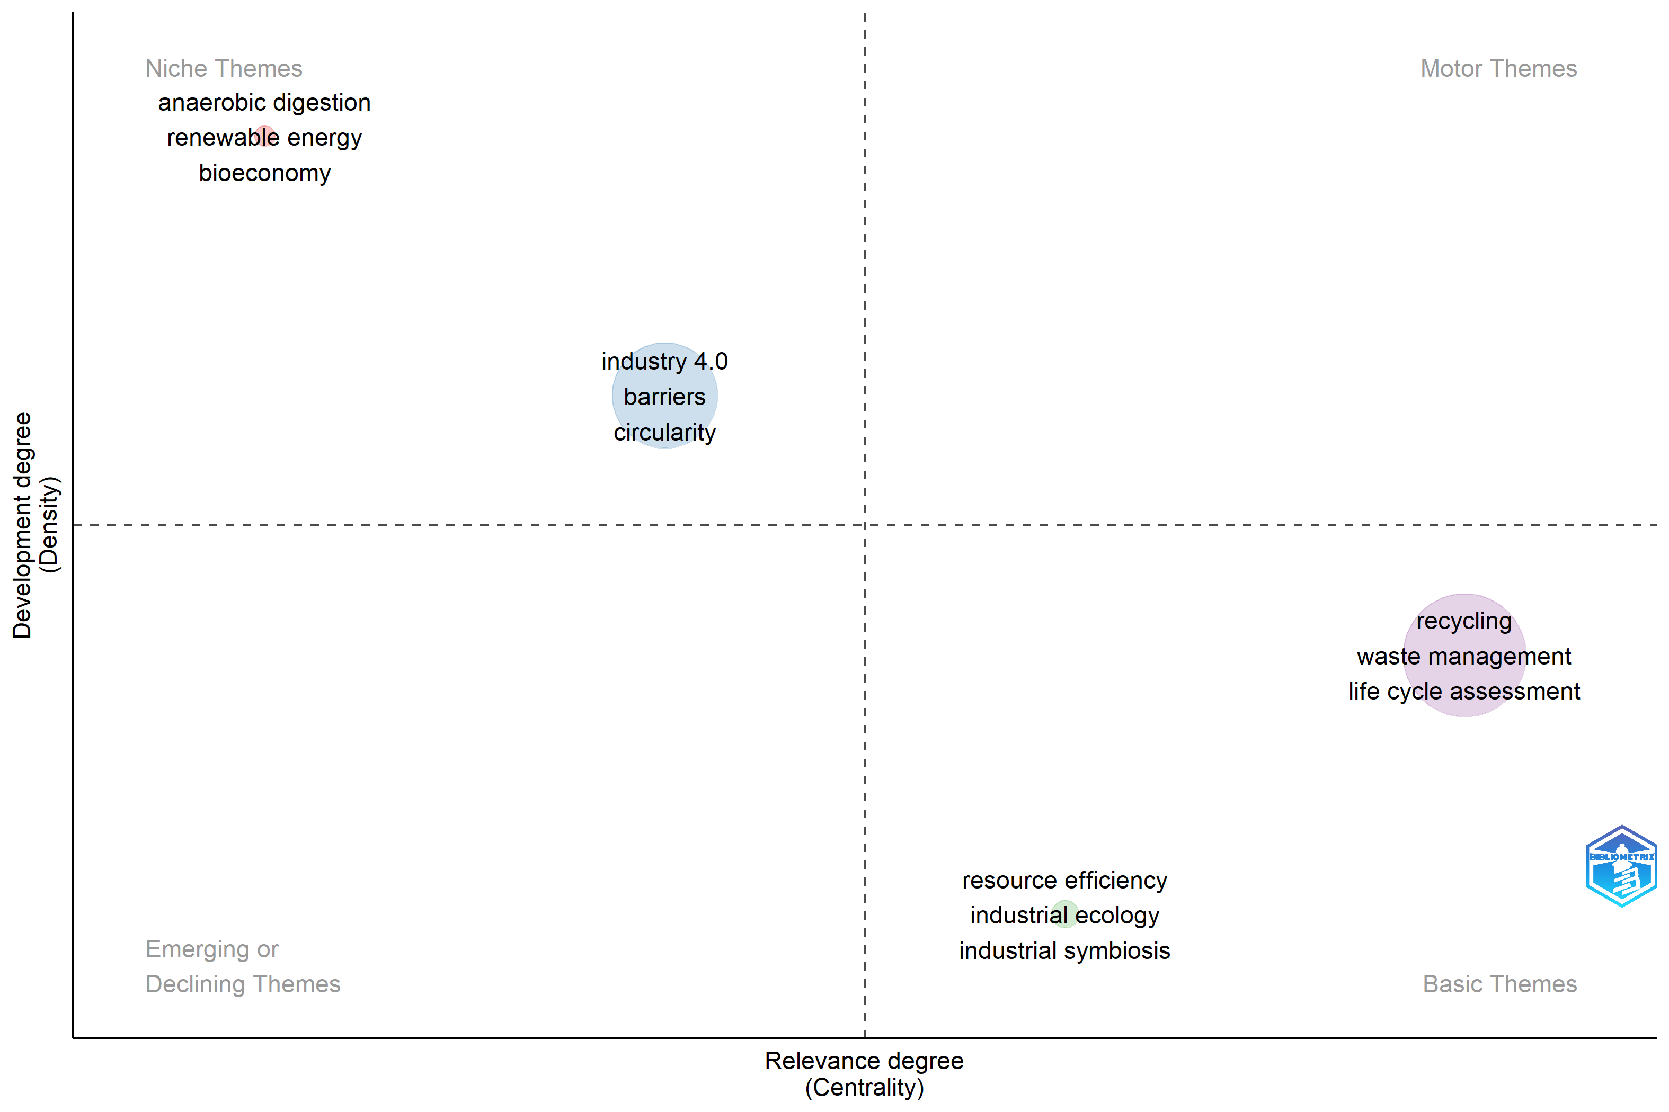
CE 2004-2013
CE 2014-2023
IE
IE
Thematic Evolution map – CE (2004-2023). Source: Biblioshiny
Notes:
In contrast, the IE concept within the CE field was considered 'basic' in the first decade and seems to have declined in importance thereafter. Along with the thematic analysis, we also looked at the associated networks, which show that the IE field is characterized by a greater diversity of research themes (or clusters of nodes), while the CE field increasingly focuses on fewer themes, incorporating more concepts (nodes) within them. Another interesting element is that the theme of Industry 4.0 emerges as one of the key themes of CE, representing the link between the ecological and digital transitions.

Slide 17
TO SUMMARIZE
TREND
AUTHORS
IE and CE demonstrate different trend
COUNTRIES
AUTHOR’S KEYWORDS AND THEMES
Environmental
Food waste
Industrial symbiosis
Life cycle assessment
Recycling
Waste
Waste management
Cleaner production
3R(reduce, reuse, recycle)
Cloosed loop systems
IE
CE
Sustainability – Sustainable Development – Industrial ecology – Circular Economy
Notes:
We saw that, there are differences in terms of trend, authors and countries of origin of authors.
Regarding the authors' keywords and the identified themes, there are interesting overlaps. Starting with the goal: for both, the goal is the transition to a circular production and consumption model (opposite to the current linear one).
Environmental
Food waste
Industrial symbiosis
Life cycle assessment
Recycling
Waste
Waste management
Cleaner production
3R(reduce, reuse, recycle)
Cloosed loop systems
These are the most recurring keywords and themes in both fields.
While "Sustainability," "Sustainable Development," "Industrial Ecology," and "Circular Economy" undoubtedly form the foundation for both fields, they were excluded from the analysis as they are the most commonly occurring keywords.
Another interesting element is that the theme of Industry 4.0 emerges as one of the key themes of CE, representing the link between the ecological and digital transitions.

Slide 18
LIMITS AND FURTHER INVESTIGATION
IE
?
CE
As this is a quantitative analysis, it provides indicative values that are influenced by at least three aspects: subjectivity in the selection of data and algorithms, parameters used in the analysis and the potential intrinsic limits of the tools chosen.
The two research fields can be further addressed, in order to identify and deepen themes and application fields, interdisciplinary and often overlapping (Content Analysis).
Notes:
The analyses conducted have provided many interesting insights that are worth exploring further. Clearly, the analysis has some limitations, particularly as a quantitative analysis provides indicative values influenced by three main factors: subjectivity in data and algorithm selection, the parameters used, and the potential limitations of the chosen tools.
The two research fields can be further addressed, in order to identify and deepen themes and application fields, interdisciplinary and often overlapping through a content analysis. This analysis could reveal potential areas of synergy between the two fields, highlighting how the principles and tools from IE could enrich or refine circular economy practices, addressing current challenges and driving innovation in the transition to more sustainable systems.

Slide 19
THANK YOU FOR YOUR ATTENTION!
For further information, contact:
Veronica.casolani@unich.it
PhD Candidate
Department of Legal and Social Sciences University Chieti-Pescara (Italy)
Notes:
Thank you for your attention. I’d be glad to answer any questions.

