Slide 1



ANALYSIS OF EU COUNTRIES IN TERMS OF CIRCULARITY:
MCDM APPROACH
Greendeal, Circular Economy and Industrial Ecology Symposium
Clermont-Ferrand, France
December 05-06, 2024
Assoc. Prof. Ayhan DEMİRCİ
Toros University, Mersin, Turkiye

Slide 2
Outline
Motivation and Purpose
Circularity and sustainability
Method and Main Data
EuroStat
MCDMT (Entropy, WASPAS)
Spearman Rank Correlation
4. Applications and Results
5. Conclusion
Assoc. Prof. Ayhan DEMİRCİ, Toros University, Turkiye.

Slide 3

Motivation and Purpose
Assoc. Prof. Ayhan DEMİRCİ, Toros University, Turkiye.

Slide 4
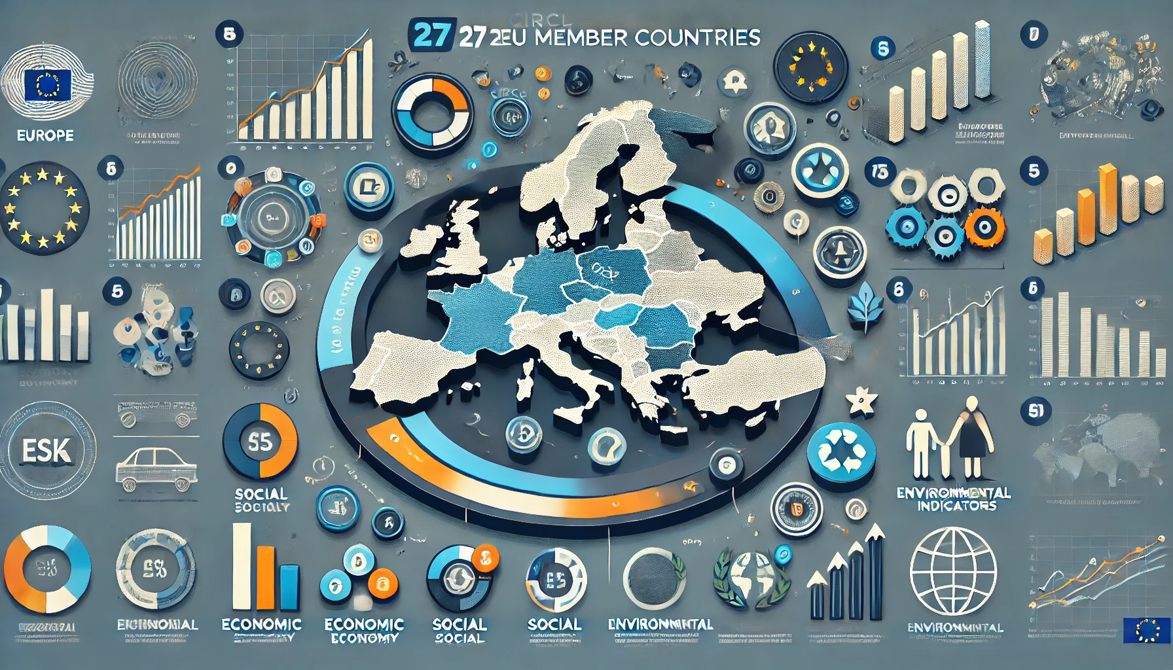
Motivation and Purpose
Assoc. Prof. Ayhan DEMİRCİ, Toros University, Turkiye.

Slide 5
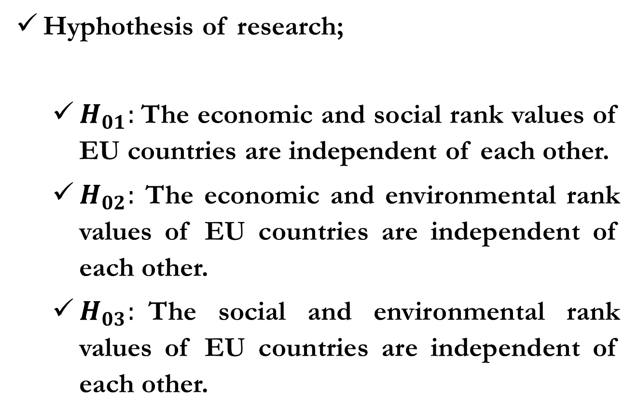
Motivation and Purpose
Hyphothesis of research;
  $H_{01}:$The economic and social rank values ​​of EU countries are independent of each other.
  $H_{02}:$ The economic and environmental rank values ​​of EU countries are independent of each other.
  $H_{03}:$The social and environmental rank values of EU countries ​​are independent of each other.
Assoc. Prof. Ayhan DEMİRCİ, Toros University, Turkiye.

Slide 6
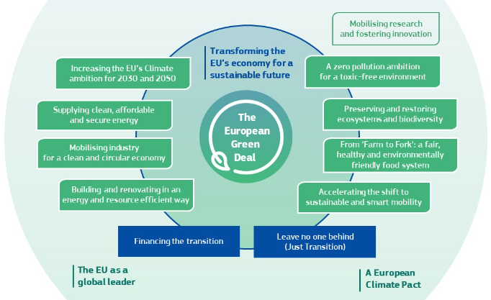
Green Deal
The European Green Deal
Assoc. Prof. Ayhan DEMİRCİ, Toros University, Turkiye.

Slide 7

Green Deal
Assoc. Prof. Ayhan DEMİRCİ, Toros University, Turkiye.

Slide 8

Sustainability
Sustainable Development Goals
Assoc. Prof. Ayhan DEMİRCİ, Toros University, Turkiye.

Slide 9
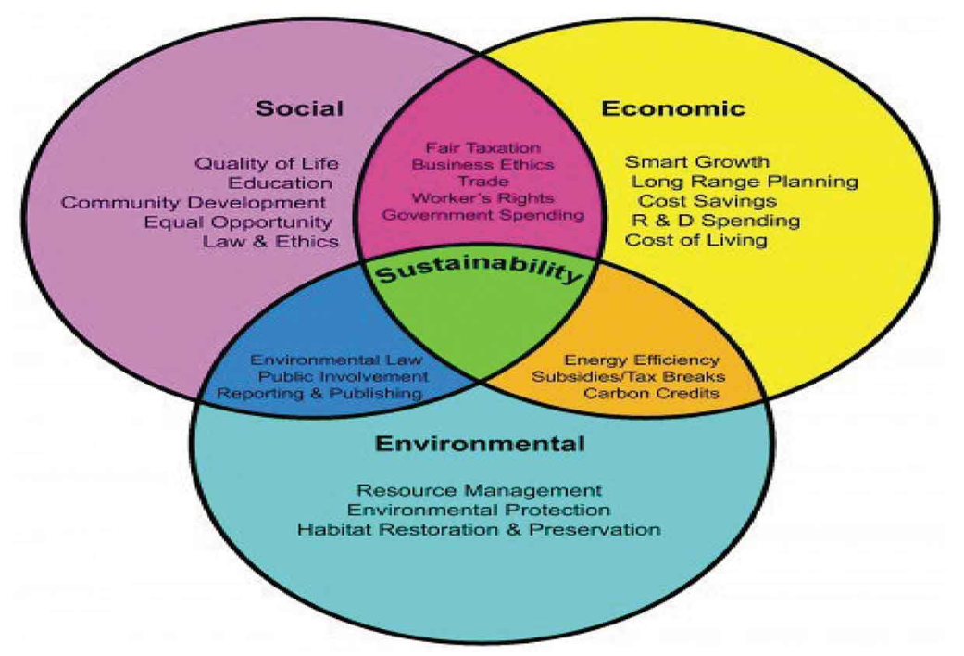
Sustainability
Dimensions of Sustainability
Assoc. Prof. Ayhan DEMİRCİ, Toros University, Turkiye.

Slide 10
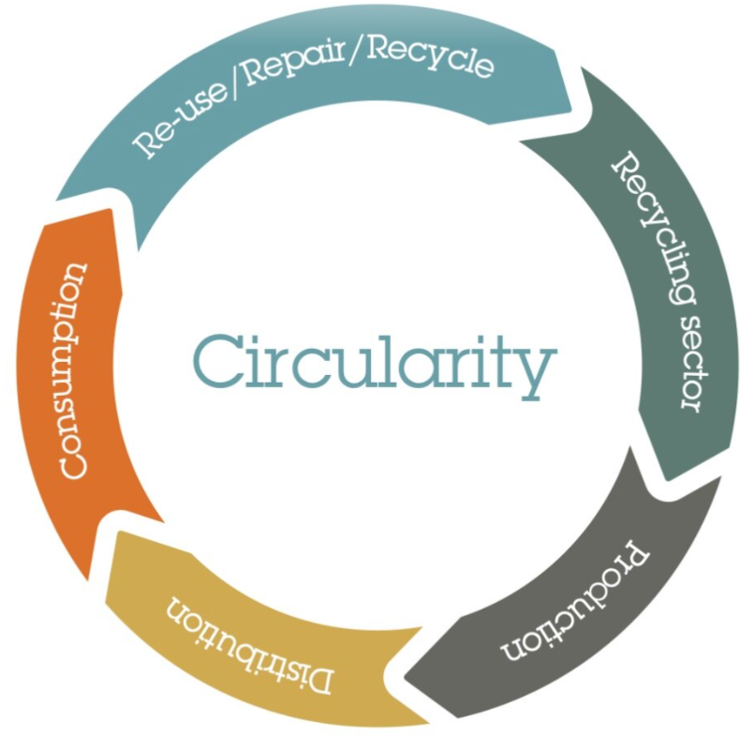
Circularity
Circularity refers to practices that optimize resource use and minimize waste across the entire production and consumption cycle, emphasizing sustainability and economic efficiency.
Assoc. Prof. Ayhan DEMİRCİ, Toros University, Turkiye.

Slide 11
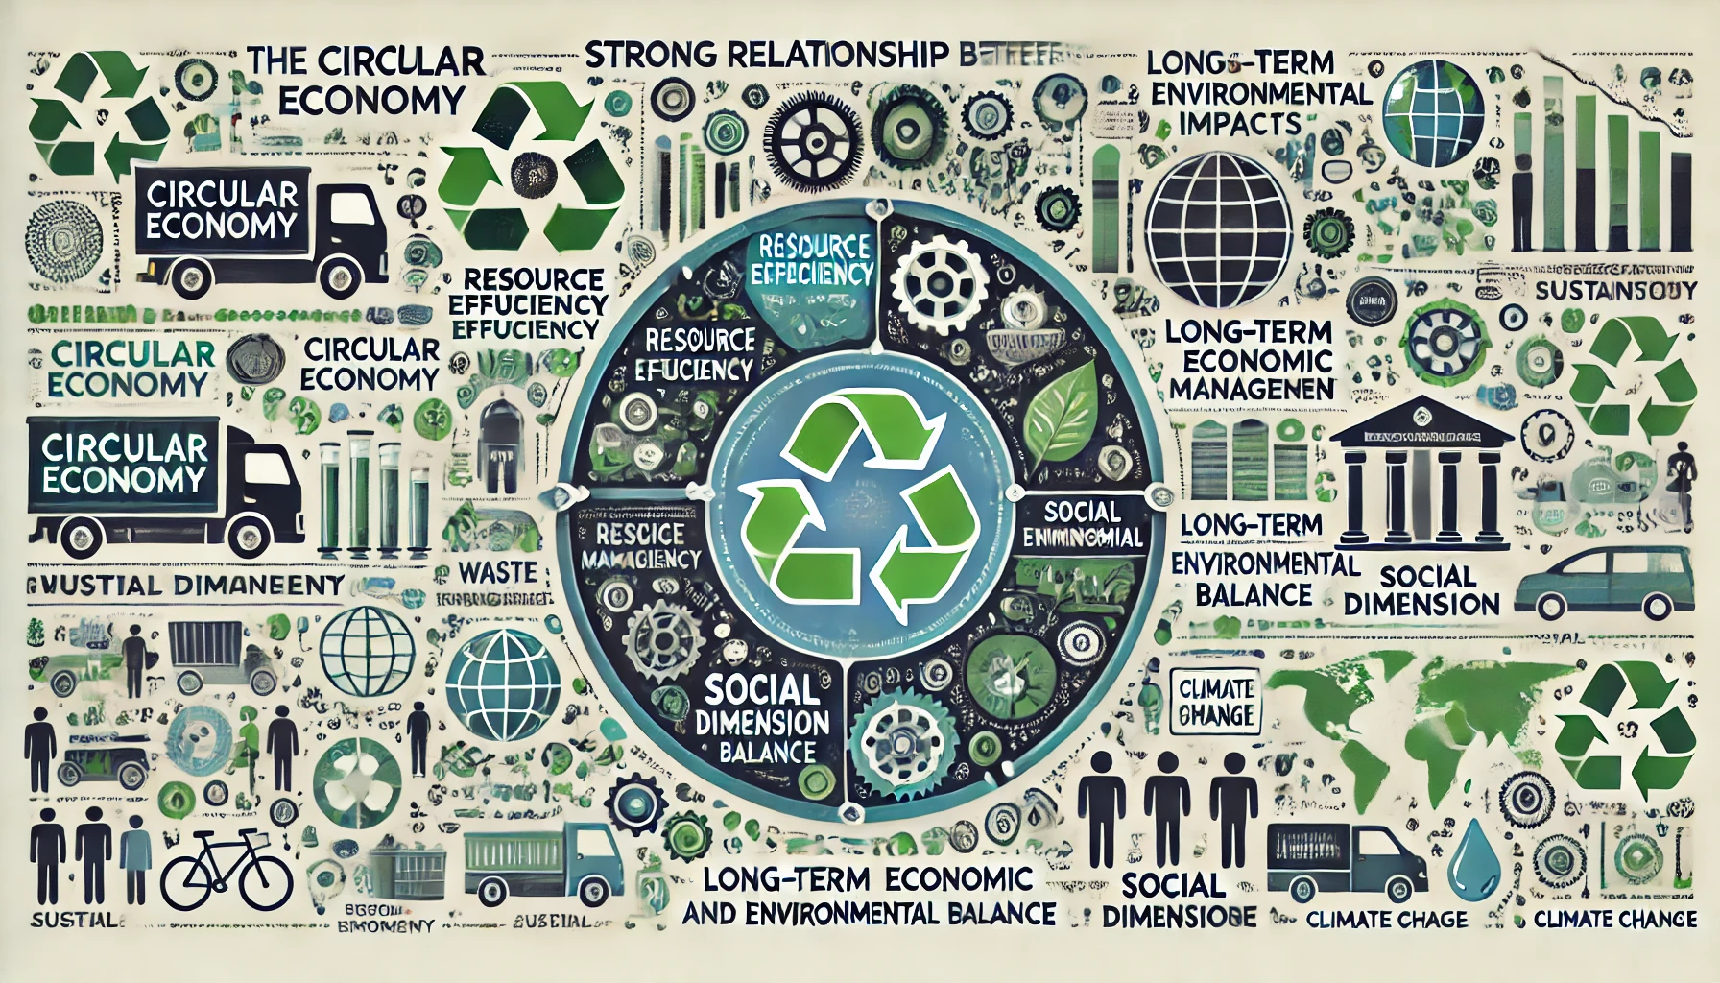
Circularity
Assoc. Prof. Ayhan DEMİRCİ, Toros University, Turkiye.

Slide 12

Method and
Main Data
Multi-Criteria Decision-Making Techniques
Assoc. Prof. Ayhan DEMİRCİ, Toros University, Turkiye.

Slide 13
Method and
Main Data
Entropy
The most criticized part of multi-criteria decision-making techniques is undoubtedly the criterion weighting stage.
As a matter of fact, the criteria affecting the decision are often weighted at this stage based on the opinions of one or more experts.
This causes the results of the methods to be subjective.
Assoc. Prof. Ayhan DEMİRCİ, Toros University, Turkiye.

Slide 14
Method and
Main Data
Entropy
Because it will not be an easy process for the experts whose opinions are asked at this stage to make an impartial decision beyond their own value judgments.
Therefore, while subjective weighting methods mostly consist of personal judgments, objective criterion weighting methods are more rational and unbiased in terms of providing solutions depending on the criteria's own quantitative values.
Assoc. Prof. Ayhan DEMİRCİ, Toros University, Turkiye.

Slide 15
Method and
Main Data
Entropy
At this point, the Entropy, which provides a more objective evaluation, is a method used in weighting the criteria.
There are five steps for Entropy technique, in the literature.
Assoc. Prof. Ayhan DEMİRCİ, Toros University, Turkiye.

Slide 16
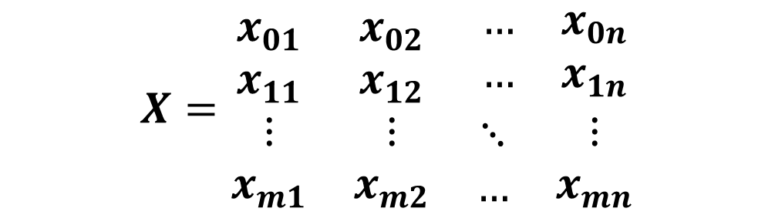
Method and
Main Data
Entropy
Preparing the Decision Matrix
$$X=\begin{matrix}x_{01} & x_{02} & \begin{matrix}… & x_{0n}\end{matrix} \\ x_{11} & x_{12} & \begin{matrix}… & x_{1n}\end{matrix} \\ \begin{matrix}⋮ \\ x_{m1}\end{matrix} & \begin{matrix}⋮ \\ x_{m2}\end{matrix} & \begin{matrix}\begin{matrix}⋱ \\ …\end{matrix} & \begin{matrix}⋮ \\ x_{mn}\end{matrix}\end{matrix}\end{matrix}$$
Assoc. Prof. Ayhan DEMİRCİ, Toros University, Turkiye.

Slide 17

Method and
Main Data
Entropy
Normalization of the Decision Matrix
$$r_{ij}=\frac{x_{ij}}{\sum_{i=1}^{m}{x_{ij}}}$$
Assoc. Prof. Ayhan DEMİRCİ, Toros University, Turkiye.

Slide 18


Method and
Main Data
Entropy
Calculatiıng the Entropy Value
$$e_{j}=−k\sum_{i=1}^{m}{r_{ij}∗ln{ r}_{ij}}$$
$$k=\frac{1}{\ln{m}}$$
Assoc. Prof. Ayhan DEMİRCİ, Toros University, Turkiye.

Slide 19
Method and
Main Data
Entropy
Calculating the Differentiation Degree Values
$$d_{j}=1−e_{j}$$
Assoc. Prof. Ayhan DEMİRCİ, Toros University, Turkiye.

Slide 20

Method and
Main Data
Entropy
Calculating the Weights of Criteria
$$w_{j}=\frac{d_{j}}{\sum_{i=1}^{n}{d_{j}}}$$
Assoc. Prof. Ayhan DEMİRCİ, Toros University, Turkiye.

Slide 21
Method and
Main Data
WASPAS
This technique gives a compromise result of the weighted sum technique and the weighted multiplication technique.
Weighted Aggregated Sum Product Assessment (WASPAS) was proposed by Zavadskas et al. (2012).
The technique has 6 stages including the determination of the criteria weights.
Assoc. Prof. Ayhan DEMİRCİ, Toros University, Turkiye.

Slide 22
Method and
Main Data
WASPAS
Preparing the Decision Matrix
$$X=\begin{matrix}x_{01} & x_{02} & \begin{matrix}… & x_{0n}\end{matrix} \\ x_{11} & x_{12} & \begin{matrix}… & x_{1n}\end{matrix} \\ \begin{matrix}⋮ \\ x_{m1}\end{matrix} & \begin{matrix}⋮ \\ x_{m2}\end{matrix} & \begin{matrix}\begin{matrix}⋱ \\ …\end{matrix} & \begin{matrix}⋮ \\ x_{mn}\end{matrix}\end{matrix}\end{matrix}$$
Assoc. Prof. Ayhan DEMİRCİ, Toros University, Turkiye.

Slide 23
Method and
Main Data
WASPAS
Normalization Decision Matrix
Benefit Oriented Cost Oriented
Assoc. Prof. Ayhan DEMİRCİ, Toros University, Turkiye.

Slide 24
Method and
Main Data
WASPAS
Weighted Sum Technique
Assoc. Prof. Ayhan DEMİRCİ, Toros University, Turkiye.

Slide 25
Method and
Main Data
WASPAS
Weighted Product Technique
Benefit Oriented Cost Oriented
Assoc. Prof. Ayhan DEMİRCİ, Toros University, Turkiye.

Slide 26
Method and
Main Data
WASPAS
Compromised Solution
Assoc. Prof. Ayhan DEMİRCİ, Toros University, Turkiye.

Slide 27
Method and
Main Data
Spearman Rank Correlation
Spearman's rank correlation measures the strength and direction of association between two ranked variables.
It basically gives the measure of monotonicity of the relation between two variables i.e. how well the relationship between two variables could be represented using a monotonic function.
Assoc. Prof. Ayhan DEMİRCİ, Toros University, Turkiye.

Slide 28
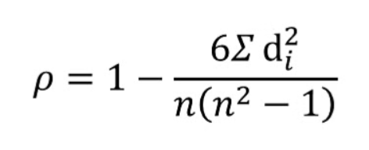

Method and
Main Data
Spearman Rank Correlation
is Spearman Rank Correlation Coefficient
di is the difference between the two ranks of each observation
n is the number of observations
Assoc. Prof. Ayhan DEMİRCİ, Toros University, Turkiye.

Slide 29
Method and
Main Data
Main Data
Economic
Social
Environmental
EuroStat
Assoc. Prof. Ayhan DEMİRCİ, Toros University, Turkiye.

Slide 30
Method and
Main Data
Main Data
Economic
1. GNI per Capita, PPP
2. Inflation (Consumer Prices)
3. Logistics Performance İndex
4. Ease of Doing Business
5. Central Government Debt
Social
Environmental
Assoc. Prof. Ayhan DEMİRCİ, Toros University, Turkiye.

Slide 31
Method and
Main Data
Main Data
Social
1. GINI Index
2. Unemployment (Totaly)
3. Life Expectancy at Birth
4. Labor Force Partipication Rate, Female
5. School enrollment tertiary
Economic
Environmental
Assoc. Prof. Ayhan DEMİRCİ, Toros University, Turkiye.

Slide 32
Method and
Main Data
Main Data
Economic
Social
Environmental
1. Waste treatment
2. Circular material use rate (%)
3. Material flows for circular economy (Import)
4. Material flows for circular economy (Export)
5. Total environmental taxes in total tax revenue
6. Persons employed in circular economy sectors in total employee
7. Private investment related to circular economy sectors
8. Gross value added related to circular economy sectors
9. Waste generation per capita kilogram
10. Greenhouse gases emissions from production activities
Assoc. Prof. Ayhan DEMİRCİ, Toros University, Turkiye.

Slide 33
Method and
Main Data
Main Data (Economic Criteria)
Countries | GNI per Capita, PPP | Inflation (Consumer Prices) | LPI | Ease of Doing Business | Central Government Debt
 | 2023 | 2023 | 2022 | 2019 | 2022
 | + | - | + | + | +
Austria | 73520 | 7,8 | 4,0 | 11 | 75,05
Belgium | 71990 | 4,0 | 4,0 | 22 | 94,04
Bulgaria | 37380 | 9,4 | 3,2 | 30 | 30,30
Cyprus | 51330 | 3,5 | 3,2 | 27 | 91,67
Czechia | 51370 | 10,7 | 3,3 | 18 | 14,10
Germany | 72110 | 5,9 | 4,1 | 9 | 20,93
Denmark | 79390 | 3,3 | 4,1 | 1 | 75,26
Spain | 52420 | 3,5 | 3,9 | 12 | 111,43
Estonia | 47350 | 9,2 | 3,6 | 6 | 25,20
Finland | 64940 | 6,3 | 4,2 | 8 | 58,25
France | 62130 | 4,9 | 3,9 | 13 | 98,66
Greece | 40880 | 3,5 | 3,7 | 33 | 203,29
Croatia | 45950 | 7,9 | 3,3 | 25 | 82,08
Hungary | 44650 | 17,1 | 3,2 | 26 | 75,53
Ireland | 98650 | 6,3 | 3,6 | 10 | 46,71
Italy | 58650 | 5,6 | 3,7 | 29 | 77,46
Lithuania | 50100 | 9,1 | 3,4 | 4 | 36,05
Luxembourg | 98490 | 3,7 | 3,6 | 32 | 2,90
Latvia | 41420 | 8,9 | 3,5 | 7 | 10,26
Malta | 56880 | 5,1 | 3,3 | 35 | 69,81
Netherland | 77750 | 3,8 | 4,1 | 19 | 54,29
Poland | 47380 | 11,5 | 3,6 | 17 | 60,45
Portugal | 47850 | 4,3 | 3,4 | 16 | 5,66
Romania | 46620 | 10,4 | 3,2 | 28 | 50,45
Slovak Republic | 43500 | 10,5 | 3,3 | 21 | 64,51
Slovenia | 54130 | 7,4 | 3,3 | 15 | 16,25
Sweden | 72990 | 8,5 | 4,0 | 3 | 36,25
Assoc. Prof. Ayhan DEMİRCİ, Toros University, Turkiye.

Slide 34
Method and
Main Data
Main Data (Social Criteria)
Countries | GINI Endex | Unemployment (Totaly) | Life Expectancy at Birth | Labor Force Partipicaton Rate, Female | School enrollment tertiary
 | 2022 | 2023 | 2022 | 2023 | 2023
 | - | - | + | + | +
Austria | 30,7 | 5,2 | 81,1 | 56,75 | 93,94
Belgium | 26,6 | 5,5 | 81,7 | 50,55 | 82,69
Bulgaria | 39,0 | 4,3 | 74,4 | 50,11 | 74,03
Cyprus | 31,3 | 6,0 | 81,9 | 60,26 | 96,54
Czechia | 26,2 | 2,6 | 79,0 | 51,92 | 69,11
Germany | 31,7 | 3,0 | 80,7 | 56,45 | 75,67
Denmark | 28,3 | 5,1 | 81,3 | 59,52 | 84,59
Spain | 33,9 | 12,1 | 83,1 | 52,63 | 94,59
Estonia | 31,8 | 6,3 | 77,9 | 61,14 | 71,43
Finland | 27,7 | 7,2 | 81,2 | 57,72 | 104,94
France | 31,5 | 7,3 | 82,2 | 52,78 | 70,79
Greece | 32,9 | 11,0 | 80,6 | 45,19 | 150,20
Croatia | 28,9 | 6,1 | 77,6 | 47,93 | 72,33
Hungary | 29,2 | 4,1 | 76,0 | 53,98 | 56,52
Ireland | 30,1 | 4,3 | 83,1 | 59,87 | 78,78
Italy | 34,8 | 7,6 | 82,9 | 41,27 | 71,29
Lithuania | 36,7 | 7,0 | 75,8 | 57,08 | 71,91
Luxembourg | 32,7 | 5,2 | 83,0 | 57,82 | 20,73
Latvia | 34,3 | 6,5 | 74,6 | 55,68 | 91,33
Malta | 31,4 | 3,1 | 82,7 | 56,94 | 78,62
Netherland | 25,7 | 3,6 | 81,7 | 61,72 | 88,95
Poland | 28,5 | 2,9 | 77,3 | 51,58 | 73,98
Portugal | 34,6 | 6,5 | 81,6 | 55,29 | 71,87
Romania | 33,9 | 5,6 | 75,3 | 42,37 | 55,27
Slovak Republic | 24,1 | 5,8 | 77,1 | 56,29 | 52,50
Slovenia | 24,3 | 3,6 | 81,3 | 53,85 | 82,39
Sweden | 29,8 | 7,6 | 83,1 | 63,38 | 83,90
Assoc. Prof. Ayhan DEMİRCİ, Toros University, Turkiye.

Slide 35
Method and
Main Data
Main Data (Environmental Criteria)
Countries | Waste treatment | Circular material use rate (%) | Material flows for circular economy (Imports) | Material flows for circular economy (Exports) | Total environmental taxes in total tax revenue | Persons employed in circular economy sectors | Private investment related to circular economy sectors | Gross value added related to circular economy sectors | Waste generation per capita kilogram | Greenhouse gases emissions from production activities
 | 2022 | 2022 | 2022 | 2022 | 2022 | 2022 | 2021 | 2021 | 2020 | 2022
 | + | + | + | + | + | + | + | + | - | -
Austria | 2,696162545 | 22,2 | 1,044705961 | 45,07410377 | 0,048653658 | 0,024802664 | 1,4 | 1,7 | 5899 | 6824,27486
Belgium | 14,36316696 | 4,8 | 0,142229429 | 71,81160586 | 0,153246491 | 0,028795052 | 0,6 | 1,5 | 16785 | 8238,92316
Bulgaria | 3,50860778 | 11,9 | 0,222408022 | 56,60750052 | 0,041721601 | 0,034207708 | 0,4 | 1,4 | 3598 | 8901,41274
Cyprus | 3,036220805 | 7,4 | 0,678650599 | 20,54616353 | 0,056896186 | 0,011602681 | 0,9 | 1,8 | 3453 | 12372,71658
Czechia | 4,027241499 | 13 | 0,249648222 | 14,01452633 | 0,038774421 | 0,025413202 | 0,9 | 2,2 | 4824 | 7391,81001
Germany | 14,70570568 | 16 | 0,176453451 | 54,05360246 | 0,069345676 | 0,035685108 | 0,7 | 1,9 | 12163 | 10226,90455
Denmark | 2,641495597 | 1,8 | 0,578936677 | 15,36788349 | 0,040102992 | 0,021207435 | 0,6 | 2,9 | 3248 | 11950,63996
Spain | 2,94642852 | 3,1 | 0,205549217 | 17,2344059 | 0,130078195 | 0,033796869 | 0,1 | 0,5 | 2651 | 7479,62681
Estonia | 1,530887198 | 7,1 | 0,247184257 | 8,97532949 | 0,039847435 | 0,047813933 | 0,5 | 1,9 | 2230 | 4927,18191
Finland | 3,688976919 | 19,3 | 0,151375016 | 11,35486359 | 0,043346026 | 0,030797543 | 0,8 | 1,6 | 4593 | 4853,92345
France | 1,086656802 | 5,8 | 0,464489469 | 45,96545267 | 0,090002415 | 0,053809784 | 0,7 | 2,2 | 1483 | 4606,96281
Greece | 2,285900321 | 18,7 | 0,187361936 | 5,500106711 | 0,051172573 | 0,063966719 | 0,7 | 2,5 | 2942 | 5425,46581
Croatia | 1,564045739 | 3,2 | 0,273017171 | 19,3133893 | 0,060019313 | 0,037023211 | 0,2 | 1,6 | 2491 | 7642,78891
Hungary | 0,757027696 | 5,4 | 0,592294204 | 95,6649719 | 0,072525589 | 0,037171253 | 0,7 | 1,5 | 1501 | 4943,35824
Ireland | 1,360656708 | 4,1 | 0,460798618 | 73,74048003 | 0,047642398 | 0,040227988 | 0,8 | 1,8 | 2396 | 6965,98646
Italy | 12,49618452 | 5,2 | 4,905507773 | 10,17290692 | 0,03088436 | 0,006082694 | 1 | 1,1 | 14618 | 12090,51969
Lithuania | 1,910741932 | 7,9 | 0,217888886 | 48,87964483 | 0,053382977 | 0,056732796 | 0,7 | 1,7 | 1759 | 5101,31743
Luxembourg | 6,096037095 | 15,1 | 0,034603806 | 17,45542982 | 0,056320238 | 0,02869134 | 1,1 | 2,9 | 6847 | 3705,6988
Latvia | 3,876372659 | 27,5 | 1,018494347 | 51,2191989 | 0,06089572 | 0,015951886 | 1 | 1 | 7175 | 8227,72475
Malta | 4,615695257 | 13,8 | 0,540598996 | 20,01129 | 0,043168347 | 0,017957879 | 1,4 | 2 | 7728 | 6063,69521
Netherland | 3,886146077 | 8,4 | 0,183330003 | 27,69722093 | 0,079328486 | 0,057288104 | 0,7 | 1,8 | 4492 | 9587,31138
Poland | 0,944908305 | 2,6 | 0,223968314 | 16,49515394 | 0,050396654 | 0,034029237 | 0,8 | 1,5 | 1612 | 4882,36736
Portugal | 7,592193339 | 1,4 | 0,085860778 | 35,76984282 | 0,097937779 | 0,020691214 | 0,5 | 1 | 7338 | 4775,14199
Romania | 3,82549189 | 9,4 | 1,214419271 | 92,83075882 | 0,075764823 | 0,026361406 | 0,2 | 1,5 | 3576 | 5857,96718
Slovak Republic | 1,68950995 | 9,1 | 0,230738998 | 55,58001606 | 0,070129497 | 0,031434043 | 0,5 | 1,2 | 2340 | 5658,96265
Slovenia | 21,33991656 | 0,6 | 0,160411201 | 10,43789067 | 0,056368063 | 0,028510292 | 0,3 | 1,4 | 20993 | 7738,45267
Sweden | 13,49508234 | 6,1 | 0,190483917 | 13,79939202 | 0,045194247 | 0,023475214 | 0,4 | 1,4 | 14664 | 3979,03445

Slide 36
Results
Weight Values of Criteria (CRITIC)
Economic Criteria
Criteria | GNI per Capita, PPP | Inflation (Consumer Prices) | LPI | Ease of Doing Business | Central Government Debt
wj | 0,0658 | 0,1754 | 0,0075 | 0,3160 | 0,4352
Assoc. Prof. Ayhan DEMİRCİ, Toros University, Turkiye.

Slide 37
Results
Weight Values of Criteria (CRITIC)
Social Criteria
Criteria | GINI Endex | Unemployment (Totaly) | Life Expectancy at Birth | Labor Force Partipicaton Rate, Female | School enrollment tertiary
wj | 0,0575 | 0,5749 | 0,0053 | 0,0434 | 0,3189
Assoc. Prof. Ayhan DEMİRCİ, Toros University, Turkiye.

Slide 38
Results
Weight Values of Criteria (CRITIC)
Environmental Criteria
Criteria | Waste treatment | Circular material use rate (%) | Material flows for circular economy (Imports) | Material flows for circular economy (Exports) | Total environmental taxes in total tax revenue | Persons employed in circular economy sectors | Private investment related to circular economy sectors | Gross value added related to circular economy sectors | Waste generation per capita kilogram | Greenhouse gases emissions from production activities
wj | 0,1713 | 0,1120 | 0,2974 | 0,1119 | 0,0356 | 0,0407 | 0,0503 | 0,0223 | 0,1333 | 0,0253
Assoc. Prof. Ayhan DEMİRCİ, Toros University, Turkiye.

Slide 39
Results
Rank Values of Countries (WASPAS-Economic)
Countries | λ=0,00 | λ=0,25 | λ=0,50 | λ=0,75 | λ=1,00 | Overall Rank Value
Austria | 15 | 15 | 18 | 18 | 18 | 18
Belgium | 21 | 26 | 26 | 26 | 27 | 26
Bulgaria | 13 | 13 | 11 | 12 | 11 | 11
Cyprus | 22 | 25 | 25 | 25 | 25 | 25
Czechia | 10 | 9 | 8 | 6 | 5 | 8
Germany | 7 | 8 | 10 | 11 | 15 | 10
Denmark | 4 | 4 | 3 | 2 | 2 | 3
Spain | 16 | 20 | 22 | 21 | 23 | 22
Estonia | 6 | 6 | 7 | 8 | 9 | 6
Finland | 11 | 11 | 14 | 16 | 17 | 13
France | 17 | 21 | 21 | 20 | 21 | 20
Greece | 27 | 27 | 27 | 27 | 24 | 27
Croatia | 25 | 22 | 19 | 19 | 16 | 21
Hungary | 26 | 19 | 12 | 10 | 7 | 12
Ireland | 12 | 12 | 15 | 17 | 19 | 15
Italy | 24 | 23 | 23 | 22 | 20 | 23
Lithuania | 8 | 7 | 6 | 7 | 8 | 7
Luxembourg | 1 | 1 | 1 | 1 | 1 | 1
Latvia | 3 | 3 | 4 | 4 | 4 | 4
Malta | 23 | 24 | 24 | 23 | 22 | 24
Netherland | 14 | 18 | 20 | 24 | 26 | 19
Poland | 18 | 14 | 13 | 13 | 12 | 14
Portugal | 2 | 2 | 2 | 3 | 3 | 2
Romania | 19 | 16 | 17 | 15 | 14 | 17
Slovak Republic | 20 | 17 | 16 | 14 | 13 | 16
Slovenia | 9 | 10 | 9 | 9 | 10 | 9
Sweden | 5 | 5 | 5 | 5 | 6 | 5

Slide 40
Results
Rank Values of Countries (WASPAS-Social)
Countries | λ=0,00 | λ=0,25 | λ=0,50 | λ=0,75 | λ=1,00 | Overall Rank Values
Austria | 16 | 16 | 21 | 27 | 17 | 24
Belgium | 14 | 14 | 16 | 21 | 16 | 21
Bulgaria | 9 | 9 | 11 | 17 | 20 | 13
Cyprus | 19 | 22 | 24 | 26 | 15 | 27
Czechia | 1 | 2 | 2 | 5 | 27 | 2
Germany | 4 | 4 | 4 | 13 | 23 | 4
Denmark | 13 | 13 | 15 | 24 | 18 | 22
Spain | 26 | 26 | 25 | 2 | 1 | 7
Estonia | 17 | 17 | 14 | 15 | 12 | 20
Finland | 25 | 25 | 26 | 23 | 10 | 26
France | 21 | 20 | 19 | 9 | 5 | 14
Greece | 27 | 27 | 27 | 7 | 2 | 12
Croatia | 15 | 15 | 13 | 14 | 14 | 17
Hungary | 6 | 6 | 5 | 8 | 19 | 6
Ireland | 10 | 12 | 12 | 22 | 21 | 19
Italy | 22 | 21 | 18 | 6 | 4 | 11
Lithuania | 20 | 19 | 20 | 11 | 7 | 18
Luxembourg | 2 | 1 | 1 | 1 | 3 | 1
Latvia | 23 | 23 | 22 | 19 | 13 | 25
Malta | 5 | 5 | 6 | 18 | 25 | 9
Netherland | 8 | 8 | 10 | 25 | 24 | 15
Poland | 3 | 3 | 3 | 10 | 26 | 3
Portugal | 18 | 18 | 17 | 12 | 8 | 16
Romania | 11 | 10 | 8 | 3 | 9 | 5
Slovak Republic | 12 | 11 | 9 | 4 | 11 | 8
Slovenia | 7 | 7 | 7 | 20 | 22 | 10
Sweden | 24 | 24 | 23 | 16 | 6 | 23

Slide 41
Results
Rank Values of Countries (WASPAS-Environmental)
Countries | λ=0,00 | λ=0,25 | λ=0,50 | λ=0,75 | λ=1,00 | Overall Rank Values
Austria | 25 | 25 | 25 | 25 | 26 | 25
Belgium | 21 | 21 | 20 | 14 | 12 | 19
Bulgaria | 18 | 19 | 19 | 21 | 23 | 21
Cyprus | 20 | 20 | 21 | 23 | 21 | 22
Czechia | 17 | 17 | 17 | 17 | 15 | 17
Germany | 23 | 23 | 23 | 22 | 16 | 23
Denmark | 12 | 12 | 11 | 12 | 14 | 11
Spain | 2 | 3 | 5 | 7 | 9 | 4
Estonia | 4 | 4 | 4 | 6 | 7 | 5
Finland | 10 | 9 | 9 | 11 | 13 | 9
France | 11 | 13 | 14 | 16 | 17 | 15
Greece | 7 | 7 | 8 | 5 | 6 | 7
Croatia | 5 | 5 | 7 | 8 | 11 | 8
Hungary | 14 | 14 | 10 | 9 | 10 | 10
Ireland | 16 | 15 | 16 | 19 | 18 | 18
Italy | 27 | 26 | 22 | 13 | 5 | 16
Lithuania | 8 | 10 | 13 | 18 | 22 | 14
Luxembourg | 3 | 2 | 1 | 1 | 1 | 1
Latvia | 26 | 27 | 26 | 26 | 25 | 27
Malta | 22 | 22 | 24 | 24 | 24 | 24
Netherland | 15 | 16 | 18 | 20 | 20 | 20
Poland | 1 | 1 | 2 | 3 | 3 | 2
Portugal | 6 | 6 | 6 | 4 | 4 | 6
Romania | 24 | 24 | 27 | 27 | 27 | 26
Slovak Republic | 9 | 11 | 12 | 15 | 19 | 12
Slovenia | 13 | 8 | 3 | 2 | 2 | 3
Sweden | 19 | 18 | 15 | 10 | 8 | 13

Slide 42
Results
Rank Values of Countries (WASPAS)
Countries | Economic Overall Rank Values | Social Overall Rank Values | Environmental Overall Rank Values | Overall Rank Values
Austria | 18 | 24 | 25 | 26
Belgium | 26 | 21 | 19 | 25
Bulgaria | 11 | 13 | 21 | 18
Cyprus | 25 | 27 | 22 | 27
Czechia | 8 | 2 | 17 | 5
Germany | 10 | 4 | 23 | 10
Denmark | 3 | 22 | 11 | 9
Spain | 22 | 7 | 4 | 7
Estonia | 6 | 20 | 5 | 6
Finland | 13 | 26 | 9 | 19
France | 20 | 14 | 15 | 21
Greece | 27 | 12 | 7 | 15
Croatia | 21 | 17 | 8 | 17
Hungary | 12 | 6 | 10 | 8
Ireland | 15 | 19 | 18 | 22
Italy | 23 | 11 | 16 | 20
Lithuania | 7 | 18 | 14 | 13
Luxembourg | 1 | 1 | 1 | 1
Latvia | 4 | 25 | 27 | 16
Malta | 24 | 9 | 24 | 23
Netherland | 19 | 15 | 20 | 24
Poland | 14 | 3 | 2 | 2
Portugal | 2 | 16 | 6 | 3
Romania | 17 | 5 | 26 | 14
Slovak Republic | 16 | 8 | 12 | 12
Slovenia | 9 | 10 | 3 | 4
Sweden | 5 | 23 | 13 | 11

Slide 43
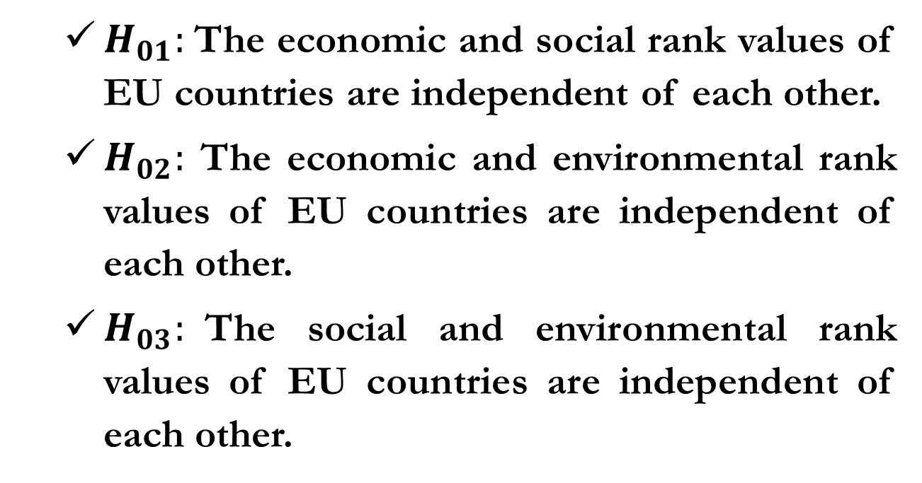
Results
Hypothesis Tests (Spearman Rank Correlation)
  $H_{01}:$The economic and social rank values ​​of EU countries are independent of each other.
  $H_{02}:$ The economic and environmental rank values ​​of EU countries are independent of each other.
  $H_{03}:$The social and environmental rank values of EU countries ​​are independent of each other.
Assoc. Prof. Ayhan DEMİRCİ, Toros University, Turkiye.

Slide 44
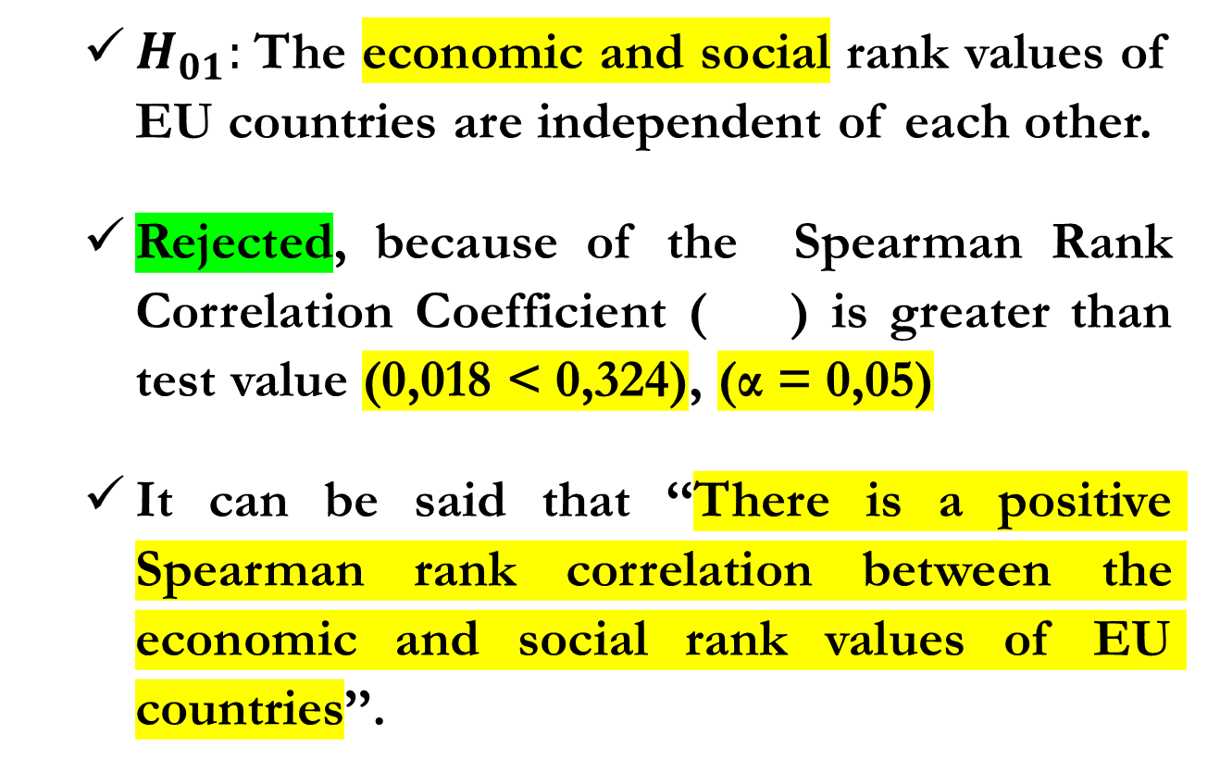
Results
Hypothesis Tests (Spearman Rank Correlation)
  $H_{01}:$The economic and social rank values ​​of EU countries are independent of each other.
  Rejected, because of the Spearman Rank Correlation Coefficient ( ) is greater than test value (0,018 < 0,324), (α = 0,05)
  It can be said that ‘‘There is a positive Spearman rank correlation between the economic and social rank values of EU countries’’.
Assoc. Prof. Ayhan DEMİRCİ, Toros University, Turkiye.

Slide 45
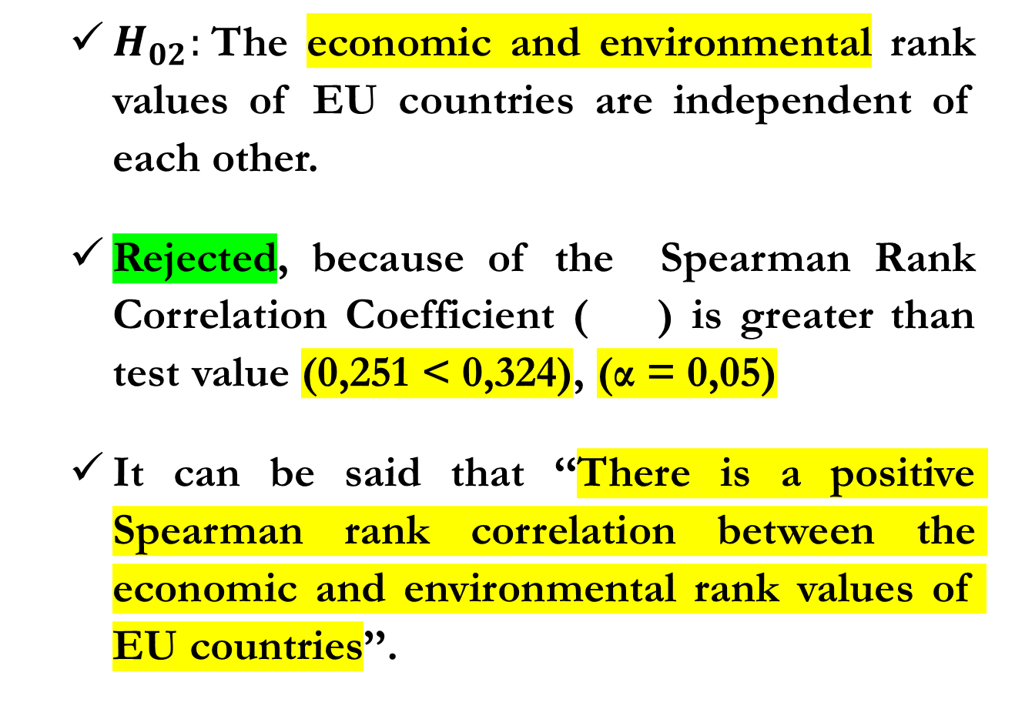
Results
Hypothesis Tests (Spearman Rank Correlation)
  $H_{02}:$The economic and environmental rank values ​​of EU countries are independent of each other.
  Rejected, because of the Spearman Rank Correlation Coefficient ( ) is greater than test value (0,251 < 0,324), (α = 0,05)
  It can be said that ‘‘There is a positive Spearman rank correlation between the economic and environmental rank values of EU countries’’.
Assoc. Prof. Ayhan DEMİRCİ, Toros University, Turkiye.

Slide 46
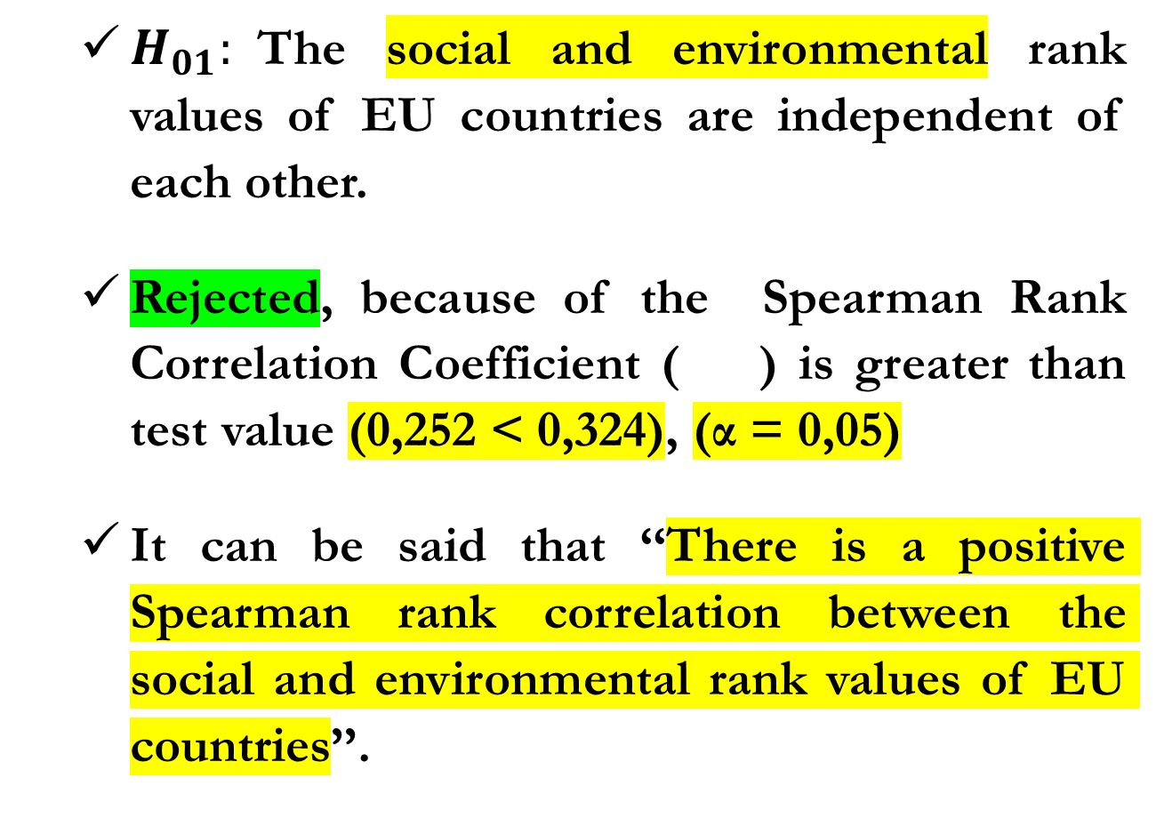
Results
Hypothesis Tests (Spearman Rank Correlation)
  $H_{01}:$The social and environmental rank values ​​of EU countries are independent of each other.
  Rejected, because of the Spearman Rank Correlation Coefficient ( ) is greater than test value (0,252 < 0,324), (α = 0,05)
  It can be said that ‘‘There is a positive Spearman rank correlation between the social and environmental rank values of EU countries’’.
Assoc. Prof. Ayhan DEMİRCİ, Toros University, Turkiye.

Slide 47
Conclusion
The aim of the study was to rank EU countries in terms of their circularity efficiencies.
For this purpose, data that were assessed to affect the circularity efficiency of EU countries were obtained from the EuroStat database.
Considering the close relationship between the concepts of circularity and sustainability, the study was carried out to cover the three dimensions of sustainability.
Assoc. Prof. Ayhan DEMİRCİ, Toros University, Turkiye.

Slide 48
Conclusion
Accordingly, the efficiency ranking of countries was determined according to economic, social and environmental dimensions.
The criteria determined for each of the three dimensions were weighted by using the Entropy technique and these weight values ​​were used in the WASPAS technique to rank countries.
The significance of the rank values ​​was evaluated according to the Spearman Rank Correlation coefficient.
Assoc. Prof. Ayhan DEMİRCİ, Toros University, Turkiye.

Slide 49
Conclusion
Considering the selected data, the efficiencies of the EU countries in the economic, social and environmental dimensions were found to be related to each other.
It was observed that especially the criteria with high weight values ​​had a significant effect on the efficiency rank values ​​of the EU countries.
Accordingly, it is evaluated that other countries can make improvements by taking these criteria into account.
Assoc. Prof. Ayhan DEMİRCİ, Toros University, Turkiye.

Slide 50
Conclusion
Economic Evaluation
Countries | GNI per Capita, PPP | Inflation (Consumer Prices) | LPI | Ease of Doing Business | Central Government Debt | Rank Value
 | 0,0658 | 0,1754 | 0,0075 | 0,3160 | 0,4352
Luxembourg | 98490 | 3,7 | 3,6 | 32 | 2,90 | 1
Portugal | 47850 | 4,3 | 3,4 | 16 | 5,66 | 2
Denmark | 79390 | 3,3 | 4,1 | 1 | 75,26 | 3
Cyprus | 51330 | 3,5 | 3,2 | 27 | 91,67 | 25
Belgium | 71990 | 4,0 | 4,0 | 22 | 94,04 | 26
Greece | 40880 | 3,5 | 3,7 | 33 | 203,29 | 27
Min. Value | 37380,00 | 3,31 | 3,20 | 1,00 | 2,90
Max. Value | 98650,00 | 17,12 | 4,20 | 35,00 | 203,29
Mean Value | 58882,22 | 7,13 | 3,62 | 17,67 | 58,77
Assoc. Prof. Ayhan DEMİRCİ, Toros University, Turkiye.

Slide 51
Conclusion
Social Evaluation
Countries | GINI Endex | Unemployment (Totaly) | Life Expectancy at Birth | Labor Force Partipicaton Rate, Female | School enrollment tertiary | Rank Value
 | 0,0575 | 0,5749 | 0,0053 | 0,0434 | 0,3189
Luxembourg | 32,7 | 5,2 | 83,0 | 57,82 | 20,73 | 1
Czechia | 26,2 | 2,6 | 79,0 | 51,92 | 69,11 | 2
Poland | 28,5 | 2,9 | 77,3 | 51,58 | 73,98 | 3
Latvia | 34,3 | 6,5 | 74,6 | 55,68 | 91,33 | 25
Finland | 27,7 | 7,2 | 81,2 | 57,72 | 104,94 | 26
Cyprus | 31,3 | 6,0 | 81,9 | 60,26 | 96,54 | 27
Min. Value | 24,10 | 2,59 | 74,36 | 41,27 | 20,73
Max. Value | 39,00 | 12,14 | 83,11 | 63,38 | 150,20
Mean Value | 30,76 | 5,75 | 79,93 | 54,45 | 78,48
Assoc. Prof. Ayhan DEMİRCİ, Toros University, Turkiye.

Slide 52
Conclusion
Environmental Evaluation
Countries | Waste treatment | Circular material use rate % | Material flows for circular economy (Imports) | Material flows for circular economy (Exports) | Total environmental taxes in total tax revenue | Persons employed in circular economy | Private investment related to circular economy sectors | Gross value added related to circular economy sectors | Waste generation per capita kilogram | Greenhouse gases emissions from production activities | Rank Value
 | 0,1713 | 0,1120 | 0,2974 | 0,1119 | 0,0356 | 0,0407 | 0,0503 | 0,0223 | 0,1333 | 0,0253
Luxembourg | 6,10 | 15,10 | 0,03 | 17,46 | 0,06 | 0,03 | 1,10 | 2,90 | 6847,00 | 3705,70 | 1
Poland | 0,94 | 2,60 | 0,22 | 16,50 | 0,05 | 0,03 | 0,80 | 1,50 | 1612,00 | 4882,37 | 2
Slovenia | 21,34 | 0,60 | 0,16 | 10,44 | 0,06 | 0,03 | 0,30 | 1,40 | 20993,00 | 7738,45 | 3
Austria | 2,70 | 22,20 | 1,04 | 45,07 | 0,05 | 0,02 | 1,40 | 1,70 | 5899,00 | 6824,27 | 25
Romania | 3,83 | 9,40 | 1,21 | 92,83 | 0,08 | 0,03 | 0,20 | 1,50 | 3576,00 | 5857,97 | 26
Latvia | 3,88 | 27,50 | 1,02 | 51,22 | 0,06 | 0,02 | 1,00 | 1,00 | 7175,00 | 8227,72 | 27
Min. Value | 0,76 | 0,60 | 0,03 | 5,50 | 0,03 | 0,01 | 0,10 | 0,50 | 1483,00 | 3705,70
Max. Value | 21,34 | 27,50 | 4,91 | 95,66 | 0,15 | 0,06 | 1,40 | 2,90 | 20993,00 | 12372,72
Mean Value | 5,26 | 9,29 | 0,54 | 35,39 | 0,06 | 0,03 | 0,69 | 1,69 | 6051,81 | 7052,60
Assoc. Prof. Ayhan DEMİRCİ, Toros University, Turkiye.

Slide 53
THANK YOU FOR YOUR INTEREST!

Slide 54
ANALYSIS OF EU COUNTRIES IN TERMS OF CIRCULARITY:
MCDM APPROACH
Greendeal, Circular Economy and Industrial Ecology Symposium
Clermont-Ferrand, France
December 05-06, 2024
Assoc. Prof. Ayhan DEMİRCİ
ayhan.demirci@toros.edu.tr
Toros University, Mersin, Turkiye

