Slide 1
Circular business models, Supply chain & Digitalization : System Thinking Tools for Sustainable and Circular Digitalization
  Hugues Ferreboeuf, Arnaud Diemer, Céline Lescop
  The Shift Project
    5th of December
Notes:
Va-t-on réussir à changer « notre système » pour conserver le climat, la biosphère, le vivant ?
Vous convaincre de l’importance de « former » massivement à la pensée systémique, au Shift, dans l’enseignement supérieur (ingénieurs, sciences politiques), chez les politiques, dans le monde professionnel…
L’accès à la pensée systémique par le plus grand nombre permettra d’augmenter la compréhension collective « du système » qui génère la dynamique qui aboutit à la déstabilisation de la biosphère et aboutir à un consensus sur les leviers à activer.

Slide 2

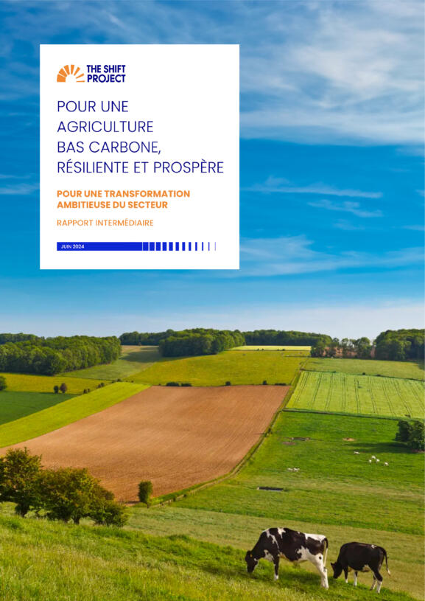

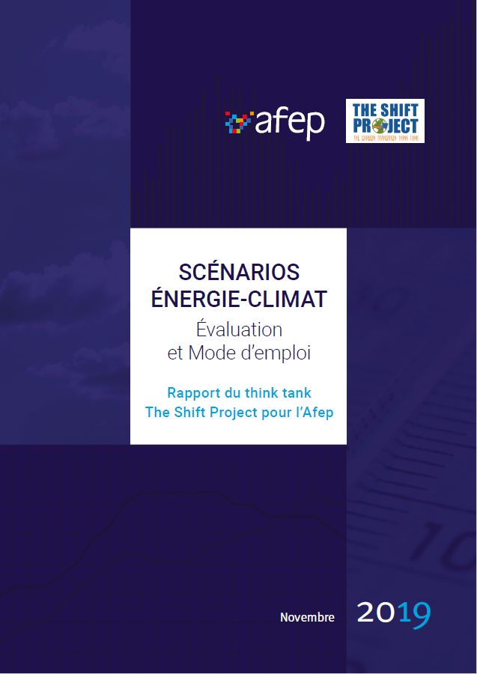


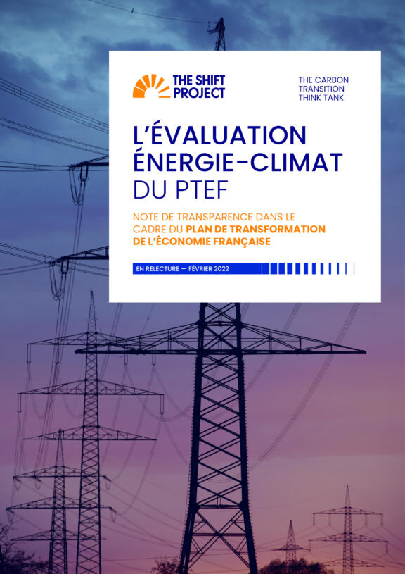

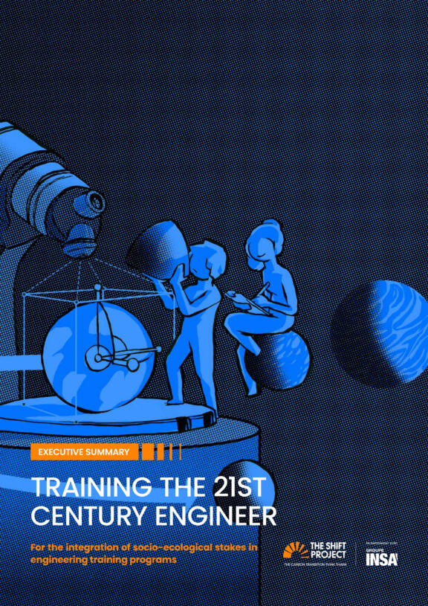

Who we are, where do we speak from
Celine Lescop: Digital Sustainability Lead, Axa Group; Associate Expert, The Shift Project
Hugues Ferreboeuf: Digital Project Director, The Shift Project
Arnaud Diemer: UCA, CERDi, ERASME
The carbon transition think-tank
  A think tank advocating the shift to a post-carbon economy
  A non-profit organisation committed to serving the general interest through scientific objectivity
  Informing & influencing the debate on energy transition in Europe
An approach that is sector-based: mobility, building, energy, public administration, agriculture, industry, health
But also transversal: education, culture, digital
In view of a systemic transformation

Slide 3
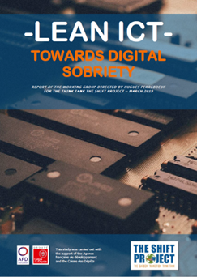
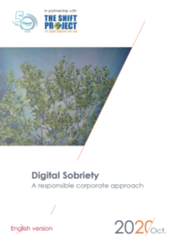
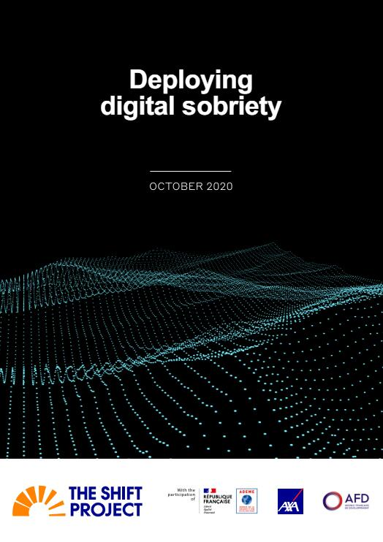
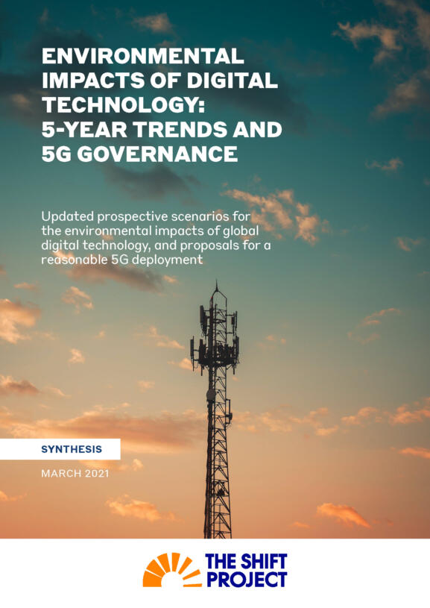
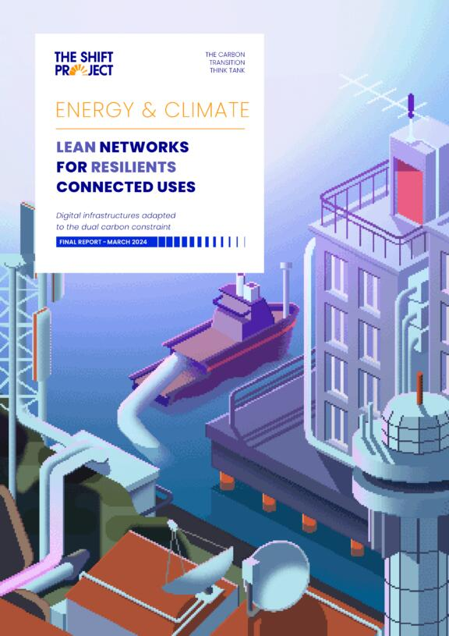
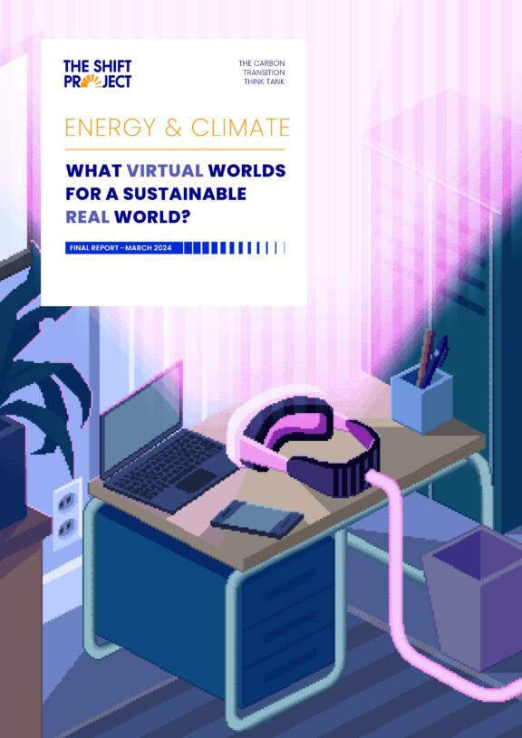

Digital: The Lean ICT program
Informing
Projects with associate experts, academics, industry representatives
France
Europe
World
Answer to public consultation
on the European Commission White Paper
“How to master Europe's digital infrastructure
needs?”
International expert workshops
Integration of digitalization into IPCC SSPs
Influencing
REEN law

Slide 4
The problem the Lean-ICT program wants to tackle: the unsustainable dynamics of the digital sector
The ICT sector GHG impact has been a growing concern since the first Gartner ICT GHG measure of 2% of global emissions in 2005, confirmed by The Shift Project in 2018 at 3,7% , recognized internationally by the United Nations (ITU, UNEP, UNCTAD, UNFCC) and exacerbated by the GEN AI hype
COP29 - New UN Climate Change Report Shows National Climate Plans 'Fall Miles Short of What's Needed’ (Report)
Current plans combined – if fully implemented – would see emissions of 51.5 gigatons of CO2 equivalent in 2030 - a level only 2.6 per cent lower than in 2019. Greenhouse gas pollution at these levels will guarantee a human and economic trainwreck for every country, without exception.
Gartner IT Sustainability :
Energy from IT will Increase… : ICT as a percentage of global electricity consumption 50x between 2010 and 2030 : the first Response action is to Control Cost/ Build Resilience
Artificial intelligence, will not, in the short-term address emissions and energy growth issues
Microsoft Wanted to be Carbon Negative. Then It went Big on AI. Article
Environmental reports rarely go viral, but that’s exactly what happened when Microsoft released its 2023 carbon review. Years after pledging to be carbon negative by 2030, the tech giant’s emissions had in fact gone up — by a staggering 30%.
COP29 - Declaration on Green Digital Action
Expressing deep concern about the potential effects that disinformation and misinformation may have on the credibility of scientific knowledge and on the global perception of the causes and potential impacts of climate change
2024 Digital economy report by United Nations
Current state of digital growth (1.5 to 3.2% of global GHG emissions in 2022, representing 0.69 to 1.6 gigatons of CO2e)
Sustainable & Inclusive Digital Future within planetary boundaries
Global Digital Compact for principles and international cooperation
Address full life cycle of digitalization, emphasizing sustainable practices
Policy objectives & integrated approach for environmental sustainability in digitalization
Transparency & evidence-based action to combat greenwashing and reduce environmental impacts
Google Is No Longer Claiming to Be Carbon Neutral. Google’s total planet-warming emissions in 2023 are 48% higher than 2019. In that period, its total energy consumption has doubled. Bloomberg– July 2024.
Digital Giants shift to nuclear energy to meet Artificial Intelligence growing needs – Le Monde – September 2024
Notes:
Les géants du numérique se convertissent au nucléaire pour étancher les besoins énergétiques toujours plus importants de l’IA

Slide 5
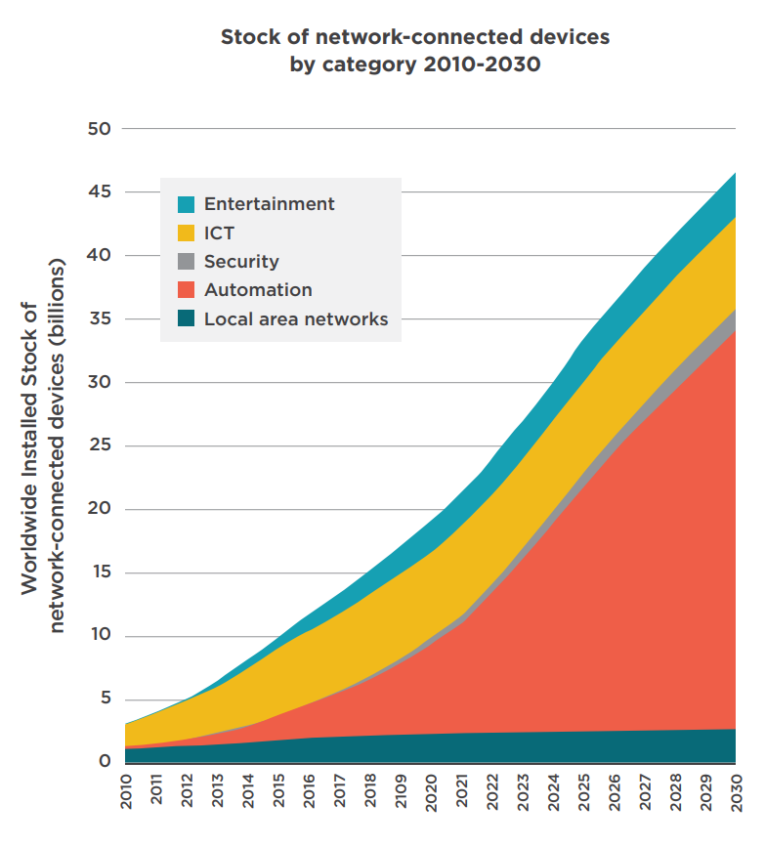
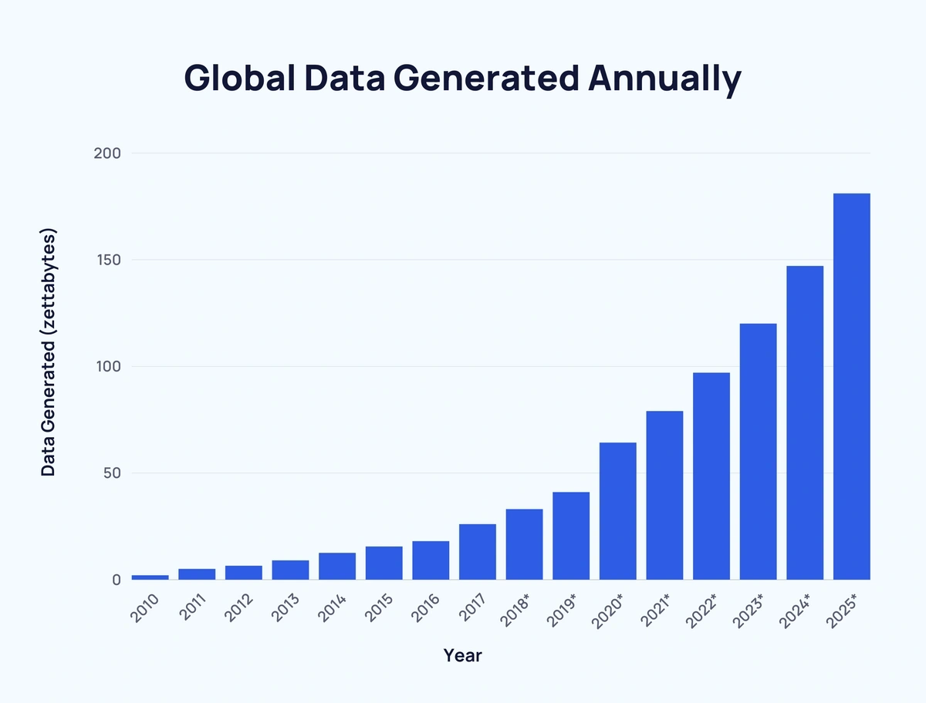
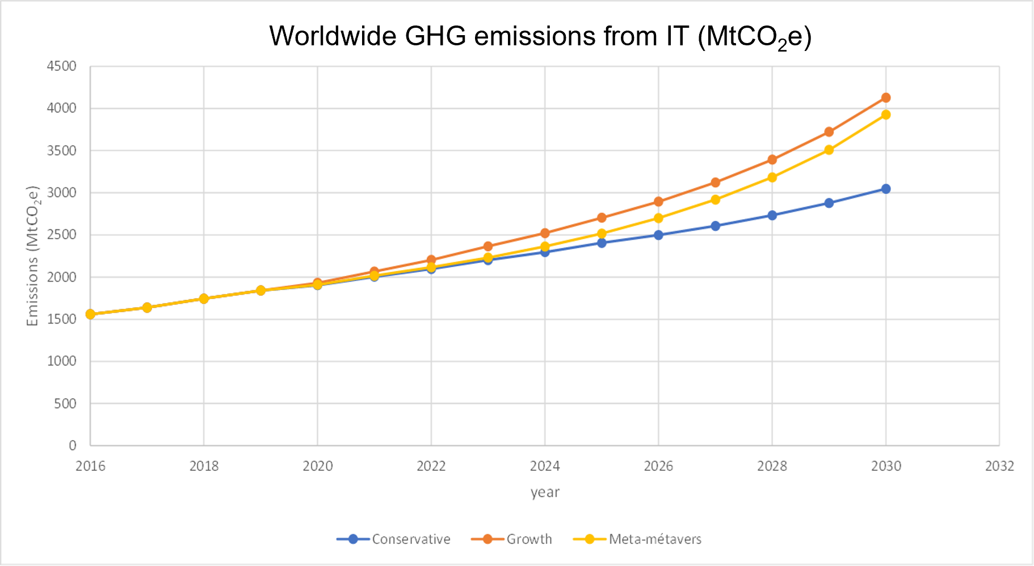
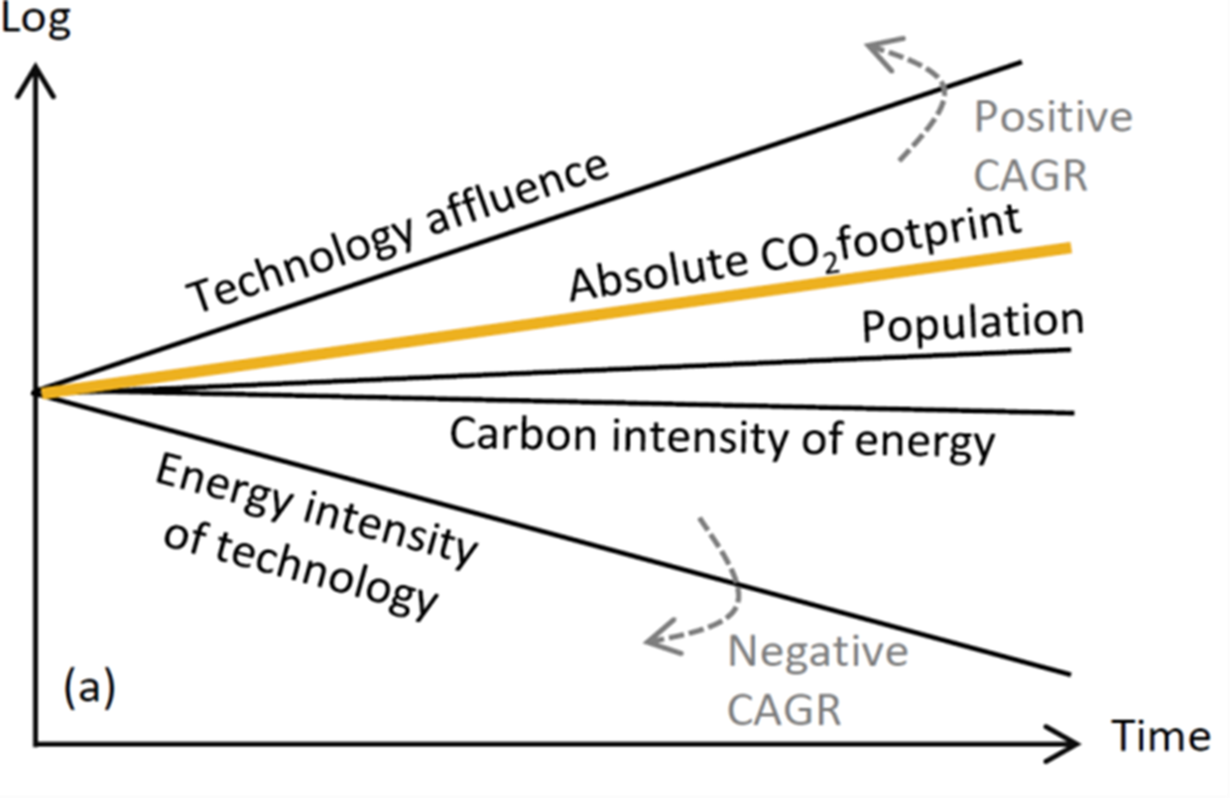
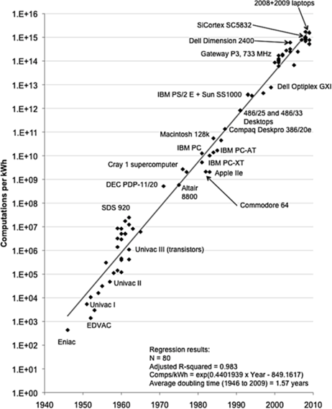
1st level analysis: GHG=affluence*intensity*carbon intensity
X 5
(sources: see last slide)
X 3
X 4
2030:
9% total GHG ?
20% total electricity consumption ?
E-waste 2030 = 3 X e-waste 2010

Slide 6

Beyond the physical evidence, multiple forces drive abundance and affluence and lower the resiliency of digital (and therefore other) ecosystems
Dominant business models are linear and extractive, stimulate overconsumption and encourage obsolescence
Innovation is mainly financed by a limited set of players and directed to entertain the abundance-based paradigms; low-tech is out of the picture
Financial markets have become dependent on the continuation of current Big Tech business models: too big to fail..
A large part of the digital sector is unregulated, favouring the preservation of private (and now very powerful) interests in a non-transparent market
Etc..
Beyond the issue of their carbon footprint, digital ecosystems (private, public) are not equipped to withstand disruptions caused by resource scarcity (energy, metals, water) which is likely to happen in the next ten years; as digital has become pervasive this will affect the resiliency of almost all other social and economic systems
It has become urgent to identify levers to alter the existing dynamics and augment resiliency
In order to create a positive momentum for this transformation, we need to be able to propose a new, future-proof design of digital ecosystems
We have identified System Dynamics as a powerful approach to tackle the issue of digital (un)sustainability: representation of existing dynamics, identification of change levers, quantitative modelling

Slide 7
System Dynamics : a powerful tool to map digitalization
There are barely any papers or reports challenging digitalization’s system, using System Dynamics and mapping leverage points for digital transformation.
Causal Loops Diagram (CLD) is a mental model, it helps to reinvent the « way we think » :
  A CLD to describe the current dynamic of ICT sector
  A CLD to understand ICT ecological footprint (pollution, energy and natural resources consumption, waste…)
  A CLD to reboot the system
  ICT introduces many reinforcing loops and few balancing loops
  Stocks and Flows Diagram (next step in our research)
  Simulation modelling (Next Step) with modules to design Business models, digital in global finance, artificial intelligence…)

Slide 8
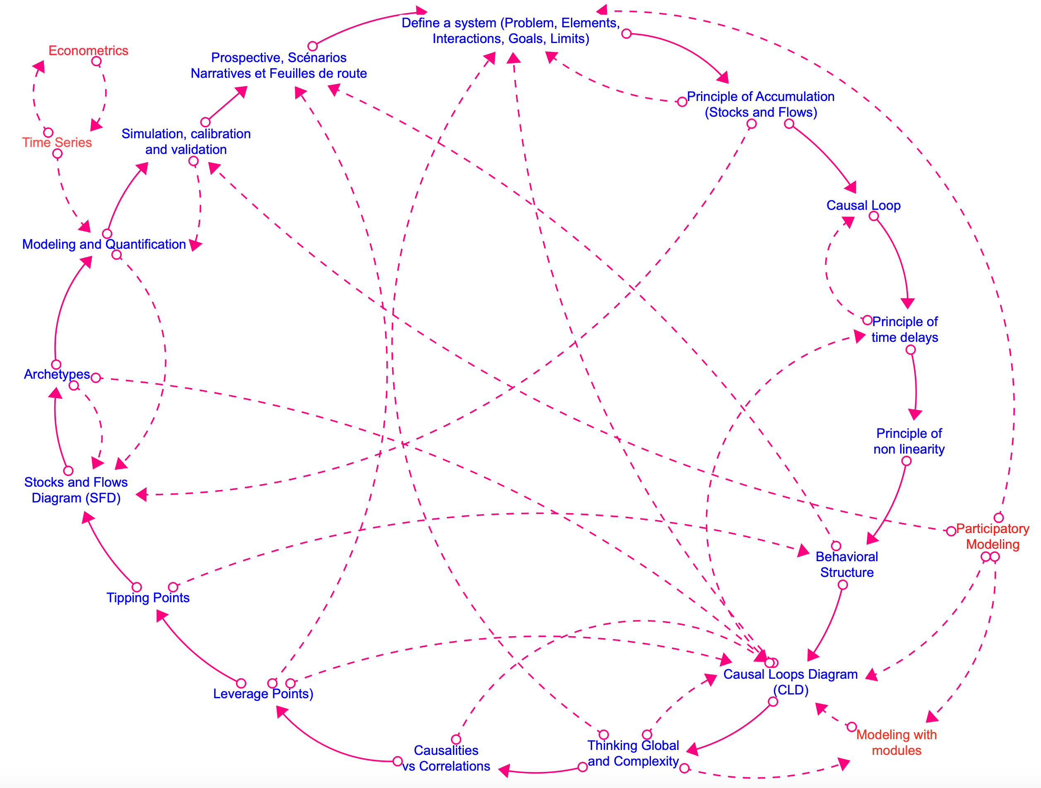
Systems thinking to System Dynamics Design
The system dynamics literature (Forrester, 1961, 1969, Sterman, 2000) places particular emphasis on the following three elements:
(i) causal loop diagrams (CLDs are visual representations of feedback loops and causal chains within a system);
(ii) stock and flow diagrams (SFDs are diagrams that show accumulations - stocks - and rates of change - flows - within a system);
(iii) the simulation model (software such as Stella, Vensim, Insight Maker or Powersim Studio) is a computer model that simulates system behavior over time (enabling experimentation and analysis).
16 steps from systems thinking to Systems Dynamics
Source : Diemer (2022, 2024)

Slide 9
Sustainability Framework for digitalization
Sustainable digital development is an approach designed to reconcile the challenges of digital transformation with those of environmental preservation, social equity and economic development.
It is based on the idea that the digital sector, while driving innovation and growth, must develop in a responsible manner that respects natural resources, while considering social and economic impacts.
Ecological footprint and planetary Boundaries
Circular economy and sustainable innovations
The role of Digitalization in other sectors
Business models
Digital Governance and ethics
Accessibility and Inclusion
Main Challenges for the four dimension of Sustainability :
Ecological,
Economics,
Social and Governance

Slide 10
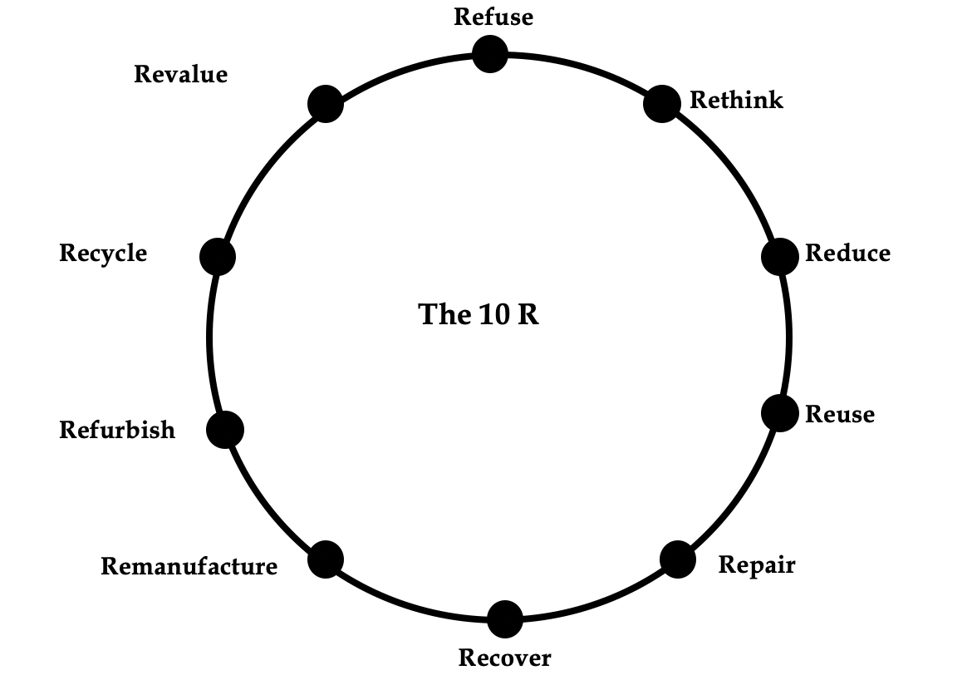
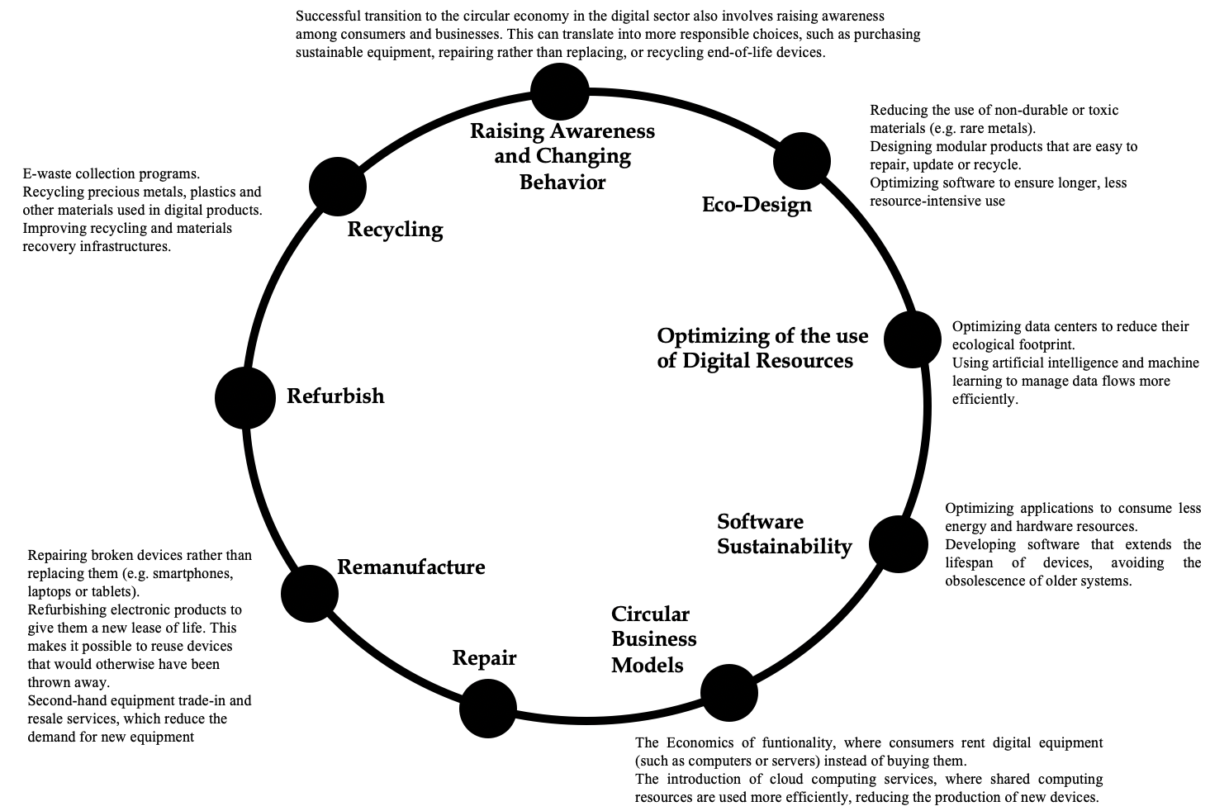
The circular economy in the digital sector refers to the application of circular economy principles to digital products and services. It aims to reduce the environmental impact of digital technologies, extend their lifespan, promote the recycling and reuse of materials, and minimize e-waste.
Circular Economy Framework for digitalization
Figure 1 : Key Drivers for Circular Economy
Figure 2 : Main Key Drivers for Digitalization
Source : Diemer (2012)
Source : The Authors

Slide 11
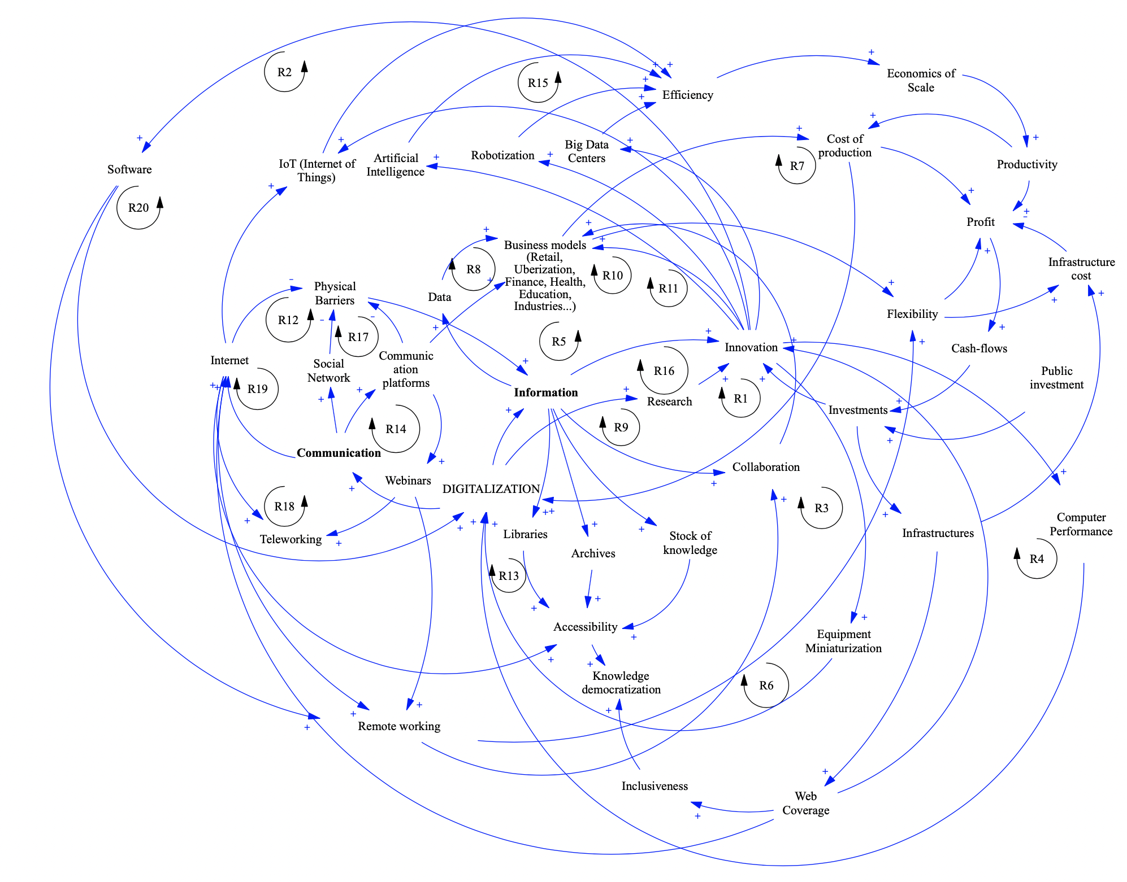
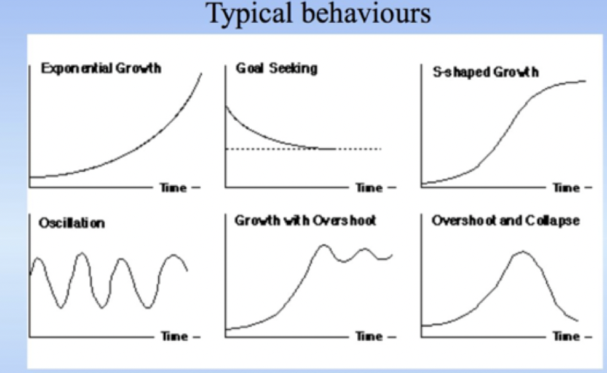
Causal Loop Diagram (CLD1) for Digitalization
Dynamics of the Digital Boom
50 Reinforcing Loops explain the boom of digitalization
10 driving forces implement dynamics in the digital system :
Communication and information process
Accessibility and knowledge democratization
New Business models
Efficiency and optimization
Transformation of work patterns
New consumption models
Infrastructures
Innovation impacts and scientific research
Growth's cycle
Public Investment

Slide 12
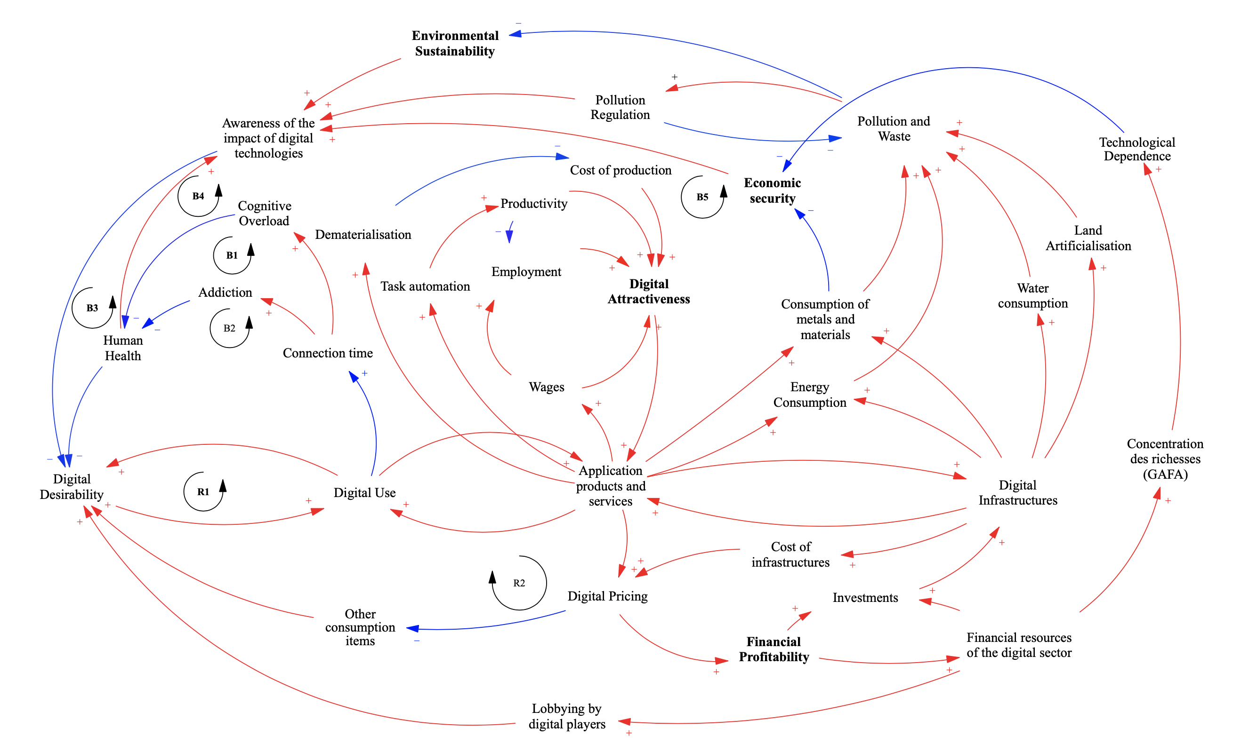
Causal Loop Diagram (CLD2) for Digitalization
Impacts of the digitalization
43 loops identified
Most of them are reinforcing loops (+) with specific driving forces : digital desirability, digital use, applications, infrastructures
Regulation loops (-) introducing the impact of digitalization (human health, pollution, waste, energy and water consumption…), the Awareness of the negative impacts of digitalization plays a key role.

Slide 13
Conclusion & next steps
Engage a modelling process with Stocks and Flows Diagrams on the scope of Digital equipment (computers, phones, data centers, network, connected objects…)
Produce digital simulation modelling with different scenarios (renewable energy and energy mix) and Narrative Shared Socio-Economic Pathways.
Reconnect this research with IPPC reports to identify leverage and tipping points between Climate and Digitalization (5% of the GhG emissions)
Introduce Circularity as a pillar such as Sustainability and Resilience for System Thinking

Slide 14
Sources (slide 5)
Stock of network-connected devices
https://www.iea-4e.org/wp-content/uploads/publications/2020/01/4E_Policy_Brief_EDNA_7_220120_-_FINAL.pdf
Global data
https://explodingtopics.com/blog/data-generated-per-day
Data center capacity
AI power: Expanding data center capacity to meet growing demand | McKinsey
GHG projections
What virtual worlds for a sustainable real world, The Shift Project
Computing efficiency
Lorenz Hilty, LCA Forum, Novembre 2019
Affluence vs Intensity
Moore’s Law and ICT Innovation in the Anthropocene, Bol, Pirson and Dekimpe, 2021
E-waste
The global e-waste monitor 2024, Unitar

