Slide 1
Impact of Circular Economy Practices on Health Outcomes and Expenditures in the EU
Assoc. Prof. Gökçe MANAVGAT
Toros University –Turkiye

Slide 2
Agenda
1. Introduction
2. Overview of Circular Economy and Public Health
3. Data and Methodology
4. Results
5. Conclusion
Assoc. Prof. Gökçe MANAVGAT

Slide 3
1. Introduction
Understanding the impact of preventive measures on both health status and health expenditure efficiency is crucial for policymakers, healthcare professionals, and the general population in EU.
One of these policies is the European Union’s (EU) effort to achieve circularity and become more sustainable led to the creation of the Green Deal, a policy developed to reach zero GHG emissions and carbon neutrality and protect human health by 2050
Assoc. Prof. Gökçe MANAVGAT

Slide 4
1. Introduction
From a health policy and health economics perspective, the Green Deal emphasizes the critical link between environmental sustainability and health outcomes, addressing issues such as
pollution-related diseases,
healthcare cost containment through preventive strategies,
the long-term economic benefits of a healthier population,
reduced healthcare burdens
Assoc. Prof. Gökçe MANAVGAT

Slide 5
1. Introduction
The objective of this study is to analyze the impacts of circular economy practices on public health and their implications for healthcare expenditures.
The study examines the direct and long-term effects of circular economy practices, such as environmental sustainability, efficient resource utilization, wastewater management, and air quality, on health outcomes and healthcare expenditures for 27 European Union member states during the 2013–2022 period.
Assoc. Prof. Gökçe MANAVGAT

Slide 6
2.Overview of Circular Economy and Public Health
The relationship between economic growth, environmental quality, and health expenditure is multifaceted, complex, and significant (Chaabouni and Saidi 2017).
Due to economic growth, uncontrolled resource consumption, urbanization, and the release of various air pollutants into the environment, air quality has deteriorated considerably. It leads to negative health outcomes. (Brauer et al. 2012; Wu et al. 2020).
Assoc. Prof. Gökçe MANAVGAT

Slide 7
2. Overview of Circular Economy and Public Health
For a long time, public health and environmental issues were seen as separate. Additionally, political authorities have realized that they should more clearly state the impact of environmental pollution on human health and the health costs associated with environmental quality.
That is, the social determinants argument should be taken into account when governments consider the optimal balance of spending on health promotion and spending on other public areas (Cylus et al. 2018).
Assoc. Prof. Gökçe MANAVGAT

Slide 8
2. Overview of Circular Economy and Public Health
Epidemiological studies around the world in the last decade have measured the increasing mortality and morbidity related to air pollution. Measuring the public health effects of air pollution has become increasingly important in policy debates (Wang et al. 2019).
Assoc. Prof. Gökçe MANAVGAT

Slide 9
2. Overview of Circular Economy and Public Health
The Relationship Between Circular Economy Activities and Health
Circular economy approaches aim to mitigate environmental damage through practices such as recycling waste, improving resource efficiency, and reducing carbon emissions, thereby may contributing to a reduction in societal healthcare expenditures.
Notably, the decline in health issues such as respiratory diseases may caused by air pollution illustrates the indirect contribution of this economic model to public health.
Assoc. Prof. Gökçe MANAVGAT

Slide 10
2. Overview of Circular Economy and Public Health
According to WHO 2019 report :General findings on the implications for human health from the implementation of a Circular Economy approach are as follows:
Assoc. Prof. Gökçe MANAVGAT

Slide 11
2. Overview of Circular Economy and Public Health
Positive Impacts:
Reducing primary resource use, maintaining high material and product value through recycling and reuse.
Environmental improvements in manufacturing (better air, water, and soil quality, and reduced GHG emissions) bring direct and indirect health benefits and cost savings in the health sector.
Health benefits can also arise from changing usage patterns, such as healthcare systems adopting performance.
Assoc. Prof. Gökçe MANAVGAT

Slide 12
2. Overview of Circular Economy and Public Health
Negative Impacts:
Risks associated with recycling and reusing materials, particularly due to harmful chemicals like A (BPA) and brominated flame (BFRs), may pose health concerns.
Negative impacts often disproportionately affect vulnerable groups.
Assoc. Prof. Gökçe MANAVGAT

Slide 13
2. Overview of Circular Economy and Public Health
Key Insights:
Major knowledge gaps exist, particularly regarding the negative effects of hazardous chemicals.
The CE transition offers a unique opportunity for substantial health gains that support SDGs, but strategies and policies need to better integrate health considerations to mitigate potential adverse effects.
Assoc. Prof. Gökçe MANAVGAT

Slide 14
3.Data and Methodology
In this study, used annual data on health expenditures, life expectancy at birth, GDP per capita, circular economy practices, and related variables for the 27 EU countries over the period 2013–2022.
All data have been sourced from Eurostat and transformed using natural logarithms.
Health expenditure represents the sum of private and public spending.
The definitions of the variables and descriptive statistics are presented in Tables 1 and Table 2.
Assoc. Prof. Gökçe MANAVGAT

Slide 15
3.Data and Methodology
Table 1. Dataset and Definations
Variable | Definition | Measurement | Resource
HEX | Current Total health care expenditure | Million Euro | Eurostat
LIFE | Life expectancy at birth | Year | Eurostat
GDPp | Gross domestic product at market prices | Current prices, Euro per capita | Eurostat
OLD | The proportion of the population aged 65 and over | % share of the total population | Eurostat
WAST | Total waste metarial management operations (Disposal - incineration- Recovery - backfilling, recycling) | Thousand tonnes | Eurostat
GHE | Total greenhouse gases emissions from production activities | Kilograms per capita | Eurostat
WIM | Material flows for circular economy-Total imports of waste for recovery - recycling | Thousand tonnes | Eurostat
WEX | Material flows for circular economy-Total emports of waste for recovery - recycling | Thousand tonnes | Eurostat
Assoc. Prof. Gökçe MANAVGAT

Slide 16
3.Data and Methodology
Table 2. Descriptive Statistics
 | Variables
 | HEX | LIFE | GDPp | OLD | WAST | GHE | WIM | WEX
Mean | 48177.4 | 76.9 | 30184.7 | 18.8196 | 65649.9 | 7694.98 | 4583.45 | 4399.09
Std. Dev. | 85174.9 | 3.70 | 20691.6 | 1.90109 | 82305.2 | 2963.29 | 5448.49 | 5986.02
Max | 465855 | 81.5 | 118310 | 24.6 | 335216 | 17544.4 | 21733 | 26580
Min | 795.04 | 68 | 5790 | 14.2 | 875 | 3620.33 | 15 | 57
Skewness | 0.2050 | 0.000 | 0.2459 | 0.0416 | 0.1710 | 0.0049 | 0.0000 | 0.0296
Kurtosis | 0.0000 | 0.000 | 0.0972 | 0.6441 | 0.0000 | 0.0036 | 0.0015 | 0.3114
Num. Obs. | 270 | 270 | 270 | 270 | 270 | 270 | 270 | 270
Assoc. Prof. Gökçe MANAVGAT

Slide 17
3.Data and Methodology
Modeling and methodological frameworks
The Autoregressive Distributed Lag (ARDL) approach enables to determine short-run and long-run relationships between variables.
There are some advantages of implementing the ARDL models (Haseeb et al. 2019; Olayungbo and Quadri 2019; Cirakli and Yildirim 2019; Ozata 2020).
Assoc. Prof. Gökçe MANAVGAT

Slide 18
3.Data and Methodology
The ARDL approach enables us to estimate the model with I(0) and I(1) variables. Therefore, there is no need that variables should be stationary at the same level in the ARDL approach.
The Pooled Mean Group (PMG) estimator has been used in the study. The PMG model is an important version of the ARDL approach, also the PMG model estimates with likelihood at maximum level (Zaidi and Saidi 2018).
Assoc. Prof. Gökçe MANAVGAT

Slide 19
3.Data and Methodology
The study is based on Pesaran et al. (1999) PMG estimator, which is associated with pooling and averaging of coefficients over cross-sectional data.
There are some advantages implementing the PMG estimator:
The error variances, short-term coefficients, and intercepts can be differed freely across groups (Pesaran et al. 1999).
The PMG estimator enables us to examine long-term homogeneity without parameter homogeneity in the short term (Pesaran et al. 1999).
Assoc. Prof. Gökçe MANAVGAT

Slide 20
3.Data and Methodology
The econometric framework of study is given below:
Dependent Variable Health Expenditures (HEX)
$$Δ {HEX}_{it}=α_{i}+\sum_{j=1}^{m−1}{β_{ij}}Δ{HEX}_{i,t−j}+\sum_{l=0}^{n−1}{φ_{il}}Δ{GDPp}_{i,t−l}+\sum_{r=0}^{p−1}{γ_{ir}}Δ{OLD}_{i,t−r}+\sum_{u=0}^{s−1}{θ_{iu}}Δ{WAST}_{i,t−u}+σ_{1}{HEX}_{i,t−1}+σ_{2}{GDPp}_{i,t−1}+σ_{3}{OLD}_{i,t−1}+σ_{4}{WAST}_{i,t−1}+e_{1 i,t}$$
$$Δ{HEX}_{it}=α_{i}+\sum_{j=1}^{m−1}{β_{ij}}Δ{HEX}_{i,t−j}+\sum_{l=0}^{n−1}{φ_{il}}Δ{GDPp}_{i,t−l}+\sum_{r=0}^{p−1}{γ_{ir}}Δ{OLD}_{i,t−r}+\sum_{u=0}^{s−1}{θ_{iu}}Δ{WIM}_{i,t−u}+σ_{1}{HEX}_{i,t−1}+σ_{2}{GDPp}_{i,t−1}+σ_{3}{OLD}_{i,t−1}+σ_{4}{WIM}_{i,t−1}+e_{1 i,t}$$
$$Δ{HEX}_{it}=α_{i}+\sum_{j=1}^{m−1}{β_{ij}}Δ{HEX}_{i,t−j}+\sum_{l=0}^{n−1}{φ_{il}}Δ{GDPp}_{i,t−l}+\sum_{r=0}^{p−1}{γ_{ir}}Δ{OLD}_{i,t−r}+\sum_{u=0}^{s−1}{θ_{iu}}Δ{WEX}_{i,t−u}+σ_{1}{HEX}_{i,t−1}+σ_{2}{GDPp}_{i,t−1}+σ_{3}{OLD}_{i,t−1}+σ_{4}{WEX}_{i,t−1}+e_{1 i,t}$$
$$Δ{HEX}_{it}=α_{i}+\sum_{j=1}^{m−1}{β_{ij}}Δ{HEX}_{i,t−j}+\sum_{l=0}^{n−1}{φ_{il}}Δ{GDPp}_{i,t−l}+\sum_{r=0}^{p−1}{γ_{ir}}Δ{OLD}_{i,t−r}+\sum_{u=0}^{s−1}{θ_{iu}}Δ{GHE}_{i,t−u}+σ_{1}{HEX}_{i,t−1}+σ_{2}{GDPp}_{i,t−1}+σ_{3}{OLD}_{i,t−1}+σ_{4}{GHE}_{i,t−1}+e_{1 i,t}$$
Assoc. Prof. Gökçe MANAVGAT

Slide 21
3.Data and Methodology
The econometric framework of study is given below:
Dependent Variable Life Expectancy at Birth (LIFE)
$$Δ{LIFE}_{it}=α_{i}+\sum_{j=1}^{m−1}{β_{ij}}Δ{HEX}_{i,t−j}+\sum_{l=0}^{n−1}{φ_{il}}Δ{GDPp}_{i,t−l}+\sum_{r=0}^{p−1}{γ_{ir}}Δ{OLD}_{i,t−r}+\sum_{u=0}^{s−1}{θ_{iu}}Δ{WAST}_{i,t−u}+σ_{1}{HEX}_{i,t−1}+σ_{2}{GDPp}_{i,t−1}+σ_{3}{OLD}_{i,t−1}+σ_{4}{WAST}_{i,t−1}+e_{1 i,t}$$
$$Δ{LIFE}_{it}=α_{i}+\sum_{j=1}^{m−1}{β_{ij}}Δ{HEX}_{i,t−j}+\sum_{l=0}^{n−1}{φ_{il}}Δ{GDPp}_{i,t−l}+\sum_{r=0}^{p−1}{γ_{ir}}Δ{OLD}_{i,t−r}+\sum_{u=0}^{s−1}{θ_{iu}}Δ{WIM}_{i,t−u}+σ_{1}{HEX}_{i,t−1}+σ_{2}{GDPp}_{i,t−1}+σ_{3}{OLD}_{i,t−1}+σ_{4}{WIM}_{i,t−1}+e_{1 i,t}$$
$$Δ{LIFE}_{it}=α_{i}+\sum_{j=1}^{m−1}{β_{ij}}Δ{HEX}_{i,t−j}+\sum_{l=0}^{n−1}{φ_{il}}Δ{GDPp}_{i,t−l}+\sum_{r=0}^{p−1}{γ_{ir}}Δ{OLD}_{i,t−r}+\sum_{u=0}^{s−1}{θ_{iu}}Δ{WEX}_{i,t−u}+σ_{1}{HEX}_{i,t−1}+σ_{2}{GDPp}_{i,t−1}+σ_{3}{OLD}_{i,t−1}+σ_{4}{WEX}_{i,t−1}+e_{1 i,t}$$
$$Δ{LIFE}_{it}=α_{i}+\sum_{j=1}^{m−1}{β_{ij}}Δ{HEX}_{i,t−j}+\sum_{l=0}^{n−1}{φ_{il}}Δ{GDPp}_{i,t−l}+\sum_{r=0}^{p−1}{γ_{ir}}Δ{OLD}_{i,t−r}+\sum_{u=0}^{s−1}{θ_{iu}}Δ{GHE}_{i,t−u}+σ_{1}{HEX}_{i,t−1}+σ_{2}{GDPp}_{i,t−1}+σ_{3}{OLD}_{i,t−1}+σ_{4}{GHE}_{i,t−1}+e_{1 i,t}$$
Assoc. Prof. Gökçe MANAVGAT

Slide 22
4.Results
Cross-Section Dependency
If cross-sectional dependence is present, it may affect the model’s results in panel regression analysis and therefore needs to be tested.
The test developed by Pesaran (2004) is particularly applicable to panels with short time series dimensions and is widely used.
Assoc. Prof. Gökçe MANAVGAT

Slide 23
4.Results
Table 3. Pesaran CD test
Variables | CD-test | p-value
lnHEX | 54.83 | 0.000
lnLIFE | 26.49 | 0.000
LnGDPp | 55.63 | 0.000
lnOLD | 57.22 | 0.000
LnWAST | 4.60 | 0.000
Ln GHE | 27.76 | 0.000
LnWIM | 13.90 | 0.000
LnWEX | 18.73 | 0.000
All variables demonstrate significant cross-sectional dependence (p-value = 0.000), which suggests a common factor or correlation across countries.

Slide 24
4.Results
Unit root test
The Cross-sectionally Augmented Dickey-Fuller (CADF) test examines whether series are stationary in panel datasets while accounting for cross-sectional dependence.
When cross-sectional dependence is present, the CADF test should be used, as traditional unit root tests can be misleading
Assoc. Prof. Gökçe MANAVGAT

Slide 25
4.Results
Unit root test
Table 4.Pesaran's CADF test
 | Pesaran's CADF test
Varibales | t-bar (at level) | t-bar (diffecences)
HEX | -1.813 | -1.988*
LIFE | -1.922 | -3.384***
GDPp | -1.434 | -1.885 *
OLD | -1.516 | - 2.085 **
WAST | -2.139** | -1.484
GHE | -2.428*** | -3.074**
WIM | -1.712 | -1.956 *
WEX | -2.364*** | -1.902
Note: *, **, *** denoted as significance at level 10%, 5%, and 1%
Assoc. Prof. Gökçe MANAVGAT

Slide 26
4.Results
Panel ARDL Model Results
Dependent variables : HEX
Model 1 |  | Model 2 |  | Model 3 |  | Model 4
Long-run Results |  | Long-run Results |  | Long-run Results |  | Long-run Resutls
GDPp | .7719 ( 0.000) | GDPp | .0924 ( 0.410) | GDPp | .8010 ( 0.000) | GDPp | .9284 ( 0.000)
OLD | 1.233 (0.000) | OLD | 2.0122 (0.000) | OLD | 1.1302 (0.000) | OLD | 0.9192 (0.000)
WAST | 1.0427 (0.000) | WIM | .4895 (0.000) | WEX | 0.9001 (0.000) | GHE | .4895 (0.000)
Short- run Results |  | Short- run Results |  | Short- run Results |  | Short- run Results
ECM | -.2289 ( 0.199) | ECM | -.2195 (0.000) | ECM | -.2289 ( 0.199) | ECM | -.1541 (0.000)
GDPp | .3572 ( 0.010) | GDPp | .1485 ( 0.065) | GDPp | .6597 ( 0.001) | GDPp | .2855 ( 0.005)
OLD | -1.0241 ( 0.272) | OLD | -1.2204 ( 0.080) | OLD | -0.8111 (0.5431) | OLD | -.9201 ( 0.120)
WAST | -.05826 (0.315) | WIM | -.03310 ( 0.490) | WEX | -.0260 (0.432) | GHE | .3213 ( 0.000)
Cons. | 1.0790 ( 0.150) | Cons. | -.0742 ( 0.434) | Cons. | 1.3219 ( 0.012) | Cons. | 0.9574 ( 0.031)

Slide 27
4.Results
Panel ARDL Model Results
Dependent variables :LIFE
Model 1 |  | Model 2 |  | Model 3 |  | Model 4
Long-run Results |  | Long-run Results |  | Long-run Results |  | Long-run Results
GDPp | -.01615 (0.000) | GDPp | -.0298 (0.003) | GDPp | -.0051 (0.010 | GDPp | -.07832 (0.000)
OLD | .0035 (0.063) | OLD | .1075 (0.000) | POP | .0848 (0.00) | OLD | .3758 (0.000)
WAST | -.0094 (0.012) | WIM | -.0553 (0.000) | WEX | -.0061 (0.004) | GHE | -.0628 (0.001)
Short- run Results |  | Short- run Results |  | Short- run Results |  | Short- run Results
ECM | -.8269 (0.000) | ECM | .-4175 (0.000) | ECM | -.82137 (0.000) | ECM | -37713 (0.000)
GDPp | .09872 (0.000) | GDPp | .0435 (0.005) | GDPp | .0891 (0.000) | GDPp | .09275 (0.000)
OLD | -.0841 (0.574) | OLD | -.0985 (0.414) | OLD | -.0364 (0.713) | OLD | -.09669 (0.333)
WAST | -.0258 (0.189) | WIM | -.0128 (0.305) | WEX | -.0084 (0.083) | GHE | -.0246 (0.091)
Cons. | -3.5308 (0.000) | Cons. | -2.002 (0.000) | Cons. | -3.443 (0.000) | Cons. | -1.7244 (0.000)

Slide 28
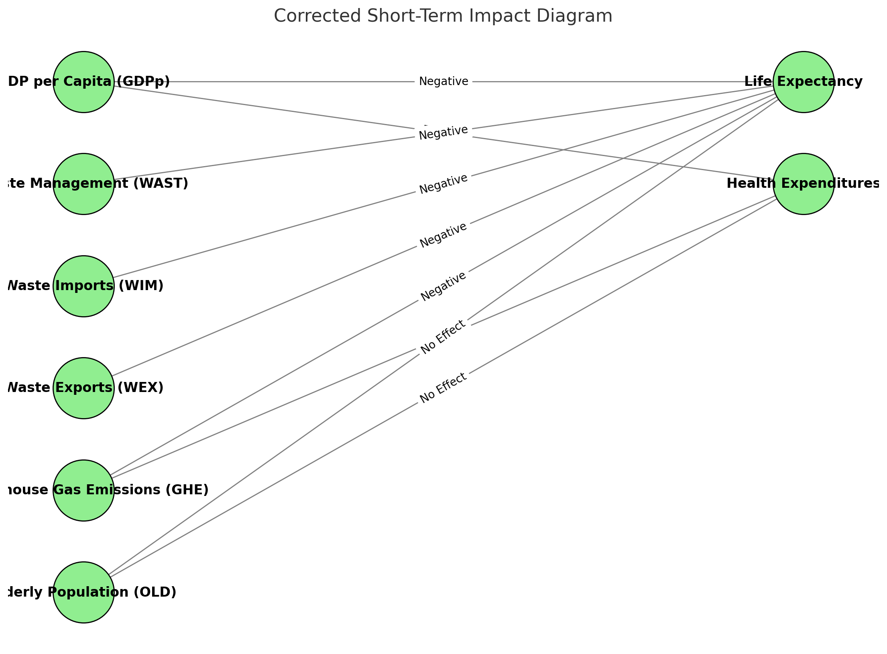
4.Results
Short-term effects
Assoc. Prof. Gökçe MANAVGAT

Slide 29
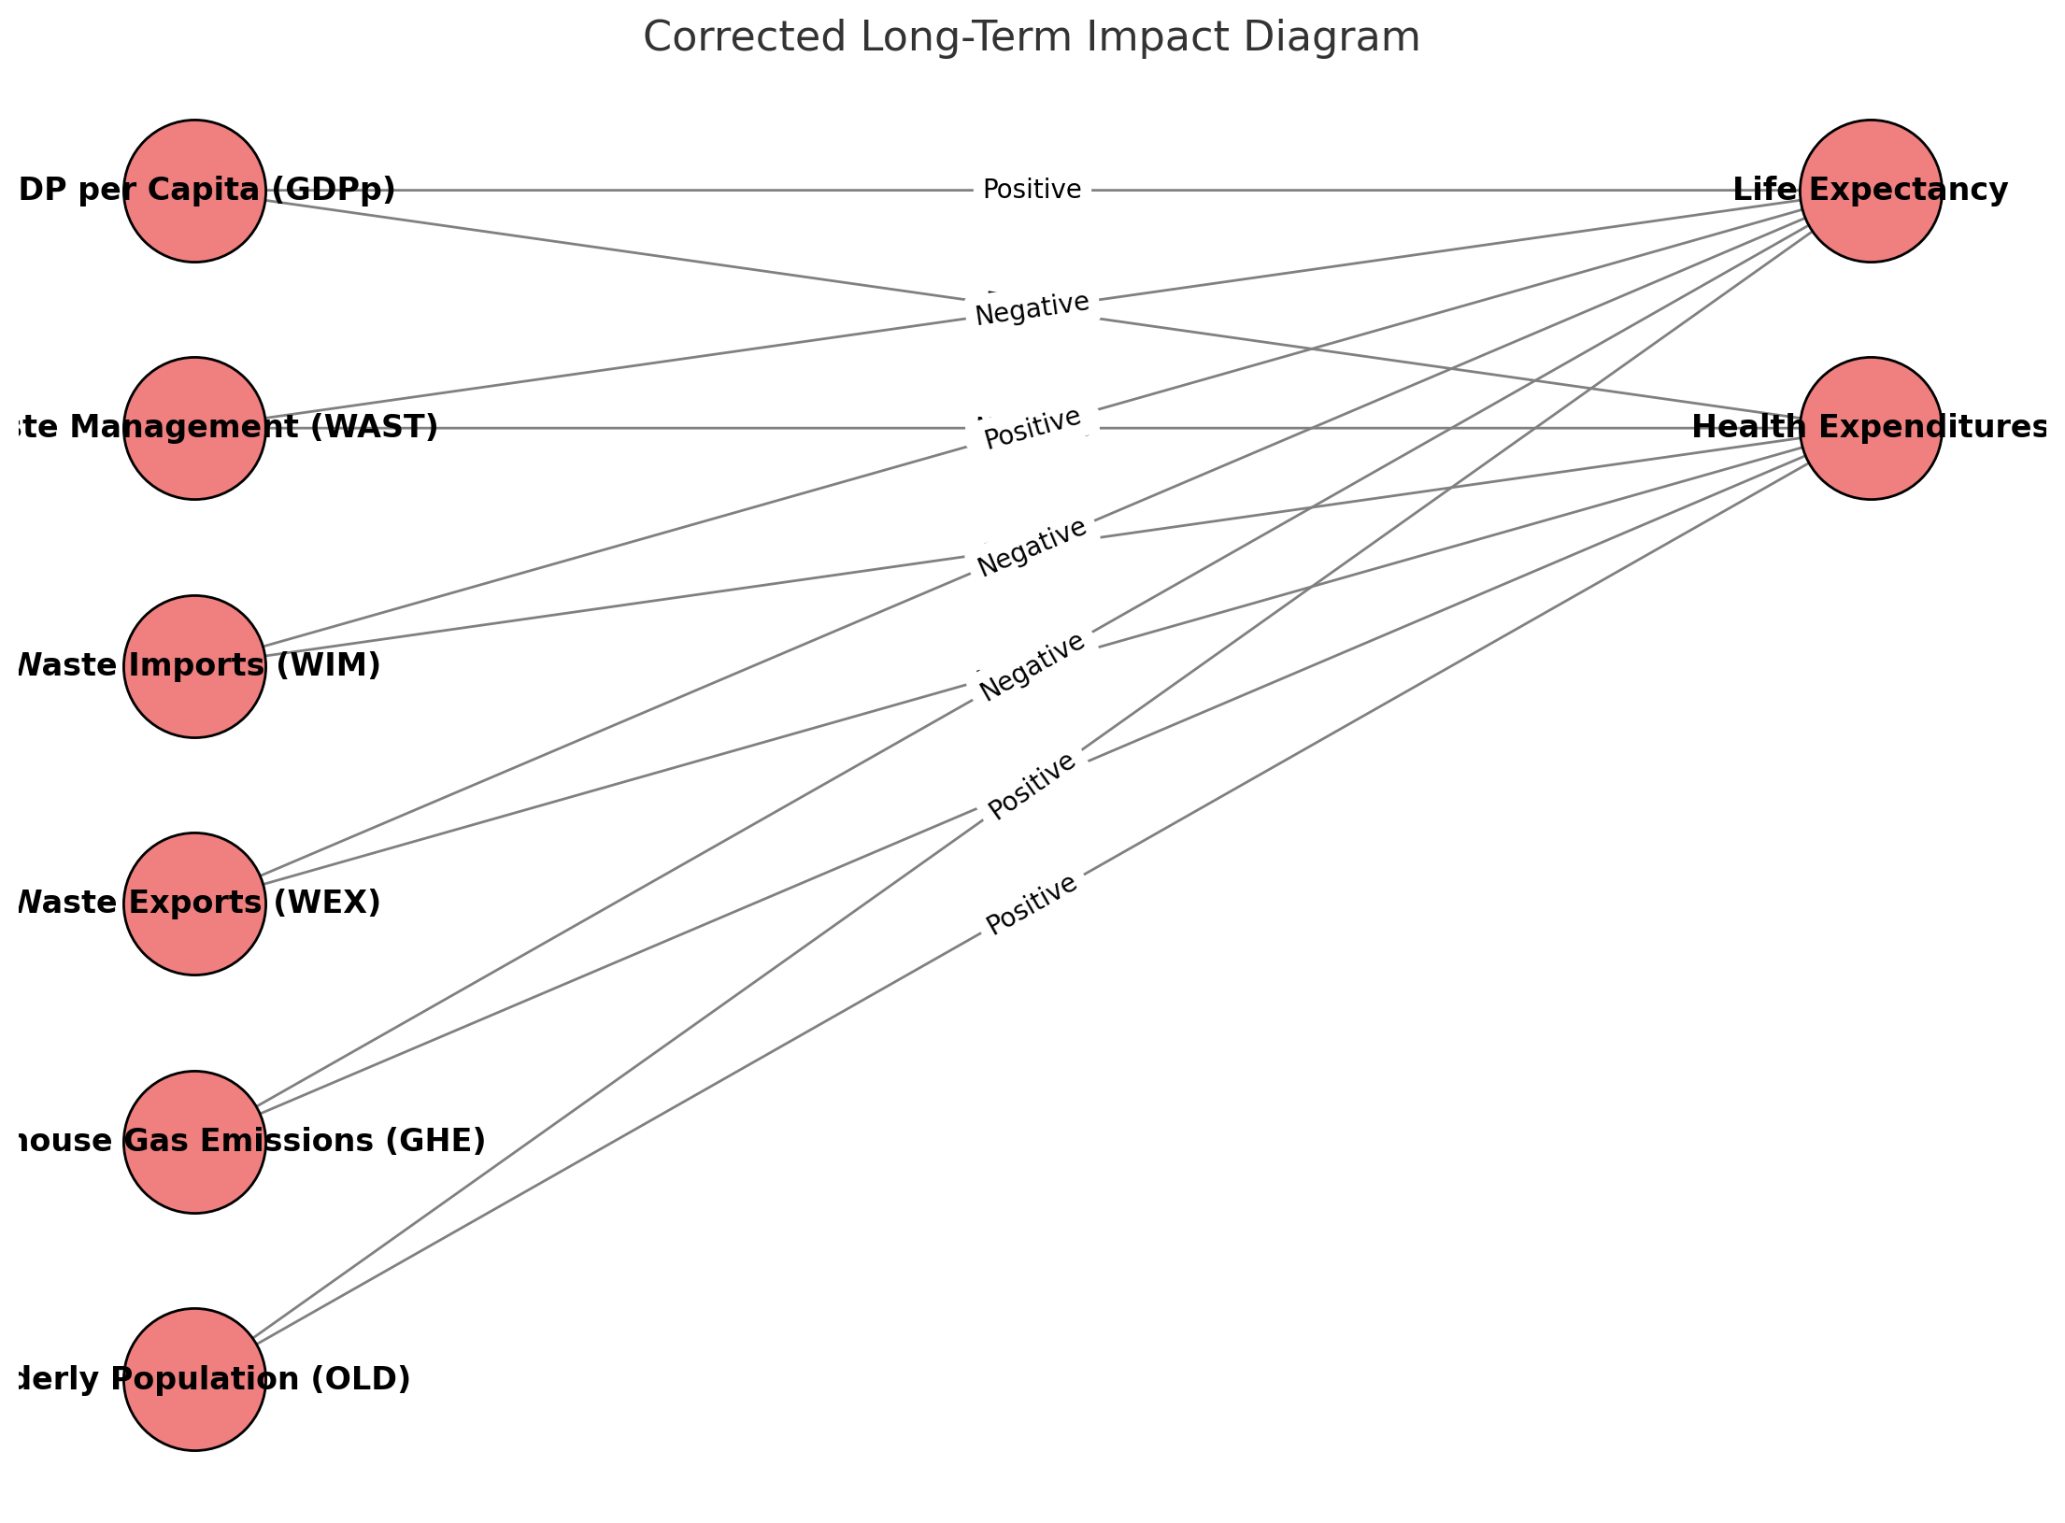
4.Results
Long-term effects
Assoc. Prof. Gökçe MANAVGAT

Slide 30
5. Conclusion
While economic and demographic factors such as GDP per capita and an aging population contribute positively to health outcomes, environmental factors related to circular economy activities and emissions reveal potential risks to public health over time.
The results suggest that, alongside economic growth, effective management of environmental practices and healthcare resources is crucial to sustain long-term health outcomes and manage healthcare expenditures efficiently.
Assoc. Prof. Gökçe MANAVGAT

Slide 31
5. Conclusion
The negative long-term effects of circular economy practicies (waste management, imports, and exports) on life expectancy suggest that current waste management processes (especially disposal and incineration) may lead to harmful emissions that adversely impact public health.
It is essential to develop more sustainable and innovative waste management strategies to mitigate the environmental and, consequently, health risks associated with circular economy practices.
Furthermore, the long-term negative impact of greenhouse gas emissions on life expectancy and health expenditures clearly reveals the damaging effects of environmental pollution on health.
To reduce the health risks associated with circular economy practices, it is essential to adopt more efficient, predictable, and health-impact-minimizing measures.
Assoc. Prof. Gökçe MANAVGAT

Slide 32
5. Conclusion
KEY MESSAGES:
It is essential to adopt more widespread environmentally friendly approaches to mitigate the negative health impacts of environmental risks posed by circular economy practices and greenhouse gas emissions.
Current waste management strategies in European Union countries, such as disposal and incineration methods, have the potential to threaten public health through harmful emissions. This highlights the critical importance of innovative and eco-friendly solutions.
Effective environmental management is key to reducing health risks, enhancing life expectancy, and controlling healthcare costs, with sustainable waste management and emission reduction being essential for long-term public health.
Assoc. Prof. Gökçe MANAVGAT

Slide 33
Thank you
Assoc. Prof. Gökçe MANAVGAT
gokce.manavgat@toros.edu

