Slide 1
Different Strategies for Improving Contractor’s Maturity of Transformation Towards Circular Economy Construction
Jaroslaw Gorecki, PhD
gorecki@pbs.edu.pl
Clermont-Ferrand, 6 December 2024

Slide 2
Different Strategies for Improving Contractor’s Maturity of Transformation Towards Circular Economy Construction

Slide 3
Agenda

Slide 4
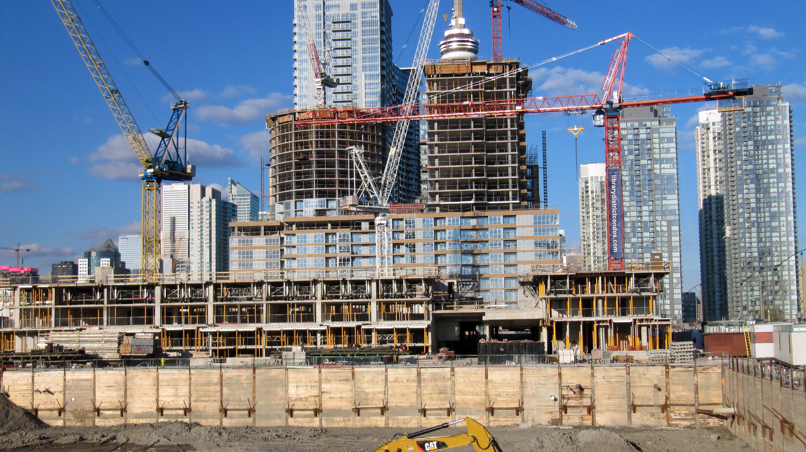
Theoretical background

Slide 5
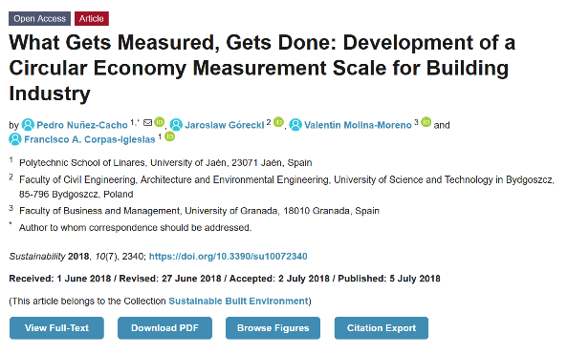

Slide 6
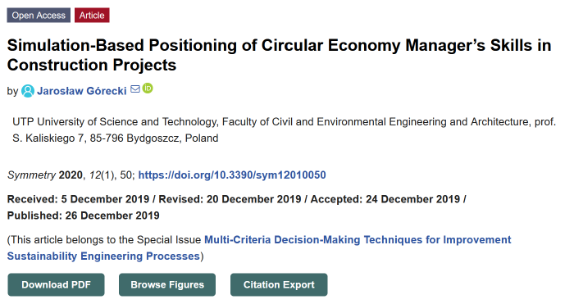

Slide 8
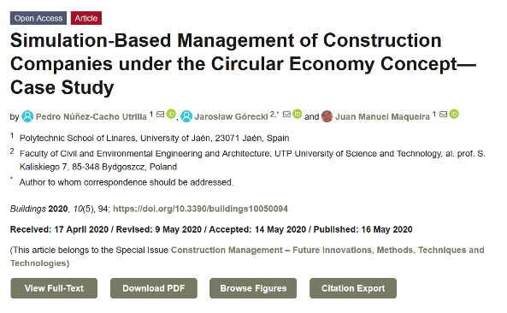

Slide 9
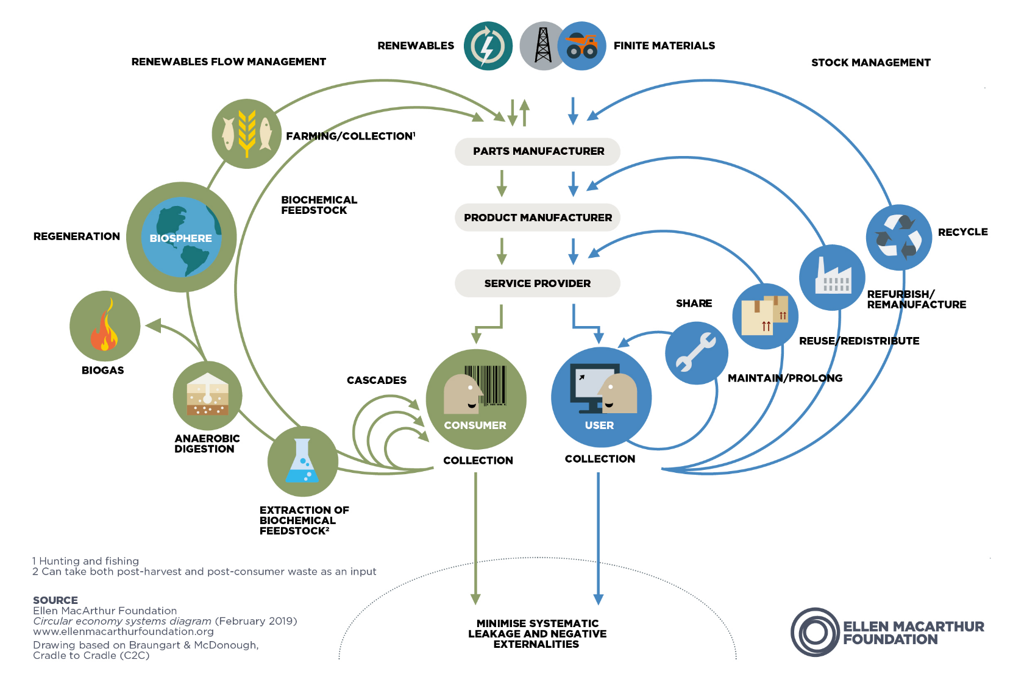

Slide 10
- ELLEN MACARTHUR FOUNDATION
The circular economy is based on three principles, driven by design:
Eliminate waste and pollution
Circulate products and materials (at their highest value)
Regenerate nature

Slide 11
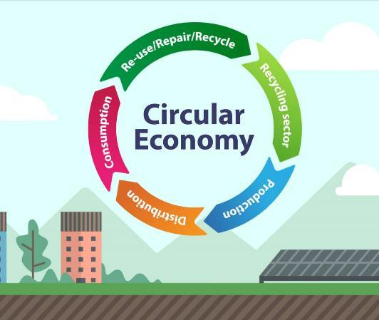
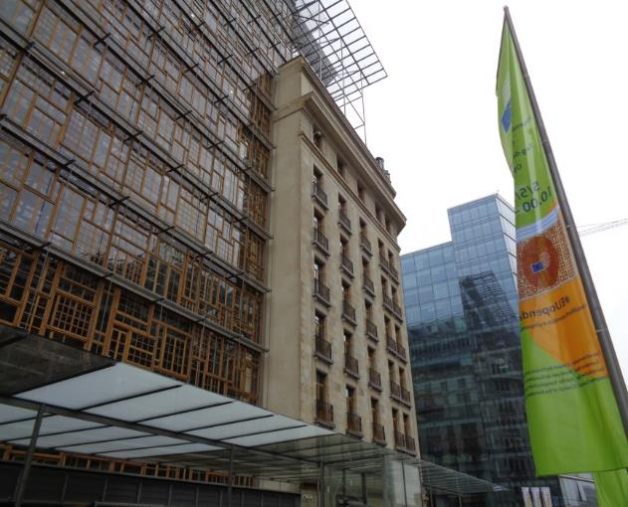
Construction industry - example
Circular Economy
cultural diversity
European crafts
← Patchwork with wooden window frames in new Europa building, Brussels

Slide 12
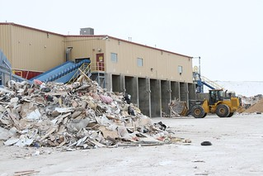
WHY construction industry?
It directly uses 1.8 billion tonnes of raw materials, or 25% of total demand for raw materials.
It generates more than 600 million tons of waste per year, or 36% of the amount of waste.

Slide 13
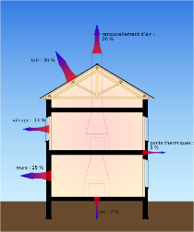
WHY construction industry?
Uses indirectly or directly (throughout the life cycle of buildings) - 40% of the energy produced
As a result of energy demand for construction, 36% of total CO2 emissions are generated in the European Union

Slide 14
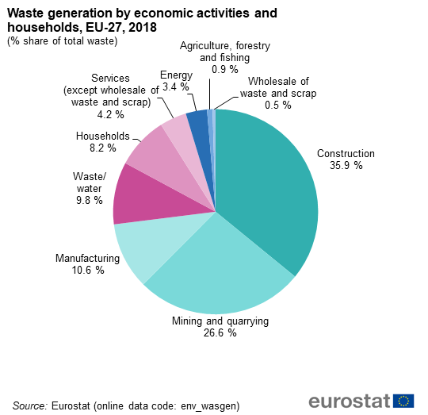
The „waste” problem
In 2003, nearly 170 million tons of waste from the construction, demolition and renovation of buildings were generated in the USA (data from the Environmental Protection Agency). The total amount of waste generated in the European Union in 2012 amounted to over 2.5 billion Mg, of which 33% (860 million Mg) was waste from construction and demolition works, and 29% (733 million Mg) waste from the mining industry (according to Eurostat).

Slide 15
“It’s very difficult to make predictions, especially about the future.”
“Problems as we know they will be over in six months.”
Looking through a crystal ball

Slide 16
Circular Economy Maturity

Slide 17
Basic dimensions of Circular Economy Maturity in a construction company
CEM of human resources
CEM of technical infrastructure
CEM of organizational culture
CEM of organizational structure
CEM in management of construction projects
CEM in organization management

Slide 18
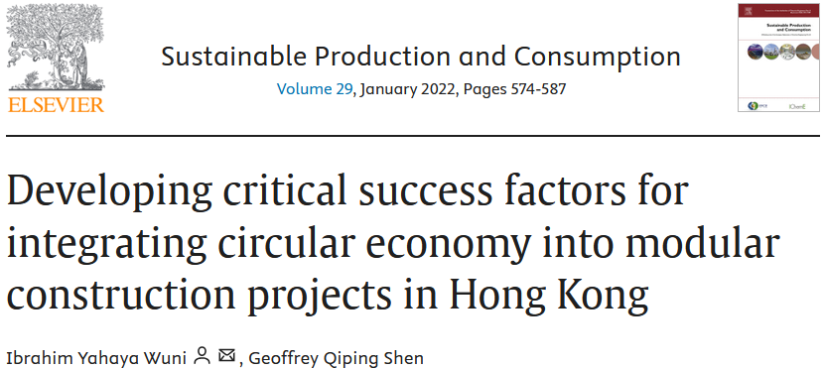
ID | Critical success factors/Principal success factors | Mean | Weightings
PSF1 | Effective supply chain management | 37,52 | 0,421
CSF19 | Inventory management and control | 3,44 | 0,092
CSF22 | Use of hedging strategies and transport delay avoidance | 3,51 | 0,094
CSF10 | Integrating circular economy principles into the supply chain of modular construction projects | 3,76 | 0,1
CSF8 | Extensive upfront planning for circular modular construction projects | 3,97 | 0,106
CSF21 | Effective use of document management system | 3,38 | 0,09
CSF17 | Effective management of critical tolerances between interfaces | 3,91 | 0,104
CSF7 | Design for manufacture, assembly, and circular economy | 4,08 | 0,109
CSF23 | Adequate lead time for the bespoke processes of circular modular construction projects | 3,82 | 0,102
CSF14 | Effective coordination of onsite and offsite work packages | 3,84 | 0,102
CSF20 | Use of just-in-time delivery arrangement | 3,81 | 0,102
PSF2 | Competence and early commitment | 32,38 | 0,364
CSF18 | Early engagement of certification body for factory inspection | 3,64 | 0,112
CSF3 | Effective leadership and support of a specialist contractor | 4,2 | 0,13
CSF1 | Adequate knowledge and experience of the project team | 4,19 | 0,129
CSF6 | Suitable site characteristics and layout | 3,79 | 0,117
CSF2 | Early understanding and commitment of the client | 4,23 | 0,131
CSF11 | Early and active involvement of critical project stakeholders | 4,05 | 0,125
CSF15 | Using suitable structural system and construction material | 3,97 | 0,123
CSF5 | Early design completion and freezing | 4,31 | 0,133
PSF3 | Collaboration and information management | 19,17 | 0,215
CSF4 | Collaborative working and information sharing among project teams | 4,17 | 0,218
CSF13 | Leveraging information from demolition and design life-cycle stages | 3,97 | 0,207
CSF16 | Effective use of building information modeling | 3,55 | 0,185
CSF12 | Effective coordination and integration of stakeholders | 3,84 | 0,2
CSF9 | Use of collaborative procurement system and contracting | 3,64 | 0,19
https://www.sciencedirect.com/science/article/pii/S2352550921003225
Hong Kong

Slide 19
Area | Measures | Possible initiatives | Importance factor | Practice rate
Financial perspective | Construction and demolition waste transportation costs | Reduce the size of waste | 3,15 | 85%
 |  | Sale of the waste
 | Adoption of the circular (shared) economy in the construction sector for waste minimization | Optimize resource usage | 3,14 | 83%
 |  | Design sustainable solutions
 | Selling of used/excess/redundant materials for reuse/recycle/energy recovery (incineration) | Develop partnerships with material sellers for return option | 2,96 | 71%
 |  | Develop partnerships with other construction companies for selling needed materials if they are used/excess/redundant
 | Cost of waste segregation on site | Apply lean practices to reduce the amount and time on segregation | 2,91 | 80%
 | Expenditures for training for C&DW treatment | Knowledge sharing between functional structures inside the company | 2,68 | 78%
 |  | Use manuals and regulation standards
Customers and other important stakeholders' perspective | Each contractor managing its own waste on construction sites | Follow the methodology of conducted works | 3,39 | 85%
 |  | Follow the guideline of project regulations
 | Collaboration between stakeholders within the construction value chain | Data sharing between contractors involved in the process | 3,29 | 78%
 |  | Joint decision making
 |  | Risk and reward sharing
 | Suppliers to minimize the excess packaging of materials | Correct evaluation of needed materials and packaging | 3,28 | 84%
 |  | Avoid excess orders
 | Prioritization of C&DW among other solid waste categories | Include a term in project guidelines | 3 | 75%
 | Suppliers' ability to supply small quantities of materials | Develop interest of supplier in project progress | 2,9 | 79%

Slide 20
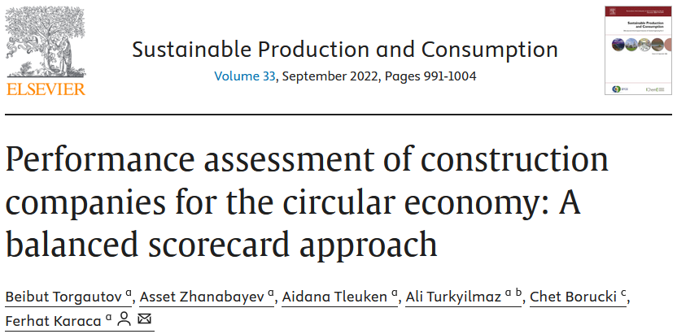
Area | Measures | Possible initiatives | Importance factor | Practice rate
Internal processes perspective | Accurate material estimates and procurement | Develop methodology and standards of exact material needed per work performed | 3,84 | 91%
 | Reduction of work hazard health impacts | Establish health and safety guidelines and strictly follow this | 3,77 | 88%
 | Following correct construction methods and sequence | Establish internal standards of following project sequence and methodology | 3,71 | 94%
 | Generate site waste management plan before the construction phase | Project engineers and supervisors should identify areas for waste management | 3,58 | 74%
 | Use of BIM software as part of the waste quantification, minimization, and waste management | Integrate waste data into a BIM system | 3,58 | 72%
Learning and growth perspective | Internal knowledge sharing | Share data through digital platforms available for all the staff | 3,59 | 88%
 | Access to new technologies and smart devices for the staff | Purchase needed equipment | 3,42 | 75%
 | Information exchange within the industry | Participate in local and global communities, conferences, and meetings | 3,38 | 76%
 | Employees training for effective C&DW management | Establish methodology and guidelines for proper waste management | 3,23 | 76%
 | Local government waste processing knowledge | Prepare project reports, including waste management sections | 3 | 88%
https://www.sciencedirect.com/science/article/pii/S2352550922002263#t0010
Kazakhstan

Slide 21
«Maturity – Transformation» relationship
CE MATURITY
General advancement in CE
Key Performance Indicators
TRANSFORMATION
Strategy of transformation
Critical Success Factors
Roadmaps
Readiness to transform
Quantifiable metrics a company uses to evaluate progress toward critical success factors
Critical steps companies perform to achieve their goals and objectives and implement their strategies

Slide 22
CE Maturity
Complement of the Energy Use Intensity = 1-EC/GVA, where: EC – Energy Costs, GVA – Gross Value Added.
----------------------------
Both EC and GVA are estimated for the whole organisation on the basis of particular projects
Level | Perspec-tive | Indicators (Measures) | Desired value of the indicator (Target) | Justification
ORGANISATION | DE | ‘Designing for deconstruction’ strategies - percentage | 100% | Majority of experts pointed it out
 | MM | “Better …” initiatives for sustainable production - percentage | 80% | Majority of experts pointed it out
 | CP | Complement of the Energy Use Intensity index - percentage | 90% | Majority of experts pointed it out
 | MA | Building management strategies - percentage | 80% | Majority of experts pointed it out
 | EL | Decision accuracy of demolition time and transition to another loop - percentage | 70% | Majority of experts pointed it out
DE – design phase, MM – manufacture of materials phase, CP – construction process phase, MA – maintenance phase, EL – end-of-life phase, CE – circular economy

Slide 23
CE Maturity
Level | Perspec-tive | Indicators (Measures) | Desired value of the indicator (Target) | Justification
PROCESSES | DE | Designs prepared in full BIM standard - percentage | 100% | Majority of experts pointed it out
 | MM | Continual improvement in CE (management control system) - percentage | 90% | Majority of experts pointed it out
 | CP | Construction site waste sorting - percentage | 100% | Majority of experts pointed it out
 | MA | Processes based on BMS - percentage | 80% | Majority of experts pointed it out
 | EL | Decision accuracy of demolition methods - percentage | 90% | Majority of experts pointed it out
DE – design phase, MM – manufacture of materials phase, CP – construction process phase, MA – maintenance phase, EL – end-of-life phase, BIM – Building Information Modelling, CE – circular economy, BMS – Building management system

Slide 24
CE Maturity
Level | Perspec-tive | Indicators (Measures) | Desired value of the indicator (Target) | Justification
WORKGROUP | DE | ‘Close loop’ instructions for designers - percentage | 70% | Majority of experts pointed it out
 | MM | More sustainable sources (reused components, recycled and controlled virgin feedstock) - percentage | 100% | Majority of experts pointed it out
 | CP | Waste collected for reuse and recycle - percentage | 40% | Majority of experts pointed it out
 | MA | CE / BMS instructions based on BIM - percentage | 90% | Majority of experts pointed it out
 | EL | Decision accuracy of demolition techniques - percentage | 90% | Majority of experts pointed it out
DE – design phase, MM – manufacture of materials phase, CP – construction process phase, MA – maintenance phase, EL – end-of-life phase, BIM – Building Information Modelling, CE – circular economy, BMS – Building management system

Slide 25
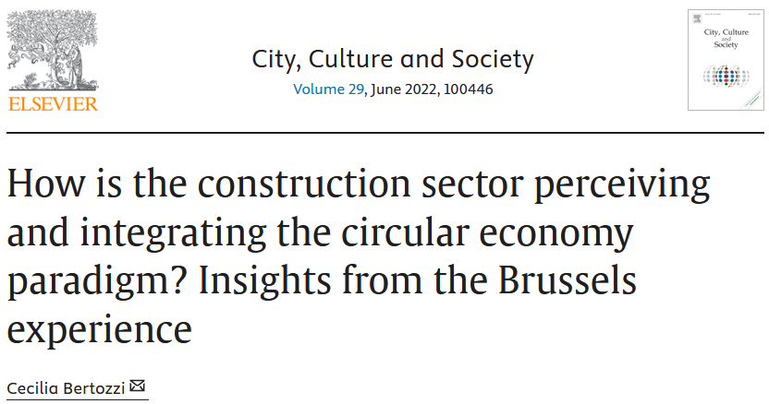
Main barriers of CE transformation | Frequency of response | Importance
Financial | 30 | 21%
Lack of Knowledge | 24 | 16%
Regulations | 23 | 16%
Cultural | 21 | 14%
Legislation | 18 | 12%
Lack of Actors / Materials' Chain | 13 | 9%
Lack of Coordination | 11 | 8%
Lack of Support from Public Administration | 5 | 3%
Other | 1 | 0,1%
https://www.sciencedirect.com/science/article/pii/S1877916622000078
Brussels, Belgium

Slide 26
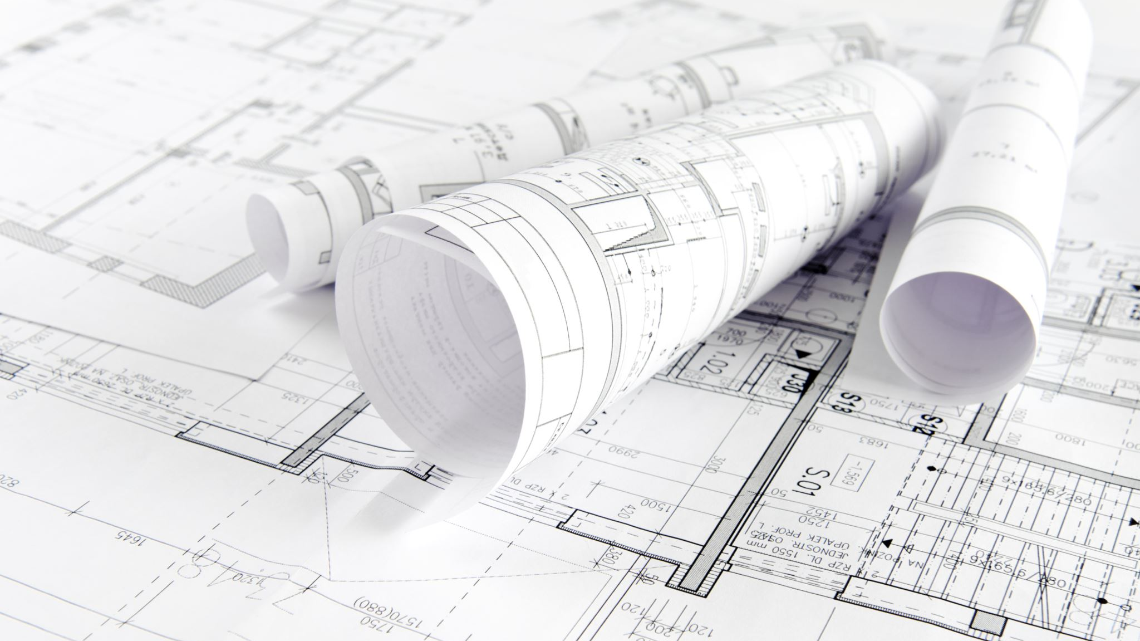
Features of construction project

Slide 27
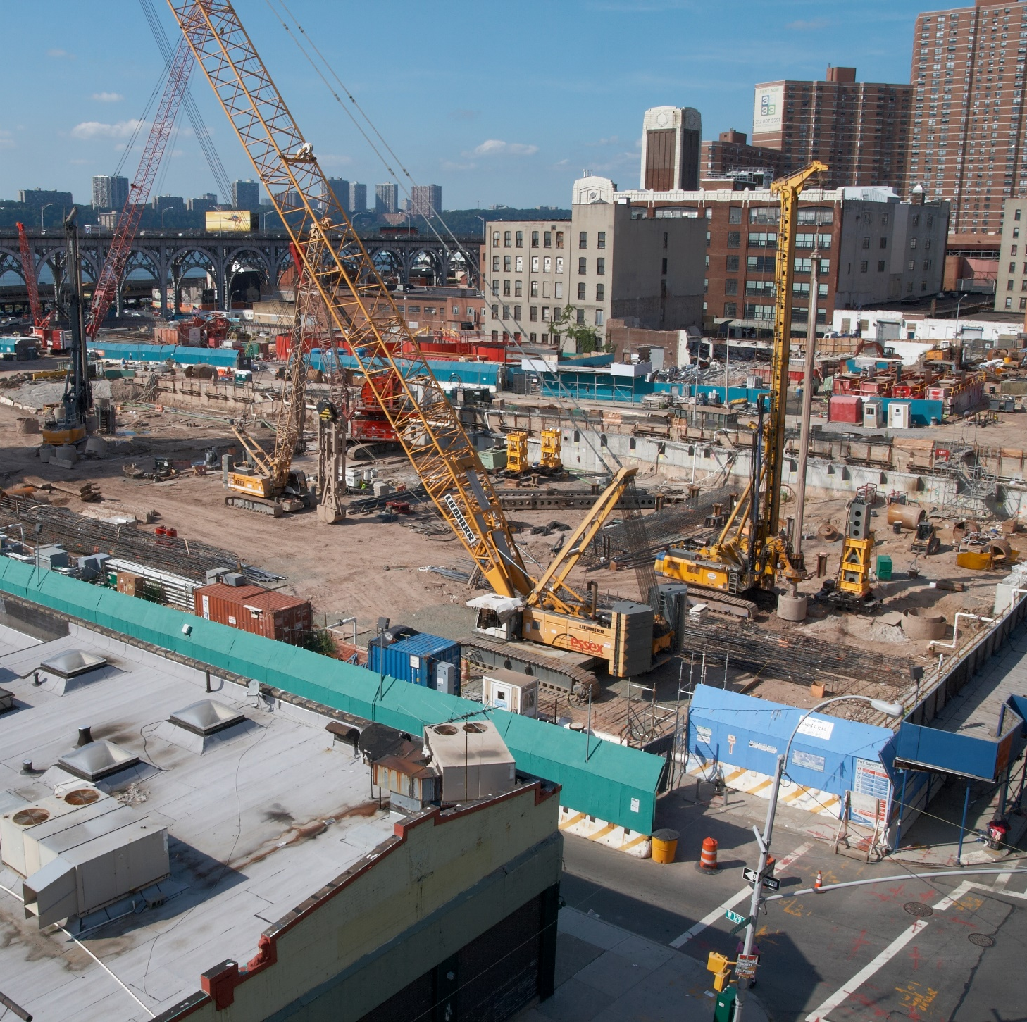
Construction
Construction is a collaborative teamwork process with successful projects dependent upon a strong weave of owner, architect, engineer, contractor, and supplier into a collaborative team, a working society

Slide 28
Construction project management
Construction project management includes practices required for effective oversight of the planning, design, and construction of a facility.
To zdjęcie, autor: Nieznany autor, licencja: CC BY

Slide 30
CE initiation phase | Frequency of response | Start-point potential
Permit | 13 | 31%
Final Design | 11 | 26%
Draft | 6 | 14%
Competition | 5 | 12%
Other | 4 | 10%
Tender | 3 | 7%
https://www.sciencedirect.com/science/article/pii/S1877916622000078
Brussels, Belgium

Slide 31
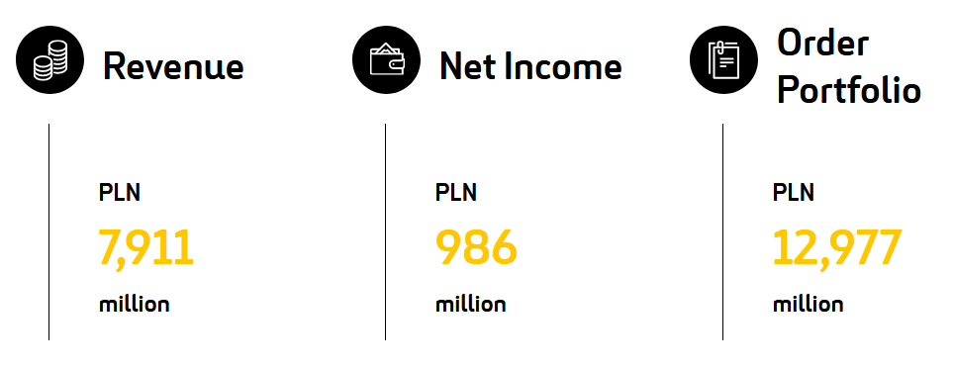
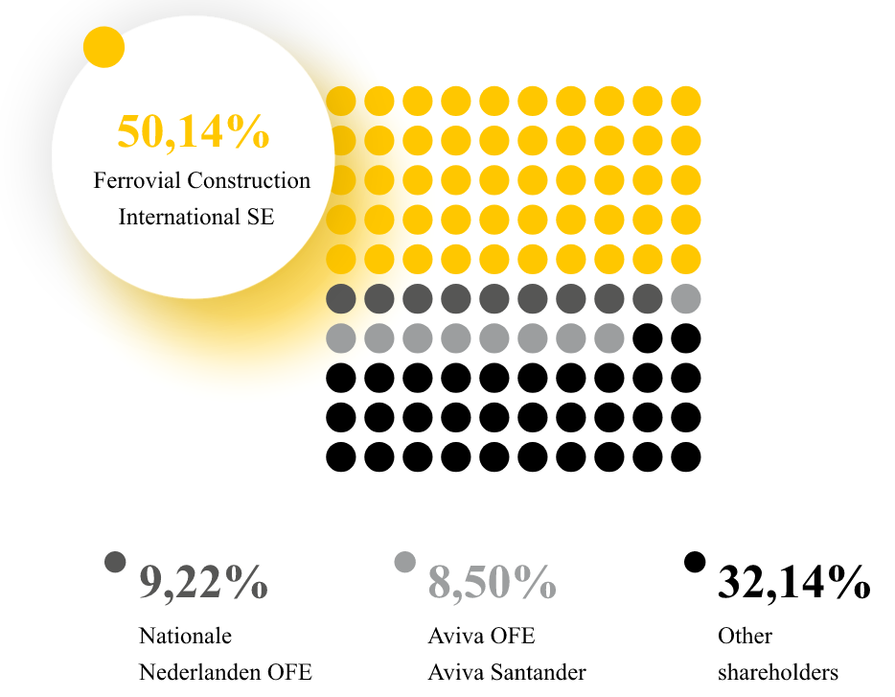
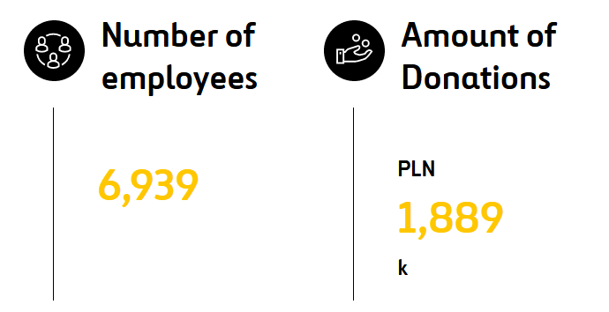
https://raportroczny.budimex.pl

Slide 32
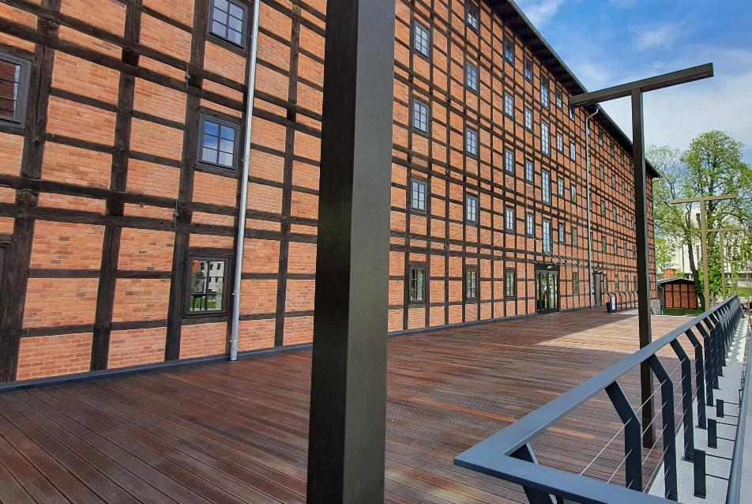
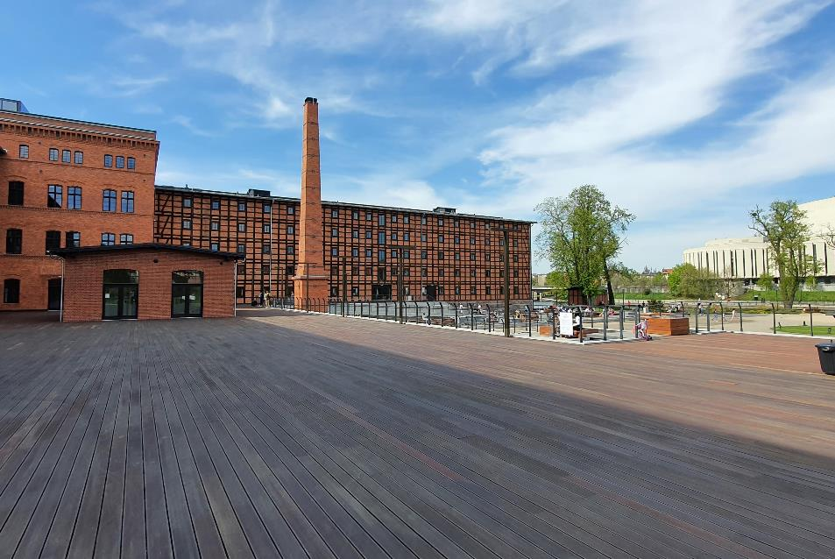
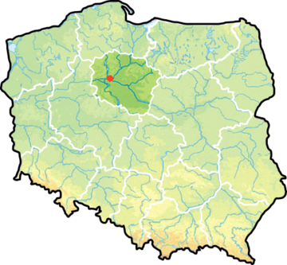
Bydgoszcz – Mill Island and Rother’s Mills

Slide 33
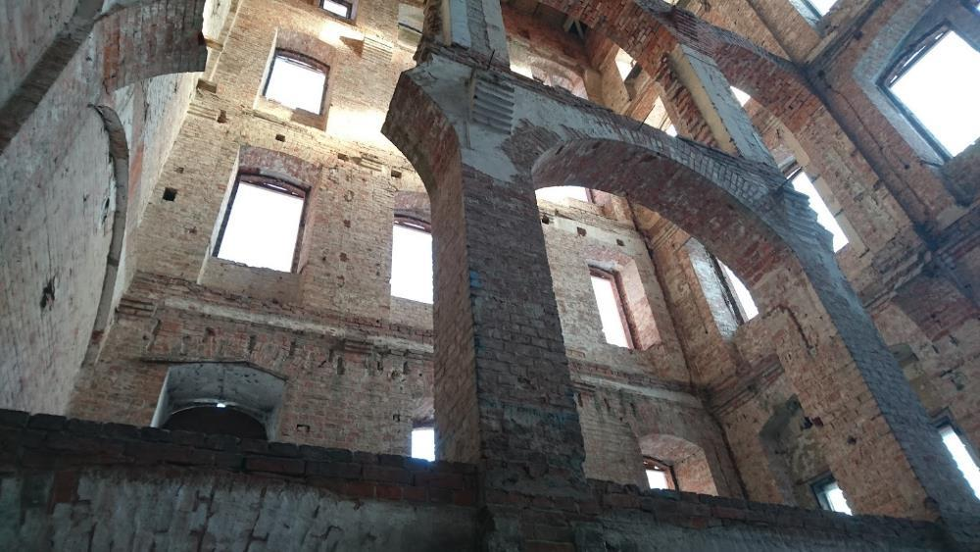
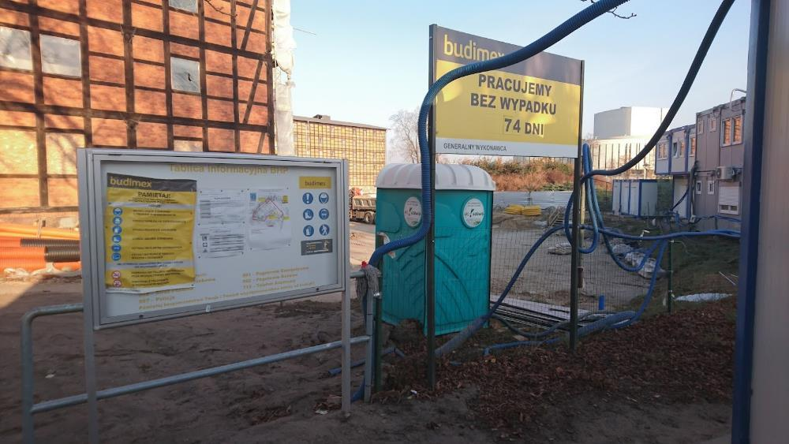
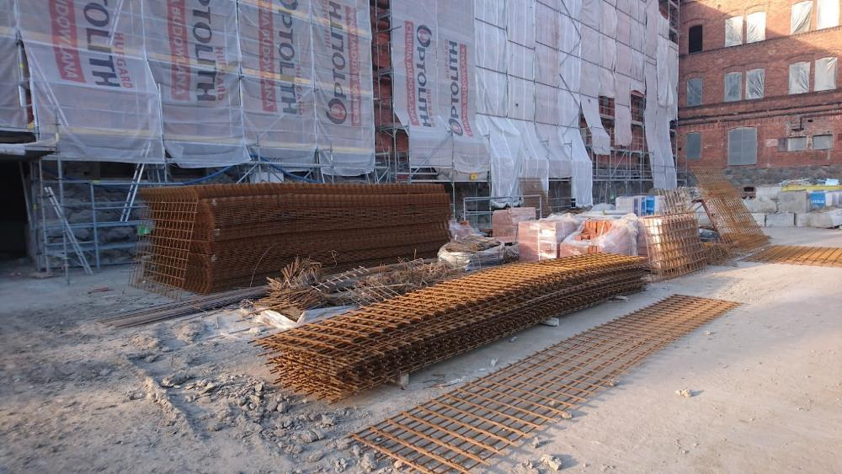

Slide 34
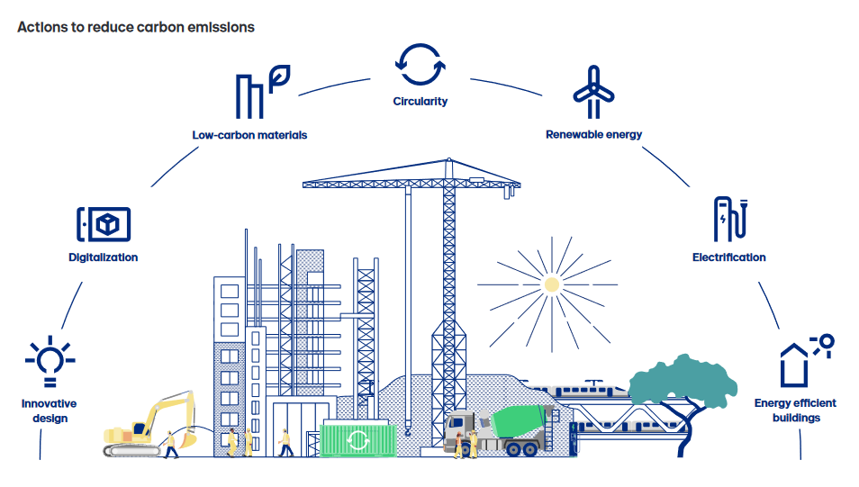
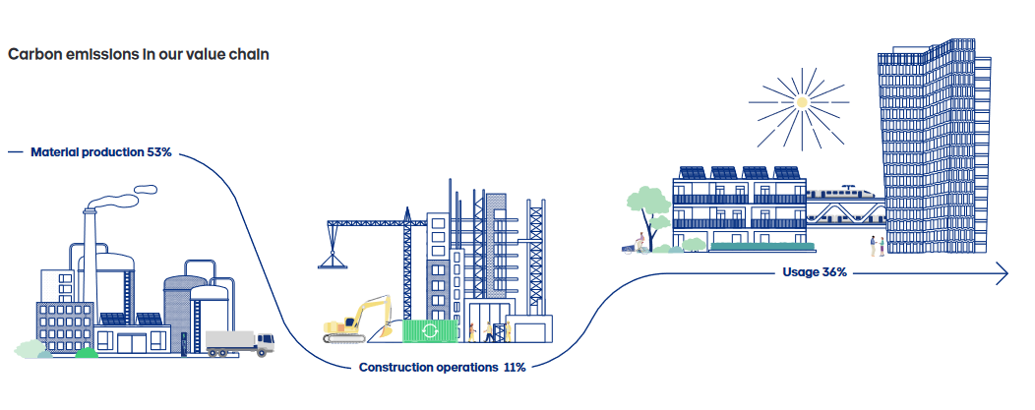
Working with partners, Skanska has successfully reused 39 concrete hollow decks from one project to another, reducing carbon emissions 93 percent per hollow deck and eliminating 98 tons of waste.
The main challenge in doing this lies in ensuring the quality of the hollow decks, as there are currently no standards in place for reused building structures.
Together with partners Contiga and Omsorgsbygg, Skanska developed a new process and control system to document the properties of these materials.
https://group.skanska.com

Slide 35
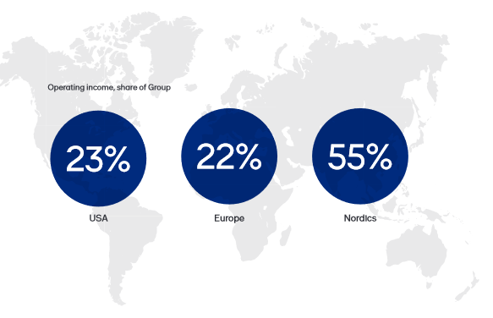
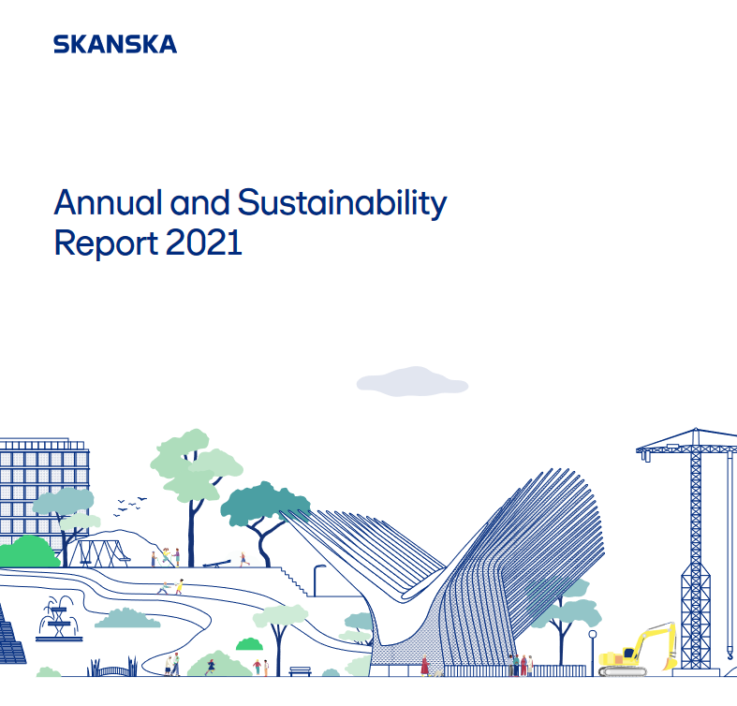
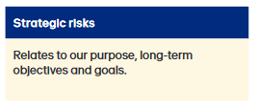
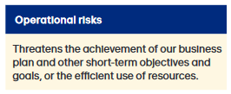
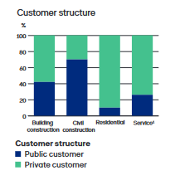
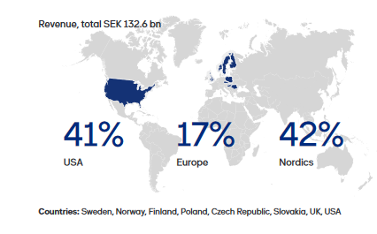
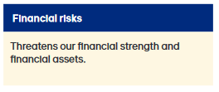
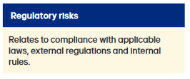

Slide 36
Proposed model based on 7 groups of factors

Slide 37
Source: https://www.mdpi.com/2071-1050/10/7/2340

Slide 38
Transition to CE

Slide 39
Management of materials

Slide 40
Energy

Slide 41
Water management

Slide 42
3R, Reduce, Reuse and Recycle

Slide 43
Emissions generated

Slide 44
Waste management

Slide 45
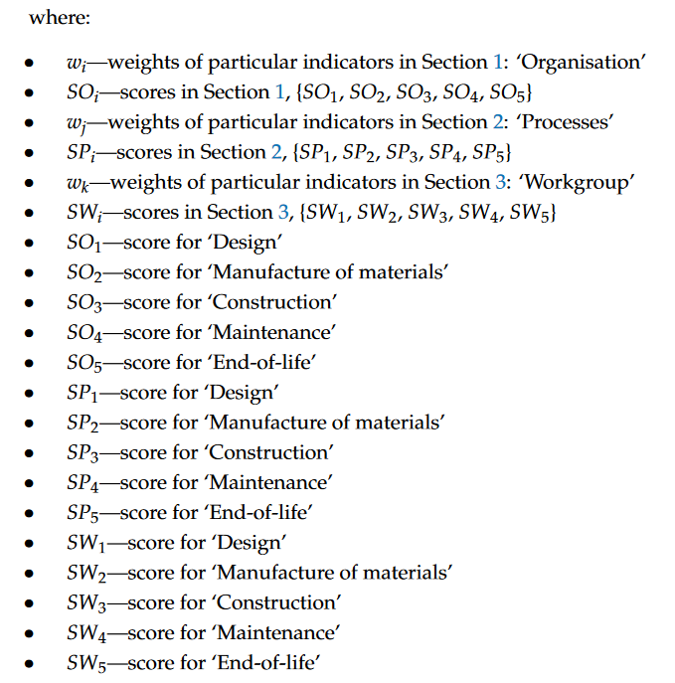
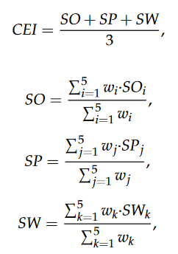
Source: https://www.mdpi.com/2075-5309/10/5/94
While:

Slide 46
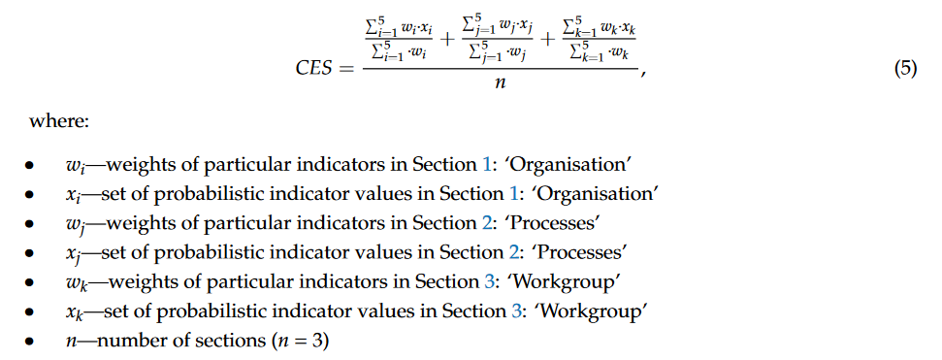

Slide 47
Strategy settings

Slide 48
CE initiator | Frequency of response | Key power
Project Owner | 17 | 39,5%
Architect | 14 | 32,5%
Public Authority | 5 | 11,6%
Advisor Engineer | 3 | 7,0%
Constructor | 2 | 4,7%
Other | 2 | 4,7%
https://www.sciencedirect.com/science/article/pii/S1877916622000078
Brussels, Belgium

Slide 49
Strategy matrix
Risk-averse
Risk-seeking
TIME SEGMENTS
Low risk – Long term
High risk – Long term
Low risk – Short term
High risk – Short Term
X-axis
SCALE OF R LIABILITY

Slide 50
Strategy matrix
Final destination, the big picture
TIME SEGMENTS
Low risk – Long term
High risk – Long term
Low risk – Short term
High risk – Short Term
Y-axis
SCALE OF R LIABILITY
Stepping stones along the way

Slide 51
Strategy scenarios

Slide 52
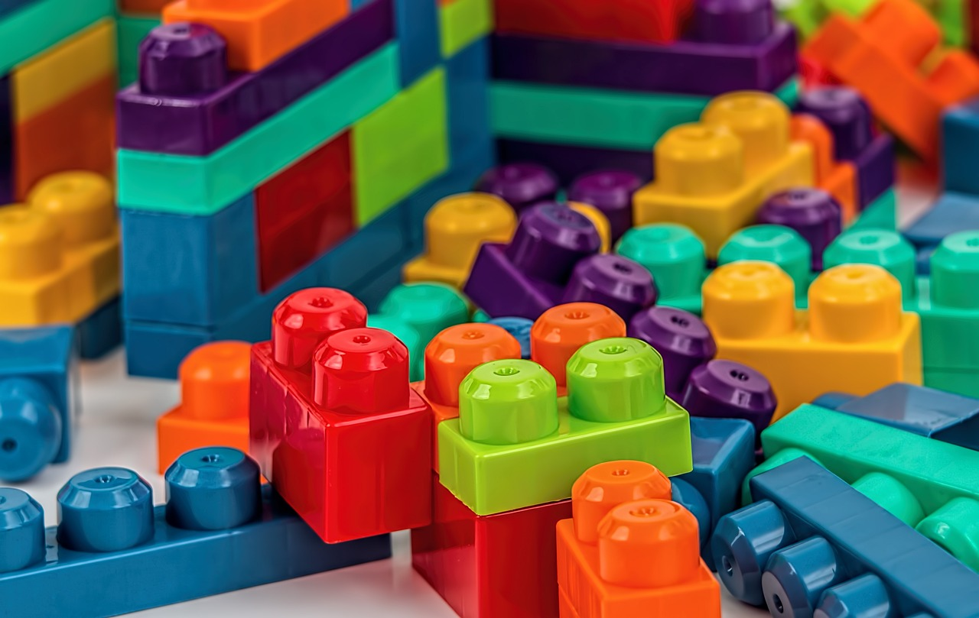
Conservative pretense Incremental adjustments
LR – LT
HR – LT
LR – ST
HR – ST
Focusing on gradual, low-risk changes with minimal disruptions to existing workflows.
Aim to adopt circular economy (CE) principles slowly without committing to major overhauls.

Slide 53
Conservative pretense Incremental adjustments
LR – LT
HR – LT
LR – ST
HR – ST
MATERIALS
Switching to suppliers offering recycled materials for non-structural elements.
ENERGY
Gradually replacing old equipment with energy-efficient alternatives during regular maintenance cycles.
WATER
Installing water-saving fixtures on a pilot project basis to assess viability.
WASTE
Introducing a basic on-site sorting system for construction debris.

Slide 54
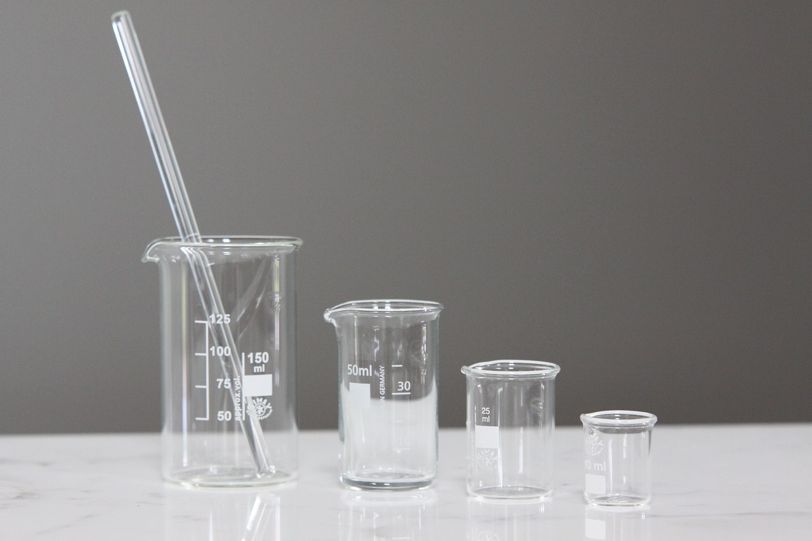
Risky evolution Experimental innovations
LR – LT
HR – LT
LR – ST
HR – ST
Encouraging taking risks on smaller-scale pilot projects to test CE initiatives.
Combining risk tolerance with a gradualist approach to minimize potential failures.

Slide 55
Risky evolution Experimental innovations
LR – LT
HR – LT
LR – ST
HR – ST
MATERIALS
Testing bio-based materials (e.g., hempcrete, mycelium) on specific components of a pilot project.
ENERGY
Trialing renewable energy solutions, such as solar panels on temporary site offices.
TRANSITION TO CE
Collaborating with clients to design modular, deconstructable structures for select small-scale projects.
TRANSITION TO CE
Launching pilot contracts that prioritize circular-friendly suppliers.

Slide 56
Conservative vision Strategic alignment
LR – LT
HR – LT
LR – ST
HR – ST
Emphasising on aligning long-term goals with CE principles while keeping risks low.
Involving research, planning, and preparing for larger transformations without immediate execution.

Slide 57
Conservative vision Strategic alignment
LR – LT
HR – LT
LR – ST
HR – ST
TRANSITION TO CE
Developing company-wide sustainability policies and guidelines, e.g., mandating life cycle assessments (LCAs) in planning phases.
TRANSITION TO CE
Establishing partnerships with green certification agencies (e.g., LEED, BREEAM).
MATERIALS
Starting the implementation of BIM (Building Information Modeling) to track material flows.
TRANSITION TO CE
Initiating employee training programs on CE methodologies and green construction techniques.

Slide 58
Revolution Radical transformation
LR – LT
HR – LT
LR – ST
HR – ST
Pursuing ambitious, high-risk changes aimed at fully embedding CE principles across the organization in one bold move.
Supporting significant investment, cultural shifts, and top-down leadership commitment.

Slide 59
Revolution Radical transformation
LR – LT
HR – LT
LR – ST
HR – ST
TRANSITION TO CE
Reconstructing all project workflows to follow cradle-to-cradle design principles.
3Rs
Investing in technologies like on-site material recycling plants or closed-loop water systems for all projects.
EMISSIONS
Committing to zero-emission construction practices, with large upfront investments in carbon offsetting projects and renewable energy.
Acquiring material suppliers and recycling companies to create a self-sustaining CE supply chain.
TRANSITION TO CE

Slide 60
Summary
Transformation is not the same as maturity.
Transformation is a process.
Maturity is a state.
Transformation requires defining critical steps.
Maturity requires metrics.

Slide 61
Summary
CE maturity can be determined based on a scale.
Transformation can be based on the 7-dimensional scale.
Transformation strategies can be input into a two-dimensional matrix.
In reality, extremes are rare, there are shades of gray.
The most effective strategy does not exist, it depends on the specific business conditions of the company.

Slide 62
Summary
Choosing the right quadrant depends on the contractor's risk tolerance and readiness for change.
Small steps or big leaps—each strategy leads toward a Circular Economy.

Slide 63
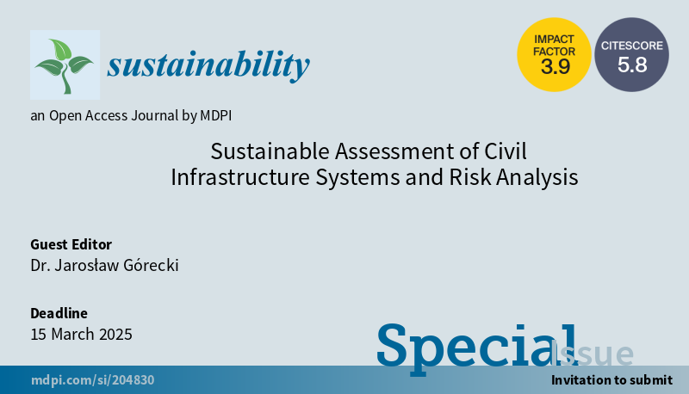
https://www.mdpi.com/journal/sustainability/special_issues/9725N1E3FL

Slide 64
Thank you!

