Slide 1
Circular Economy for agriculture in the Maule Region, Chile
Álvaro Jiménez, Gemma Cervantes
Sustainability Institute, Universitat Politècnica de Catalunya
Clermont-Ferrand, 6 December 2024

Slide 2
Table of contents
Introduction
1.1 Justification
1.2 Objectives
1.3 Hypothesis
2. Methodology
3. Results
3.1 Diagnosis
3.2 Integrated Composting and Vermicomposting Management
3.3 Establishment of non-productive areas
3.4 Photovoltaics and agricultural irrigation
3.5 Harnessing pruning biomass as an energy source
3.6 Obtaining biogas from waste from the wine industry
3.7 Synergies around the agro-industrial sector of the Maule Region
3.8 Sustainable Development Indicator System
3.9 Sustainability analysis and ethical implications
4. Conclusions
5. Future Work
3.
3.
4.
4.
5.
6.
6.
7.
8.
9.
12.
14.
16.
19.
24.
25.
26.
JIMENEZ, CERVANTES. Circular Economy for agriculture in the Maule Region, Chile

Slide 3
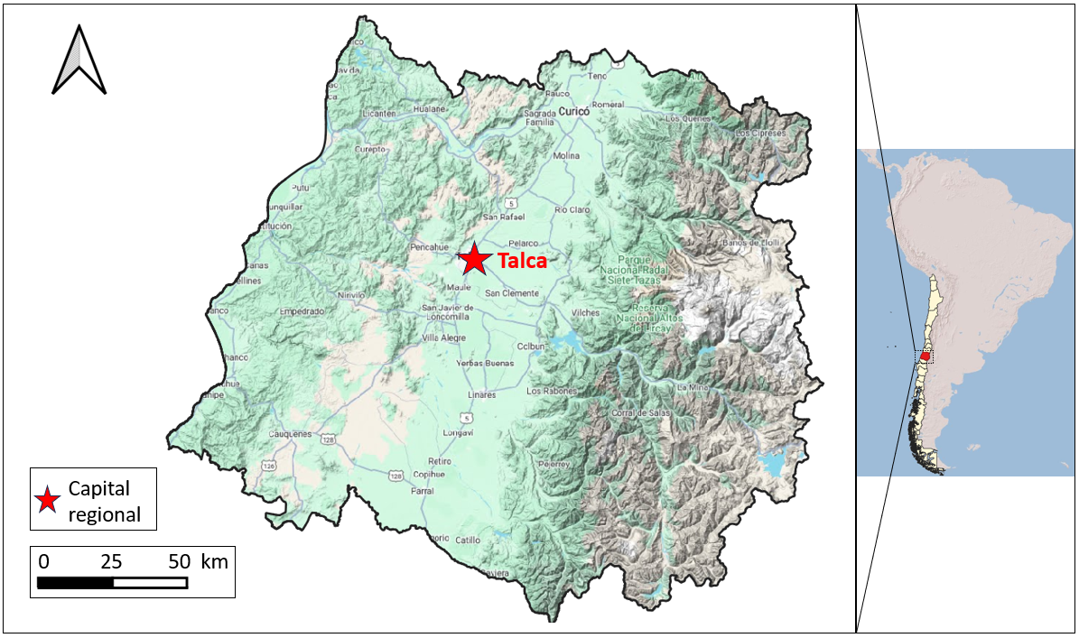
1. Introduction
1. Introduction
Agroindustry generates 46% of organic solid waste and contributes to 21% of global GHG emissions.
The Maule region is characterized by its strong agricultural activity:
Océano Pacífico
70%
Water Consumption
26,2% Jobs
15,44% GDP
Formulate BAP to achieve a closed-loop systems for materials, minimize environmental impacts, and promote social and economic development for the Maule Region
JIMENEZ, CERVANTES. Circular Economy for agriculture in the Maule Region, Chile
Notes:
PIB Chile = USD$16.800 Agroindustry plays a key role in the local economy but also has a huge impact on the environment.

Slide 4
2. Methodology
I. Background Review
II. Proposals with principles of sustainability and circular economy for the agricultural sector
III. Synergy Diagram around the Agro-industrial Sector
IV. Development of a Sustainable Development Indicators System
V. Sustainability analysis and ethical implications
JIMENEZ, CERVANTES. Circular Economy for agriculture in the Maule Region, Chile

Slide 5
3.1 Results: Diagnosis
Water and Climate Dependencies
Energy Transition
Loss of Biodiversity
There is an important competition for water resources.
Geography and economic structure result in high risk from climate change.
Important potential for the adoption of renewable energy sources:
Agriculture and forestry activities have displaced a large part of the native forest, which is in decline.
- Photovoltaic Energy
- Biomass Fuel
- Biogas
The adoption of BAP can reduce the impacts of agricultural activity and improve its resilience.
JIMENEZ, CERVANTES. Circular Economy for agriculture in the Maule Region, Chile
Notes:
Agricultura representa el 70% del consumo de agua de la región.
Déficit hídrico ha causado una pérdida del 10% en la producción agrícola
El 84% de la matriz eléctrica de la región proviene de fuentes hídricas.

Slide 6
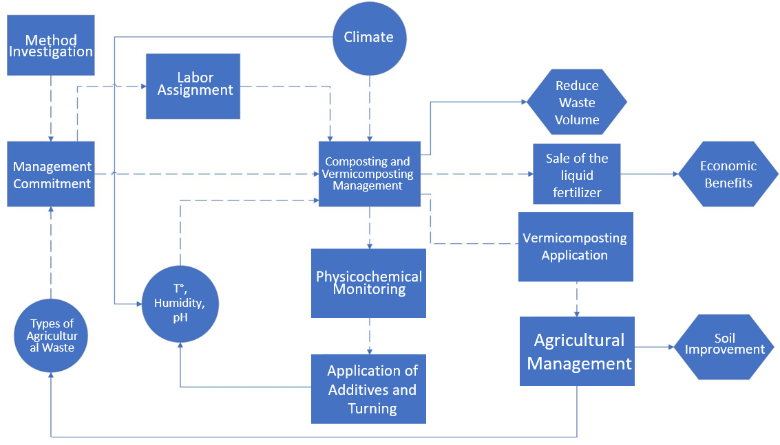
3.2 Results: Composting and Vermicomposting
JIMENEZ, CERVANTES. Circular Economy for agriculture in the Maule Region, Chile
Notes:
In agricultural systems, the use of rows with mechanical turning is recommended.
The Influence Diagram helps support the design and decision-making of the system.

Slide 7
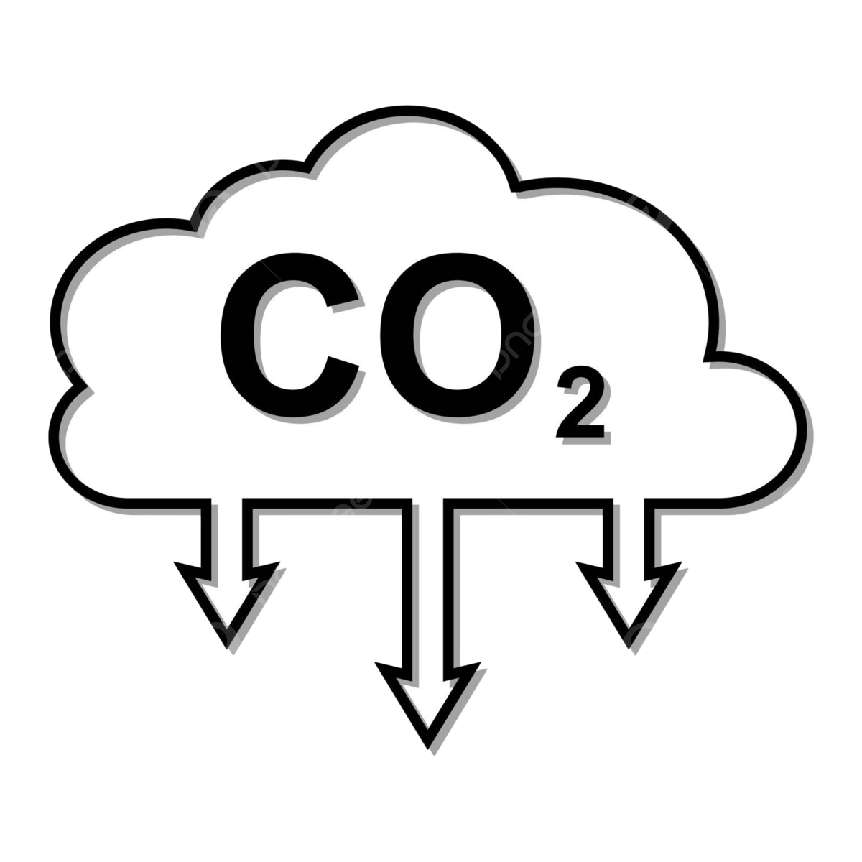
3.3 Results: Non-Productive Zones
NPZ are areas with native vegetation, whether planted or spontaneous, located on the margins or within agricultural farms.
They allow to:
Protect Biodiversity
Mitigate climate change
Improve Resilience
Designating 4% of irrigated agricultural land as NPZ would enable the restoration of a surface equivalent to 64% of the regional area under national protection.
JIMENEZ, CERVANTES. Circular Economy for agriculture in the Maule Region, Chile
Notes:
In the Maule Region, there are 500 endemic species of Chile and 27 unique species from this region.
Proteger la biodiversidad: Las ZNP generan heterogeneidad en el paisaje y permiten la conectividad entre los distintos hábitats presentes, mitigando el efecto de la
actividad agrícola en la fauna y flora local. De la misma forma, actúan como refugio para animales, aves e insectos.
- Mitigación del cambio climático: Estas zonas no ocupadas no requieren trabajos de manejo de suelos, fertilización ni aplicación de fitosanitarios, actividades todas
asociadas a la emisión de CO2. Además, la biomasa de su vegetación incrementa la captura de CO2.
- Resiliencia: La presencia de estas cubiertas vegetales permiten aumentar la retención de agua de los suelos y disminuir la escorrentía. Esto además permite
reducir los riesgos de erosión e inundación, compactando el suelo y actuando como cortavientos.

Slide 8
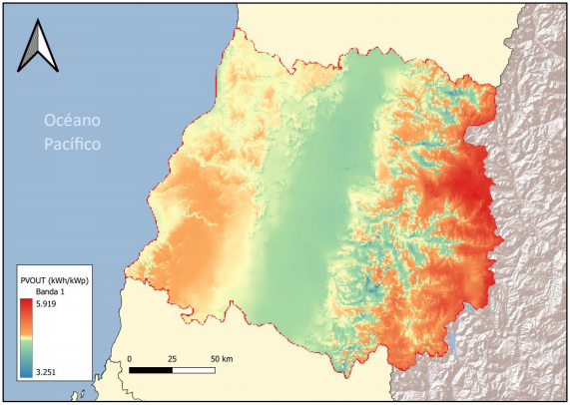
3.4 Results: Photovoltaic Energy
Photovoltaic solar energy can be integrated into irrigation systems and other agro-industrial processes.
The Net Billing Law allows for the sale of excess generation.
A system of 18 panels was evaluated for the irrigation of 8,5 hectares of vineyard.
JIMENEZ, CERVANTES. Circular Economy for agriculture in the Maule Region, Chile

Slide 9
3.4 Results: Photovoltaic Energy
JIMENEZ, CERVANTES. Circular Economy for agriculture in the Maule Region, Chile

Slide 10
3.4 Results: Photovoltaic Energy
The initial investment is approximately € 7.500
It generates 11.822 kWh of irrigation energy annually, with 58% for self-consumption and 42% for the sale of excess.
It avoids the release of 3,44 tons of CO₂ annually.
Financial Results over 25 Years
NPV | € 11.377
Payback | 6,53 years
IRR | 15,94%
Emission Factors
SEN | 336 | kg CO₂ eq/MWh
Photovoltaic | 45 | kg CO₂ eq/MWh
JIMENEZ, CERVANTES. Circular Economy for agriculture in the Maule Region, Chile

Slide 11
3.5 Results: Biomass
An emission factor for pruning biomass in vineyards was calculated at 89,93 kg CO₂/MWh.
Hectares
Biomass Estimation
Calorific Potential
Vineyard
Apple
Cherry
Hazelnut
Olives
The potential energy of the biomass was calculated at 453.399,7 MWh annually, equivalent to 1,47 times the total monthly energy consumed in the Maule Region.
JIMENEZ, CERVANTES. Circular Economy for agriculture in the Maule Region, Chile
Notes:
Each MWh of energy obtained through vineyard biomass instead of from the national electric grid (SEN), the release of 246,39 kg CO₂

Slide 12
3.6 Results: Biogas
From the waste generated by the wine industry, the potential for biogas from this activity was estimated at the regional level.
In the Maule Region, 503 million liters of wine are produced annually.
It is proposed to integrate a cogeneration process to obtain electrical energy:
Waste Volume
% Volatile Solids
Methanogenic potential
Energy value
0,109 €/kWh
Economic valuation
9.400.000€
Annual Generation
86.646 MWh
Emission Factor
220 kg CO₂/kWh
Emissions reduction
10.078 ton CO₂
JIMENEZ, CERVANTES. Circular Economy for agriculture in the Maule Region, Chile
Notes:
From the expert interviewed, it is concluded that there is no gas pipeline infrastructure in the Maule Region, a key characteristic for the design of methanation projects.

Slide 13
3.7 Results: Synergies
The main processes associated with agricultural activity require water, material and energy inputs.
These in turn generate effluents and by-products of different characteristics that must be managed.
Inputs
Agro-industrial Processes
Irrigation
Pruning
Agricultural Management and Harvesting
Operational processes
Effluents
JIMENEZ, CERVANTES. Circular Economy for agriculture in the Maule Region, Chile

Slide 14
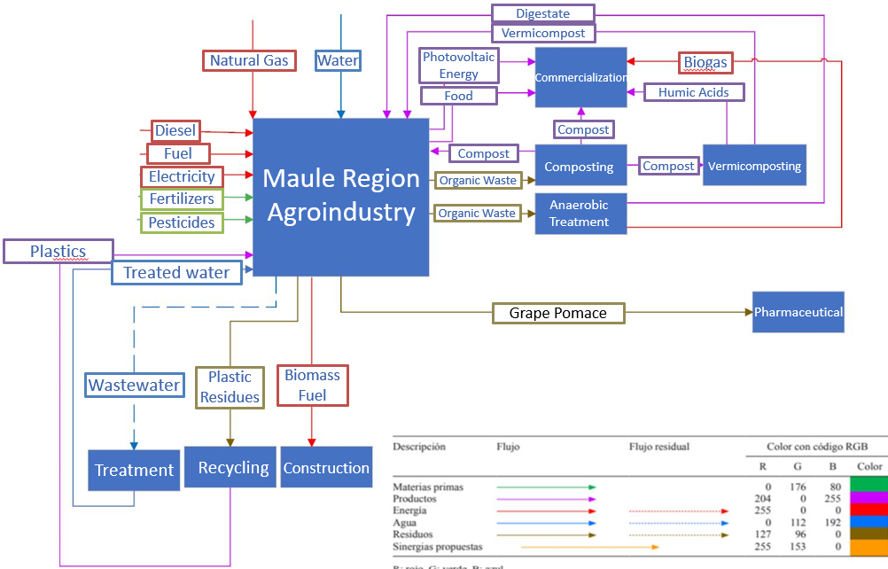
3.7 Results: Synergies
JIMENEZ, CERVANTES. Circular Economy for agriculture in the Maule Region, Chile

Slide 15
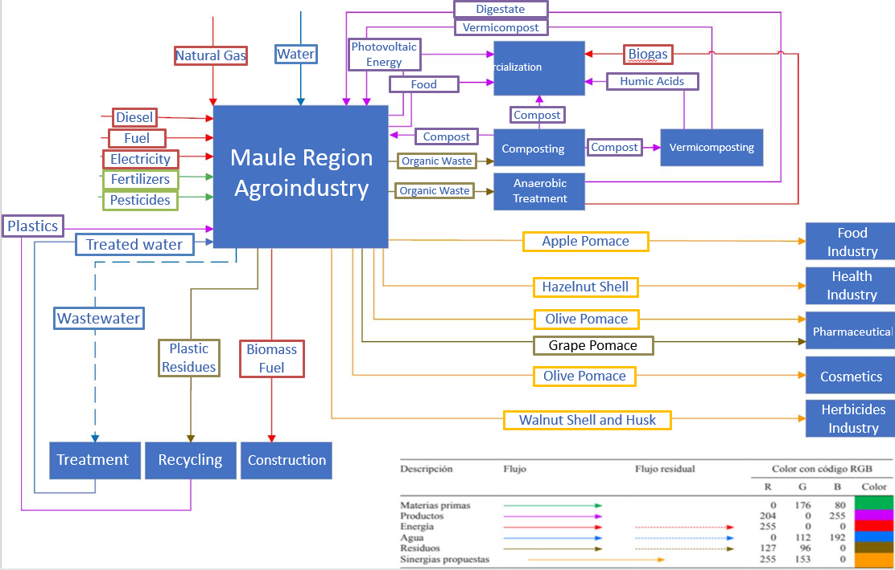
3.7 Results: Synergies
JIMENEZ, CERVANTES. Circular Economy for agriculture in the Maule Region, Chile

Slide 16
3.7 Results: Synergies
Source | Residue | Recovery process | Target Industry | Processed products
Walnuts | Husks | Extraction of juglona | Herbicide Industry | Herbicides (Juglona)
Walnuts | Shells | Ground | Agricultural | Fertilizers, Soil Cover
Olive Oil Industry | Olive pomace | Antioxidant extraction | Pharmacist | Bioactive compounds (antioxidants)
Olive Oil Industry | Olive pomace | Pigment extraction | Cosmetics | Pigments
Hazelnuts | Husks | Prebiotic extraction | Healthcare Industry | Prebiotics
Juice industry | Apple pomace | Incorporation into functional products and manufacture of Apple Flour | Food industry | Snacks, Yogurts, Drinks
Composting | Mature compost | Vermicomposting | Agricultural, Sale | Humic and fulvic acids
JIMENEZ, CERVANTES. Circular Economy for agriculture in the Maule Region, Chile

Slide 17
3.8 Results: Indicators
Main function of the system: Produce food for the domestic and international market by applying GAP principles.
System of 34 indicators of sustainable development (SD) in three aspects: Environmental, Social and Economic.
They allow the state of the system to be evaluated with respect to the adoption of GAP that incorporate principles of sustainability and local development.
Its calculation reflects the state of the system with respect to the SD criteria, allows setting objectives and monitoring progress.
JIMENEZ, CERVANTES. Circular Economy for agriculture in the Maule Region, Chile

Slide 18
3.8 Results: Indicators
Environmental aspects
n° | Criteria | Objectives | Topics | Indicators | Units
1 | Soil Quality Protection | Maintain and improve soil fertility and health | Agricultural management | Agricultural area with crop rotation | [%]
2 |  |  | Soil contamination | Concentration of pesticides and fertilizers in the soil | [mg/kg]
3 |  |  | Soil health | Deviation of soil organic matter content from the optimum value (5%) | [%]
4 | Care of the water cycle | Promoting the efficient and sustainable use of water | Water reuse | Percentage of water reuse | [%]
5 |  |  | Water quality | Levels of nitrates and phosphates in nearby effluents and water bodies | [mg/L]
6 | Adoption of sustainable practices | Promoting the transition to sustainable management | Environmental certifications in fruit growing | Percentage of fruit farms (>5 ha.) certified GLOBAL GAP | [%]
7 | Protecting biodiversity | Conserve and promote biodiversity | Non-productive areas | Total area of non-productive areas of native forest over total land | [%]
8 |  |  | Native species | Number of species and native flora per hectare of non-productive area | [#/ha]
9 | Air Quality Protection | Reduction of emissions into the atmosphere | Reducing emissions from recycling | Reduction of GHG emissions associated with waste recycling | [%]
JIMENEZ, CERVANTES. Circular Economy for agriculture in the Maule Region, Chile

Slide 19
3.8 Results: Indicators
Social Aspects
n° | Criteria | Objectives | Topics | Indicators | Units
17 | Improving jobs | Improve the quality of life of workers and their families | Satisfaction | Proportion of satisfied employees | [%]
18 |  |  | Labor rights | Percentage of workers with formal contracts | [%]
19 |  |  | Occupational safety | Annual rate of occupational accidents per 1,000 workers | N° Accidents*1000/N° Workers
20 |  |  | Fair income | Percentage of the average wage of agricultural workers compared to the regional average | [%]
21 | Promoting development and education | Provide education and training opportunities for workers | Education and training | Percentage of workers participating in training and training programmes | [%]
22 |  |  | Access to education programs | Percentage of workers participating in education programs | [%]
23 |  |  | Best practices | Percentage of jobs created associated with GAP | [%]
24 |  |  | Education | Worker literacy rate | [%]
25 | Promoting inclusion with a gender perspective | Promoting gender equality and social inclusion | Gender equity | Percentage of working women | [%]
26 |  |  | Inclusion | Number of workers with disabilities | [#]
27 |  |  | Childcare Support | Percentage of workers with access to childcare services | [%]
JIMENEZ, CERVANTES. Circular Economy for agriculture in the Maule Region, Chile

Slide 20
3.8 Results: Indicators
Economic aspects
n° | Criteria | Objectives | Topics | Indicators | Units
28 | Obtaining profits from projects with sustainability principles | Obtaining profits from environmental projects | Sale of waste | Proportion of money obtained from the sale of waste wood | [%]
29 |  | Reduced raw material costs | Waste Management | Percentage of money saved by reusing one's own compost in replacement of fertilizer purchase | [%]
30 | Diversification of the economy | Diversifying revenue streams to reduce economic risks | Diversified production | Percentage of farm income from alternative crops | [%]
31 |  |  | Income from the sale of organic waste | Proportion of money obtained from the sale of organic waste | [%]
32 |  |  | Energy transition | Percentage of revenue from the sale of electricity from renewable sources | [%]
33 | Obtaining profits by reducing consumption | Reduce costs by adopting BPA | Water Use | Percentage of money saved with water-saving projects | [%]
34 | Resilience to climate change | Strengthening financial resilience to adverse events | Agricultural Insurance | Percentage of agricultural land insured | [%]
JIMENEZ, CERVANTES. Circular Economy for agriculture in the Maule Region, Chile

Slide 21
3.8 Results: Indicators
System Function
Aspect
Indicator
Value
To produce food for both the domestic and international markets by applying BAP principles
Environmental
Percentage of fruit farms certified GLOBAL GAP (> 5 ha.)
19,7%
Social
Annual occupational accident rate per 1,000 workers
0,88
Economic
Percentage of farms with agricultural insurance
8,73%
JIMENEZ, CERVANTES. Circular Economy for agriculture in the Maule Region, Chile

Slide 22
3.9 Results: Sustainability Analysis
Risks and limitations
Measures
Release of GHGs due to mismanagement and lack of cooperation networks Difficulties in adapting native fauna to climate change Arrangement of photovoltaic equipment
Promote continuous monitoring of systems Establish regional strategies for equipment disposal and recycling
Environmental Point of View
Low incentives to adopt ZNPs Lack of resources to make initial investments Inefficient recovery processes of compounds of interest
Economic Point of View
Create a Climate Credit system Promote R+D+i with regional institutions
Social Point of View
Resistance to change Increased inequalities due to lack of resources for change
Facilitate training programs Promote funding and operational support systems
JIMENEZ, CERVANTES. Circular Economy for agriculture in the Maule Region, Chile

Slide 23
4. Conclusions
Agriculture in the Maule Region plays a key socio-economic role but impacts biodiversity, waste, and water consumption, which need proper management.
Integrated composting, vermicomposting, and ZNP incorporation can improve waste management and expand native forests, promoting biodiversity.
The transition to renewable energy reduces CO2 emissions and enhances waste management, with photovoltaic projects proving profitable for vineyard irrigation.
Seven proposed industrial symbioses promote the circular economy by valorizing agricultural waste and utilizing high-value by-products.
The proposed indicator system tracks the agro-industrial sector’s status and progress, supporting informed decision-making.
JIMENEZ, CERVANTES. Circular Economy for agriculture in the Maule Region, Chile

Slide 24
5. Future Work
Validate and replace theoretical values obtained by means of a bibliographic search that is not specific to the Maule Region and that were used in the calculations of this TFM.
Implementation of pilot plants that allow estimating values, improving the proposed strategies, and promoting the technical training of local communities.
It is possible to incorporate into this work other GAP associated with the adoption of new technologies, regenerative agriculture practices and nature-based solutions.
JIMENEZ, CERVANTES. Circular Economy for agriculture in the Maule Region, Chile

Slide 25
Thank You
Álvaro Jiménez
alvaro.jimenez@estudiantat.upc.edu
Gemma Cervantes
gemma.cervantes@upc.edu
25

Slide 26
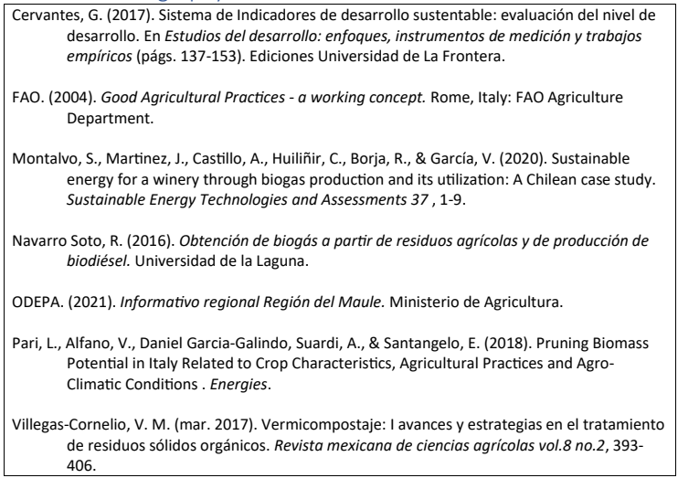
6. Indicative Bibliography
JIMENEZ, CERVANTES. Circular Economy for agriculture in the Maule Region, Chile

Slide 27
ANNEX: Detail of Photovoltaic Analysis Parameters
JIMENEZ, CERVANTES. Circular Economy for agriculture in the Maule Region, Chile

