Slide 1


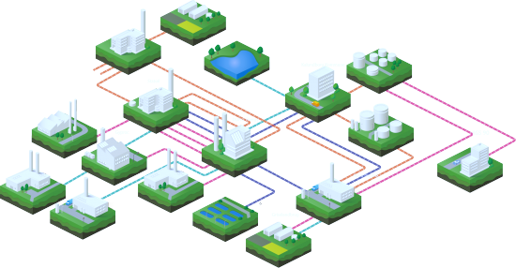
Empirical assessment of the Circular economy transition. Indicators for a multi-level perspective
6/December/2024
Dr. Manuel Morales

Slide 2
Outline
Circular economy paradigm
Empirical assessment of the Circular economy transition
Multi-scale complexity for transitions
Research protocol to measure systemically circular economy
Results & Discussion

Slide 3
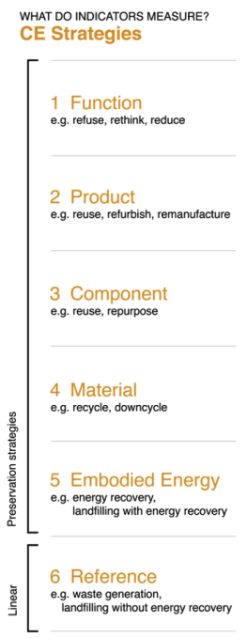

1. Circular economy paradigm
Circular economy (CE): Circular Economy (CE) is understood as the regenerative system approached through a systems perspective (Kirchherr et al., 2017).
Principles
Long life loops
Closing loops (Recycling, Materials & eco-design)
Extended loops (industrial symbiosis)
Intensifying loops (Circular business models)
Slowing down loops
SOURCE: Blomsma, 2018
SOURCE: Moraga et al., 2017
Notes:
9.3 billion tons have been saved worldwide from the adoption of the principles of circularity.

Slide 4
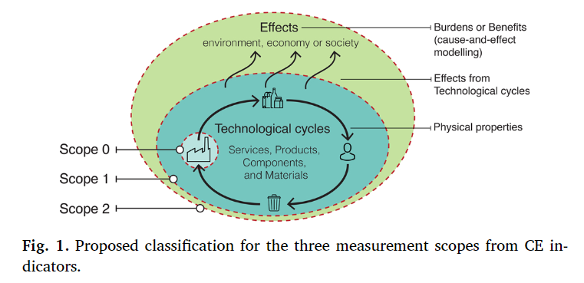
2. Empirical assessment of the Circular economy transition (1/2)
CE indicators are classified in three types:
Scope 0: the indicators measure physical properties from the technological cycles without LCT approach
Scope1: the indicators measure physical properties from the technological cycles with full or partial LCT approach ,e.g. Recyclability
Scope2: the indicators measure the effects (burdens/benefits) from technological cycles regarding environmental, economic, and/or social concerns in a cause-and-effect chain modelling
None of the current available indicators can assess the preservation of functions, instead of products, with strategies such as sharing platforms, industrial symbiosis, or multifunctionality. Finally, the framework illustration suggests that a set of indicators should be used to assess CE instead of a single indicator.
SOURCE: (Moraga et al., 2019)
Notes:
Scope 0: the indicators measure physical properties from the technological cycles without LCT approach
Scope1: the indicators measure physical properties from the technological cycles with full or partial LCT approach ,e.g. Recyclability
Scope2: the indicators measure the effects (burdens/benefits) from technological cycles regarding environmental, economic, and/or social concerns in a cause-and-effect chain modelling

Slide 5
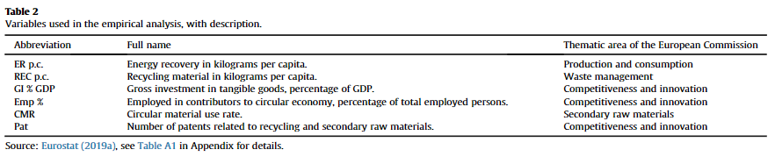
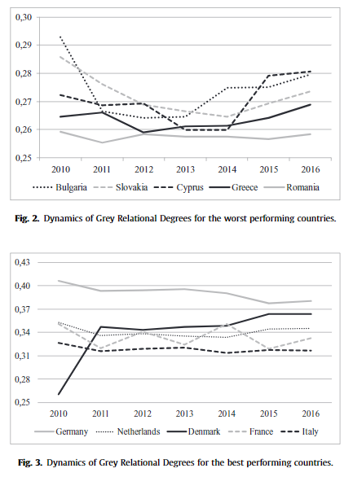
2. Empirical assessment of the Circular economy transition (2/2)
Grey Relational Analysis
SOURCE: Skrinjari T., 2020
Education, R&D investment and innovations surely present one of the major conditions for a greater CE of any of the economies in the future.
Notes:
The grey relational analysis is the non-parametric approach of constructing a ranking system of countries based on different criteria. Thus, some correlating factors between the best and worst-performing ones exist which surely influence their results. Some of the countries found to be the worst-ranked have greater corruption indices in the world rankings, as well as lower government efficiency indices, with worse PISA results in schooling. Greater effects for the GINI variable compared to the GDP per capita. This means that variables related to the inequality within a society could affect the CE achievements and goals in a greater manner compared to the growth of the economy.

Slide 6
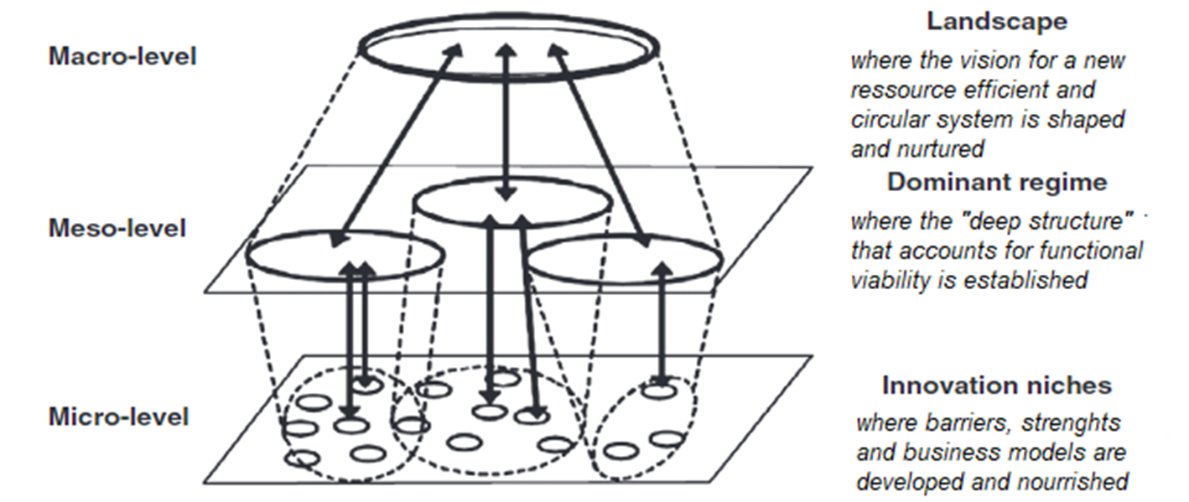
3. Multi-scale complexity for transitions
The multi-level perspective (MLP) allows the integration of Complex Adaptive Systems and System Dynamics over socio-technical transitions. The MLP framework is composed of three interconnected layers: 1) niche-innovations, 2) socio-technical regime, and 3) socio-technical landscape. Socio-technical transitions can be thus considered as the outcome of the interconnected dynamics of these three levels.
Figure 4. Multi-level perspective framework for transitions.
Source: adapted from (Geels & Schots, 2007)

Slide 7
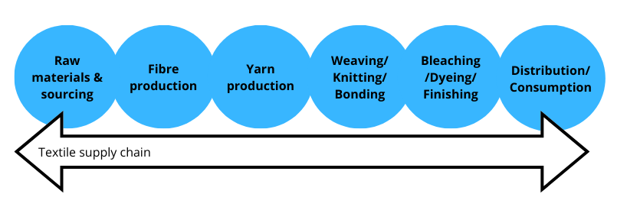
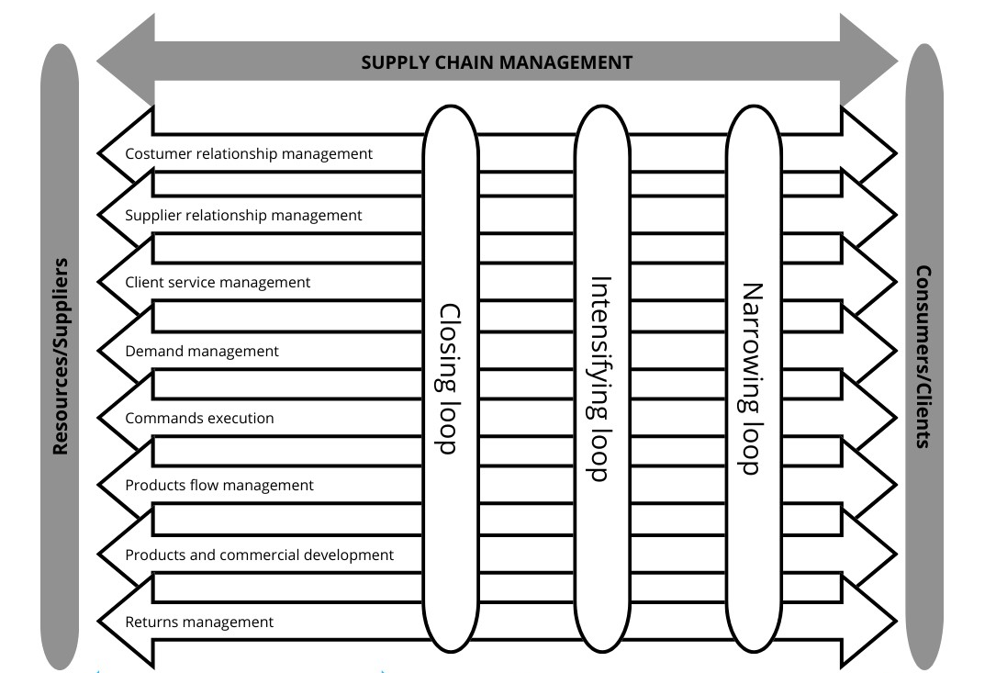
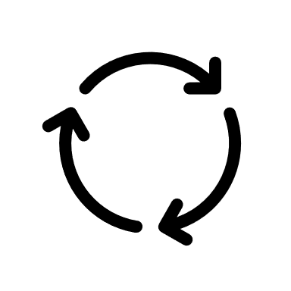

Figure 1. Supply chain management framework for Circular economy inspired from (Hazen et al. 2020)

Slide 8
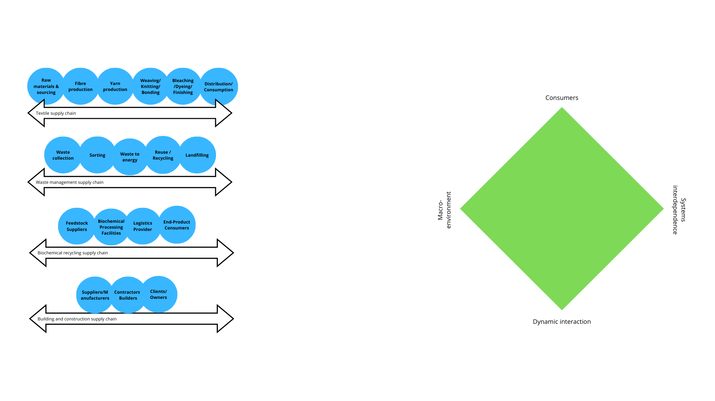
3.1. Ecosystems approach deployed by Circular Textile transition

Slide 9
3.2. Innovation business strategies on Circular textile
Sorting
Recycling
Production
Closing loops
Resource recovery
Sharing platforms
Logistics
Industrial symbiosis
Narrowing loops
Product use extension
Long-life & Dematerializing loops
Circular-design
Circular input
Product as a service
Intensifying loops
Biophysical materials
Supply chain integration
Intra-firm innovation

Slide 10
4. Research protocol
  4.1. Protocol design
COUNTRY | POSITION | ORGANIZATION
Austria | Executive Director | Circular Economy Forum Austria
Greece | Professor | Technical University of Crete
Germany | Research fellow & Cofounder of SortSmart | Deutsche Bundesstiftung Umwelt
France | Responsable territorial littoral | ECOPAL
France | Professor-researcher | Université de Lorraine
Spain | Postdoctoral researcher | Universidad de Almeria
Austria | Postdoctoral researcher | University of Graz and KTH Stockholm
Italy | Professor | University of Pisa
Lithuania | Director | Kauno RATC Kauno Waste Management Centre
Lithuania | Head of Innovation Policy Group | Ministry of Economy and Innovation of the Republic of Lithuania
SUBSET | DRIVERS | INDICATORS & PROXYS
CROSS | Innovation | R&D expenditure (% of GDP) in the Business enterprise sector
ENV | Material circularity | Circular material use rate
ECO | Resource productivity | Resource productivity (ratio GDP/DMC)
ECO | Competition | Economic complexity index
ECO | Value-added | Value added by Manufacturing in percentage
SOC | Wages of employees | High-pay wages level (thousand persons)
SOC | Internationalisation | Exports (million euros)
INST | Government revenue | General government revenue, (Thousand US dollars/capita)
INST | Taxation, incentives, and subsidies | General government spending. Environmental protection + Education, % of GDP
ORG | Education and competences | Employment by tertiary level (% total employment of 25–64-year-olds)
ORG | Skills Upgradability* | Percentage of total employment on High-technology manufacturing and knowledge-intensive positions

Slide 11
4. Research protocol
  4.1. Protocol implementation

Slide 12
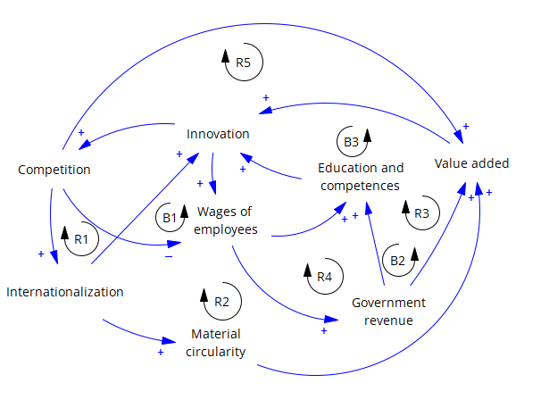
5. Results

Slide 13
  5. Discussion on the textile ecosystem in Europe
KEYDRIVER | INFLUENCING ELEMENTS | PROPOSED STRATEGIES
Innovation | Value added of circularity adoption | Biochemical recycling technologies and industrial symbiosis efforts that entail an inter-organizational collaboration and coordination among different value chain aside from textile production
 |  | The circular design which entails the adoption of advanced modular materials evaluated through life cycle assessment criteria
 | Internationalization of environmental & regulation standards | Circular design and composition requirements using certifications, regulations and standards adoption obtained by the global macro-environment (socio-economic, organizational, institutional and environmental)
 |  | Sensibilization on environmental & social benefit awareness out of circular technological changes
 | Education and competences of workforce | Multiple-stakeholders integration, including the consumers perspective and moral stance (Ki, Park, and Ha-Brookshire 2021) as proposed by the Quintuple Helix Model in creating circular fashion economy and the knowledge feedback and flows to promote innovation
 |  | Open innovation (Bagherzadeh, Markovic, and Bogers 2021) and systems-thinking training of stakeholders to support data-driven solutions addressed to CE. Education and competences training for circularity are here addressing mainly high-skilled STEM employees

Slide 14
Conclusion
Since there is not consensus in the measurement of operationalization of circular economy, a set of indicators should be used to better assess CE instead of a single indicator. The assessment should include a systemic and holistic perspective. Scholars and practitioners should develop a set of indicators able to assess the preservation of functions (inter-supply chains), SCOPE 2, instead of just products/components as with Life cycle assessments. The set of indicators should be able to depict all the five Circular economy principles including the slowing down loop.
Circularity transition in textile present Innovation as the most significative variables, whilst Innovation is found to be defined mainly by Value added of circularity adoption; Internationalization of environmental & regulation standards; and Education and competences of workforce.

Slide 15
REFERENCES
Blomsma, F. (2018). Collective ‘action recipes’ in a circular economy – On waste and resource management frameworks and their role in collective change. Journal of Cleaner Production, 199, 969–982. https://doi.org/10.1016/j.jclepro.2018.07.145
Geels, F. W., & Schot, J. (2007). Typology of sociotechnical transition pathways [Article]. Research Policy, 36(3), 399–417. https://doi.org/10.1016/j.respol.2007.01.003
Kirchherr, J., Reike, D., & Hekkert, M. (2017). Conceptualizing the circular economy: An analysis of 114 definitions. In Resources, Conservation and Recycling (Vol. 127, pp. 221–232). Elsevier B.V. https://doi.org/10.1016/j.resconrec.2017.09.005
Moraga, G., Huysveld, S., Mathieux, F., Blengini, G. A., Alaerts, L., van Acker, K., de Meester, S., & Dewulf, J. (2019). Circular economy indicators: What do they measure? Resources, Conservation and Recycling, 146, 452–461. https://doi.org/10.1016/j.resconrec.2019.03.045
Morales, M. E., Diemer, A., & Cervantes, G. (2021). CombiningEfficiency and Resilience Assessments in Industrial Symbiosis Value Chains: A Comprehensive Flow Analysis. International Journal of Engineering Research and Applications Www.Ijera.Com, 11(11), 51–65. https://doi.org/10.9790/9622-111101516551|P
Škrinjarí, T. (2020). Empirical assessment of the circular economy of selected European countries. Journal of Cleaner Production, 255. https://doi.org/10.1016/j.jclepro.2020.120246

Slide 16

Thank you!
Dr. Manuel E. Morales
Associate Professor manuel.morales@esc-clermont.fr

