Slide 1

Demand-side and circular scenarios for mined phosphorus in the Global South to 2050
Claudiu Eduard Nedelciu, Derek Chan, Birgit Kopainsky, Kristin Vala Ragnarsdottir, Ingrid Stjernquist, Peter Schlyter
Green Deal, Circular Economy and Industrial Ecology Symposium 5-6.12.2024

Slide 2
Why phosphorus
Key macronutrient in agriculture;
>90% is mined;
Almost 80% of the mined P comes from 5 countries (China, Morocco, US, Russia, Jordan);
P also a major source of pollution and one of the PBs;
Major losses along the supply chain;
Geopolitical issues (e.g. Morocco-W. Sahara, Russia´s war in the Ukraine).
Notes:
This monopoly of P reserves and production makes most

Slide 3
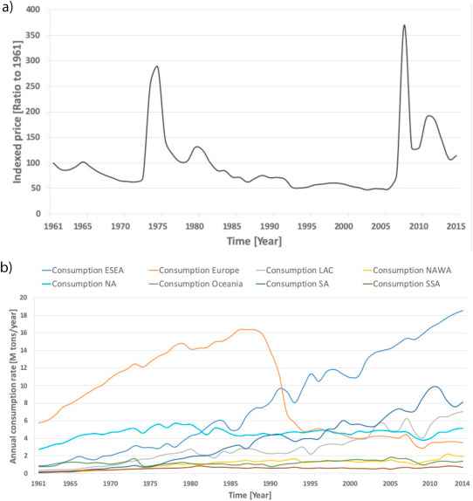
Why the global south
P a critical resource for food security;
Monopoly of reserves and production makes Global South vulnerable;
Higher exposure to price spikes;
Lower purchasing power for farmers;
Region with a rich tradition in farming more sustainably;
Unequal ecological exchange with the Global North adds to risk and vulnerability;
Nedelciu et al. 2020
https://doi.org/10.1016/j.gfs.2020.100426
Notes:
Geopolitical games on P trade, transportation bottlenecks and transportation times

Slide 4
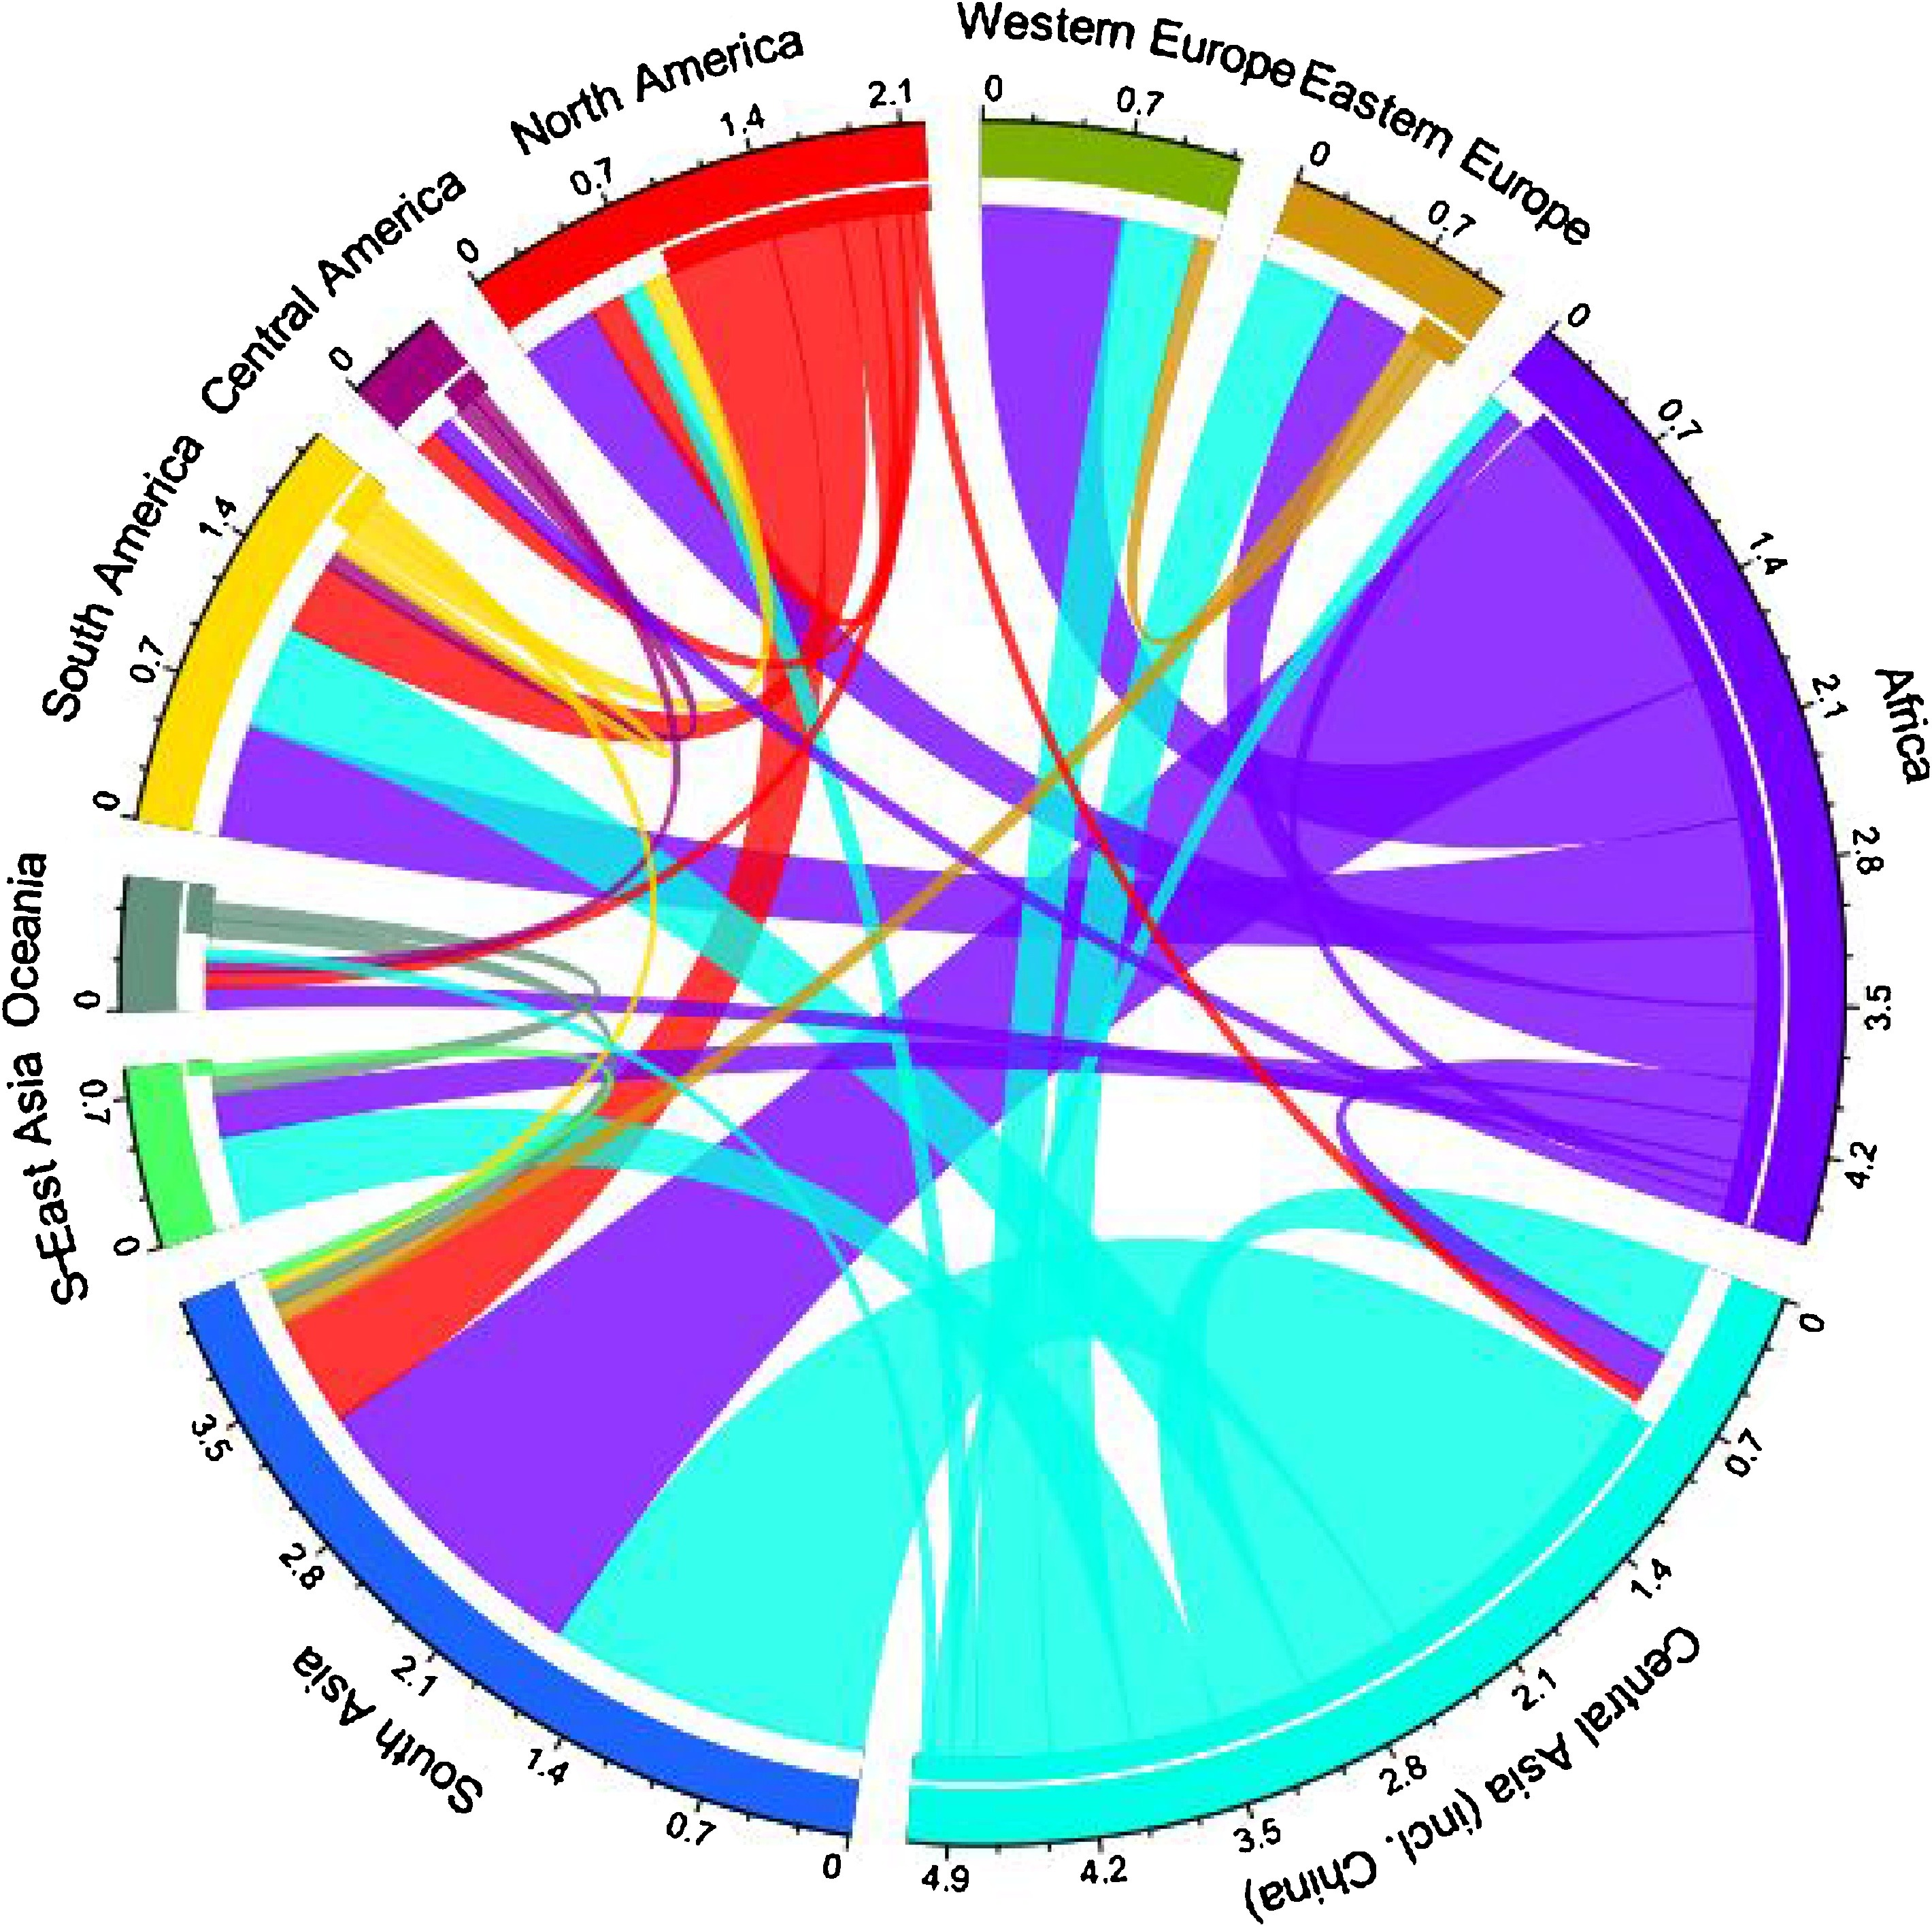
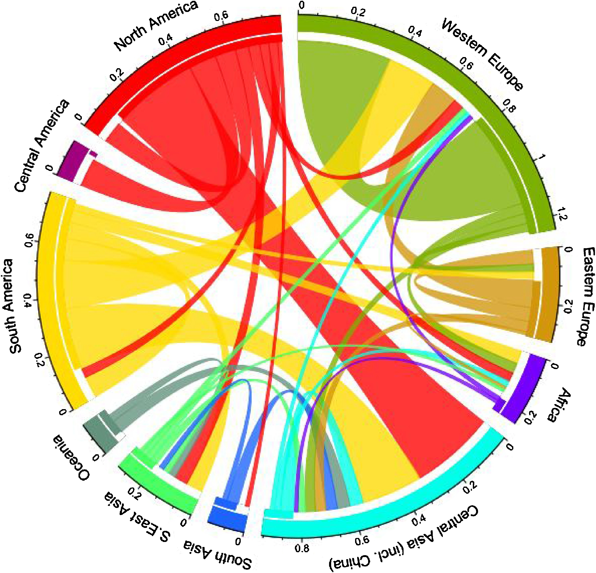
Nesme, Metson, and Bennett 2018
https://doi.org/10.1016/j.gloenvcha.2018.04.004
Notes:
Large scale P movements may make it increasingly difficult to recycle P resources from human, animal and food waste streams back to the agricultural lands that need it. Trade may increase vulnerability of both exporting and importing countries.

Slide 5
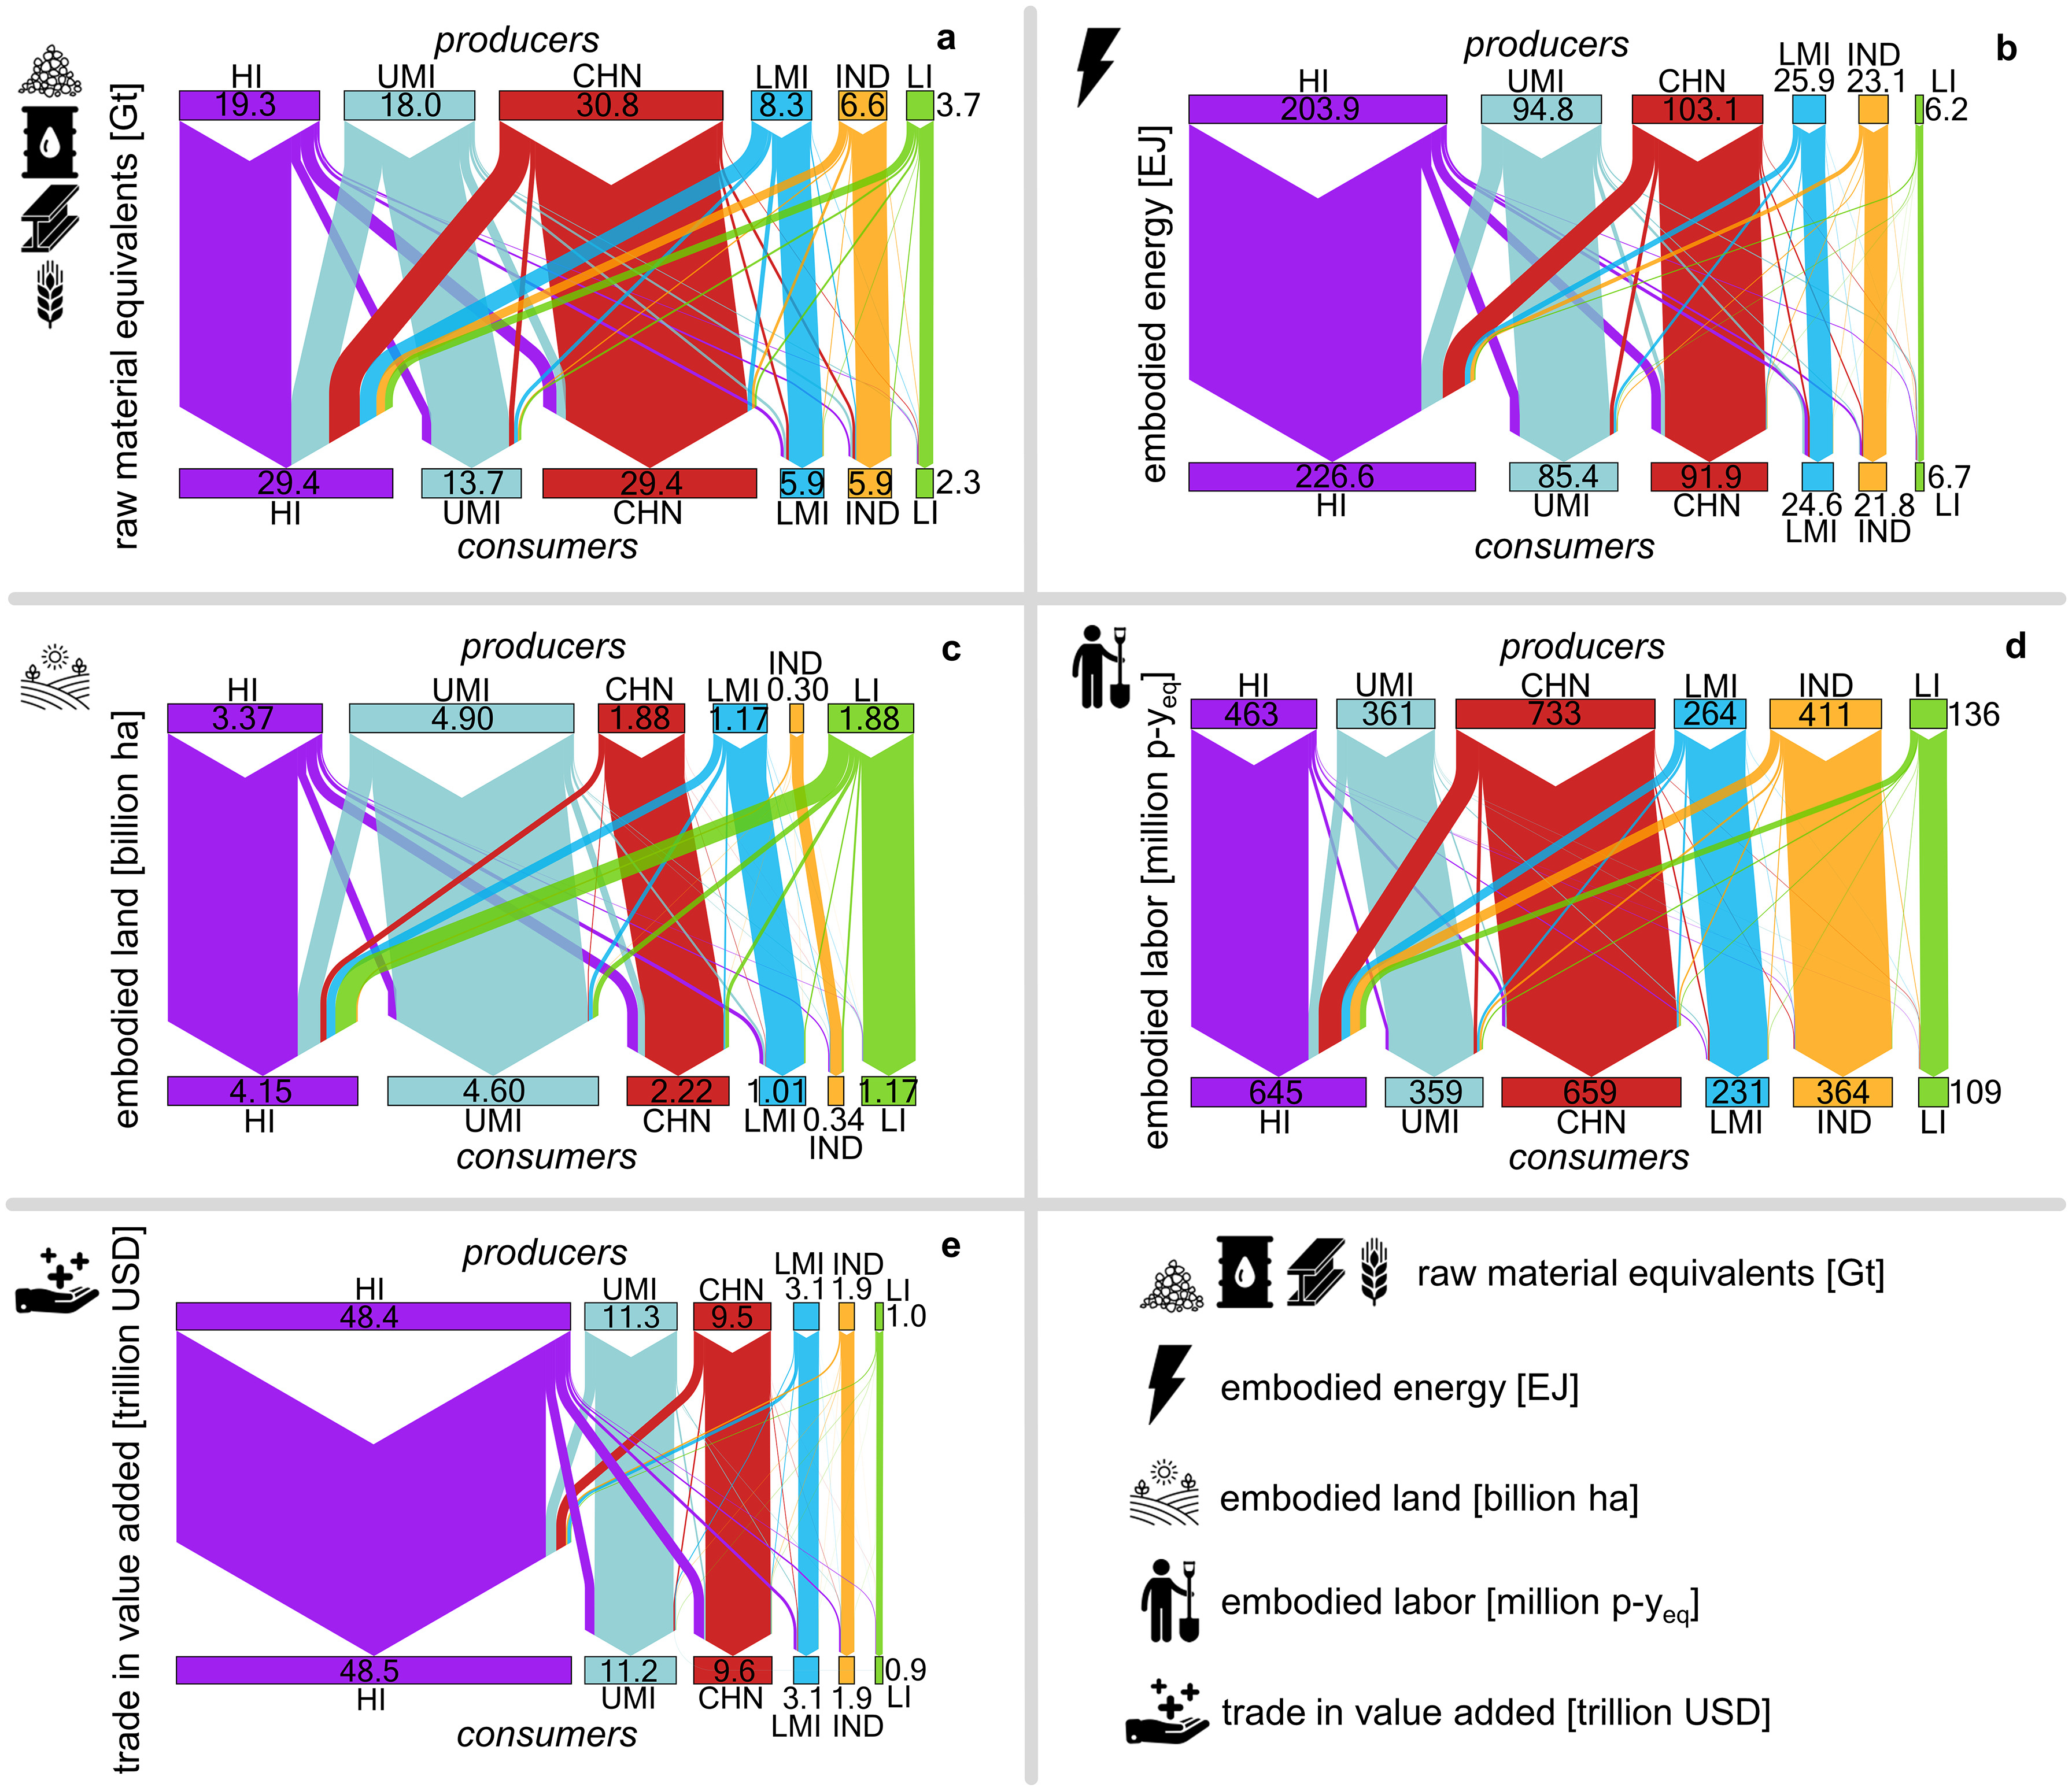
Dorninger et al. 2021
https://doi.org/10.1016/j.ecolecon.2020.106824

Slide 6
The gap
Demand-side scenarios needed for climate change adaptation and mitigation;
Lower material and energy footprint needed, but transition should meet social needs: affordable, sufficient and healthier food, income generation to keep small-scale farmers out of poverty, community resilience & cohesion;
A need for versatile, umbrella solutions that are comprehensive and holistic and allow for tailored implementation on the ground vs. one size fits all;
There is a lack of studies on the Global South, although the region is most vulnerable to climate change risks, including food security;

Slide 7
AimS & Research questions
Aim: assess the potential of demand-side and circular interventions to reduce P demand in the Global South.
What are some of the “universal”, key processes driving a reduction in P demand and P loss?
What is the potential of these processes to reduce BAU demand in the Global South?
Notes:
Farming systems, recycling, food loss

Slide 8
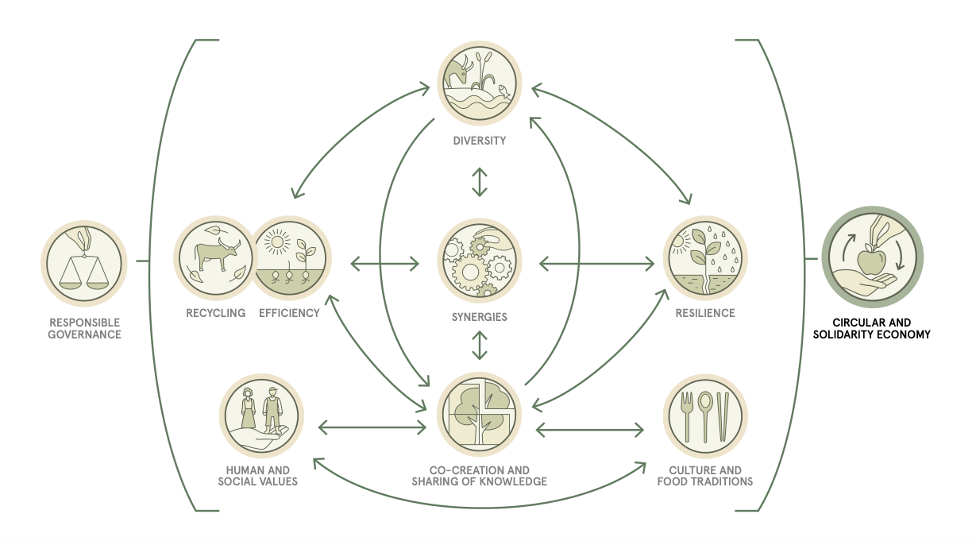
FAO’s 10 elements of Agroecology
FAO’s 10 elements of Agroecology
FAO 2019a

Slide 9
An umbrella term but higher expectations
Organic farming/agriculture
Regenerative farming
Pastoralism
High-Nature Value Farmlands
Sustainable agriculture
Indigenous farming practices
Integrated Pest Management
Permaculture
Family farming

Slide 10
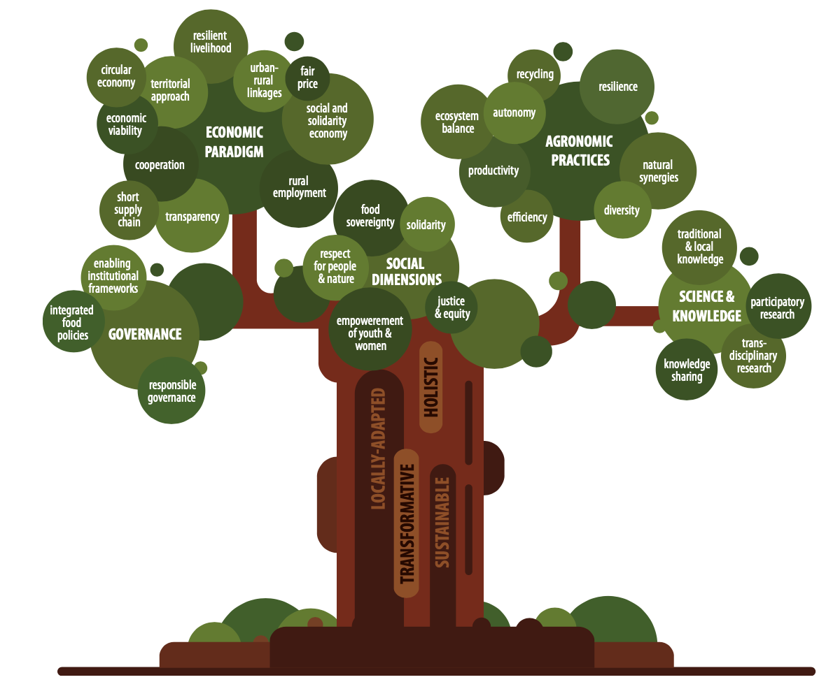
IPES-Food 2020

Slide 11
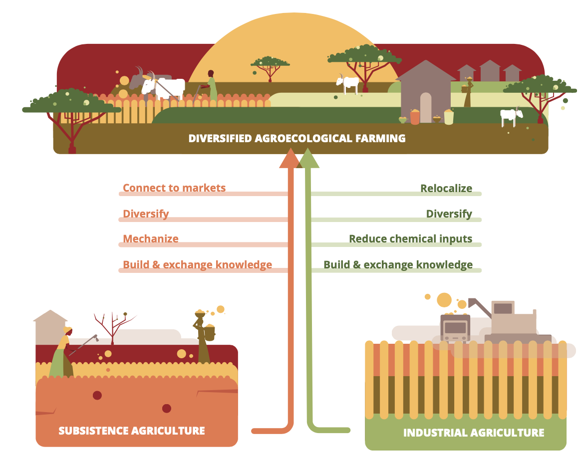
IPES-Food 2020

Slide 12
methodology
Material flow analysis of P in global south regions;
P demand linked to regional population dynamics and historical increases;
5 scenarios: BAU, food loss reduction, recycling (from WW), agroecology, FDL+R+AE;
Review of 276 case studies on agroecology from Global South regions;
Agroecology an umbrella term for several farming systems that are both more socially sustainable and more resource efficient;
Assumes historical use of fertilizers but improved yield = very conservative estimates.

Slide 13
Results: AE case study review
Region | No. case studies | Type of AE (%) | Average yield change
Latin America & Caribbean | 20 | 75% SRI, 20% OA, 5% general AE | +48%
Sub-Saharan Africa | 128 | 89% OA, 7% SRI, 1.5% CA, 1.5% SA, 1% IPM | +174%
North Africa & Western Asia | 12 | 92% SRI, 8% SWI | +66%
South Asia | 35 | 17% SA, 6% IPM, 77% SRI | +48%
East and South-East Asia | 81 | 1% Aquac., 1% countour farming, 1% double cropping, 2.5% IPM, 3.7% SA, 90.8% SRI | +37%

Slide 14
Results: ESEA

Slide 15
Results: SA

Slide 16
Results: NAWA
Notes:
Initial increase in efficiency decreases P uses despite population growth but then population growth pushes it up

Slide 17
Results: SSA
Notes:
Initial increase in efficiency decreases P uses despite population growth but then population growth pushes it up

Slide 18
Results: LAC

Slide 19
discussion
Recycling from WW problematic, as it depends on expensive infrastructure & cultural norms. Progress slow. Similar for food loss reduction;
Conservative estimates for P demand under AE scenarios due to assumptions of BAU historical trends and high P uses. Still highest impact;
Recycling and food loss important but only act as optimization. AE systemic;
AE allows for a plurality of solutions to farming, food, farmers livelihoods, and sustainability transitions to lower energy and resource systems;
Limitations on type of crops, exclusion of animal feed;
Future research to include more recent studies (including from FAO), and a wider range of social, ecological, and economic indicators;
More data on fertilizer use reduction can help calibrate the model for less conservative assumptions.

Slide 20
Thank you!
Q&A
Claudiu Eduard Nedelciu
System Dynamics Group
University of Bergen
Claudiu.nedelciu@uib.no

