Slide 1
THE EUROPEAN GREEN DEAL AND ENTREPRENEUSHIP ACTIVITY
Viktoriya ONEGINA
CLERMONT SCHOOL OF BUSINESS
2024

Slide 2
On the 11 of December 2019 the European Commission presented The European Green Deal – a roadmap for making the EU’s economy sustainable.
The 8th Environment Action Programme (EAP) is planned to guide the European environmental policy until 2030.
In 2020-2021 the different Directives were adopted regarding the following priority objectives:
achieving the 2030 greenhouse gas emission reduction target and climate neutrality by 2050
enhancing adaptive capacity, strengthening resilience and reducing vulnerability to climate change
advancing towards a regenerative growth model, decoupling economic growth from resource use and environmental degradation, and accelerating the transition to a circular economy
pursuing a zero-pollution ambition, including for air, water and soil and protecting the health and well-being of Europeans
protecting, preserving and restoring biodiversity, and enhancing natural capital (notably air, water, soil, and forest, freshwater, wetland and marine ecosystems)
reducing environmental and climate pressures related to production and consumption (particularly in the areas of energy, industrial development, buildings and infrastructure, mobility and the food system)

Slide 3
The aim of the study
to define the awareness of entrepreneurs concern EGD after 5 years of EDG lunching, including clarification of how the entrepreneurs are familiar with EGD regulations and evaluate the influence of EGD on entrepreneurial activity.

Slide 4
Highlighting the European Green Deal’s impact on entrepreneurial activity
Bogoslov et al. (2022) noted that the EGD is “an important step that will improve the environment, but, at the same time, will pervert the competition and the entrepreneurial activities within the EU” due to the governmental interventions and regulations.
Lee & Suh (2021) developed the approach for modelling causality between Environment, Social, and Governance (ESG) conduct and financial performance, that might be used for the influence of EGD policy on financial aspects of entrepreneurship.
Agraway (2024) considered different types of barriers for successful entrepreneurs, including financial constraints, regulatory hurdles, high initial costs, but without their connection to the European Green Deal.

Slide 5
The research methodology: 2 steps study
The first one is based on the analysis of secondary data on changes of the total entrepreneurial activity (TEA) that were obtained from Global Entrepreneurship Monitor (GEM) survey.
The second step assumes the fieldwork. To achieve the aim of the study the questionnaire was developed and shared among entrepreneurs; the quantitative methods was used for data processing and analysis.

Slide 6
Early-Stage Entrepreneurial Activity Rates and Per Capita GDP, 2007 (Source: GEM Adult Population Survey (APS) and IMF. in Bosma, N., K. Jones, E. Autio and J. Levie (2008), Global Entrepreneurship Monitor, 2007.Executive Report)

Slide 7
Total early-stage Entrepreneurial Activity (TEA) and Established Business Ownership (EBO) (both % adults) 2022/23

Slide 8
Levels of Total early-stage Entrepreneurial Activity each year since 2019 (32 economies participating in GEM for all four years; % adults), 2022/23 GEM 2023

Slide 9
Levels of Total early-stage Entrepreneurial Activity and GDP per capita 2022/23 GEM 2023

Slide 10
The percentage of those starting or running a new business who think doing so is more difficult (includes both somewhat and much more difficult) than one year ago (% Total early-stage Entrepreneurial Activity) 2022/23 GEM 2023

Slide 11
TEA in the EU countries in 2001-2023 (GEM DATA)

Slide 12
Fear of Failure Rate in the EU countries in 2001-2023, % (GEM DATA)

Slide 13
Paired Samples Test
Paired Samples Statistics
 |  | Mean | N | Std. Deviation | Std. Error Mean
Pair 1 | TEA 18 | 8.6000 | 23 | 3.59343 | .74928
 | TEA 20 | 8.6870 | 23 | 3.86762 | .80645
 |  | Paired Differences |  |  |  |  | t | df | Sig. (2-tailed)
 |  | Mean | Std. Deviation | Std. Error Mean | 95% Confidence Interval of the Difference
 |  |  |  |  | Lower | Upper
Pair 1 | TEA 18 - TEA 20 | -.08696 | 2.02312 | .42185 | -.96182 | .78791 | -.206 | 22 | .839

Slide 14
Conclusion 1. There is no strong evidence of the influence of implemented regulations on total Entrepreneurship Activity in GEM survey . There were many factors that effected the Entrepreneurship activity Last years: covid, Russian aggression. It should be special survey of the awareness and readiness of entrepreneurs to implement EGD regulations, the influence of EGD on Entrepreneurial activity

Slide 15
Age and sectorial structure of Entrepreneurship of the survey

Slide 16
The Geographical structure of Entrepreneurship

Slide 17
The Entrepreneurs’ awareness of objectives and actions

Slide 18
The Mentioned priority objectives of EGD

Slide 19
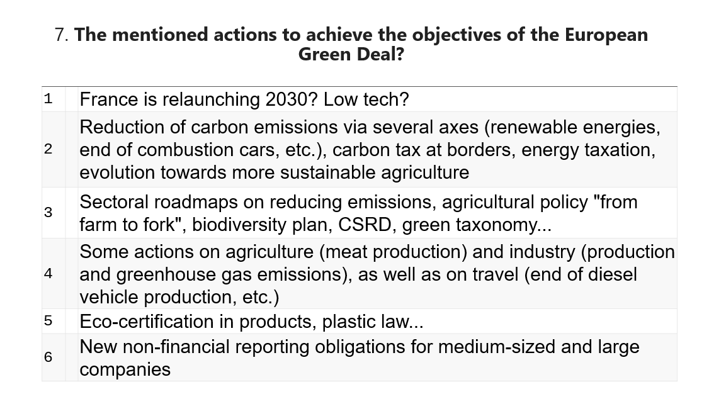
The mentioned actions to achieve the objectives of EGD

Slide 20
The EGD actions influence on business

Slide 21
The Expected degree of Possible impact of EDG on business

Slide 22
The Level of awareness of EGD regulations

Slide 23
The expected consequences of the EGD

Slide 24
The Green Deal impact on entrepreneurial activity

Slide 25
Introduction of the “green” and Circular Economy practices

Slide 26
The Information support of “Green” transformations

Slide 27
Conclusion (preliminary)
the level of entrepreneurs’ awareness of main objectives and possible regulatory impact of EGD on business still be relatively low even in five years after EDG announcing.
the such level of EDG awareness and understanding among entrepreneurs might cause difficulty in policy acceptance and slow speed of “green” transformation
the information support of business, especially with industries focus concern EDG, will be worthy for the achievement of EDG goals.

Slide 28
Limitations of the study and perspectives for the further research
The survey is in progress; the sample is not big enough.
The future study might reveal the relationship between the entrepreneurship experience, regional and industrial areas of business, and entrepreneurs’ knowledge about the objectives and actions of EDG,
, the possible impact of EGD on startups and entrepreneurship in different European countries

Slide 29
References
Agrawal, R., Samadhiya, A., Banaitis, A., B., & Anil, K. (2024). Entrepreneurial Barriers in Achieving Sustainable Business and Cultivation of Innovation: A Resource-Based View Theory Perspective. Management Decision. https://doi.org/10.1108/MD-11-2023-2032
Bogoslov, I., Lungu, A., Stoica, E., & Georgescu, M. (2022). European Green Deal Impact on Entrepreneurship and Competition: Free Market Approach. Sustainability, 14, 1-15. 12335. https://doi.org/10.3390/su141912335
Bosma, N., Acs Z., Autio, E., Coduras, A. & Levie J. (2009). Global Entrepreneurship Monitor, United Kingdom, 2008. Executive Report. https://strathprints.strath.ac.uk/16129/
Diemer A. (2023), From Life Cycle Assessment (LCA) to Life Cycle Sustainability Assessment (LCSA), methodological issues and prospects for implementing circular business models, International Journal of Scientific Engineering and Applied Science, 9 (12), 1 – 50.
European Commission (2019). Communication from the Commmission to the European Parliament, the European Council, the Council, the European Economic and Social Commmittee and the Commmittee of the Regions: The European Green Deal. Brussels. https://eur-lex.europa.eu/legal-content/EN/TXT/?uri=CELEX:52019DC0640
Global Entrepreneurship Monitor (2023). Adapting to “A New Normal”: 2022/2023 Global Report. https://www.gemconsortium.org/file/open?fileId=51147
Global Entrepreneurship Monitor (2024). GEM 25 years and growing: 2023/2024. Global Report. https://gemconsortium.org/report/global-entrepreneurship-monitor-gem-20232024-global-report-25-years-and-growing
Lee, M.T.; & Suh, I. (2022). Understanding the effects of Environment, Social, and Governance conduct on financial performance: Arguments for a process and integrated modelling approach. Sustainable Technology and Entrepreneurship, 1 (1), 100004. https://doi.org/10.1016/j.stae.2022.100004

Slide 30
Thank you very much
viktoriya.onegina@esc-clermont.fr

