Slide 1
Industrial Dynamics: applications to the PET process in the tire industry Henri Sourgou, Arnaud Diemer University of Clermont Auvergne, CERDI (CNRS-IRD)
GREENDEAL, CIRCULAR ECONOMY AND INDUSTRIAL ECOLOGY SYMPOSIUM
December 5th & 6th , 2024
Clermont-Ferrand

Slide 2
Introduction
Polyethylene terephthalate (PET) is widely used in plastics and textiles. Every year in the world, over 20 Million tons of complex waste (textile, tire, hose, …) is produced;
Most complex waste is incinerated or landfilled due to the lack of viable recycling solutions;
Contributing to over 2.06 million tons of CO2eq emissions, soil, and water contamination leading to health problems.

Slide 3
Introduction
The Whitecycle which is a lab-scale project was created to tackle the landfill and incineration of PET in complex waste;
Then, 2 tons of waste will be used to produce 3 highly technical products containing recycled PET (r-PET) notably, 100 tires, 1,500 m of hoses, and 400m² of textile;
By 2030, the project aims to recycle 2 Million tons of PET per year, reduce 2.06 Million tons CO2eq, and avoid 1.8 Million tons of PET landfilling.

Slide 4
Research question and objectives
How can System Dynamics (SD) modeling help to minimize environmental, social, and economic adverse impacts of PET recycling and to foster circular economy of PET recycling (rPET) supply chain?
Objectives:
Develop an experimental model to describe the complexity of interactions in the rPET supply chain (experimental model approach and computer use);
Identify the different inputs used and outputs in the recycling process;
Create more successful management policies and structure of rPET supply chain to minimize the environmental, social, and economic costs of PET recycling.

Slide 5
Theoretical Foundations
According to Forrester, 1961 in Industrial Dynamics, the different management components interact and lead to the dynamic behavior of the overall system
These components are interrelated by a flow of information, money, orders, and material, … (Forrester, 1961). So, the change in one component influences others (information feedback control theory) (Meadows, 2008);
Therefore, the manager’s actions, decisions, shocks, and delays in the manufacturing system components are determinants for its growth, stability, and failure (the place of decision-making in industry analysis);
The continual and non-linear process is a characteristic of most of business activities such as the PET recycling value chain which is based on circularity.

Slide 6
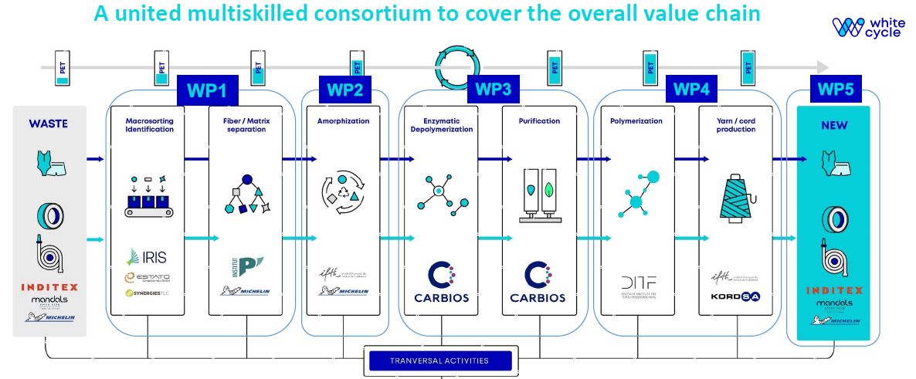
Methodology and data
We apply SD methodology in this study to model the r-PET value chain through the organization of stakeholders by Work Packages (WP) in the below picture:
Figure 1: PET recycling activities per WP

Slide 7
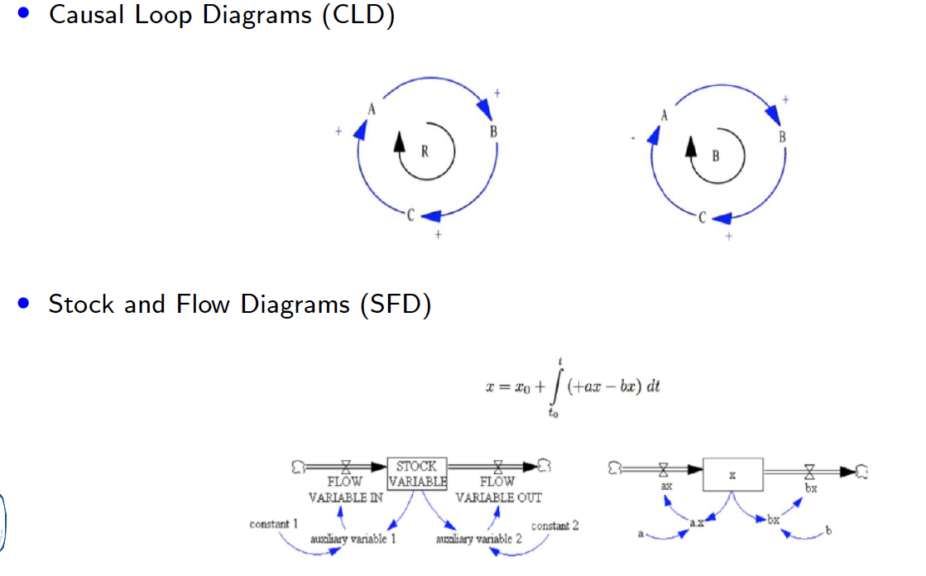
Methodology and Data
Figure 2: System Dynamics (SD) approach
Data must be provided from lab-scale experiences of waste treatments by stakeholders

Slide 8
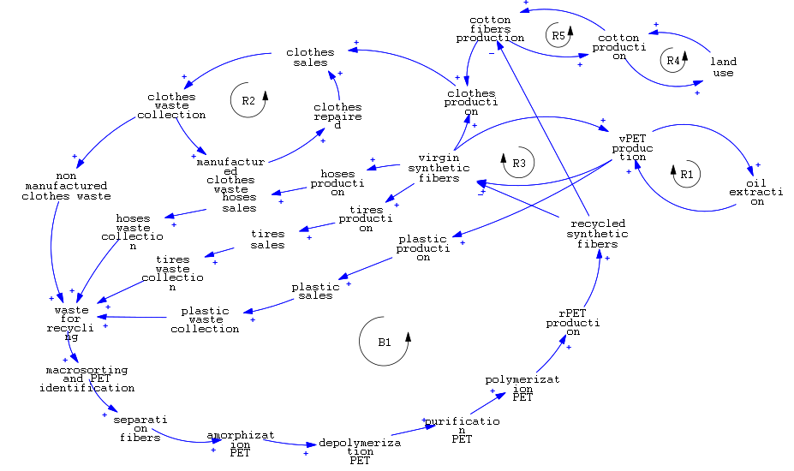
Results
Figure 3: PET supply chain organization

Slide 9
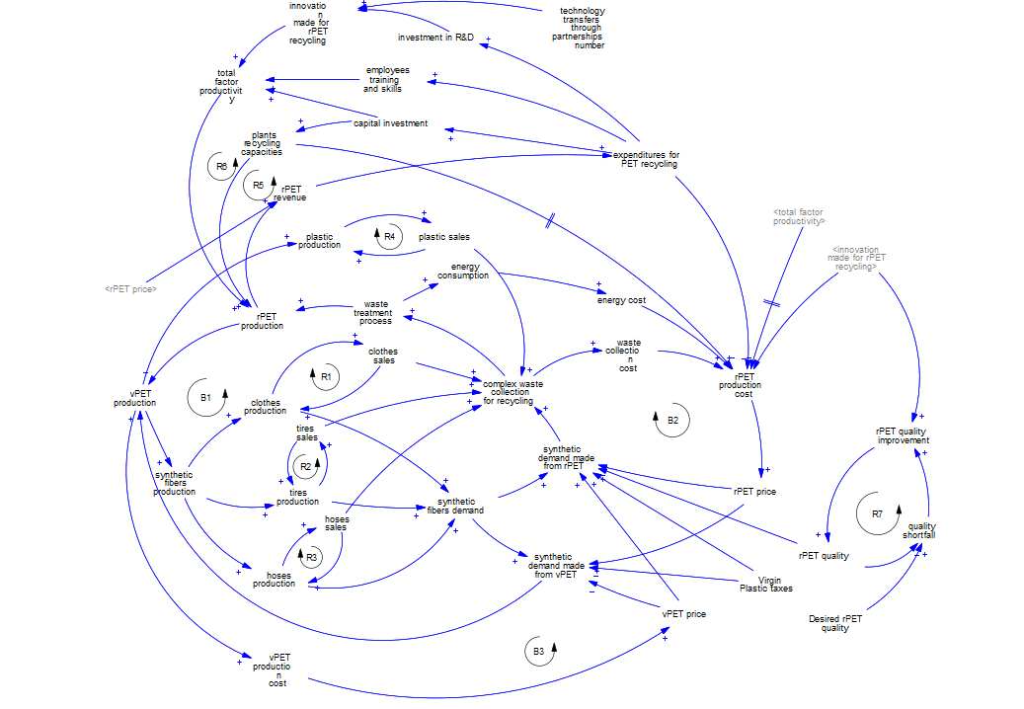
Results
Figure 4: the economic value of the rPET supply chain

Slide 10
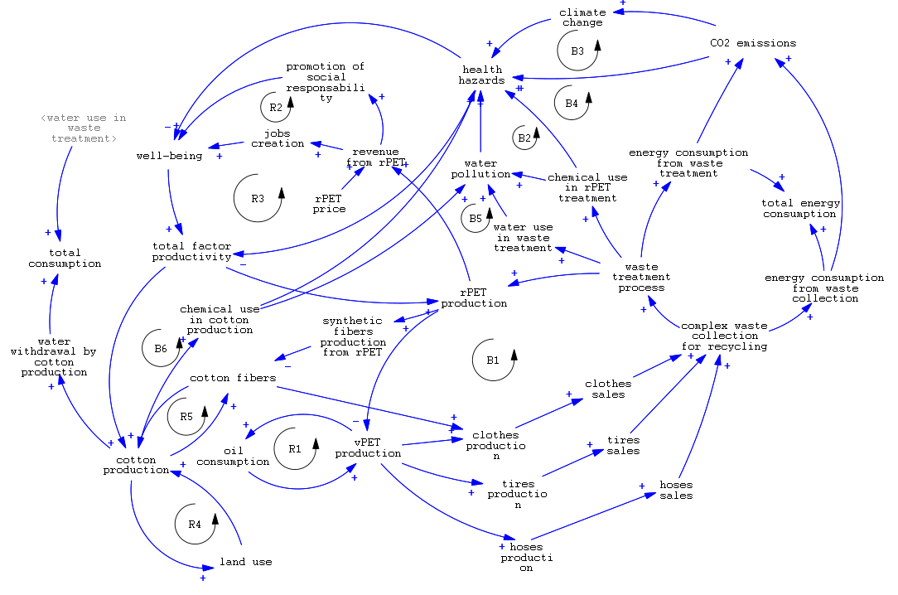
Results
Figure 5: environment and social impacts of the rPET supply chain

Slide 11
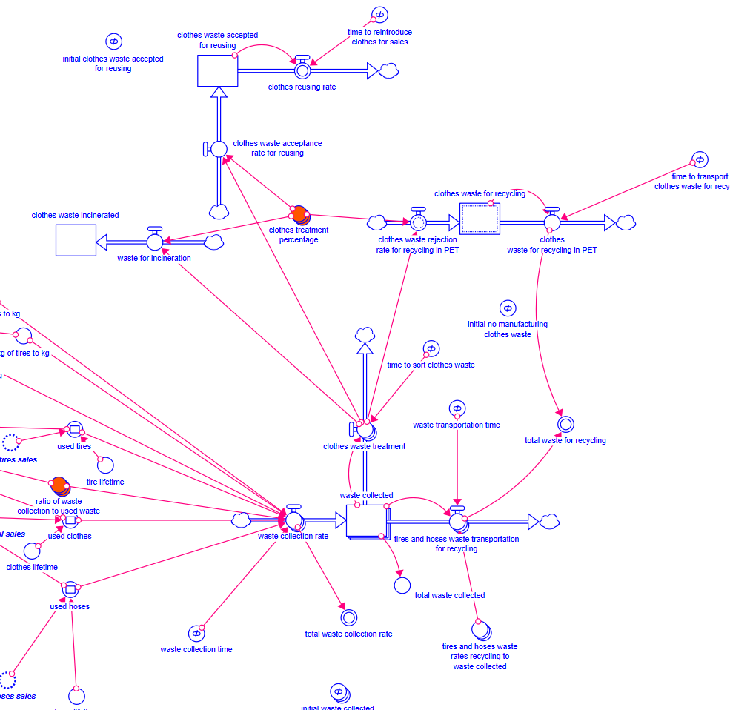
Results
Figure 6: Waste collection SFD

Slide 12
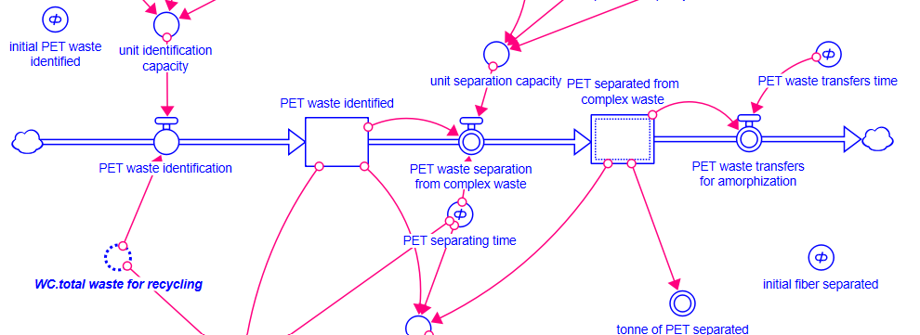
Results
Figure 7: PET identification and sorting SFD

Slide 13
Conclusion
The model development is still progressing and data acquisition from the lab-scale experience will come to improve the model’s robustness
Based on ID of Forrester, the model in progressing aims to describe the structure of the rPET supply chain and to measure the impacts associated to waste recycling
The qualitative description shows PET recycling from complex waste is associated with environmental, social, and economic impacts such as emissions, employment, revenue, investment
Then, the challenge of the White cycle project is to propose innovative and transformative innovations that minimize the negative impacts, reinforce the positive impacts of the supply chain and make the rPET more competitive than vPET.

