Slide 1
From Life Cycle Sustainability Assessment to Cross matrix impact,the project Whitecycle
Tipawan DURAND, Arnaud DIEMER
University of Clermont Auvergne, CERDI (CNRS-IRD)
Objective:
To define a step-wise method for selecting key indicators considering economic,
environmental and social impact, using SWOT and cross-impact matrix analysis
within innovative processes.

Slide 2
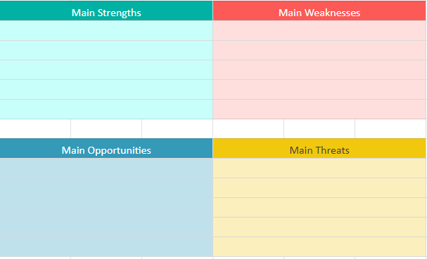
SWOT + CIM METHOD
SWOT
Strengths, Weaknesses,
Opportunities, Threats
Widely used by organizations to analyze internal and external environments, particularly during periods of strategic decision-making (Rozmi et al., 2018; Wu, 2020)

Slide 3
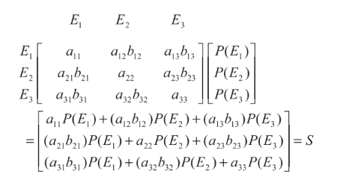
SWOT + CIM METHOD
CIM
The Cross-Impact Matrix
A tool used to forecast the potential consequences of a decision or event. It is based on the idea that one event can cause a chain reaction of other events.
Type 1. Qualitative Description of the trend-scenario.
(Ratcliffe, 2001).
Type 2. Trend Value Assessment.
(e.g. Gordon et al., 1968; Weerakkoday et al., 2003).
Type 3. The Conditional Probability.
(e.g.,Dalkey, 1972; Enzer, 1972; Gordon, 1994)
With the event i,
S = The expected impact
E = Event or indicator or variable
a = Impact of event
b = Conditional probability
P = An initial probability vector
Type 4. The Conditional Probability method combines both the level of impacts and their probability of occurrence.
(KENNETH C. , 2008)
By considering conditional probability of occurrence, given the impact to preceding events and making a matrix procedure, the method provides a more comprehensive understanding of future development.
The ref. paper presents the procedure by the study of indicators impact to the family welfare.

Slide 4
Research design
This research will utilize a multi-step approach to explore the potential impact to a WHITECYCLE project.
Economic impact
Environmental impact
Social impact
The research design proceeds in three steps:
(1) Indicator Identification (2) SWOT Matrix Development
(3) Cross-Impact Matrix Analysis

Slide 5
Step 1: Indicator Identification
Analyze relevant frameworks concerned with Circular Economy principles to identify key indicators impacting the economy & financials, environment, and society for the whitecycle projects. These frameworks include:
Company level reporting (i.e., EPD, 3P)
Cost-Benefit Analysis (CBA)
Sustainable Development Goals (SDGs)
Life Cycle Sustainability Assessment (LCSA)
LCSA = ELCA + LCC + SLCA (Kloepffer., 2008)
ELCA = Environmental Life Cycle Assessment
LCC = Life Cycle Costing
SLCA = Social Life Cycle Assessment

Slide 6
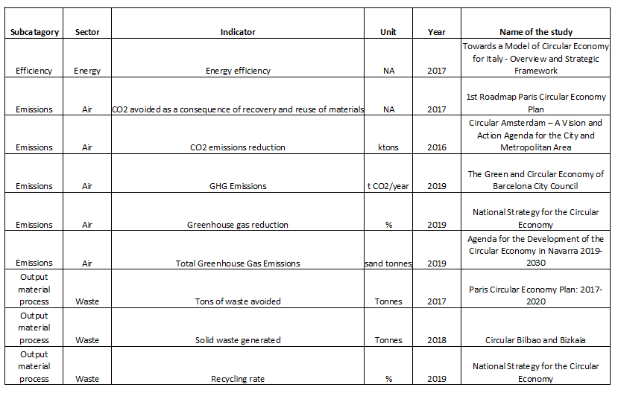
Relevant frameworks
Example of List of ELCA.,
(OECD, 2020)

Slide 7
Relevant frameworks
Example of LCC.,
(WHITECYCLE project, 2023)

Slide 8
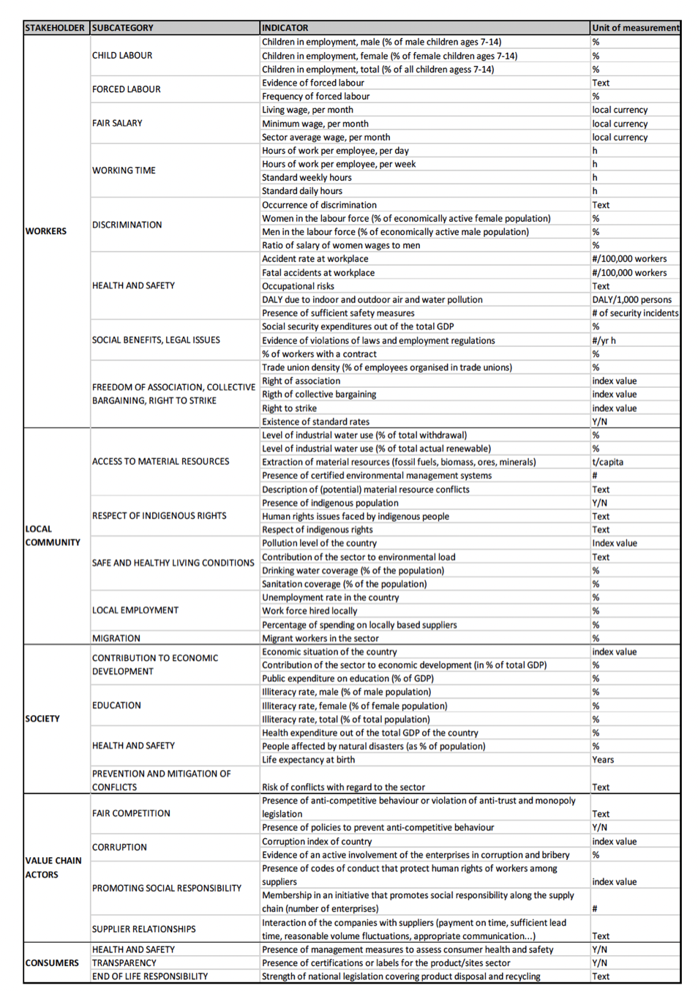
Relevant frameworks
Example of List of SLCA.,
(JRC (2015, p. 44))

Slide 9
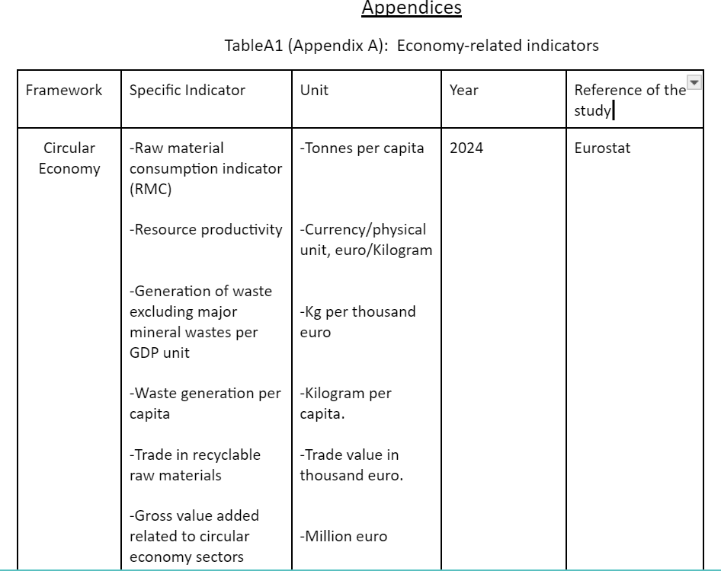
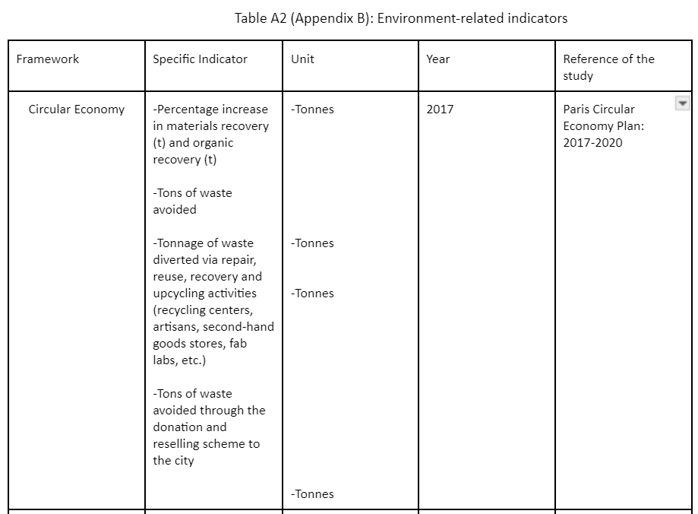
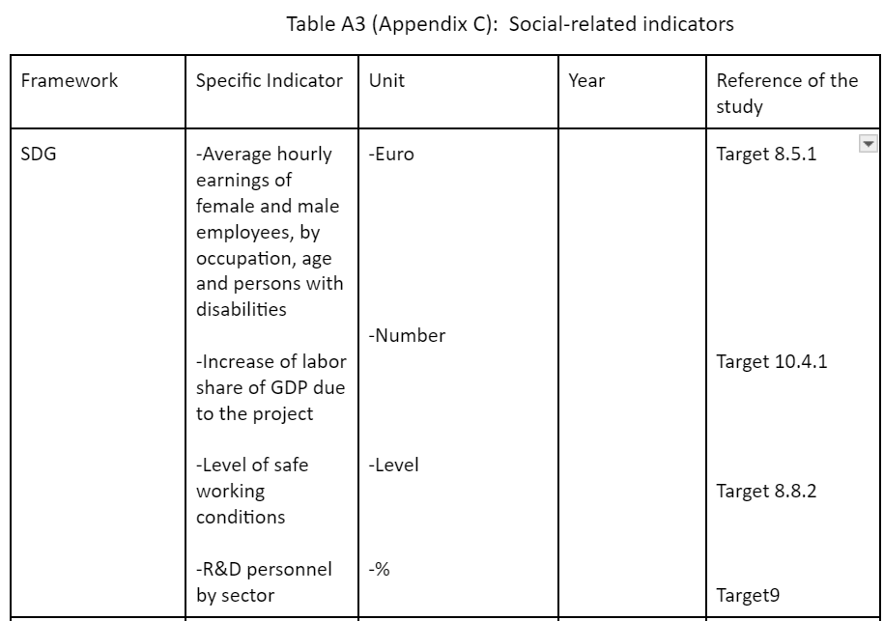
Step 1: Indicator Identification
Total indicators: 182
Environmental indicator: 87
Economic indicator: 55
Social indicator: 40

Slide 10
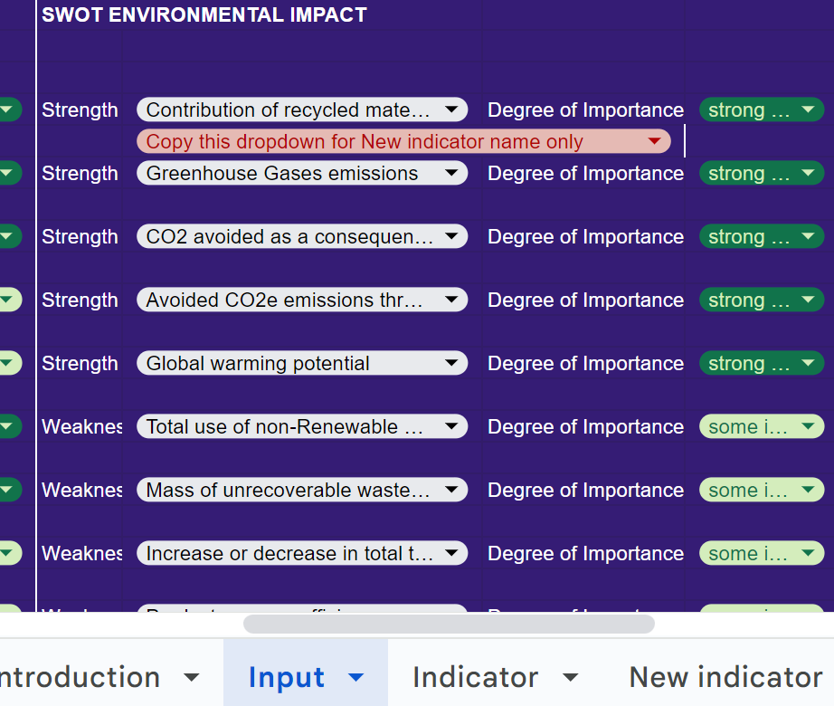
Vote SWOT indicator of 3 domains
Example of SWOT questionnaire and sheets

Slide 11
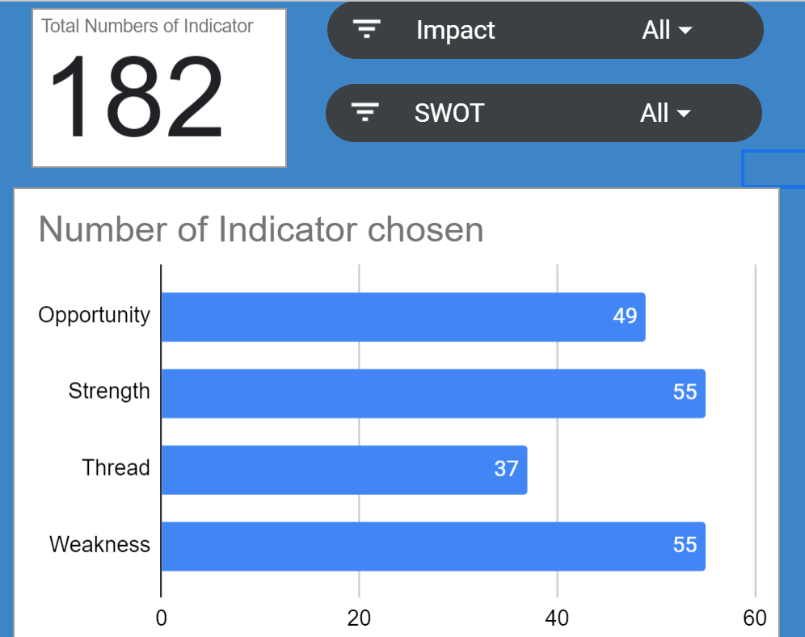
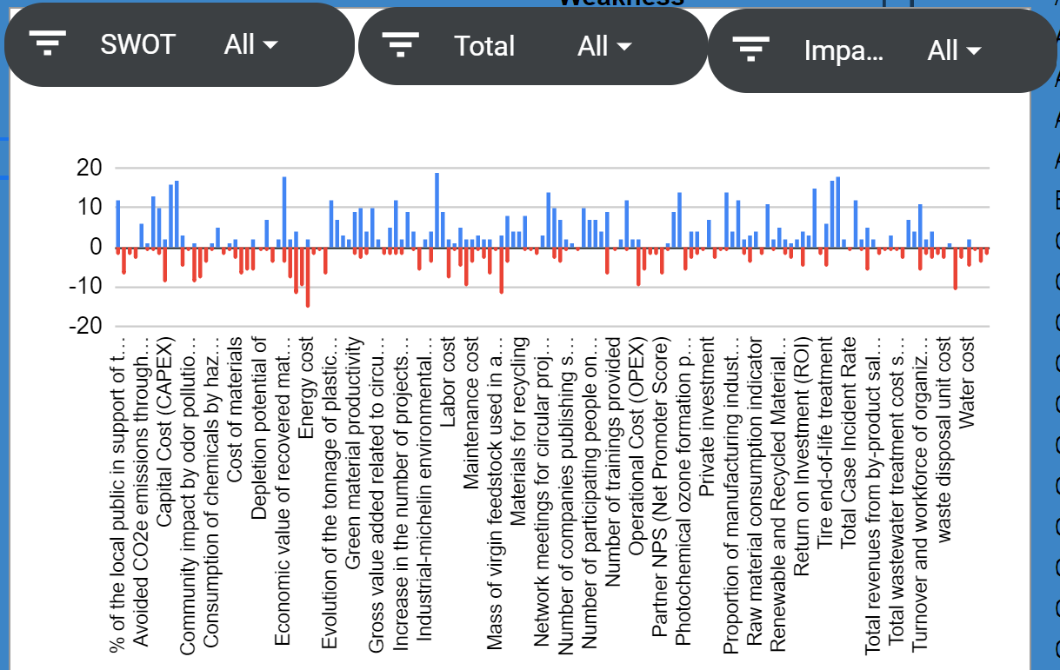
SWOT Dashboard

Slide 12
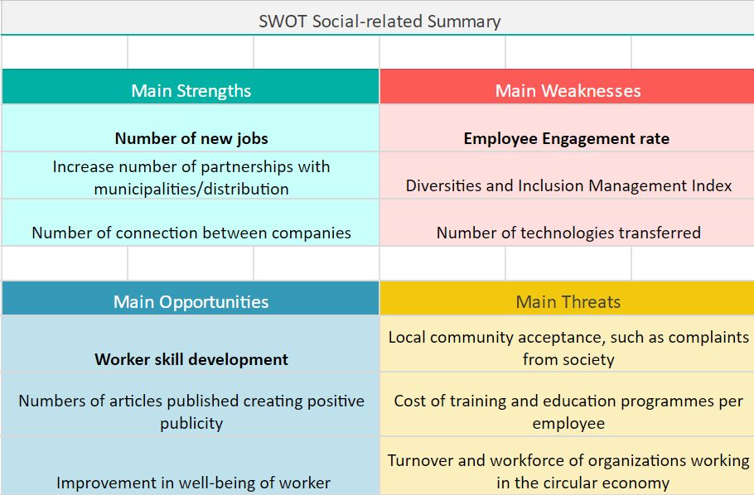
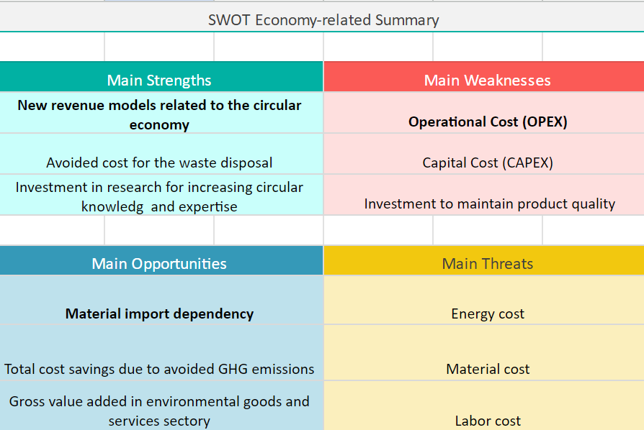
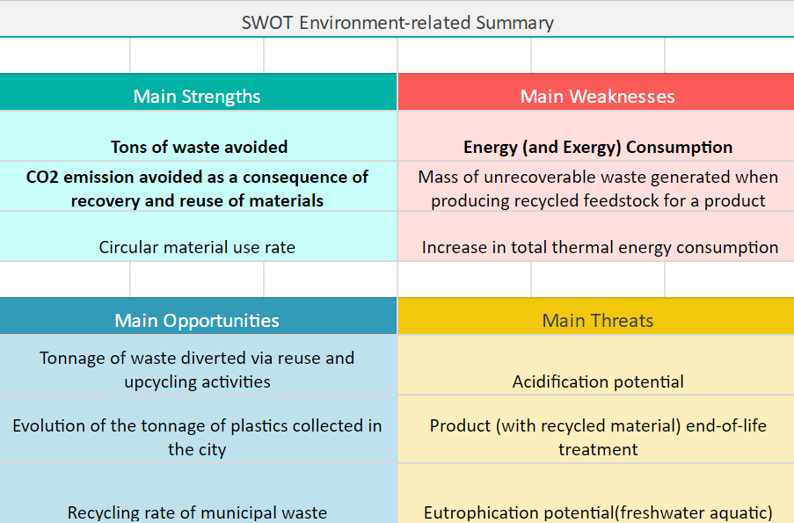

Slide 13
Review important indicators by the most vote score (whatever SWOT)
Identify impact and occurrence level to obtain cross-impact matrix

Slide 14
What is impact weight and a probability of occurrence of these indicators can be happened in the project?
Affect this/ How does this | Increased waste avoided in Ton | Reduce CO2 emission | High energy consumption during manufactured
Increased waste avoided in Ton | 5
Reduce CO2 emission |  | 3
High energy consumption during manufactured |  |  | -1
1
Increased waste avoidance in ton
3
2
Reduce CO2 emission due to recycled material
High energy (and exergy) consumption during manufacturing
Created number of new jobs
Weak employee engagement rate
3: positive impact to factor
Improve worker skill development
-3:Negative impact to factor
New revenue models related to the circular economy
1: slightly positive impact to factor
-1: slightly negative impact to factor
-5: The most negative impact to factor
5: The most positive impact to factor
Material import dependency
Increase operational Cost
Source: scale ranging: KENNETH C.(2008)

Slide 15
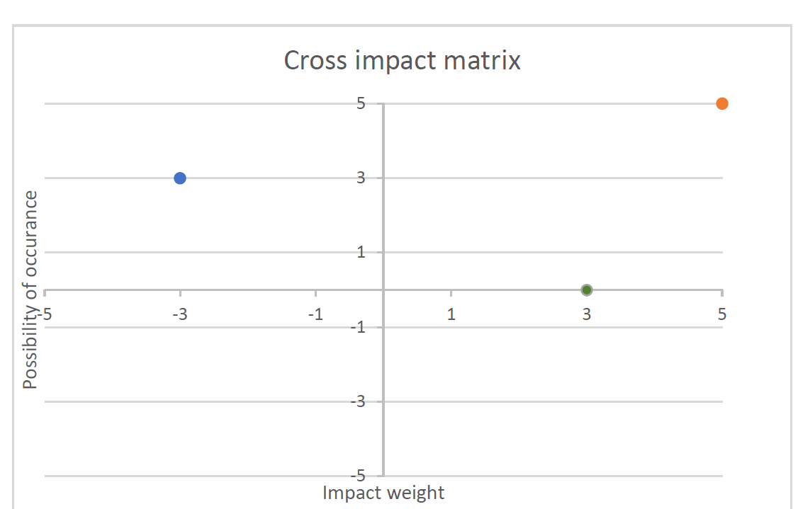
Impact and possibility of indicators to the project
Very likely to occur
Increased waste avoidance in ton
High energy (and exergy) consumption during manufacturing
Scale | Probability | Probability score | Scope
VLO | <10% | 0.1 | Very unlikely to occur
LO | 10 - <30% | 0.3 | Unlikely to occur
MED | 30 - <50% | 0.5 | May occur about half of the time
HI | 50 - <70% | 0.7 | Likely to occur
VHI | ≥70% | 0.9 | Very likely to occur
Likely to occur
Reduce CO2 emission due to recycled material reuse
May occur about half of the time
Unlikely to occur
Very unlikely to occur
Source: Project risk analysis and management guide 2nd edition (2007)

Slide 16
Impact and possibility of indicators to the project
Very likely to occur
Increased waste avoidance in ton
High energy (and exergy) consumption during manufacturing
The probability of impacting from indicator to other indicators | Increased waste avoided in ton (0.9) | Reduce CO2 emission (0.7) | High energy consumption during manufactured (0.7)
Increased waste avoided in Ton
Reduce CO2 emission
High energy consumption during manufactured
Likely to occur
Reduce CO2 emission due to recycled material reuse
May occur about half of the time
Unlikely to occur
Very unlikely to occur

Slide 17
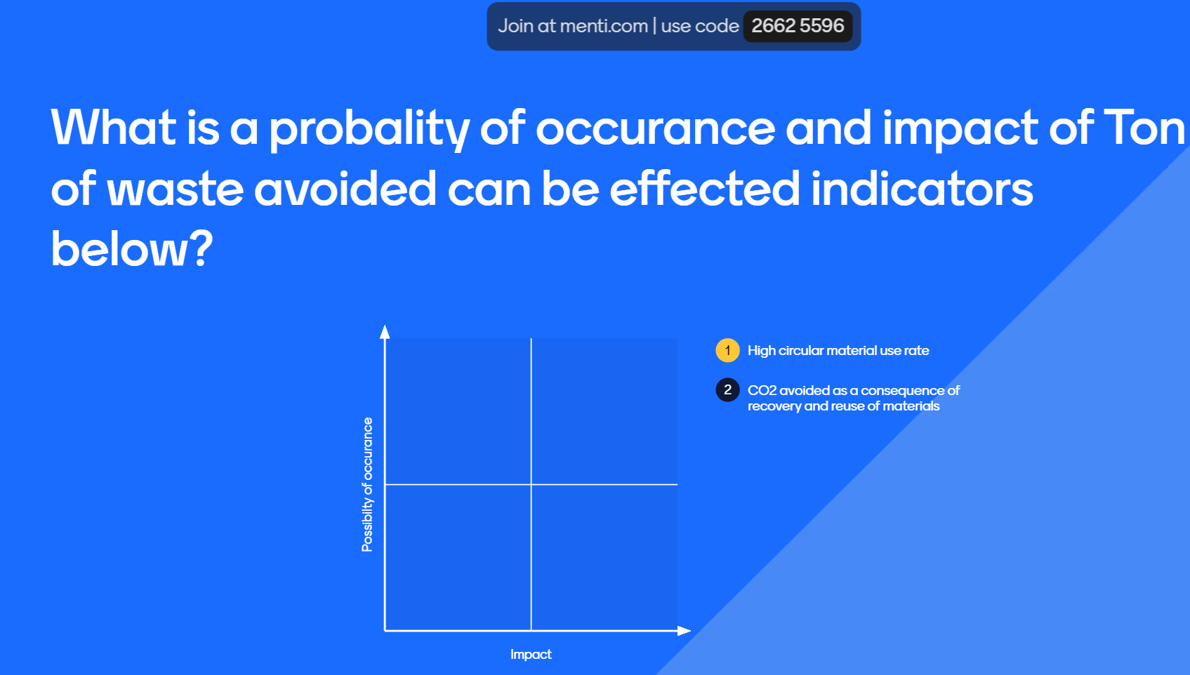
Impact and possibility between indicators to understand their interaction
What is impact of increased waste avoided in ton can be affected indicators below?
2
Affect this/ How does this | Increased waste avoided in Ton | Reduce CO2 emission | High energy consumption during manufactured
Increased waste avoided in Ton | 5
Reduce CO2 emission | 3 | 3
High energy consumption during manufactured | -1 |  | -1
Reduce CO2 emission due to recycled material reuse
3
2
3
High energy (and exergy) consumption during manufacturing
-3:Negative impact to factor
3: positive impact to factor
1: slightly positive impact to factor
-1: slightly negative impact to factor
-5: The most negative impact to factor
5: The most positive impact to factor

Slide 18
Impact and possibility between indicators to understand their interaction
The probability of impacting from indicator to other indicators | Increased waste avoided in ton (0.9) | Reduce CO2 emission (0.7) | High energy consumption during manufactured (0.7)
Increased waste avoided in Ton | 1
Reduce CO2 emission | 0.9 | 1
High energy consumption during manufactured | 0.7 |  | 1
0.9: Very likely to occur
2
Reduce CO2 emission due to recycled material reuse
3
0.7: Likely to occur
High energy (and exergy) consumption during manufacturing
0.5:May occur about half of the time
0.3: Unlikely to occur
0.1: Very unlikely to occur

Slide 19
Example of Economy cross-impact matrix
+5 +3 -1
+3 +3 -1
-1 +1 -1
1.0 0.7 0.1
0.9 1.0 0.3
0.7 0.1 1.0
5.0 2.1 -0.1
2.7 3.0 -0.3
-0.7 0.1 -1.0
Impact vector . Conditional probability vector = Likely cross-impact vector
5.0 2.1 -0.1
2.7 3.0 -0.3
-0.7 0.1 -1.0
0.9
0.7
0.7
5.90
4.32
-1.26
Likely cross-impact vector X An initial probability vector = Expected impact vector
Reference Paper: “A new look at the cross-impact matrix and its application in futures studies”, K.Chao , May 2008

Slide 20
Dashboard of net expected impact from the cross impact matrices
Economic
3.42
Social
3.2
Environment
8.96
Conclusions, study limitation and future research
Net expected impact
No standardized threshold defining impact value which require action plan
Challenges remain in comprehensively capturing cause-and-effect relationships for some indicators, necessitating careful interpretation.
All impactful indicators will be retained as critical variables for incorporation into future dynamic model studies.

Slide 21
Thank you

