Slide 1

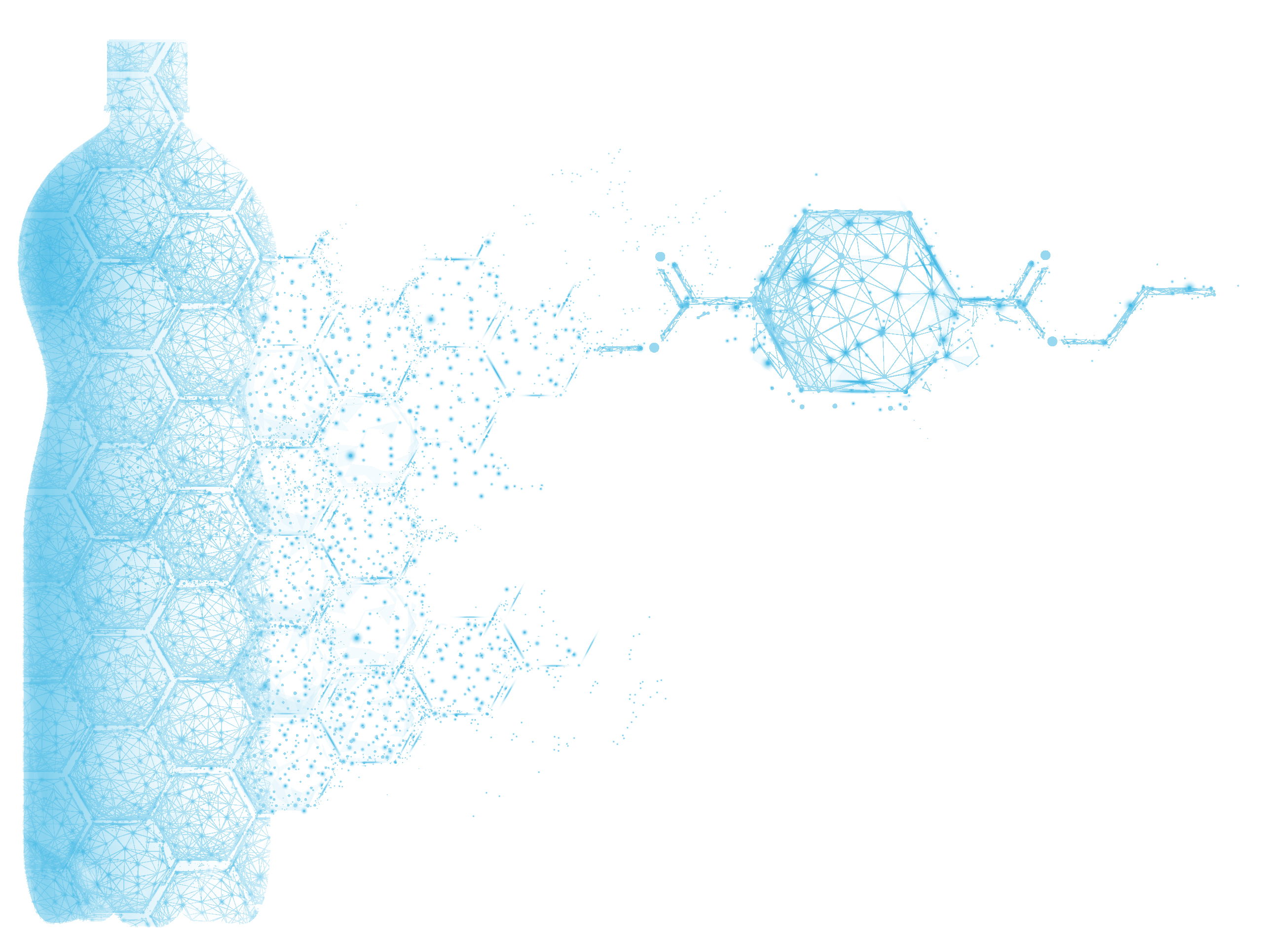

Life Cycle Assessment of Carbios Enzymatic Bio-Recycling Technology: Powering PET Plastic and Textile Circularity​
Kiyan Vadoudi
LCA and Circular Economy Specialist

Slide 2
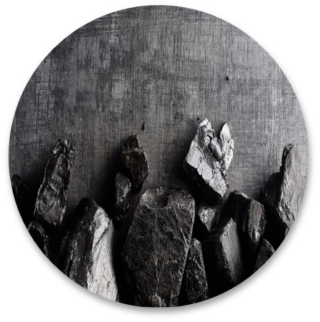


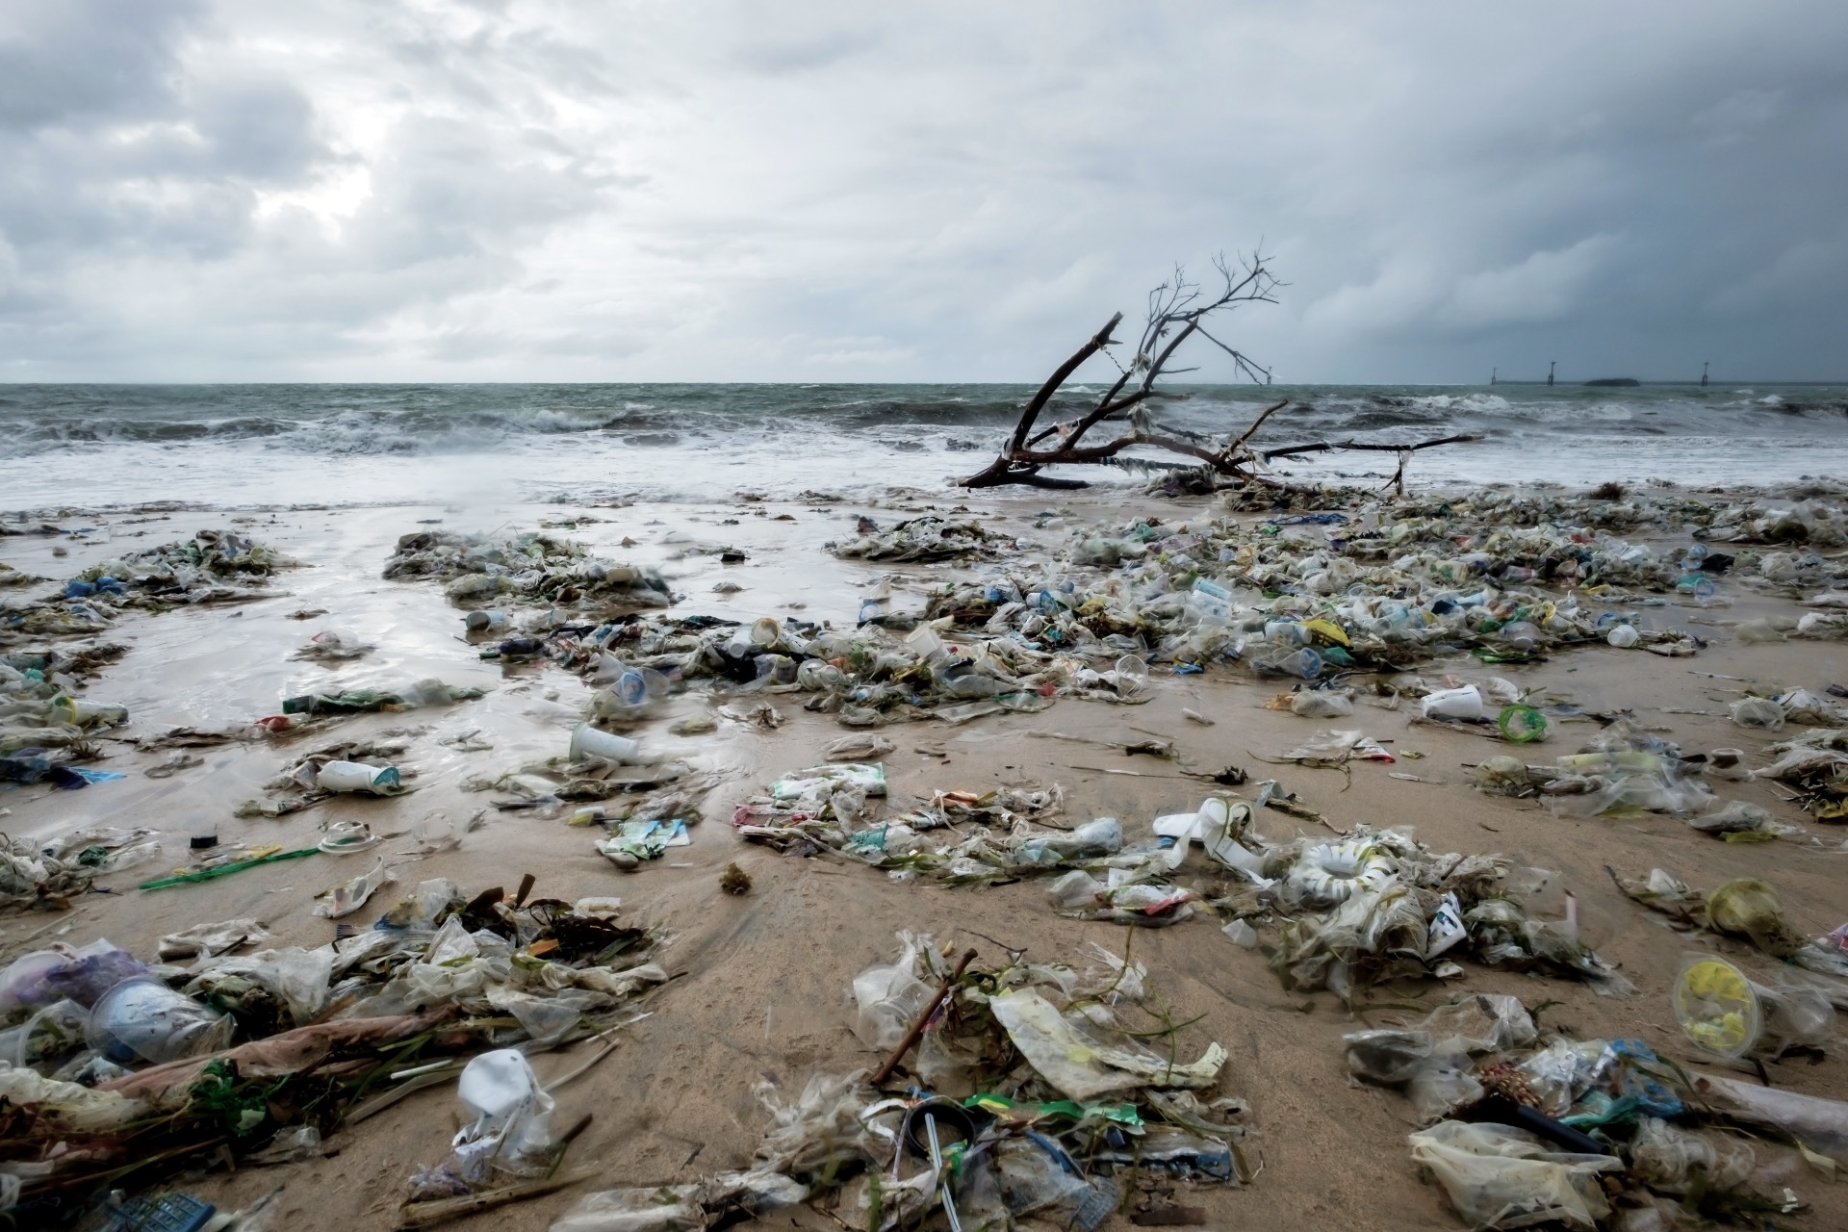

Plastic usage has created major environmental and health issues
> Plastic production
460 million tons ⁽¹⁾
of plastic produced
per year (2019)
3%
Closed-Loop
8%
> Extensive plastic pollution
Recycling
353 million tons ⁽¹⁾
of plastic waste generated
Secondary plastics produced 29Mt
1. OECD iLibrary, 2022
Notes:
Plastic production and consumption have created significant environmental impacts, and one of the main reasons for this is the current end-of-life (EOL) management situation of plastic worldwide. As you can see, in 2019, only 8% was collected for recycling, and from that, only 3% underwent closed-loop recycling.
Post-consumer recycled plastics 11% in Europe – Plastics Europe
European virgin plastics production 87.6% (5.3% PET)
Closed-Loop recycling rate in Europe 3%

Slide 3
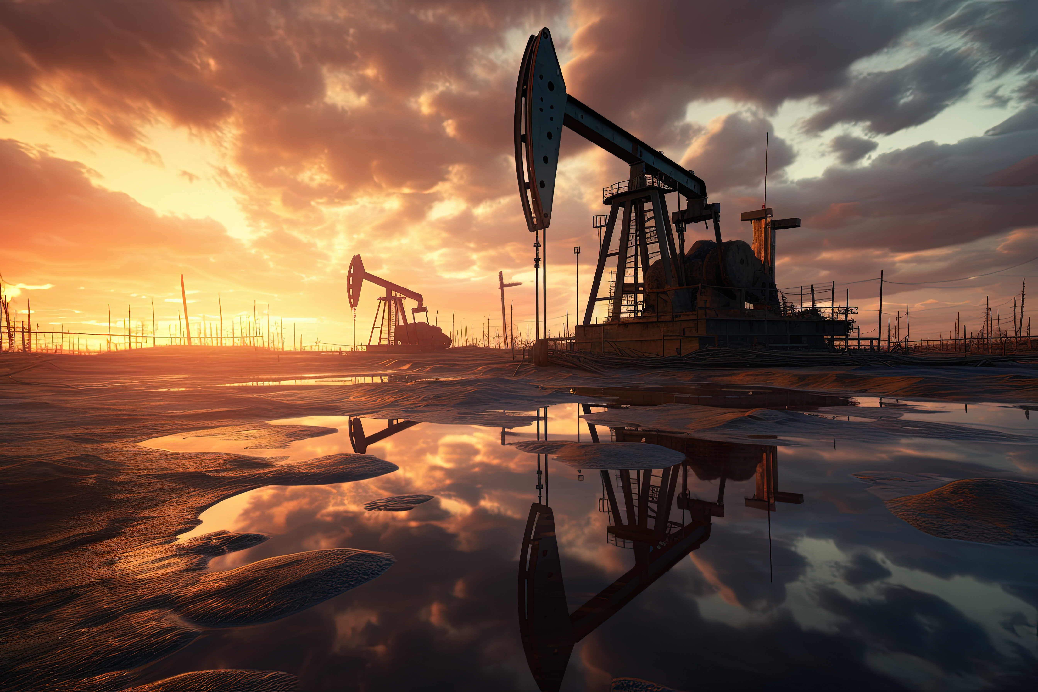
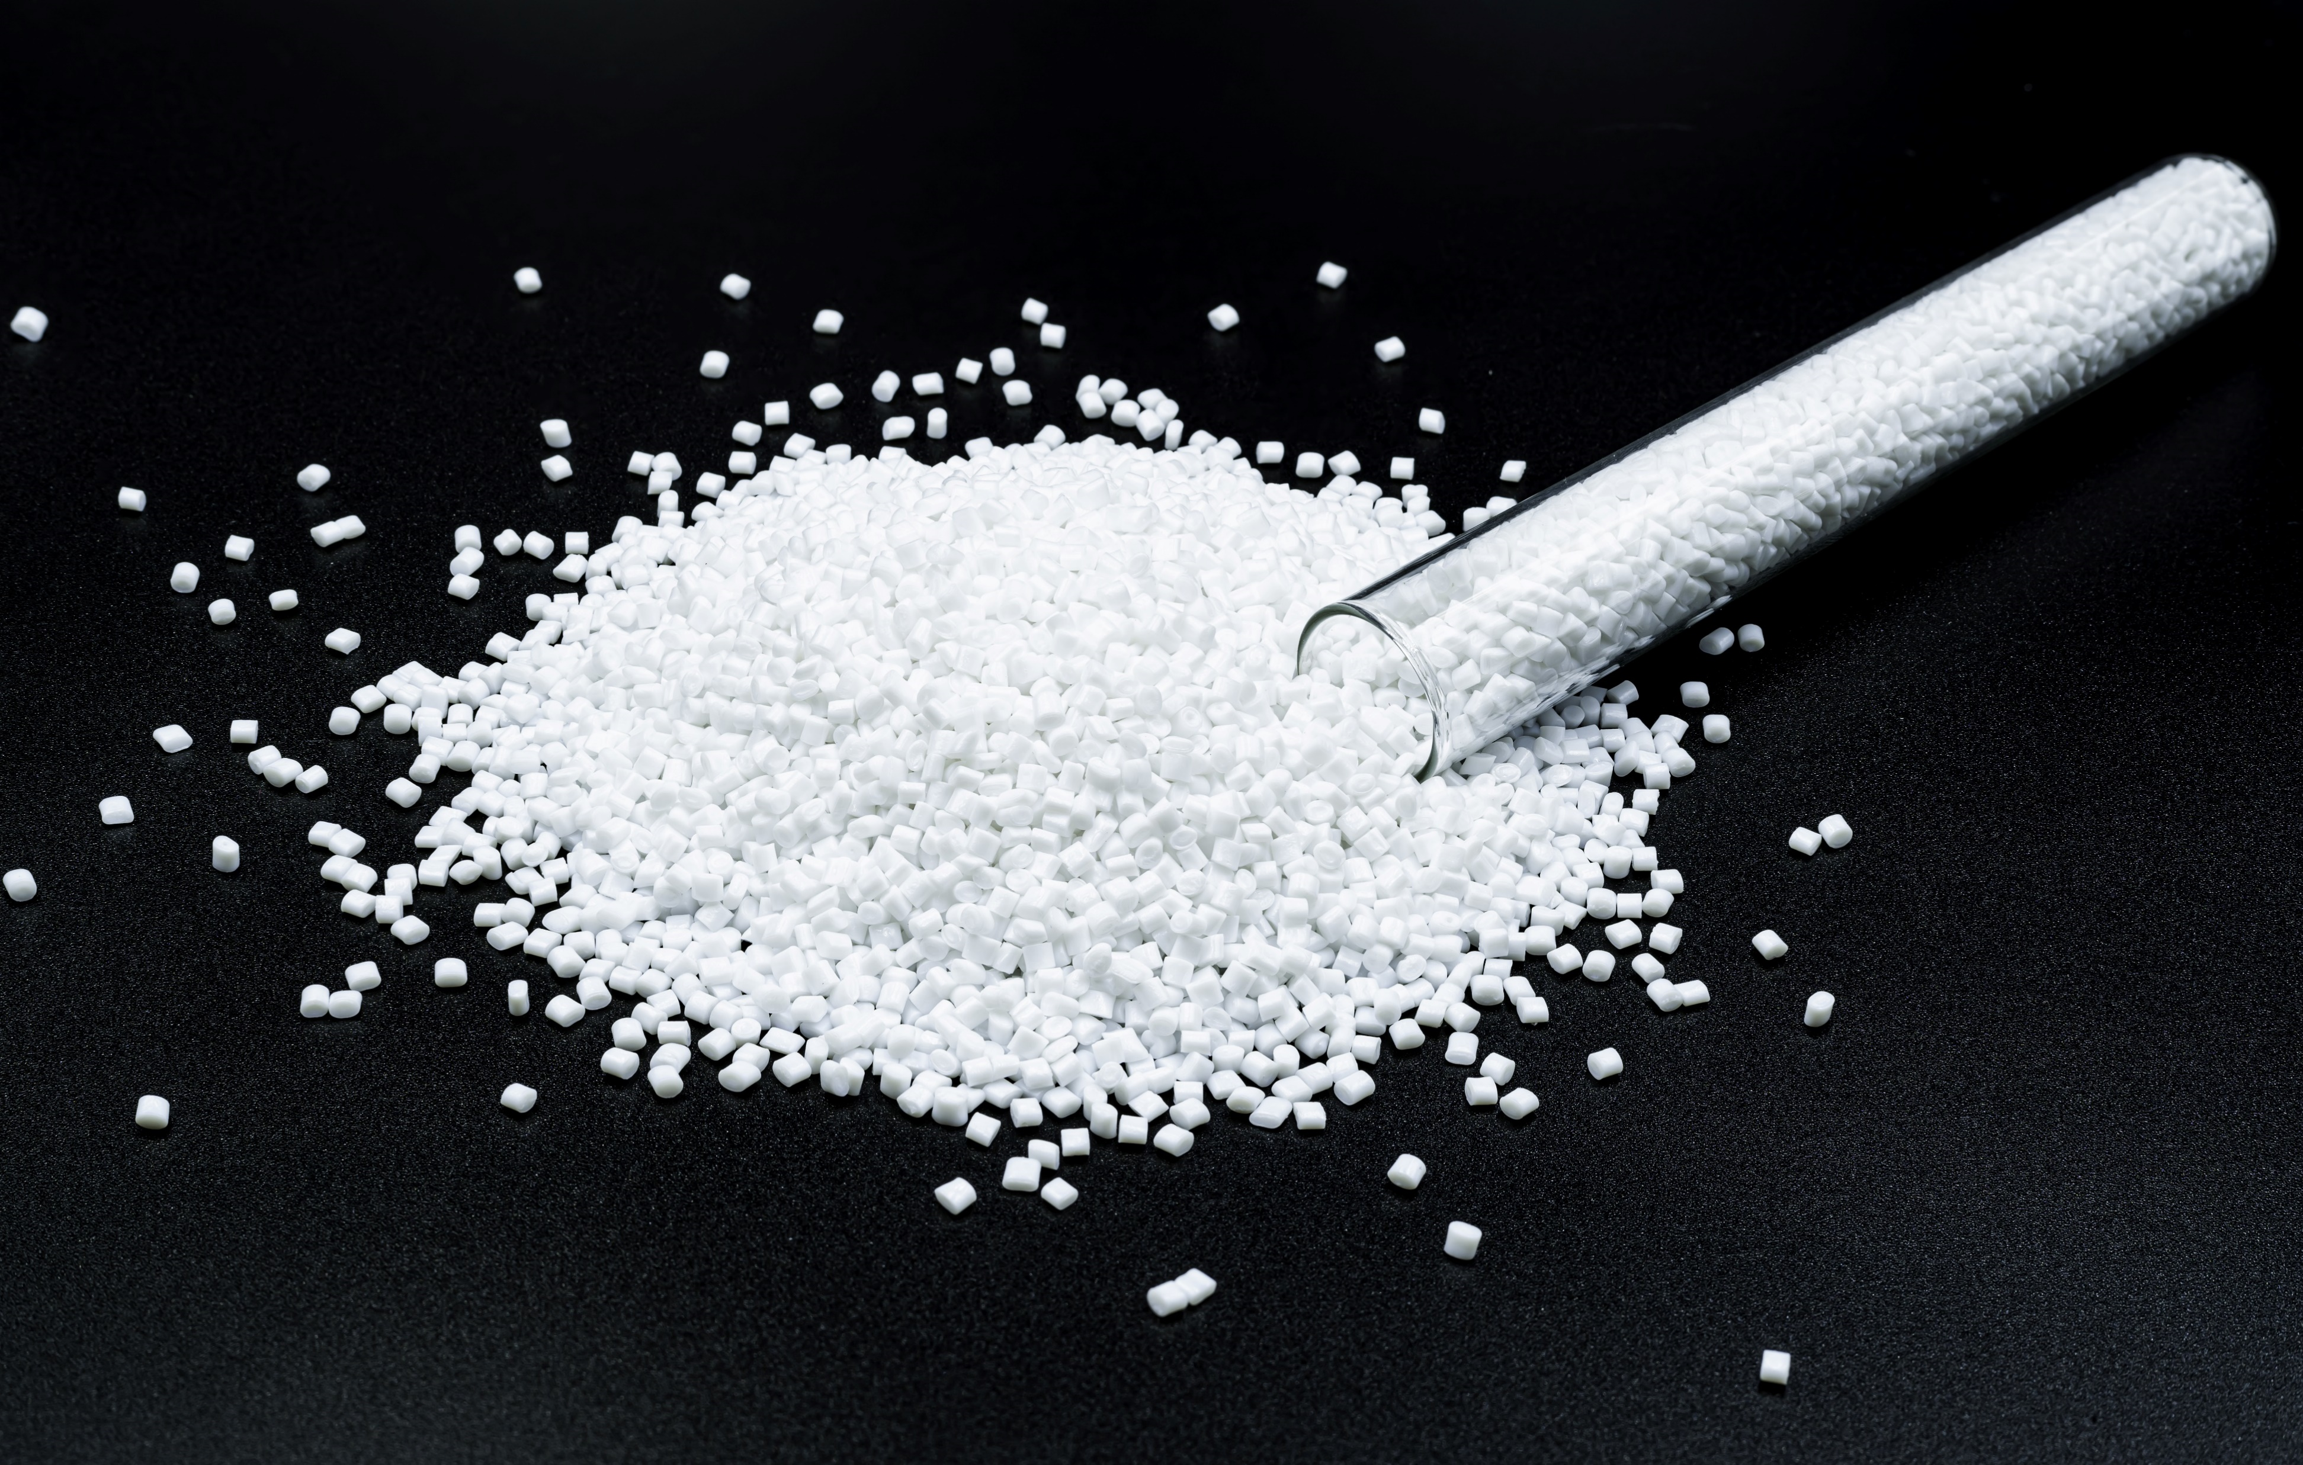
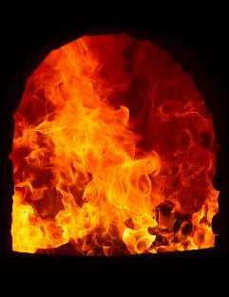
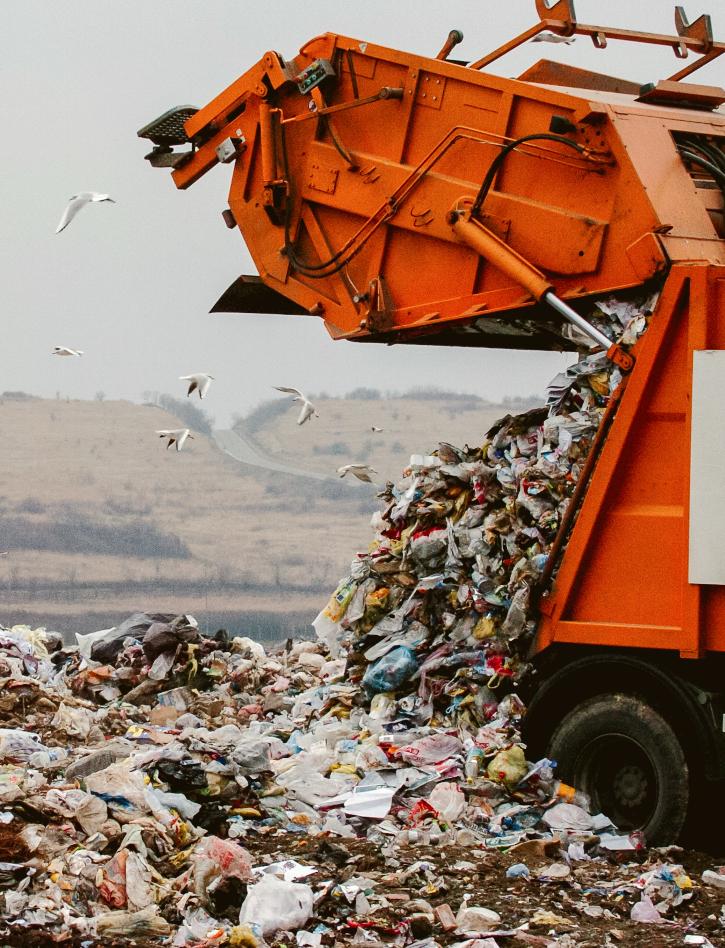
Contribution of plastic industry in global warming
Oil extraction and refining
Polymers production and conversion into plastic items
End of life of the majority of
plastic waste today
(2)
(GHG) emissions of Plastic production
(GHG) emissions of Plastic conventional End of Life
1.8 gigatons of greenhouse gas (GHG) emissions ⁽¹⁾
There’s no single solution:
We must implement the 4R principles “REDUCE, REUSE, RECYCLE and RECOVER”
1. OECD iLibrary, 2022 2. Ecoinvent 3.8 (The EOL environmental impact of plastic varies depending on the proportions of landfill and incineration)
Notes:
The plastic industry contributes about 4% to global warming potential (GWP), with virgin material extraction and polymerization accounting for approximately 70% of this impact. There’s no single solution and we must implement “REDUCE, REUSE, RECYCLE”. To reduce the GWP of plastic, we need to take action for managing its lifecycle.
4% of Global emission

Slide 4
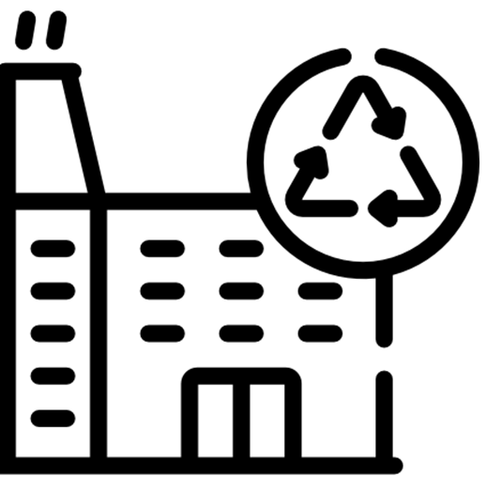
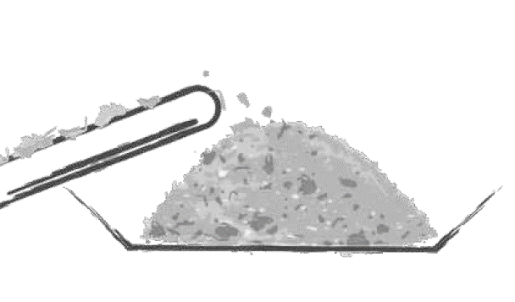


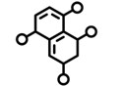
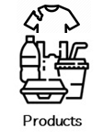



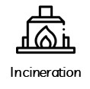







Polyethylene terephthalate (PET) value chain and European market share
Pretreatment
Virgin PET
Production
Market Share (EU) ¹
1%
9%
37%
13%
7%
33%
But Textile Global Market Share 60%-65%³
Contact Sensitive
(Food safety regulation²)
Non- Contact Sensitive
1. How circular is PET?, Zero Waste
2. European Commission
3. IHS Markit in 2021

Slide 5

Recyclability of Food grade PET waste
Today, only a small portion of PET waste is treated by mechanical recycling, with the rest (60%) ending up in incineration or landfill.
Mechanical process negatively impacts the chemical and mechanical properties.
Mechanical recycling
Pretreatment
Virgin PET
Production
DOWN-RECYCLING
By 2030, Europe wants all plastic packaging on the market to be 100% recyclable³
1. Yin, S., et al.. Mechanical reprocessing of polyolefin waste: a review. , 2015
3. European Commission
2. How circular is PET?, Zero Waste

Slide 6
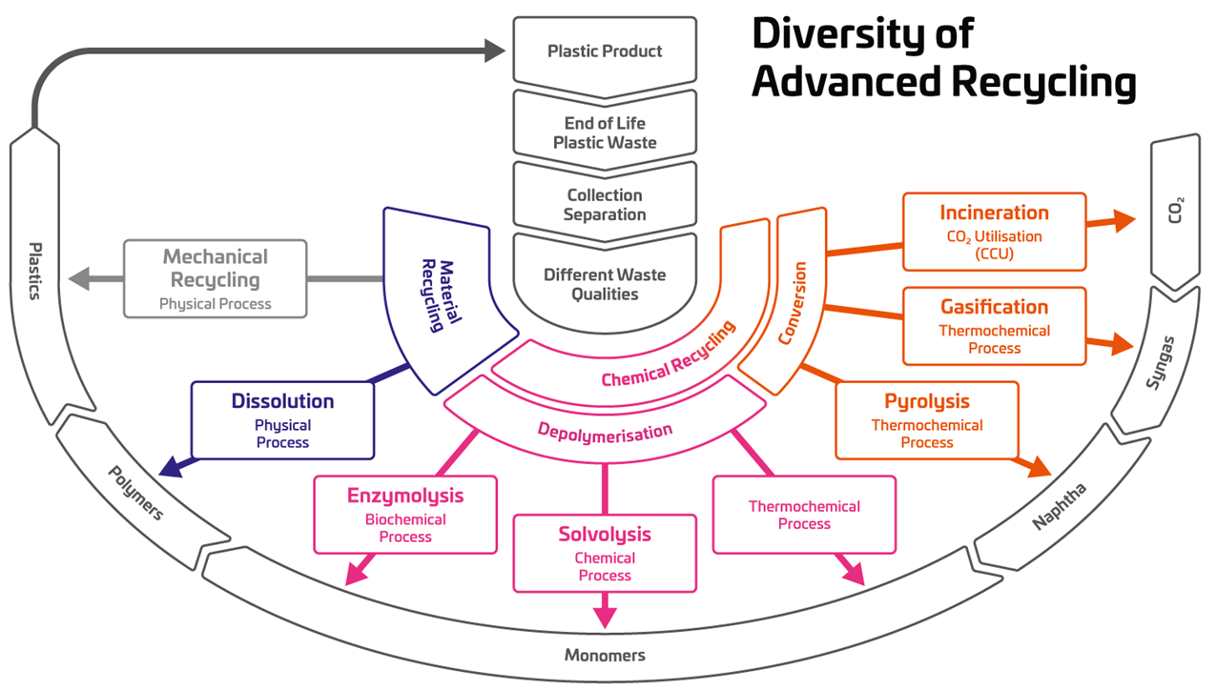
Recycling technologies for PET waste
Open-loop
Glycolysis
Methanolysis
https://renewable-carbon.eu/
Notes:
In general, there are three routes for PET recycling. One is open-loop recycling, which involves thermal treatment, and the other two routes can produce recyclate through physical treatment and depolymerization. Chemical treatment has been the major technology for monomer production, and recently, thanks to Carbios technology, a new route in this field has been introduced as biological treatment.

Slide 7
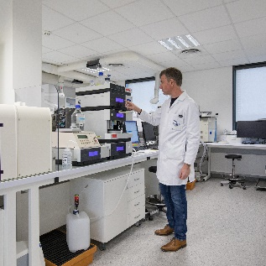
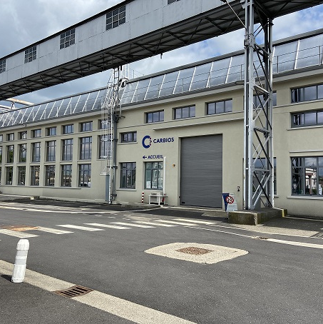
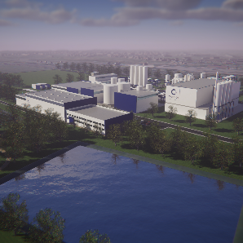






Carbios, a French biotech with international ambitions
Toulouse
Research center
Clermont-Ferrand
Headquarters
Process development
Demonstration Plant
Longlaville
PET biorecycling plant
Under construction
Preparing for operations
First products deliveries in 2026
3 sites
150 people
PopLaB
Pr Alain Marty
(Chief Scientific Officer) and team
Enzyme development
Notes:
Carbios is a French biotech pioneer in biorecycling of plastics with three sites: the headquarters, laboratory, pilot, and demonstration plants are located in Clermont-Ferrand in the center of France. Our research center is in Toulouse in collaboration with the University of Toulouse (TBI), and the plant under construction is in Loglaville, northeast of France, scheduled to commence operations in 2025.

Slide 8
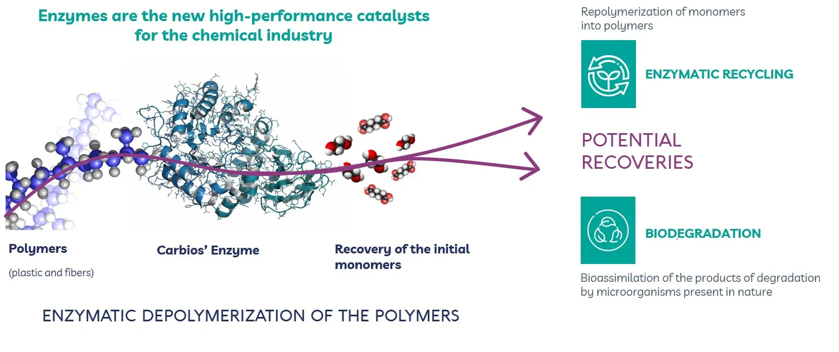
Two technologies to reinvent the life cycle of plastics and textiles
A world-first designed and developed by Carbios
Notes:
The technology is simple: the developed enzymes are added to plastic and textile waste in a hydrolysis process. At the end of the process, we recover PTA and MEG, which are ready for virgin-quality polymerization. At Carbios, we also have another technology, Enzymed PLA (Polylactic acid), which increases the degradation of PLA. Our research center is working on other types of polymers such as Polypropylene (PP) and Polyamide (PA).

Slide 9

Carbios’ PET recycling technology: Steps towards commercialization
2025
Projects under License
2021
2019
2014
2011 – now
Picoliter - Microliter
250 ml
to 5 litres
1 M³
20 M³
4 * 300 m³
Process scaling
Pilot
Demonstration plant
1st commercial -scale project
Enzyme identification and enzyme engineering
1 batch / week
25 people, 3 shifts
5 days / week
20 M€ Capex
50 000 tons / year
~ 70 direct jobs
5 shifts, 7 / 7
230 M€ Capex
Notes:
The Carbios project began in 2011 with the identification and engineering of enzymes. As part of the Life project for textiles, we entered the industrial demonstrator scale in 2021, managing 2 tons of waste. The future factory in Loglaville will manage 50,000 tons per year.

Slide 10




Environmental impacts
&
Circularity assessment
-90 % CO₂ emissions
vs one cycle of virgin PET production*
~95 ktons CO₂/year savings
in the first plant at Longlaville*
* France scenario, taking into account diversion of 75% PET waste from a conventional end-of-life
Virgin PET: 2.9kg CO₂/kg (cradle to gate), ecoinvent 3.10 base
Capacity of 50,000 tons of PET waste per year
Packaging & Textile

Slide 11
Goals and scope
Since 2018, Carbios has been carrying out an environmental assessment of Carbios enzymatic technology for PET packaging using the LCA tool.
General methods
  Use of ISO 14040/14044 standard in cradle-to-gate LCA approach
  Goals
  Assessment of environmental impact of Carbios rPET produced from PET waste in Longlaville, France (currently under construction with 50000 ton/y capacity).
  Compare environmental impacts of Carbios’ rPET versus virgin PET produced in Europe

Slide 12
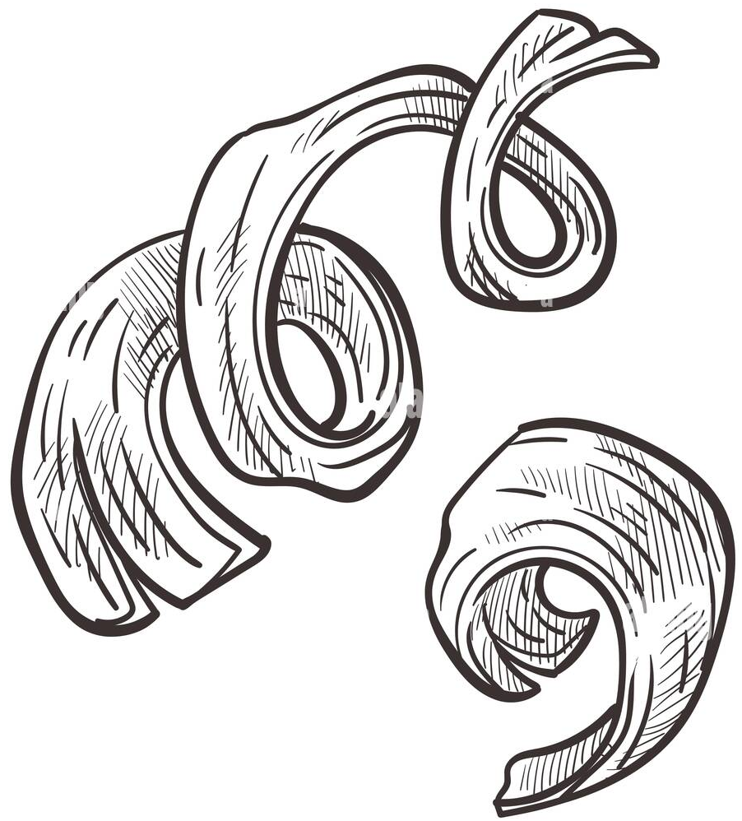
Main assumptions and data sources
Data Sources
  Process data from Material and Utilities balance of the Reference Unit ’s design
  Life cycle inventory (LCI) datasets: ecoinvent databases 3.10, ADEME 2022 and Franklin Association.
Wastes types
  Coloured and opaque bottles
  Mono and multilayer trays
  Residuals from mechanical recycling (fines)
All PET waste that could not be treated by mechanical recycling to produce food-grade clear PET
Functional Unit
  Production of 1 kg recycled PET of equivalent quality to virgin PET

Slide 13
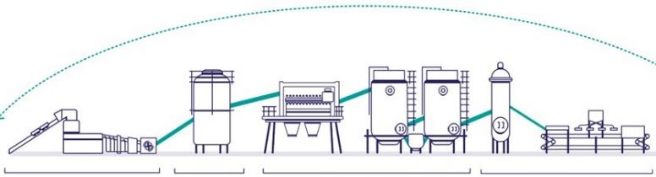
Overview of the system boundaries – Cradle-to-Gate
Burden free
Post consumer PET waste
CARBIOS full process system boundary
T
3. CARBIOS specific steps
1. Waste collection & sorting
2. Waste preparation
France (Longlaville)
T
T
France
France
Pretreatment
Depolymerization
Filtration & discoloration
Separation of TA & MEG
MEG
PTA
T
4. PET production
The Netherlands (Rotterdam)
T
Transport
Functional unit = production of 1 kg of bottle-grade PET
1. ISO 14040 et 14044

Slide 14
-90 % CO₂ emissions vs virgin PET production
-90%
-24%
-90% CO2 emission vs Virgin PET
Europe
France
France

Slide 15
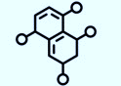
Methodological approach #1 – Cut-off
100% incineration
1,6 kg CO₂-eq/kg PET waste
2,9 kg CO₂-eq/kg PET
Virgin PET
rPET
Flakes preparation
2,2 kg CO₂-eq/kg PET
2,9 kg CO₂-eq/kg PET
-24%
Cut-off: only the recycling process
Only the material production is considered
Carbios
rPET
Virgin PET

Slide 16
Methodological approach #2 – Substitution
100% incineration
- 2,55 kg CO₂-eq/1,53 kg PET waste
2,9 kg CO₂-eq/kg PET
Virgin PET
0,3 kg CO₂-eq/kg PET
rPET
Flakes preparation
75%
-90%
Carbios
rPET
2,9 kg CO₂-eq/kg PET
Substitution: PET value chain
This approach takes into consideration the two main functions of the recycling process: material recovery & diverting waste from conventional End-of-Life
Virgin PET

Slide 17
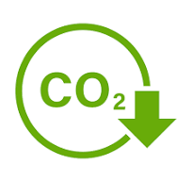
Global warming potential of Carbios recycling technology
Comparisons of Carbios rPET vs Virgin PET
-24%
Polymerization
-90%
Carbios specific Process (MEG and PTA production)
Flakes production
Collection and Sorting
Substitution Co-Products
Carbios rPET
Cut-off
Carbios rPET with
75% EOL substitution
European Virgin PET
Ecoinvent 3.10
Notes:
Add Carbios and substitution

Slide 18
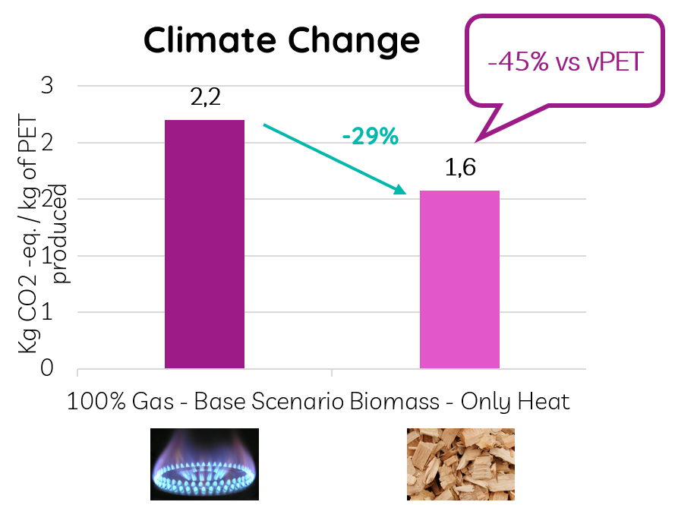
Short term opportunities for CO2 emission reduction
1. Heat source
Current: Natural gas produce 0,5 kg CO₂-eq/kg rPET
Target: On site (biomass + CSR) boiler
Potential for decrease CO2 emission : -29%
2. Enzyme
Improvement in the efficiency of enzyme production
3- Process Improvement

Slide 19
Conclusions and perspective
Carbios is bringing to the market an enzymatic hydrolysis technology with high circularity performance
  High recyclability and Robust on design and performances with complex feedstock
  Recovery yield > 85%
  Produced monomers can be used in their initial or any applications
The full potential on CO2 emissions is captured by combining
  Not only chemical recycling process but the overall value chain
  Chemical recycling is seen today as the only alternative to conventional end of Life for complex feedstocks
  CO2 impact of the value chain with Carbios block inside is 90% less than fossil-based linear system, with the integration of 75% End of Life substitution
Perspectives:
The future will be a combination of Virgin, Mechanical recycling and Chemical recycling
→ combination of LCA and circularity, due to the limits of current LCA

Slide 20
Thank you for your attention
Kiyan VADOUDI : kiyan.vadoudi@carbios.com

