Slide 1
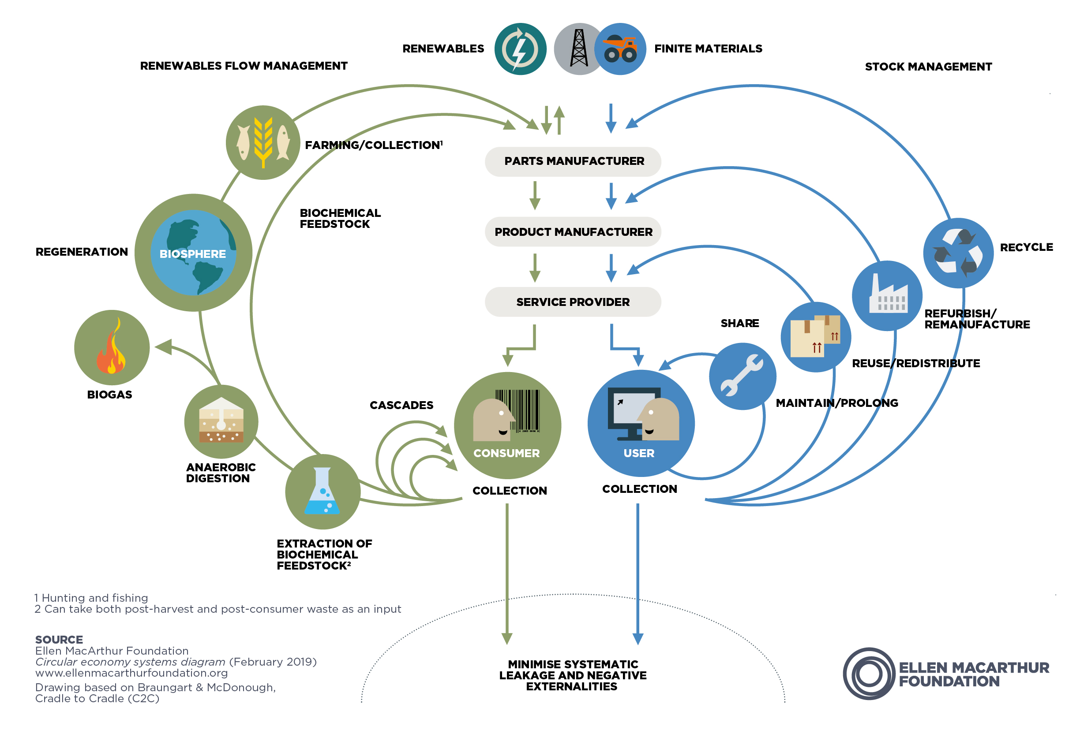
Students & Circular Economy Hackathon
How can you and your peers contribute to designing, implementing, and operating a more circular economy?
Timothy Marcroft & Constantin von Beck
Sogndal 6. February 2022

Slide 2
Students & Circular Economy Hackathon Organization
Wednesday, 9-12 (Stadionbygget 02-03):
Citizen energy initiatives examples
Preparation for the Hackathon
Presentation by Jim Skarstein (HVL Skape)
Presentation by Jørn Mortensen (SIMAS)
Presenting challenges and forming groups
Thursday: Teams work on their project ideas, and can contact experts
Friday, 9-16 (Stadionbygget 02-03):
Hackathon work session/preparation of pitch
Presentations, discussion, judging, & feedback

Slide 3
What is a Hackathon?
A hackathon is a short event in which teams come together to respond to challenges, build solutions, and pitch their ideas in a friendly competitive environment.
Usually 24 – 48 hours. Yours begins after class today. You will have 4 hours to work in-class on Friday (with access to advice and people to answer questions).
The participants:
Teams: you will divide up into 5 teams, each responding to a different challenge.
Advisors: will be present (or available online) to answer help.
Judges: the panel of judges will decide on a winner at the end of the event.
The goals:
Propose an initiative, product, website, app, or other project responding to the challenge.
Get as close to a full model of your solution as possible in the limited time.
Pitch that solution in a way that makes it attractive to the judges & potential participants.
Two prizes: one awarded by the judges and the other for the "audience favorite". Each member of these teams will get a 200 NOK gift certificate for the cafeteria.

Slide 4
What makes a good project for a Hackathon?
A project can be almost anything: a business, an app, a platform, an event, a campaign…
Here are some important things to consider when coming up with your project idea:
Does it respond to an important problem? The problem has to be important for the solution to be important.
What level of impact does it have? Does it fully solve the problem? If not, how big a contribution does it make?
Is it innovative? New ideas that haven't been tried before (at least in this specific form) are more exciting for audiences and judges.
Does it leverage an unexploited opportunity? Is there some reason why now is a good time and HVL - Sogndal is a good place to do this project?
Does your team have the skills needed to make the project happen? You should make the best use of the talents and abilities of the people on your team. If not, how are you going to find those skills?
Is it realistic? You should be clear on how you will gather the resources needed and how you plan to implement your project

Slide 5
What will you produce during this Hackathon?
Some things you could produce to pitch your project:
A name (and maybe a logo)
A timeline/calendar that shows how you plan to make this solution real
A rough budget or business plan
A website, facebook page, or similar that shows off your solution
A one-page proposal to get support (financing, volunteers, administration, members, etc.)
A presentation to accompany your pitch
A rough idea of impact of your project.
You don't need all of these things, just the ones most relevant to your project and team.

Slide 6
Some advice for better pitches
What is the first thing you should talk about in your presentation?
Your team's biography and work experience?
How the world will be different after your project?
A quick description of the project you are presenting?
The problem you are trying to solve?
What you want audience members to actually do?
Details about the implementation of your project?
Who will benefit if your project is put into place?
Something else?
Start with why:
a problem or unfulfilled need the the world or in a specific area or population

Slide 7
Some more advice for better pitches: The motivated sequence
The motivated sequence (ANSVA): structure your presentation like this for best impact
A = Attention: something to get the audience's attention. Very important in the age of smartphones. A short video, story, joke, bright colors, music, a bold vision statement, etc. Should be quick.
N = Need: what existing need in the world does your project fill? What is the problem that you are trying to solve? Why is it important that you solve this problem? Don't talk about your project yet, just why it matters. Make sure to describe the problem in a way that allows you to solve it.

Slide 8
For better pitches: The motivated sequence (continued)
S = Solution: how you plan to solve the problem you presented, your project. Describe your project with enough detail to demonstrate how it connects to the problem, and to give the audience confidence in the solution. Adapt your description to your audience in terms of level of technical details and complexity of the concepts. Diagrams & illustrations are very helpful.
V = Visualization: give your audience a clear image of what your solution will look like once it is put in place. This can mean a rendering of the final version of a product, a timeline for a campaign, a website, or some other way of really showing people what this will look like in its finished form. Be sure to include some information or description of how the world will be different after the "Need" is fulfilled. Help them visualize the change.
A = Action: finally, what do you actually want people to do after they hear your presentation? Should they invest in your company? Sign up for your campaign? Vote for your project? Tell the audience, very specifically, what you want them to do now that they have heard your presentation.

Slide 9
Making your pitch presentation
Your 5 minute (maximum) presentation should include:
Why/the problem: The problem you are trying to solve and why that matters. This can include statistics on the amount of waste you are dealing with, or evocative descriptions of the current bad situation. What conditions make it so that this project absolutely needs to happen? We have to care about the presentation before we start seriously listening to it, and that means caring about the problem.
Your solution: Explain what your response is to the challenge. What is the core concept? How does it work? Who is doing the work? How do you get the resources you need (budget)? What is your plan to make the solution continue functioning long-term? Who are going to be your users/customers? Here, you need to show us what you plan to do and why it is both a good idea and realistic. Images and diagrams are helpful.
.

Slide 10
Making your pitch presentation (continued)
Demonstration: Show us the solution as concretely as possible. A website, design sketch, user personal profile, promotional materials… anything you can use to demonstrate what this solution looks like.
Impact: tell us how the problem will be solved and how the world will be made better by the existence of your solution. Quantify this if you can, even if you are just guessing. Infographics showing the circularity of your project are particularly helpful.
Tell us what to do: join your campaign, invest, vote for your project, etc.
A powerpoint presentation is usually a good idea, but don’t just read your slides. And don't be afraid to make a little more material than you plan to present: you can use this to answer questions.
For more information, resources, and directions, see the template provided.

Slide 11
Advice on how to work during a Hackathon
Divide up tasks & work in parallel teams of 1 or 2 people.
Spend your full-group meeting time wisely: discuss organization, make important decisions, & give feedback.
The goal of full-group meetings is to remove obstacles and provide feedback to allow and improve the solo or duo time that will actually get most of the work done.
To minimize the amount of time taken up in full-group meetings, maximize the amount of thinking, research, and work you do in solo or duo teams.
Whole group
Whole group
Whole group
Initial goals & ideas
Feedback on first draft of work- product
Approval of final work-product
Solo/duo teams
Solo/duo teams
Build first draft
Build final draft
All contributions welcome
Feedback on execution
Minor feedback only

Slide 12
Some examples of pitches from a similar event: UNSW 2020
The University of New South Wales (Australia) held a Circular Economy Hackathon in 2020.
Focus: making Sydney a more circular city, reducing the impacts of cities around the world.

Slide 13
A good pitch: C Lab

Slide 14
Another good pitch: UGarden

Slide 15
A less-good pitch: 0 Waste

Slide 16
Getting help: outside advisors are available
If you need more information on , or if you want to get brief feedback on an idea that you had, you can speak with one of the following people during scheduled times.
Jim Skarstein, HVL skape
Siri Smith, Climate & Sustainability Coordinator HVL
Jørn Mortensen, Trainee, SIMAS Sogndal
Tim & Constantin: Thursday, 13.00 - 16.00, Stadionbygget 02-03

Slide 17
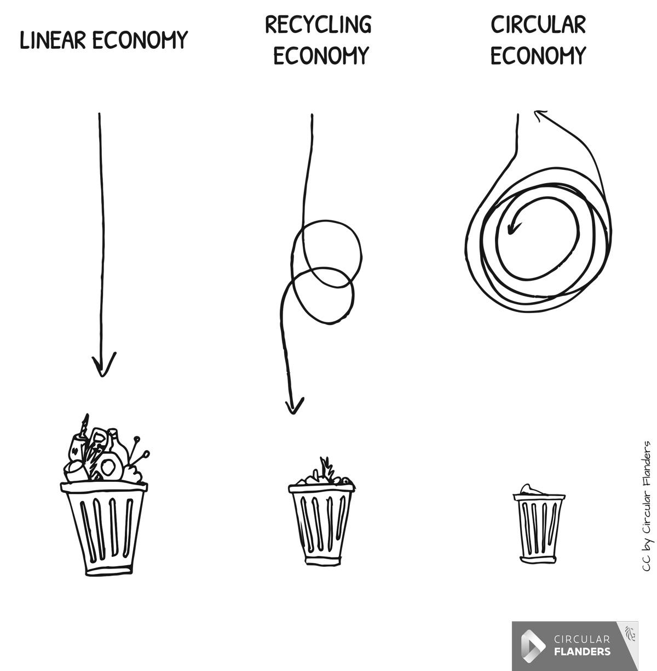
The Status Quo at HVL
Some basic statistics on:
Populations
Waste
Energy
Transport
Housing

Slide 18
Important actors in the resource & waste ecosystem in and around HVL Sogndal
Campus waste management: SIMAS, HVL Sogndal Campus Services & Maintenance Department
Food: supermarkets & restaurants, Campus cafeteria, toogoodtogo
Clothing: stores, second-hand store (NMS Gjenbruk)
Outdoor gear: Student clubs, ski areas, Intersport, Fjellsportfestivalen
Event venues: concert hall, something on campus? maybe football/soccer stadium, bars
Housing: Sammen, private homes, second hand in saman housing (Gjenbruksbui)

Slide 19
Student Housing & Waste
Sammen has:
475 rental properties in Sogndal
498 dormitories
90% occupancy rate (mostly due to low occupancy in June/July)
Waste produced by student housing (and collected by SIMAS):
Wet organic: 16,800kg
Cardboard and paper: 67,000kg
Plastic: 2,700kg
Glass and metal: 6,200kg
Residual waste (other): 90,000kg
During move-out, the residual waste increases quite a bit, though this was reduced when the re-use rooms were put into place.

Slide 20
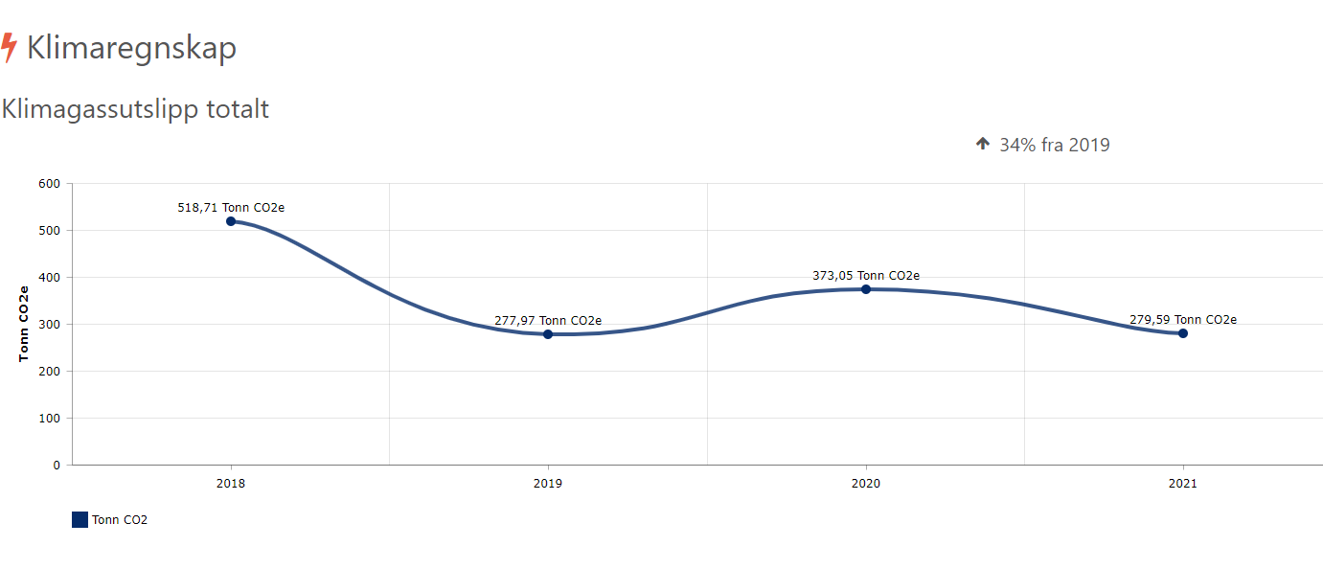
Carbon emissions attributed to HVL - Sogndal

Slide 21
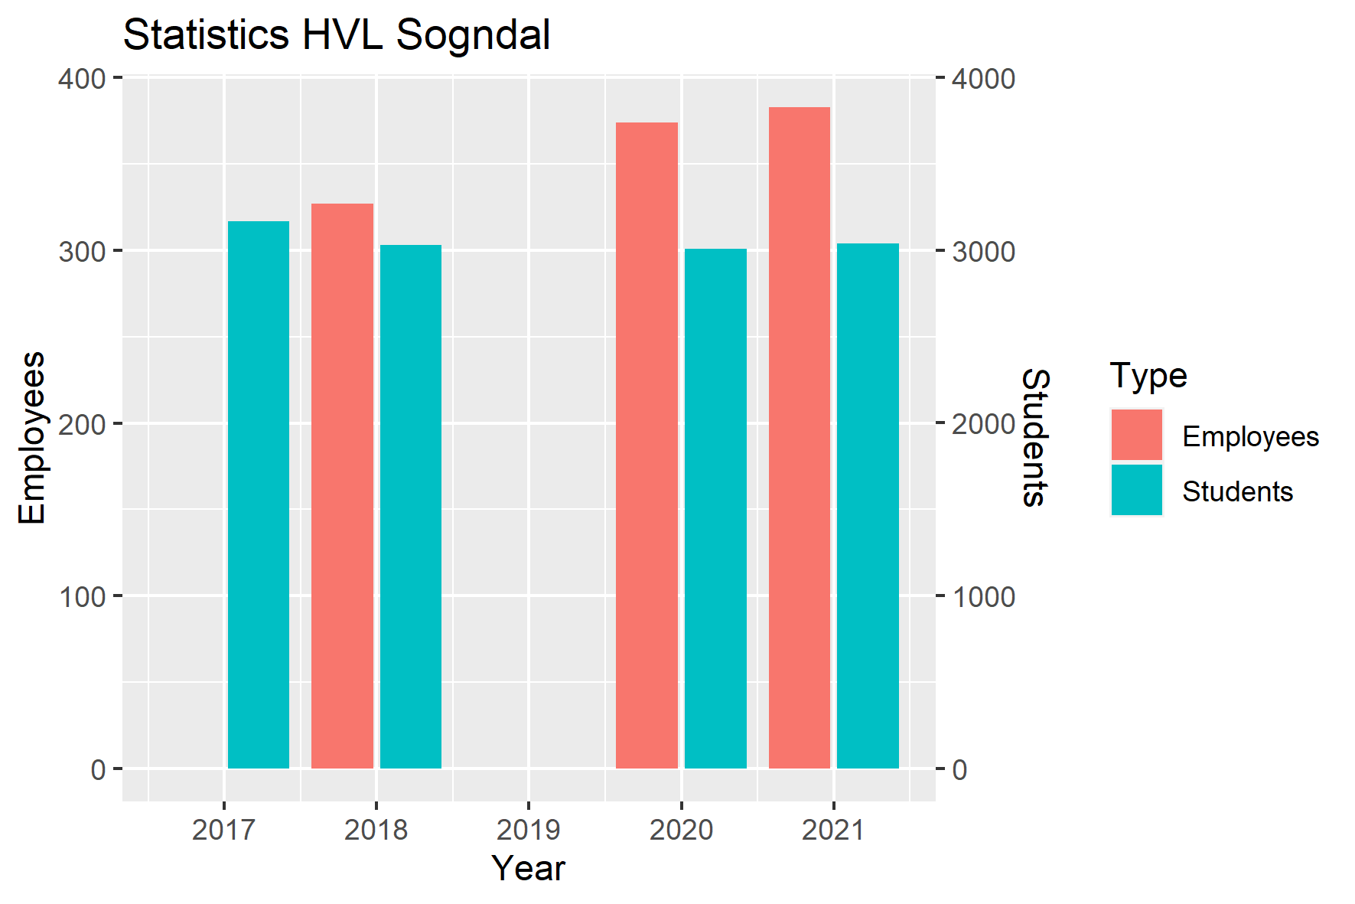
Students & Staff at HVL - Sogndal

Slide 22
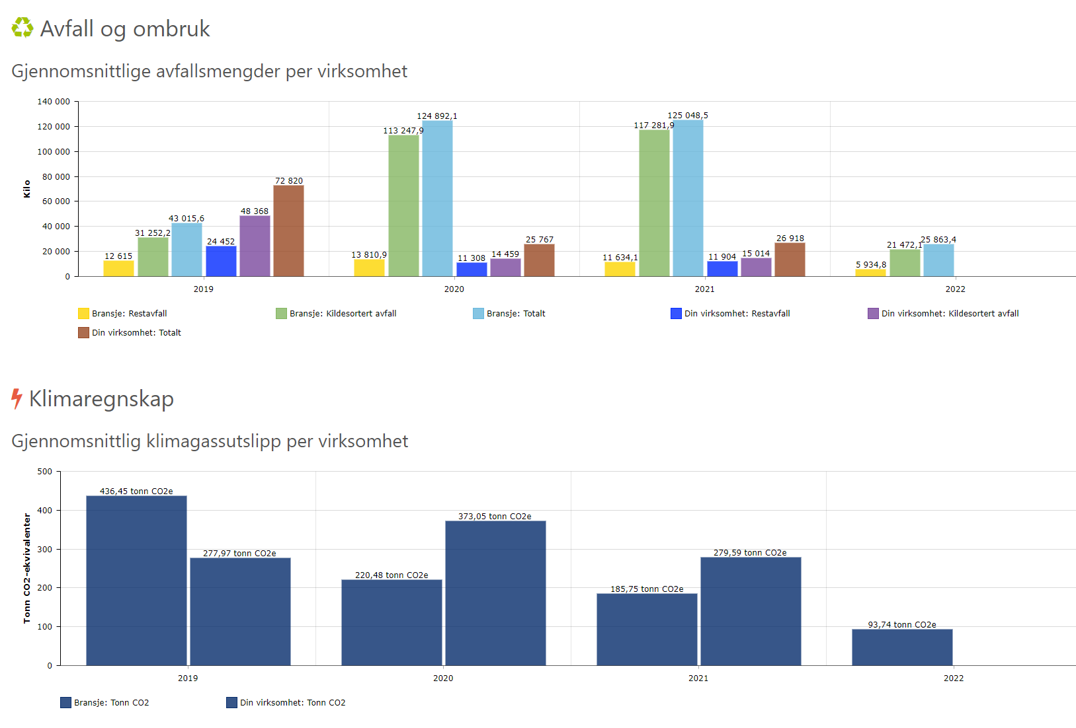
Waste at HVL - Sogndal

Slide 23
Waste at HVL - Sogndal

Slide 24
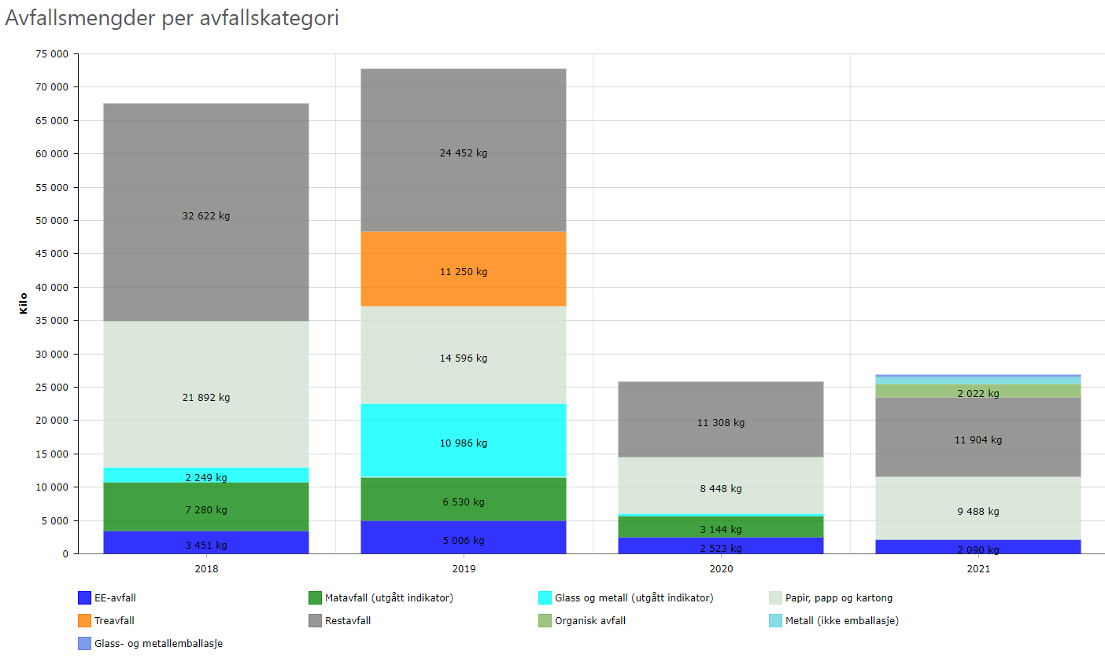
Waste at HVL - Sogndal

Slide 25
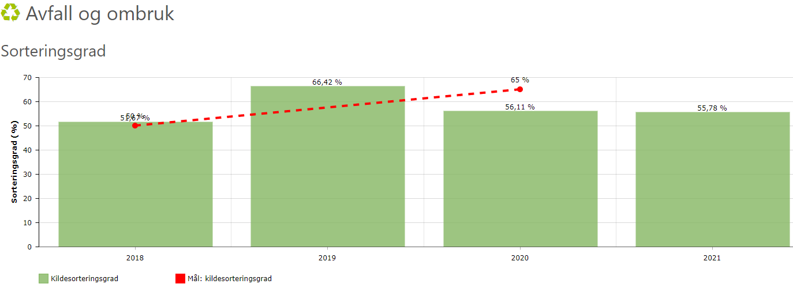
Waste at HVL - Sogndal

Slide 26
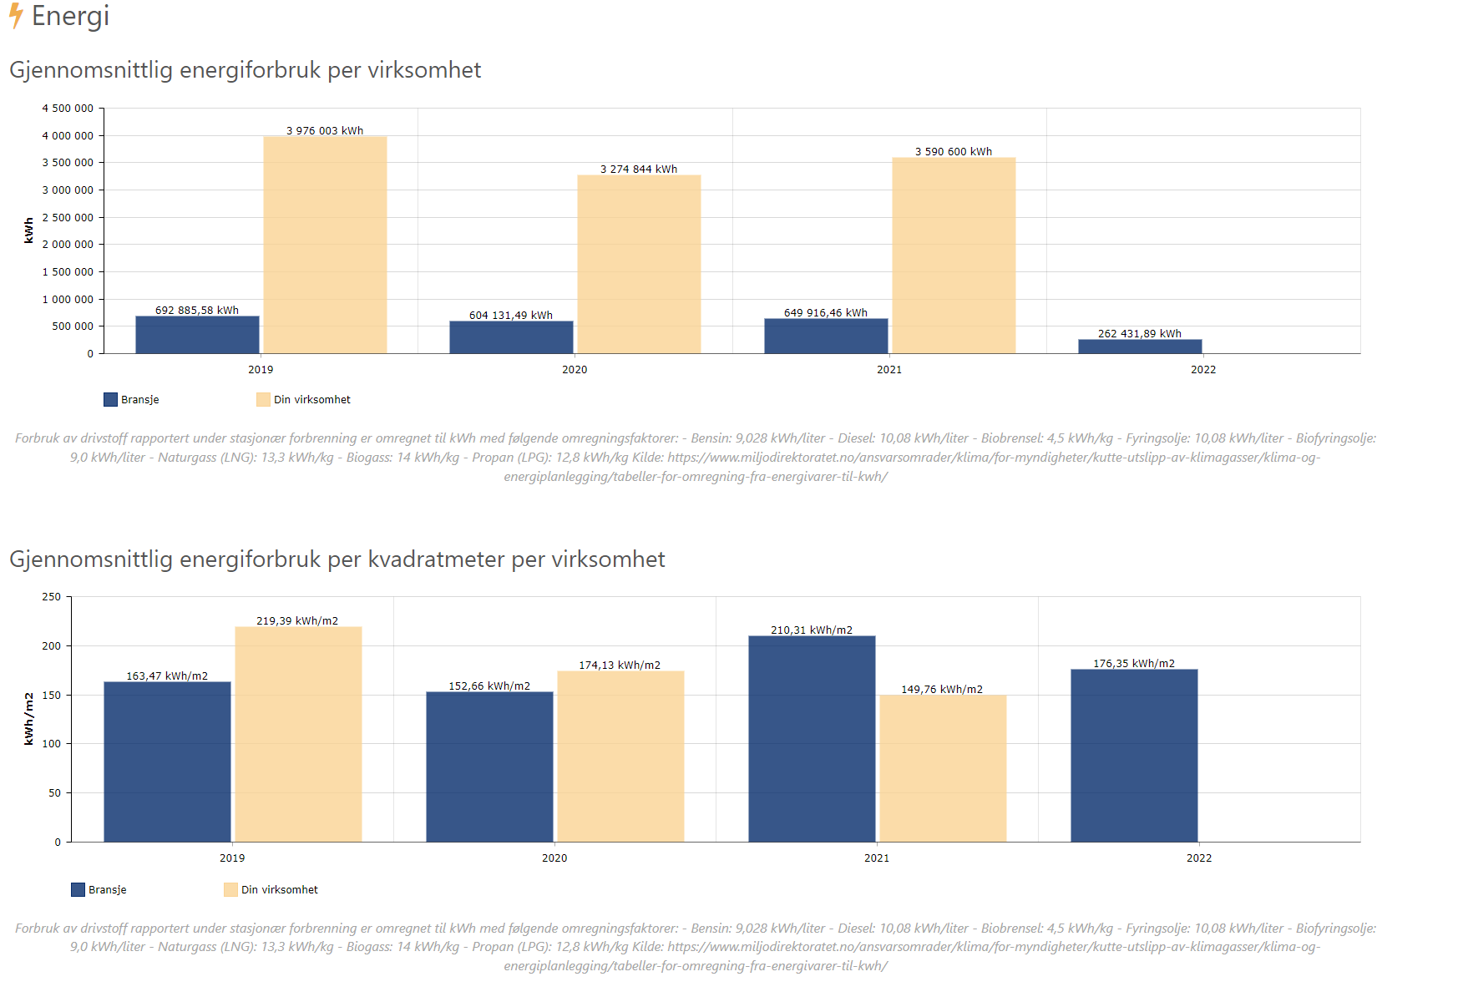
Energy use at HVL - Sogndal

Slide 27
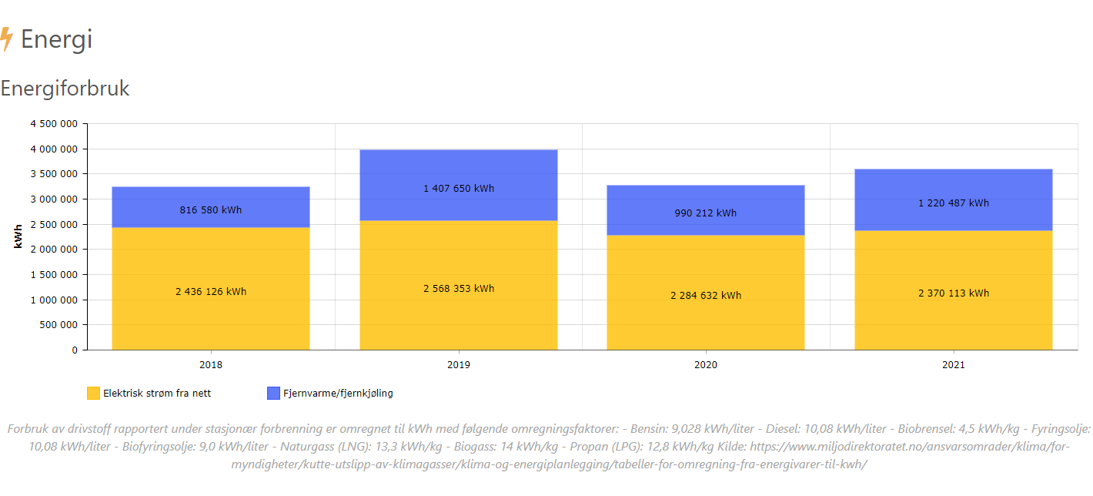
Energy use at HVL - Sogndal

Slide 28
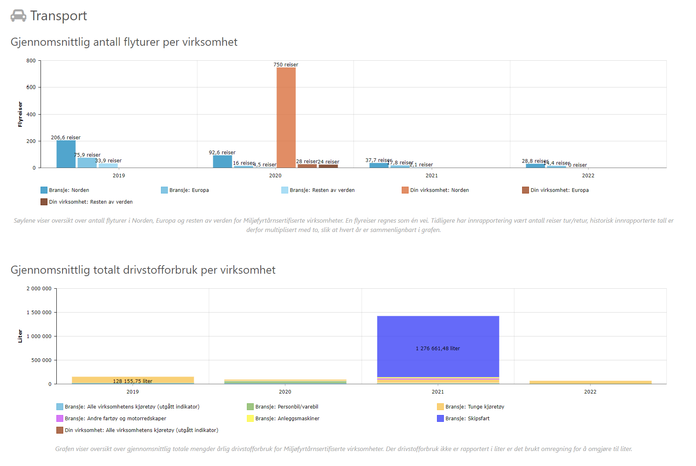
Transport at HVL - Sogndal

Slide 29
The Challenges
Housing
Food
Outdoor Sports
Campus Life
Clothing
Parties
How can students at HVL contribute to making each of these areas more circular?

Slide 30
Housing
How can students make their housing a site for the circular economy?
What materials flow into student housing and how can they be made more circular?
What are the major waste streams that come out of student housing and how can they be reduced, reused, and recycled?
Can the rapid flux of students into and out of housing be an opportunity for increased circularity?
Develop a student-led initiative (project, event, business, workshop, campaign, etc.) that addresses important shortcomings or leverages significant opportunities to make student housing more circular.

Slide 31
Food
How can students make the way they eat contribute to the circular economy?
How can students impact the practices of university cafés and cafeterias to increase their circularity?
What food waste streams from campus can be brought into circular systems in the Sogndal area?
What are the barriers currently preventing student food purchasing, consumption, and disposal done off campus from becoming more circular?
Develop a student-led initiative (project, event, business, workshop, campaign, etc.) that makes the systems that produce, distribute, prepare, or clean up after student food more circular.

Slide 32
Outdoor sports
How can students make the skiing experience in the Sogndal valley more circular for them and their peers?
How can students influence the transportation to and from skiing destinations to respect circularity principles (3R-9R)?
What outdoor equipment can be integrated into circular systems and how could students impact that?
What are the current barriers that prevent skiing in the Sogndal valley from being more circular?
Develop a student initiative/project that makes the student skiing activities in the Sogndal valley more circular and addresses current shortcomings.

Slide 33
Campus life
How can students make their everyday life on campus (other than housing) contribute to a circular economy?
How can students influence library services, study rooms and training/sports facilities to help a circular economy approach emerge?
What material flows in the on-campus life can be rethought to fit a circular economy?
What barriers are preventing student and staff behaviour from complying with a circular approach on campus?
Develop a student initiative/project that addresses shortcomings of current practices at HVL campus Sogndal to create more circularity.

Slide 34
Clothing
How can students bring their clothing habits more into alignment with the principles of the circular economy?
How can students contribute to making their acquisition, use, and disposal of clothes more circular?
What opportunities for upcycling exist in the clothes that students wear?
What practical actions can students take for sustainable clothing use and what obstacles hinder these actions?
Develop a student-led initiative (project, event, business, workshop, campaign, etc.) that addresses how students can overcome obstacles to rethink, reduce, reuse, and recycle their clothes.

Slide 35
Parties & events
How can students make the way they party/organize events contribute to the circular economy?
What are some ways to source materials (decorations, food, disposable items, etc.) for student parties/events that can be made more circular?
How can students manage the waste generated during or after parties/events and how can it be linked to circular economy principles ?
What are the main challenges of transitioning to a circular economy in student parties/events?
Develop a student-led initiative (project, event, business, workshop, campaign, etc.) that helps to make students parties and events less linear and more circular in their ecological and economic impacts.
Idea: you could choose to plan a real party to test how circular these events can be & spread the word about the circular economy.

Slide 36
Forming groups of 4 or 5
Each student writes down their 1st, 2nd, and 3rd choice for challenges individually.
We go through each challenge and get students to raise their hands and count up the number of votes on the board.
The challenge with the fewest 1st choice votes is eliminated. The people who chose the eliminated challenge as their 1st choice have priority on their 2nd choice challenge.
Any challenges with the right number of 1st choice votes forms a group
Any challenges missing 1st choice votes are filled in with 2nd choice votes (or 3rd choice votes if necessary)
Any challenges with too many 1st choice votes have people volunteer to drop down to their 2nd choice until they have the right number to form a group

Slide 37
How you will get (and give) feedback
Each group will be responsible for asking questions and giving feedback to one other group. Please come up with at least one specific piece of positive feedback, at least one specific piece of critical feedback, and at least one question.
At the end of each presentation, there will be time for questions from that other group, the teachers and judges, and anyone else who wants to ask questions.
When all the presentations are over, each group will give feedback to their assigned other group, and then the teachers and invited judges will give feedback as well.
Group number: | Gives feedback to group:
One | Two
Two | Three
Three | Four
Four | Five
Five | One
In the end, there will be two winning groups. One will be chosen by the judges, and the other by audience members. Both groups will receive gift cards to the campus cafeteria.

Slide 38
Judging
The projects will be judged qualitatively by the teaching team, as well as by Jørn Morgenstern of SIMAS, on the following criteria (adapted from UNSW Hackathon, 2020):
The Idea | Project Potential | Implementation | Presentation | Pitch Structure | Pitch Delivery
Need: Does the project identify a need and present a clear solution to the challenge? | Growth: Is the potential for the concept to grow or scale explained? | Budget: Is there a coherent budget? | Presentation: Is the overall appearance of the presentation clear and effective? | Structure: Is the team’s pitch organized, clear and concise? Is it 5 minutes or less? | Delivery: Does the team have professionalism & confidence?
Originality: How bold or fresh is the idea driving this project? | Sustainability: Does the project demonstrate the ability to sustain itself? | Timeline: Is the timeline for implementation feasible and well thought out?
 | Impact: Is the predicted impact of the project well explained? | Risks: Does the team address risks and challenges and how to overcome them?
 | Circularity: Does the idea fit the circular economy model? | Feasibility: How feasible and well thought out is the implementation?

Slide 39
Taking your project further: opportunities for experience & networking
If you are really inspired by your project or that of another group, here are two opportunities to take your project further and maybe even make it real:
Circular days
A two-day celebration of the circular economy at HVL, including presentations on projects within the university. An ambitious group could ask to become a part of this event and perhaps get some funding.
Who to talk to: Climate and Sustainability Coordinator Siri Smith
Event: March 13th & 14th, Sogndal Campus
An entrepreneurial competition held during the Mountain Sports Festival where people and groups with ideas pitch them and have the opportunity to win a 50,000NOK prize to help them get their project started. This is a good opportunity for any group with a business-type project.
Registration deadline: February 13th (register this weekend!)
Event: February 23, Sogndal Campus

Slide 40
Happy hacking!

