Slide 1
Hackathon Pitch Presentation Template
The goal of this template is to give you an idea of the sorts of things you should prepare for your presentation and how to make them. Not everything in here will be used by every project, and most projects won’t use everything. Use as much (or as little) of this template as is useful to your team. And be sure to change the design, add images, use colors, etc. A plain black-and-white presentation isn’t the most exciting.
Remember: 5 minutes maximum for this presentation

Slide 2
Attention
This probably shouldn’t actually be a slide, but remember to include something brief at the very beginning of your presentation to get the audience’s attention. The easiest thing would be a one-sentence general mission statement for your project, a powerful statistic, or a probing question like...
For a long time, campus waste has been made invisible to students…not anymore.
~
For everyone to live like the average Norwegian, we would need more than three and a half earths worth of land and resources. That has to change.
~
Who here wants to save the world?
Other ideas could be a bit of music, a joke, or a short personal story illustrating the topic.

Slide 3
Need: what’s the big problem?
Here is where you need to tell the audience about the problem you are trying to solve and why it is important. Take your challenge topic (food, clothing, campus life, etc.) and think about why the current way this thing is managed on campus or in Sogndal valley is a problem. Find some statistics that show how big a problem it is and show them here. Describe the bad impacts or the present situation. Make your audience afraid that if we don’t solve this problem then bad things will happen.
Just as important: describe the need or problem in a way that makes it clear how your project will contribute to a solution. Don’t make the problem sound so big or complex that it seems impossible.
The key here is that your audience needs to care about the problem that you are trying to solve before they will care about the solution you are offering, so make them care.

Slide 4
Solution: Introduce your project
Tell us the name of your project.
Maybe show us a logo (online free logo generator here)?
Give a summary of your project so that people know what you are talking about afterward. Make sure to connect your project explicitly to the problem.
Tell us briefly what your main activity or activities are, where you are going to get the resources to make it happen, who your important partners for this project will be, and any other details that show how you are going to solve the problem.

Slide 5
Solution: How will you promote your project?
Project promotion
For any of these projects, it is important to promote your solution. But how?
Who is your target population? Who is going to buy your product, join your campaign, or attend your event?
How many people are in your target populations? How many people to do you estimate will participate?
How will you reach those people? What channels of communication do they use? How will you gain access to those channels?
Market/partner/user research
Can you do some research about your target population? Maybe a few short interviews or a basic online questionnaire? Present the results of that research. This helps to show that your solution is something that people will want to buy or join and will actually solve the problem.
Also, have you identified any key partners like organizations or departments in an institution and have you asked them what they think of the project?

Slide 6
Visualization: Show what the world is like if your project is real
Websites, Facebook events/pages, posters, etc.: one of the best ways to make your project really concrete is to create the kind of presentation page that imagines it already exists. This lets the audience really see what it would be like if your project existed, and helps you to think in more detail about what you’re trying to communicate. If you have someone in your group who is good with illustration or graphic design, this can be a great way for them to contribute.
Depending on the project, one good way to do this is with process graphics that show how your solution actually works in a step-by-step way.
Here is a free website creator (you’ll need to sign up for an account)
Here is a free online graphic design space (you’ll need to sign up for an account here too)

Slide 7
Visualization: Show what the world is like if your project is real
Impact: this one is important. It ties back to the problem that you presented earlier. Describe how your project will impact the problem. This has two dimensions: quantitative and qualitative.
Even though you will only be using estimates, giving the audience a few numbers, such as the amount of waste that is prevented from going to the landfill or the number of people impacted by a campaign, can really help them understand why your solution is a good one. Use some of the same logic as in the Lifecycle assessment and other impact assessment tools you have learned about. Remember, it’s not important to be exactly right, just try to be realistic in your impact estimates.
Qualitatively, you want to tell the story of how the world will be different once your solution is put in place. Don’t be afraid to use evokative language or images to show. Don’t exaggerate the importance, but do help people to imagine how the world (or at least the school and community) will be improved by your project.

Slide 8
Action: Tell us what to do!
Finally, make a specific request for action of your audience. This could mean just asking the judges to select your project, but it’s better if you address the whole audience. So, what would you ask them to do if you were actually trying to make your project real?
Come to our event?
Tell your friends about our campaign?
Sign up for our website platform?
Share this information with friends and family?
Be clear and specific!

Slide 9
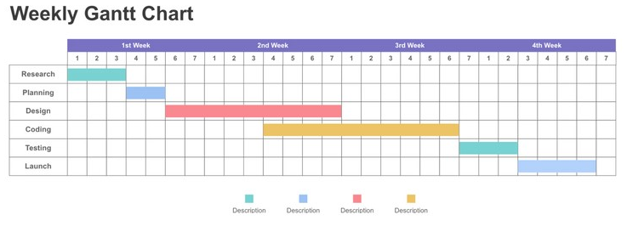
Optional: Timeline/Calendar
Timeline/calendar: you can show us, graphically, what the process of planning, executing, and following up on your project will look like. You can do this as a simple timeline graphic, or something more detailed
Gantt charts are a good tool for the more detailed plans (online Gantt chart generator, but you can also use a spreadsheet software easily)

Slide 10
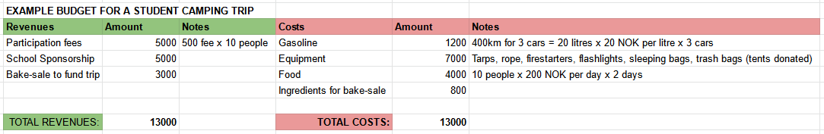
Optional: Budget
Rough budget: to demonstrate the viability of your project and the work you put into thinking about it, create a very basic budget either for the whole project (if it is a one-time campaign or event) or for a single year of operations (if it is a longer term business or organization).
The easiest way to do this is with any spreadsheet software. Here are some basic steps:
Make a costs column and a revenues column.
Figure out your costs and amounts through online research and discussion.
Figure out your possible revenue sources and their amounts. You should not count free gifts that reduce your costs as a source of revenue in a basic cash-only budget like this. Do note the expected donations though.
Re-adjust your costs (usually reducing them) based on a realistic guess of your possible revenues.
Final readjustements after more discussion.

