Slide 1
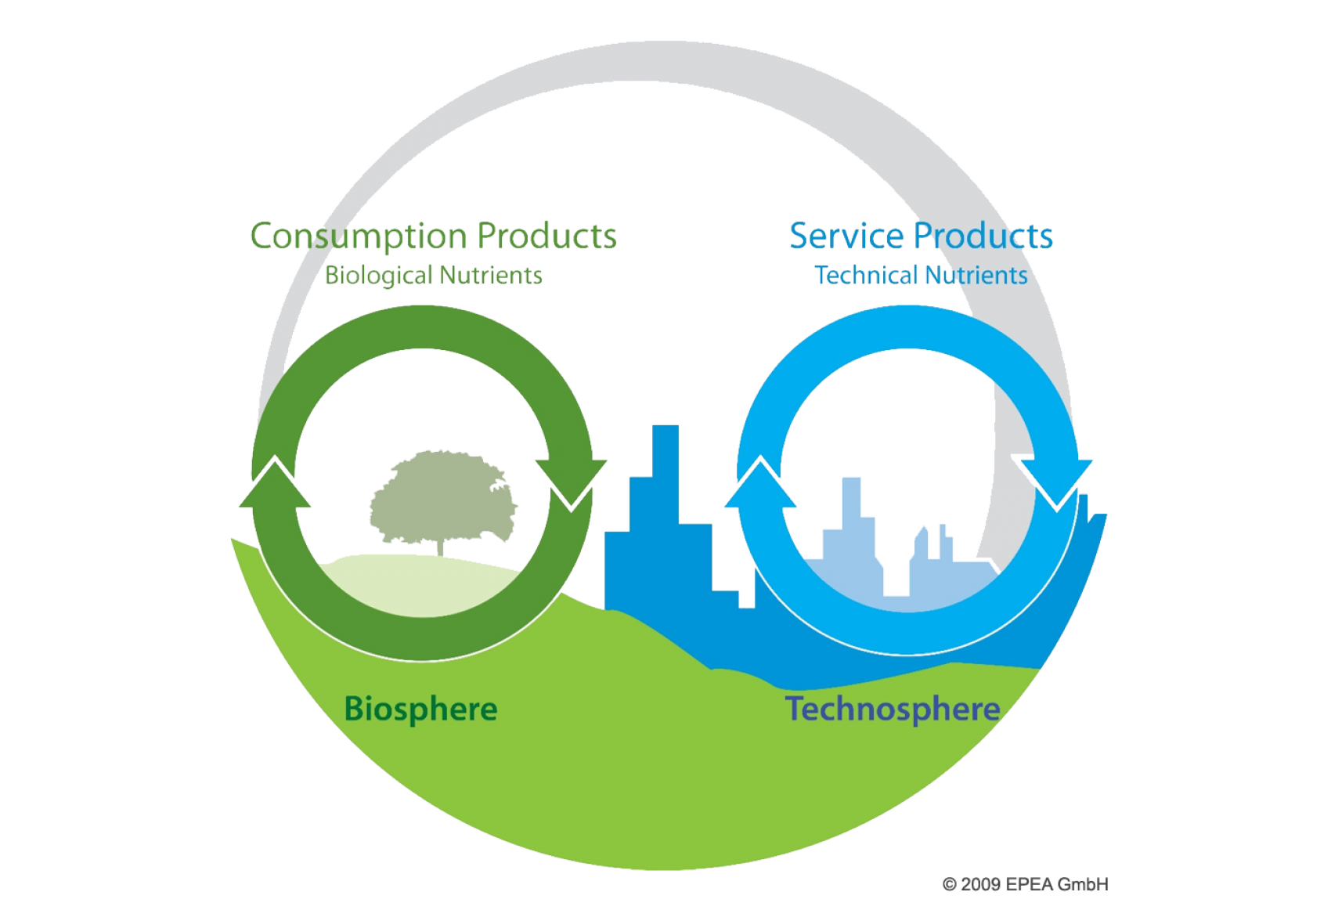
Circular economy frameworks and citizen energy examples therein
Constantin v. Beck
February 2023
Notes:
https://www.google.com/url?sa=i&url=https%3A%2F%2Farchive.ellenmacarthurfoundation.org%2Fexplore%2Fthe-circular-economy-in-detail&psig=AOvVaw298C21gs_fRQonNM5jBUe4&ust=1671721774710000&source=images&cd=vfe&ved=0CBEQjhxqFwoTCMDwwIb_ivwCFQAAAAAdAAAAABAI

Slide 2
Outline
A definition of circular economy
EU waste hierarchy
3R, 4R and 6R frameworks
Examples of 9R's in community energy
Notes:
CE definitions (highlight variety of them out there)

Slide 3
Definition of circular economy
“A circular economy describes an economic system that is based on business models which replace the ‘end-of-life’ concept with reducing, alternatively reusing, recycling and recovering materials in production/distribution and consumption processes, thus operating at the micro level (products, companies, consumers), meso level (eco-industrial parks) and macro level (city, region, nation and beyond), with the aim to accomplish sustainable development, which implies creating environmental quality, economic prosperity and social equity, to the benefit of current and future generations.”

Slide 4
EU waste hierarchy
PREVENTION
NON-WASTE
PREPARATION FOR RE-USE
RECYCLING
RECOVER
WASTE
DISPOSAL

Slide 5
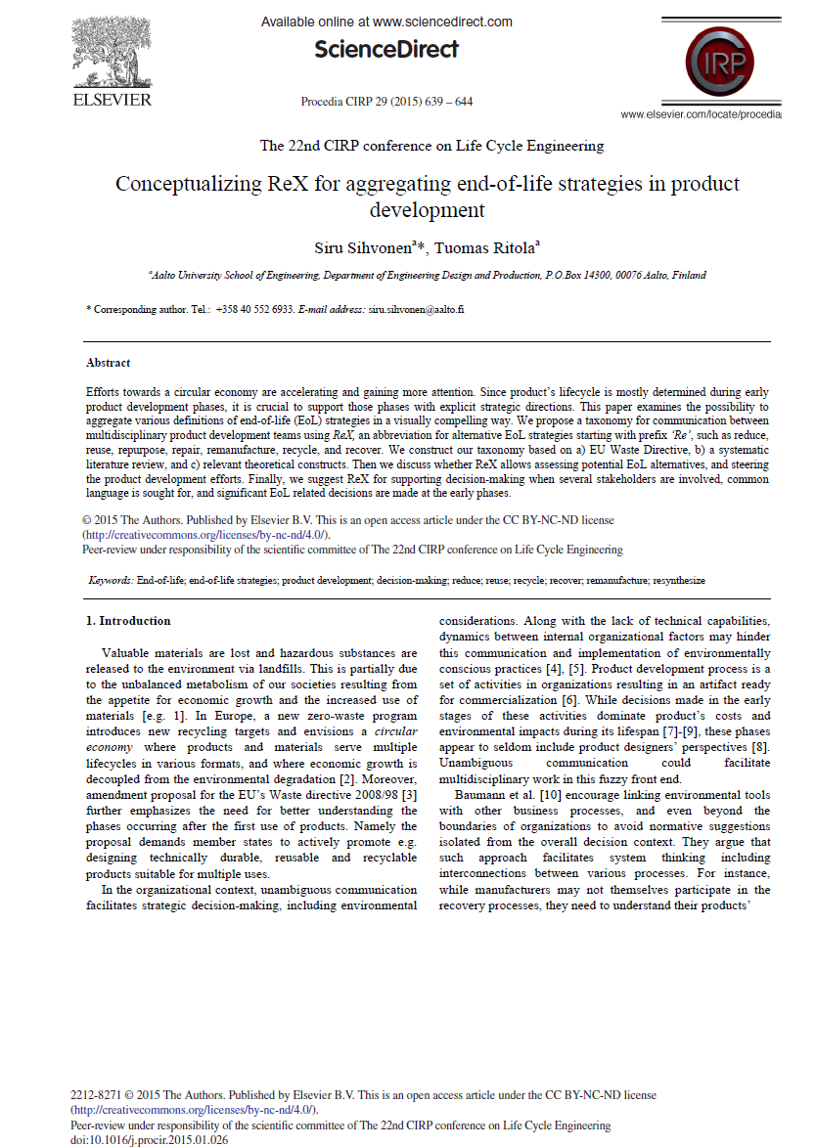
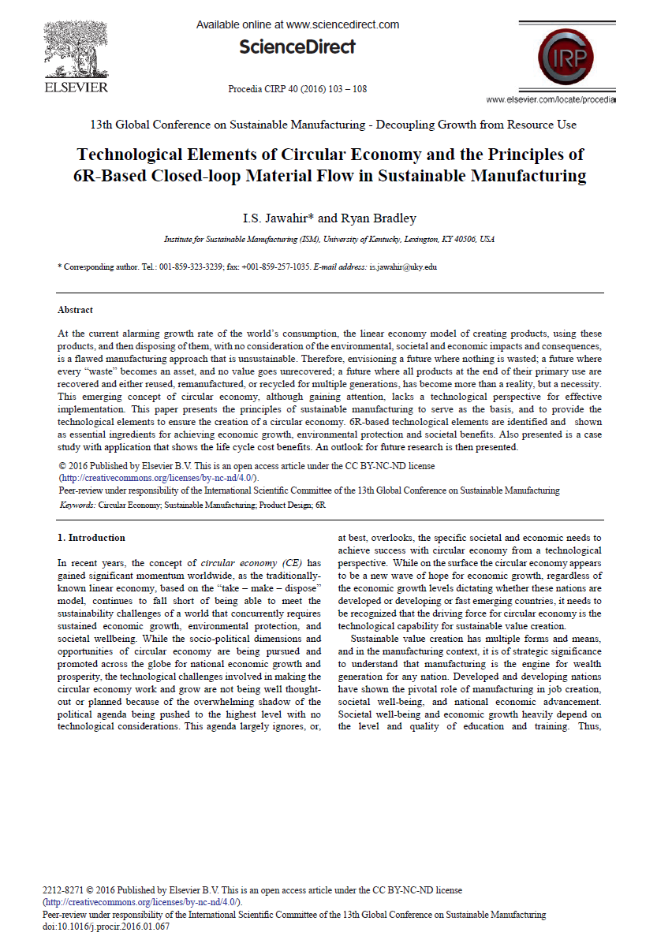
3R, 4R, 6R Framework
3R for circular economy
Reduce
Reuse
Recycle
4R for circular economy
Reduce
Reuse
Recycle
Recover
6R for circular economy
Reduce
Remanufacture
Reuse
Recover
Recycle
Redesign

Slide 6
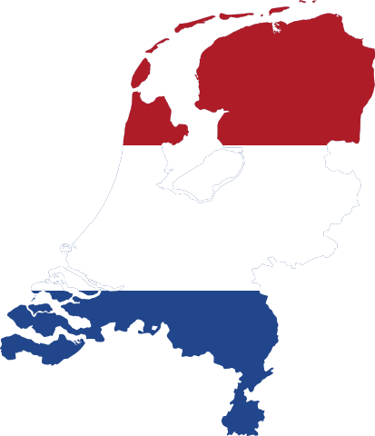
9R Framework

Slide 7
R0: Refuse

Slide 8
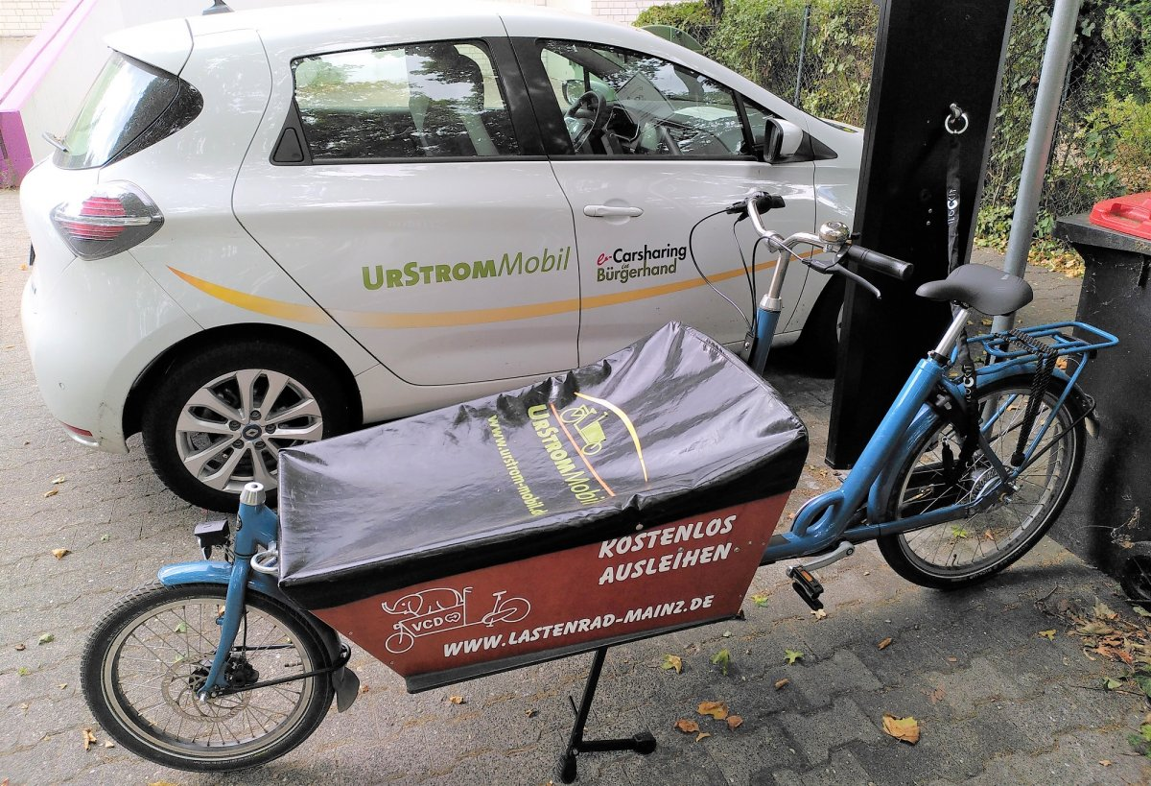
R1: Rethink

Slide 9
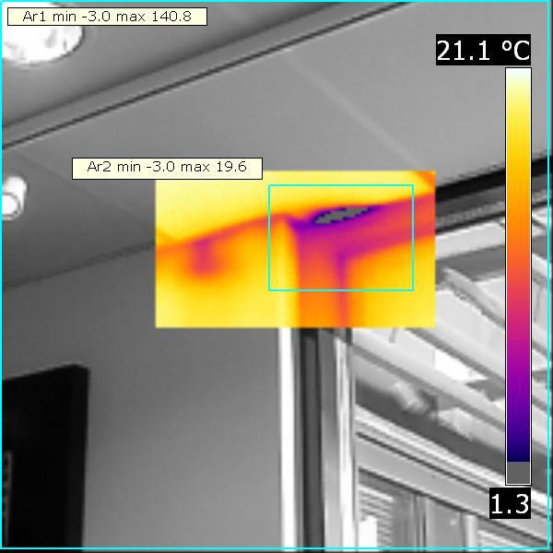
R2: Reduce

Slide 10
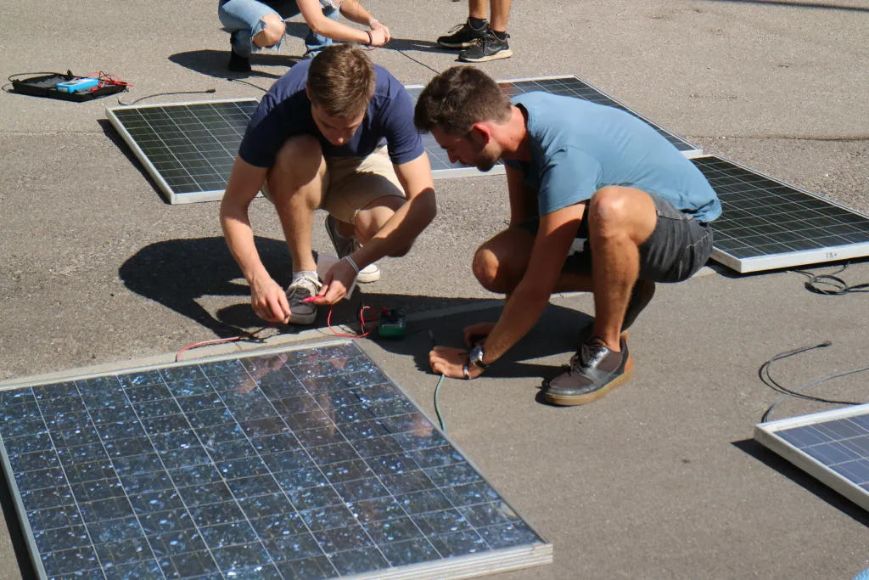
R3: Reuse

Slide 11
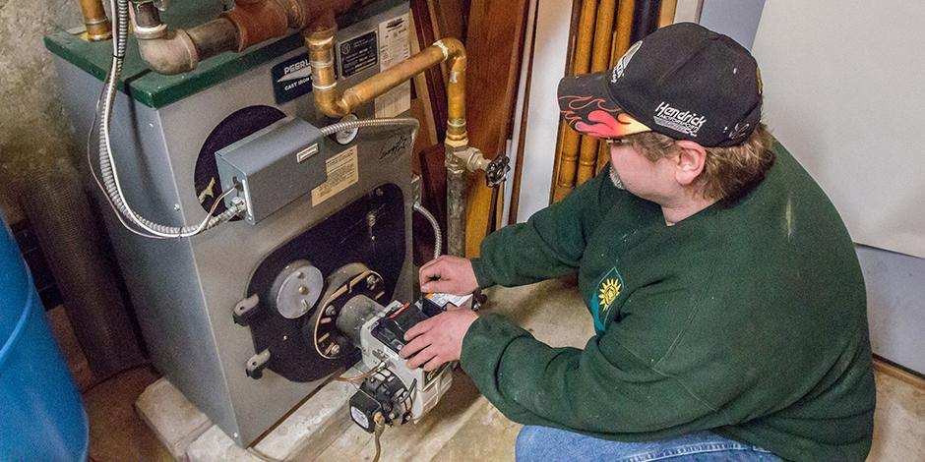
R4: Repair

Slide 12
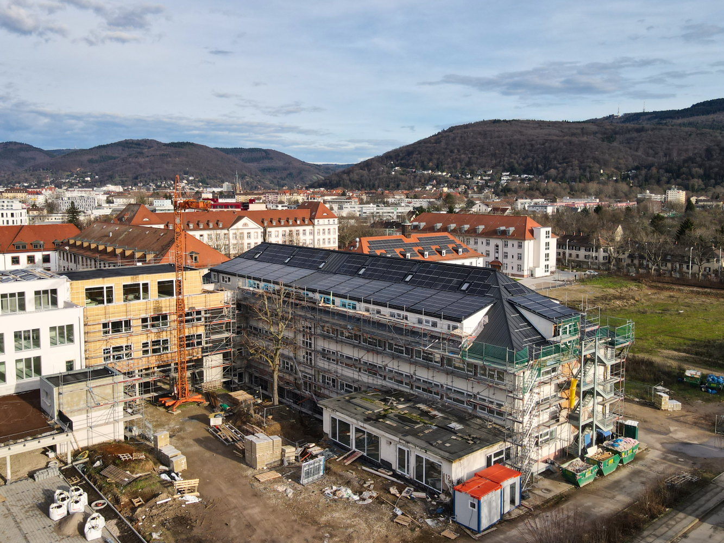
R5: Refurbish

Slide 13
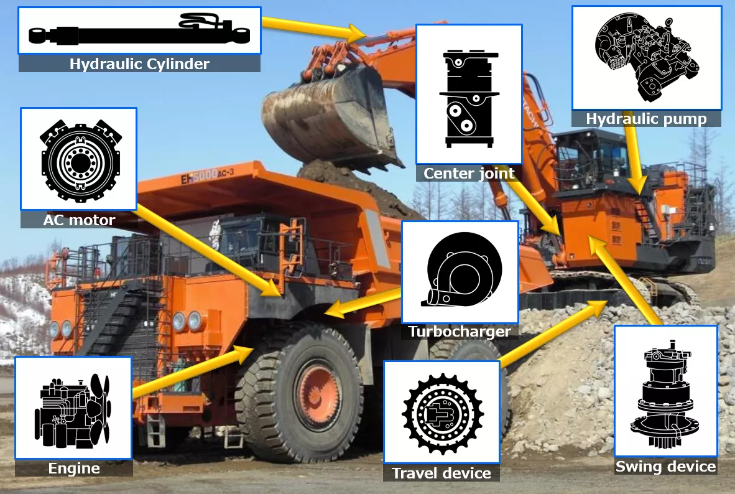
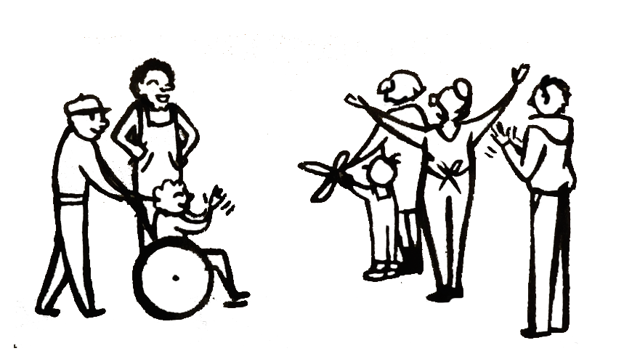
R6: Remanufacture
?
Notes:
other examples: https://meet.techsoup.org/what-we-offer/ ; https://circularcomputing.com/about/ ; https://www.komatsu.eu/en/genuine-parts/remanufactured-components
https://www.nibusinessinfo.co.uk/content/what-products-can-be-remanufactured

Slide 14
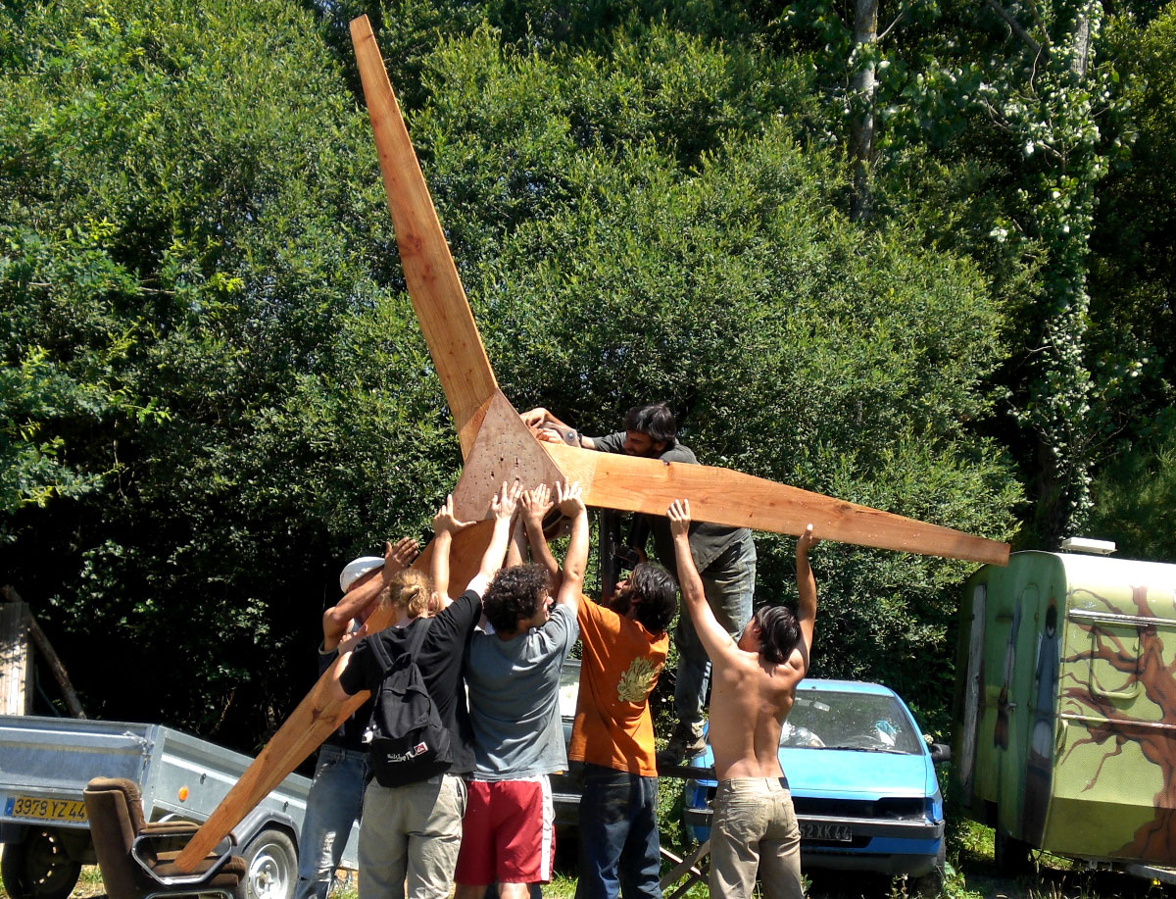
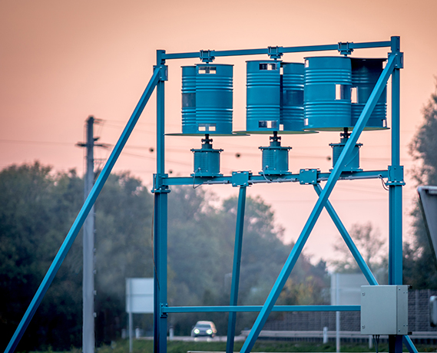
R7: Repurpose
Notes:
KWG - Kraftwerk Glatzing-Rüstorf eGen
https://www.kwg.at/strom-aus-wasserkraft/
Repurposing of car alternators in self build windmills: https://www.tripalium.org/reseau

Slide 15
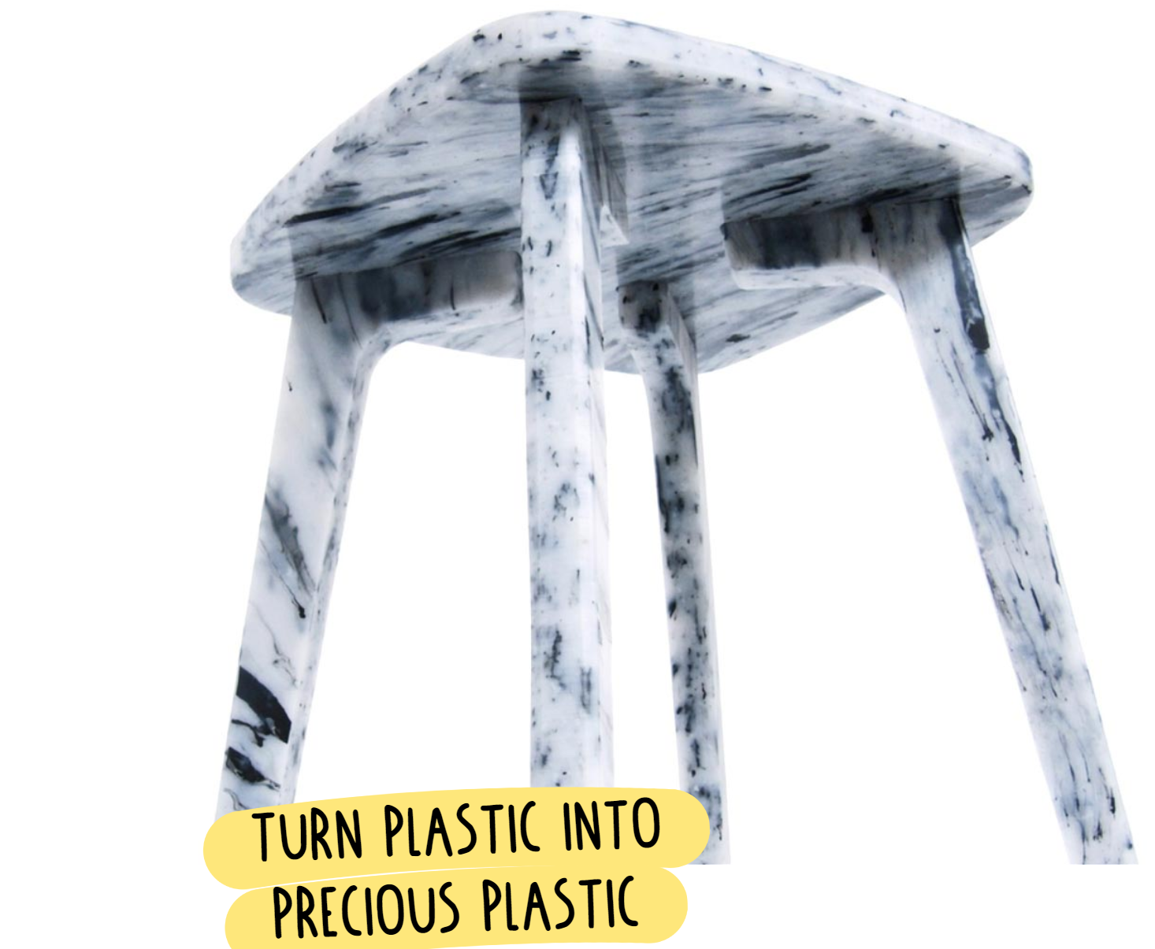
R8: Recycle

Slide 16
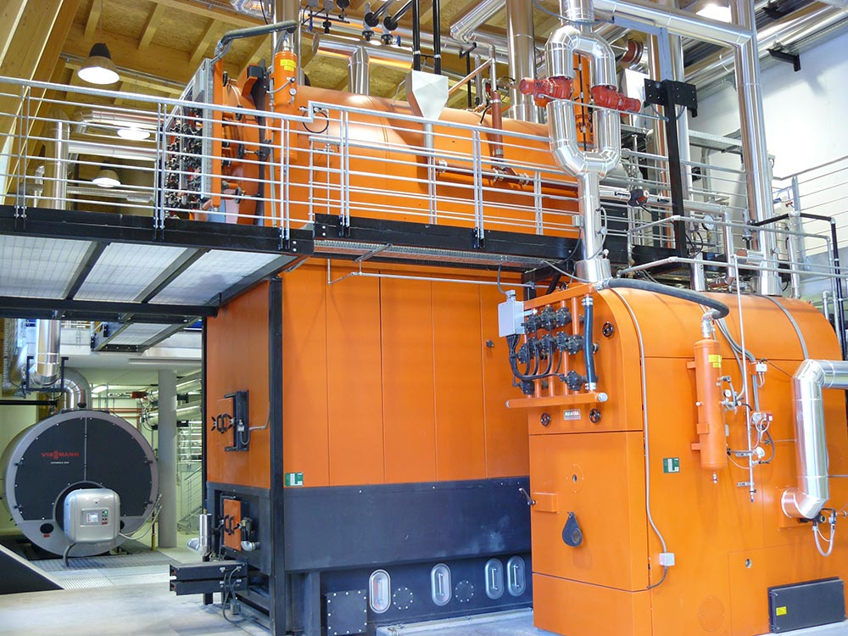
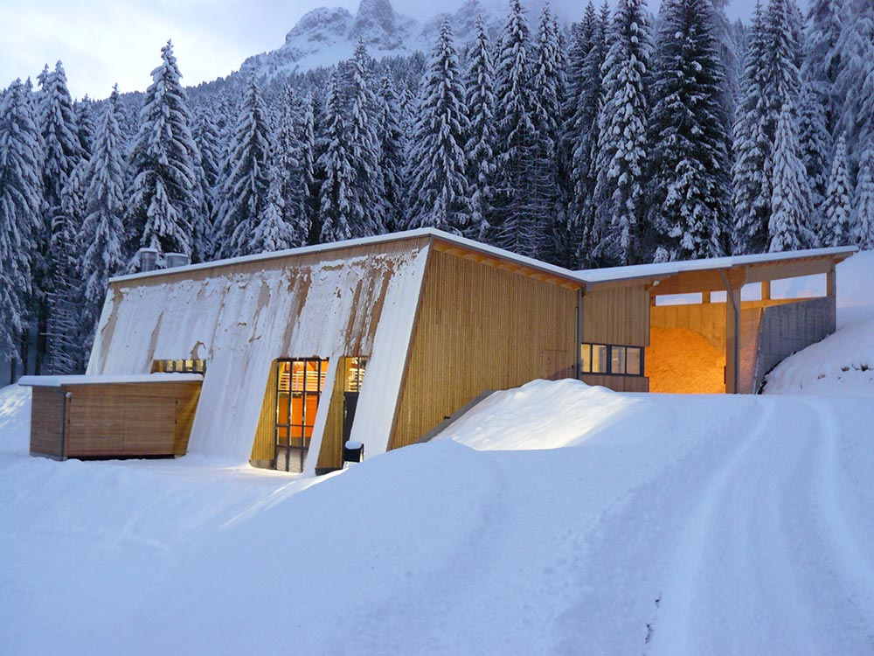
R9: Recover
Notes:
cooperative district heating network in Obereggen, Italy
runs 100% on locally produced wood waste/chips
http://www.energie-obereggen.it/#info

Slide 17
Literature & further readings
Kirchherr, Julian, Denise Reike, and Marko Hekkert. 2017. "Conceptualizing the circular economy: An analysis of 114 definitions." Resources, Conservation and Recycling 127: 221-232. https://doi.org/10.1016/j.resconrec.2017.09.005.
https://ec.europa.eu/environment/green-growth/waste-prevention-and-management/index_en.htm
Sihvonen, Siru, and Tuomas Ritola. 2015. "Conceptualizing ReX for aggregating end-of-life strategies in product development." Procedia Cirp 29: 639-644. https://doi.org/10.1016/j.procir.2015.01.026.
Jawahir, Ibrahim S., and Ryan Bradley. 2016."Technological elements of circular economy and the principles of 6R-based closed-loop material flow in sustainable manufacturing." Procedia Cirp 40: 103-108. https://doi.org/10.1016/j.procir.2016.01.067.

Slide 18
Literature & further readings ctd.
https://circulareconomy.europa.eu/platform/sites/default/files/categorisation_system_for_the_ce.pdf
https://www.researchgate.net/publication/319314335_Circular_Economy_Measuring_innovation_in_the_product_chain
https://commons.wikimedia.org/wiki/File:Flag-map_of_the_Netherlands.svg
https://upload.wikimedia.org/wikipedia/commons/5/5c/Flag-map_of_the_People%27s_Republic_of_China.svg
https://commons.wikimedia.org/wiki/File:Flag_map_of_the_European_Union.png
https://doi.org/10.1016/j.procir.2015.01.026
https://doi.org/10.1016/j.procir.2016.01.067

