Slide 1
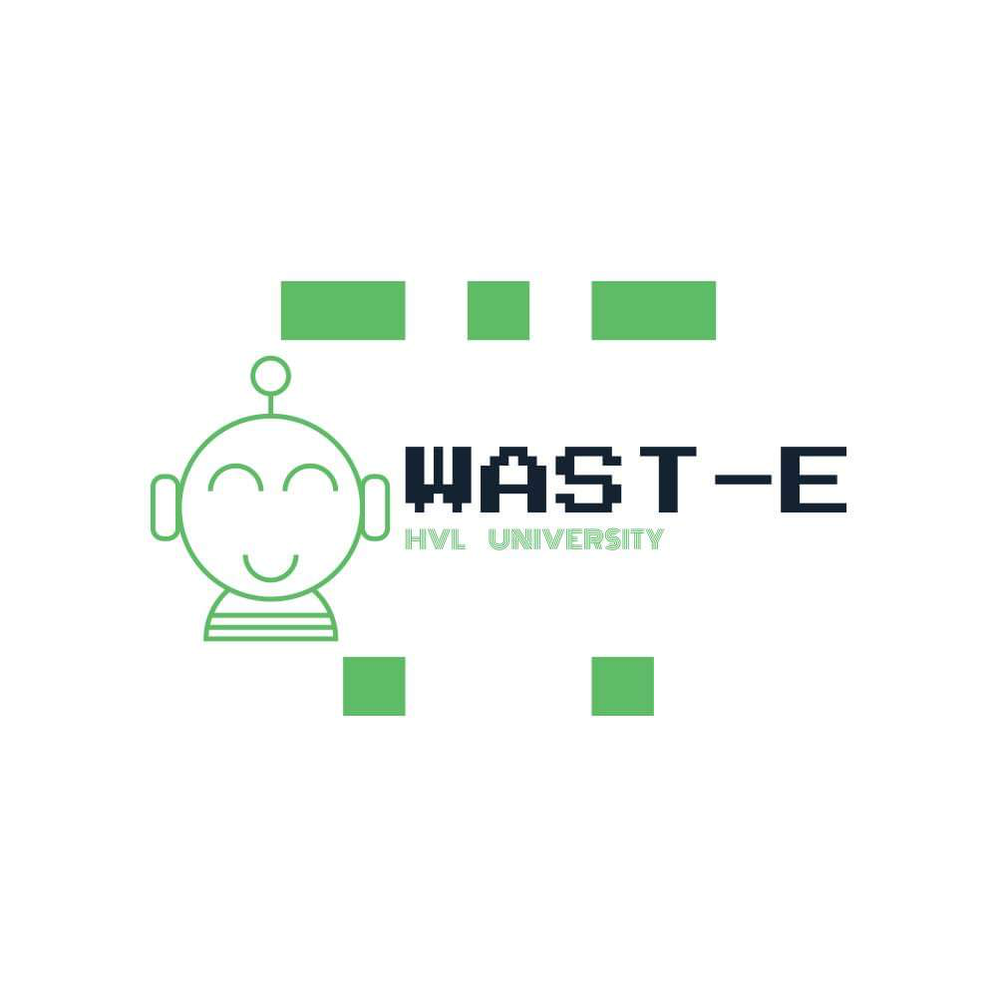

Slide 2
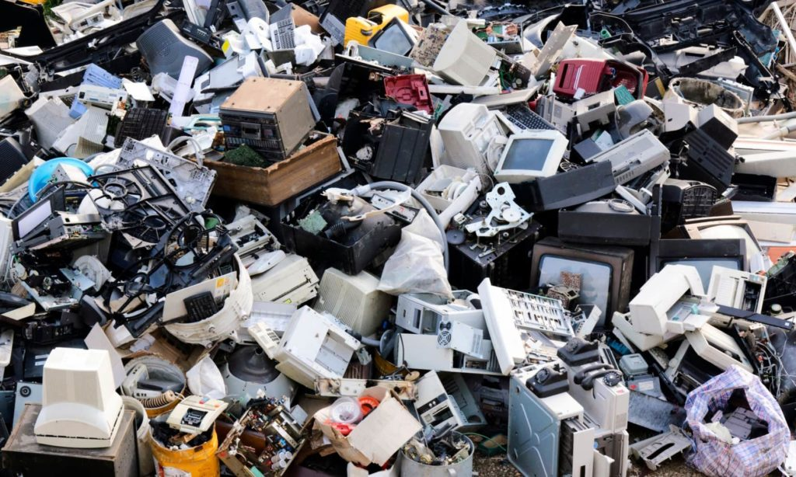
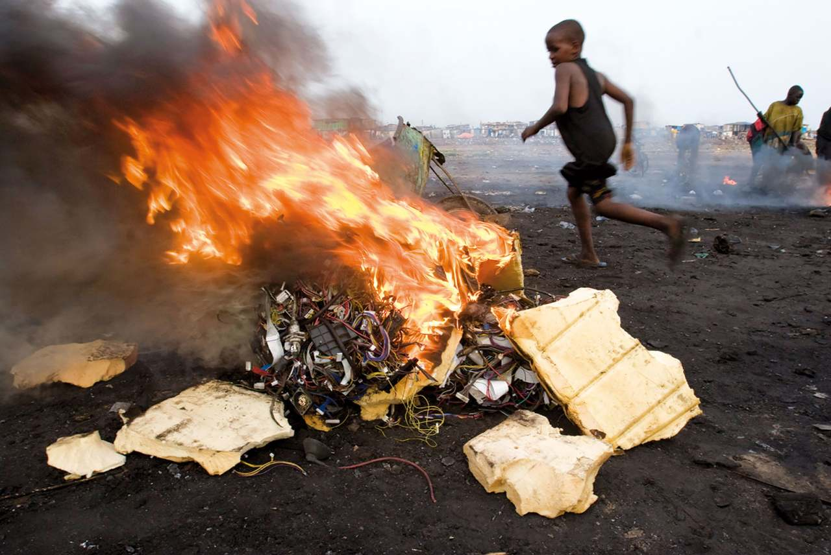
27 kg
E-WASTE per person in NORWAY per year
TOXIC MATERIALS (lead, mercury)
—> cancer, neurological damage, respiratory problems

Slide 3
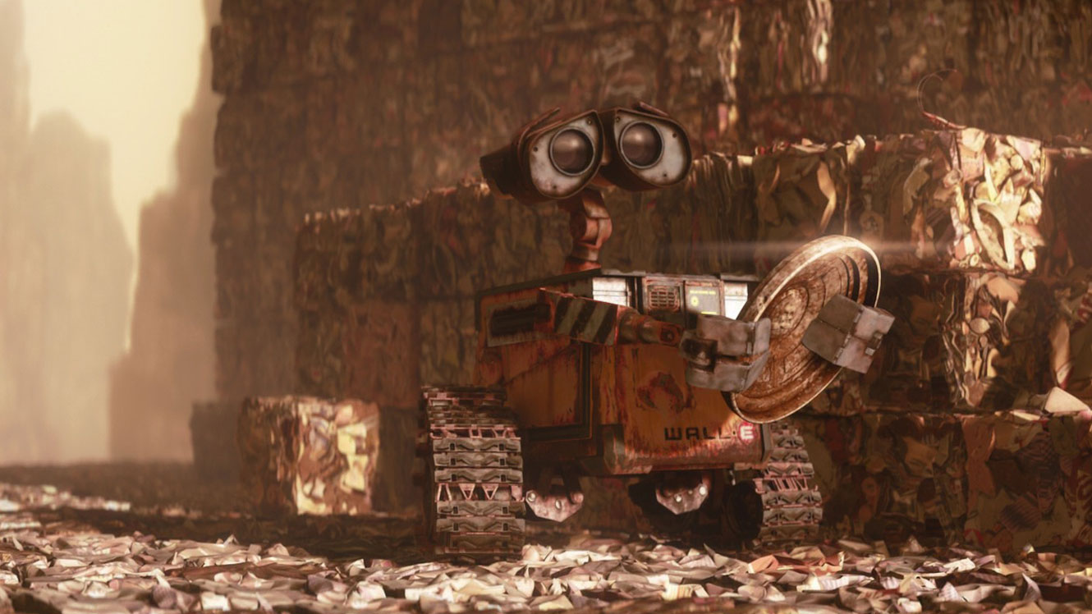
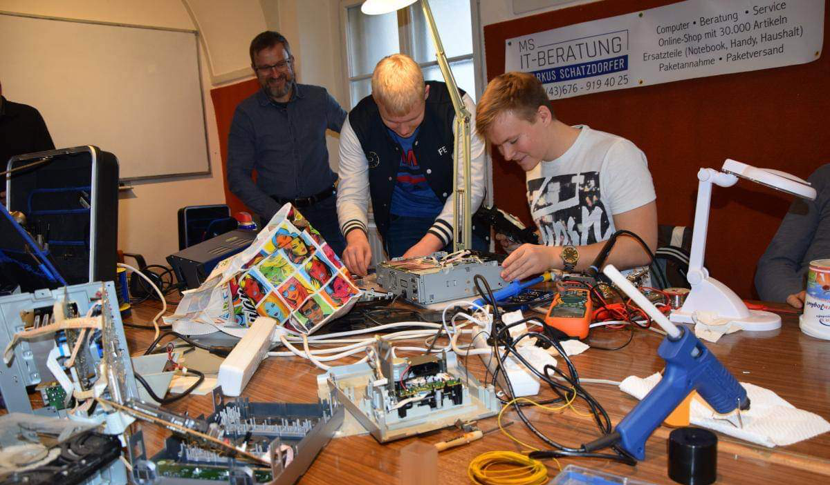
WAST-E
BRING YOUR BROKEN OR OLD ELECTRONIC DEVICES TO CAMPUS
-computers, tablets, phones-
WAST-E: a REPAIRING AND COLLECTION SERVICE will fix it or repurpose its parts.

Slide 4
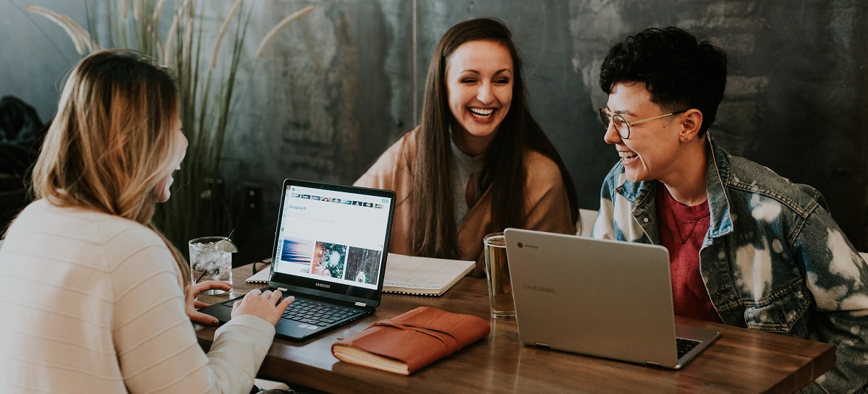
Why at campus
E-waste is growing 3 times faster than any other waste stream
Average student/staff tech items (pc, phone, tablet) e-waste in a year: 4 kg
LIFESPANS
. Laptop: 5-8 years
. Phone: 2.5 years
. Tablet: 5 years

Slide 5
HOW
. In collaboration with the IT department and the Læringslab at HVL
. New position as an IT-technician
. Getting broken electronic devices from students and staff and reusing parts for other devices —> giving credit and data in exchange

Slide 6
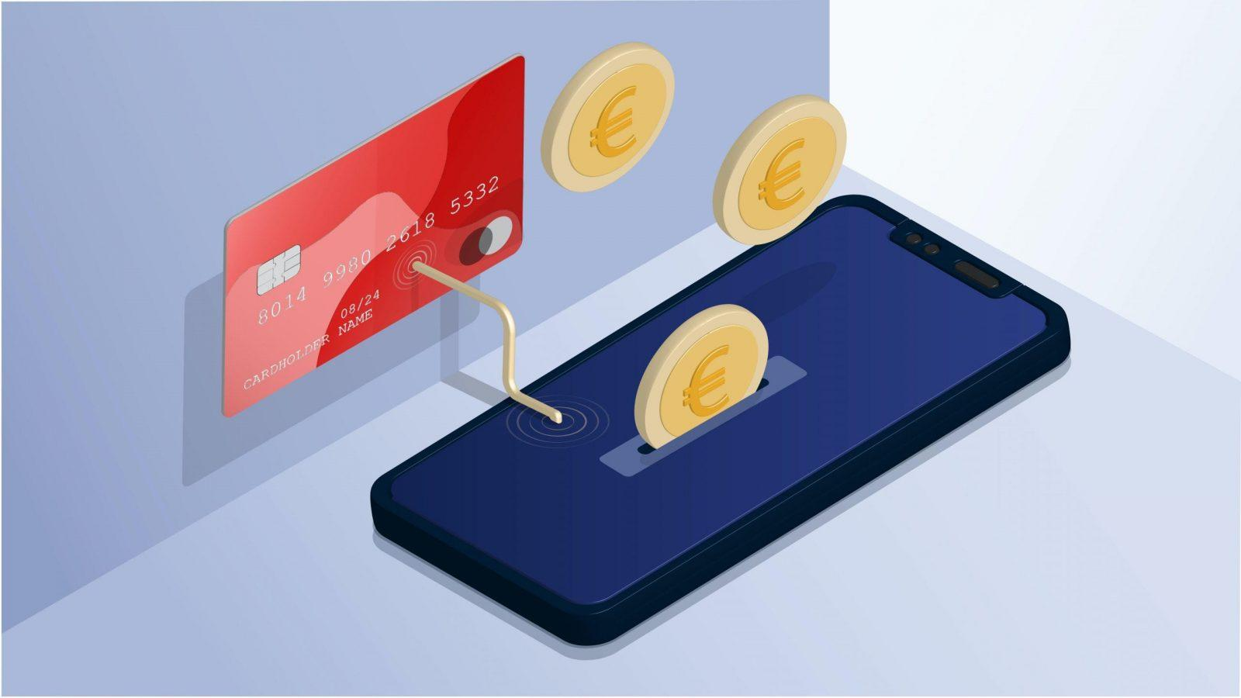
FUNDING
. Repaired items will have a cost for students and staff
. Selling parts of items that cannot be fixed will generate an income
. HVL —> part of the sustainable innovation shift and circularisation of the institution

Slide 7
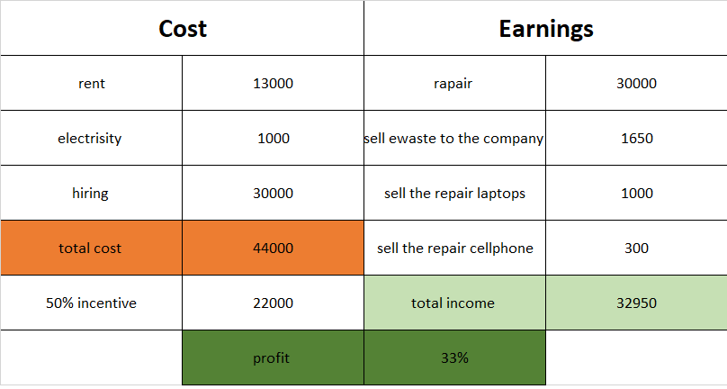

Slide 8
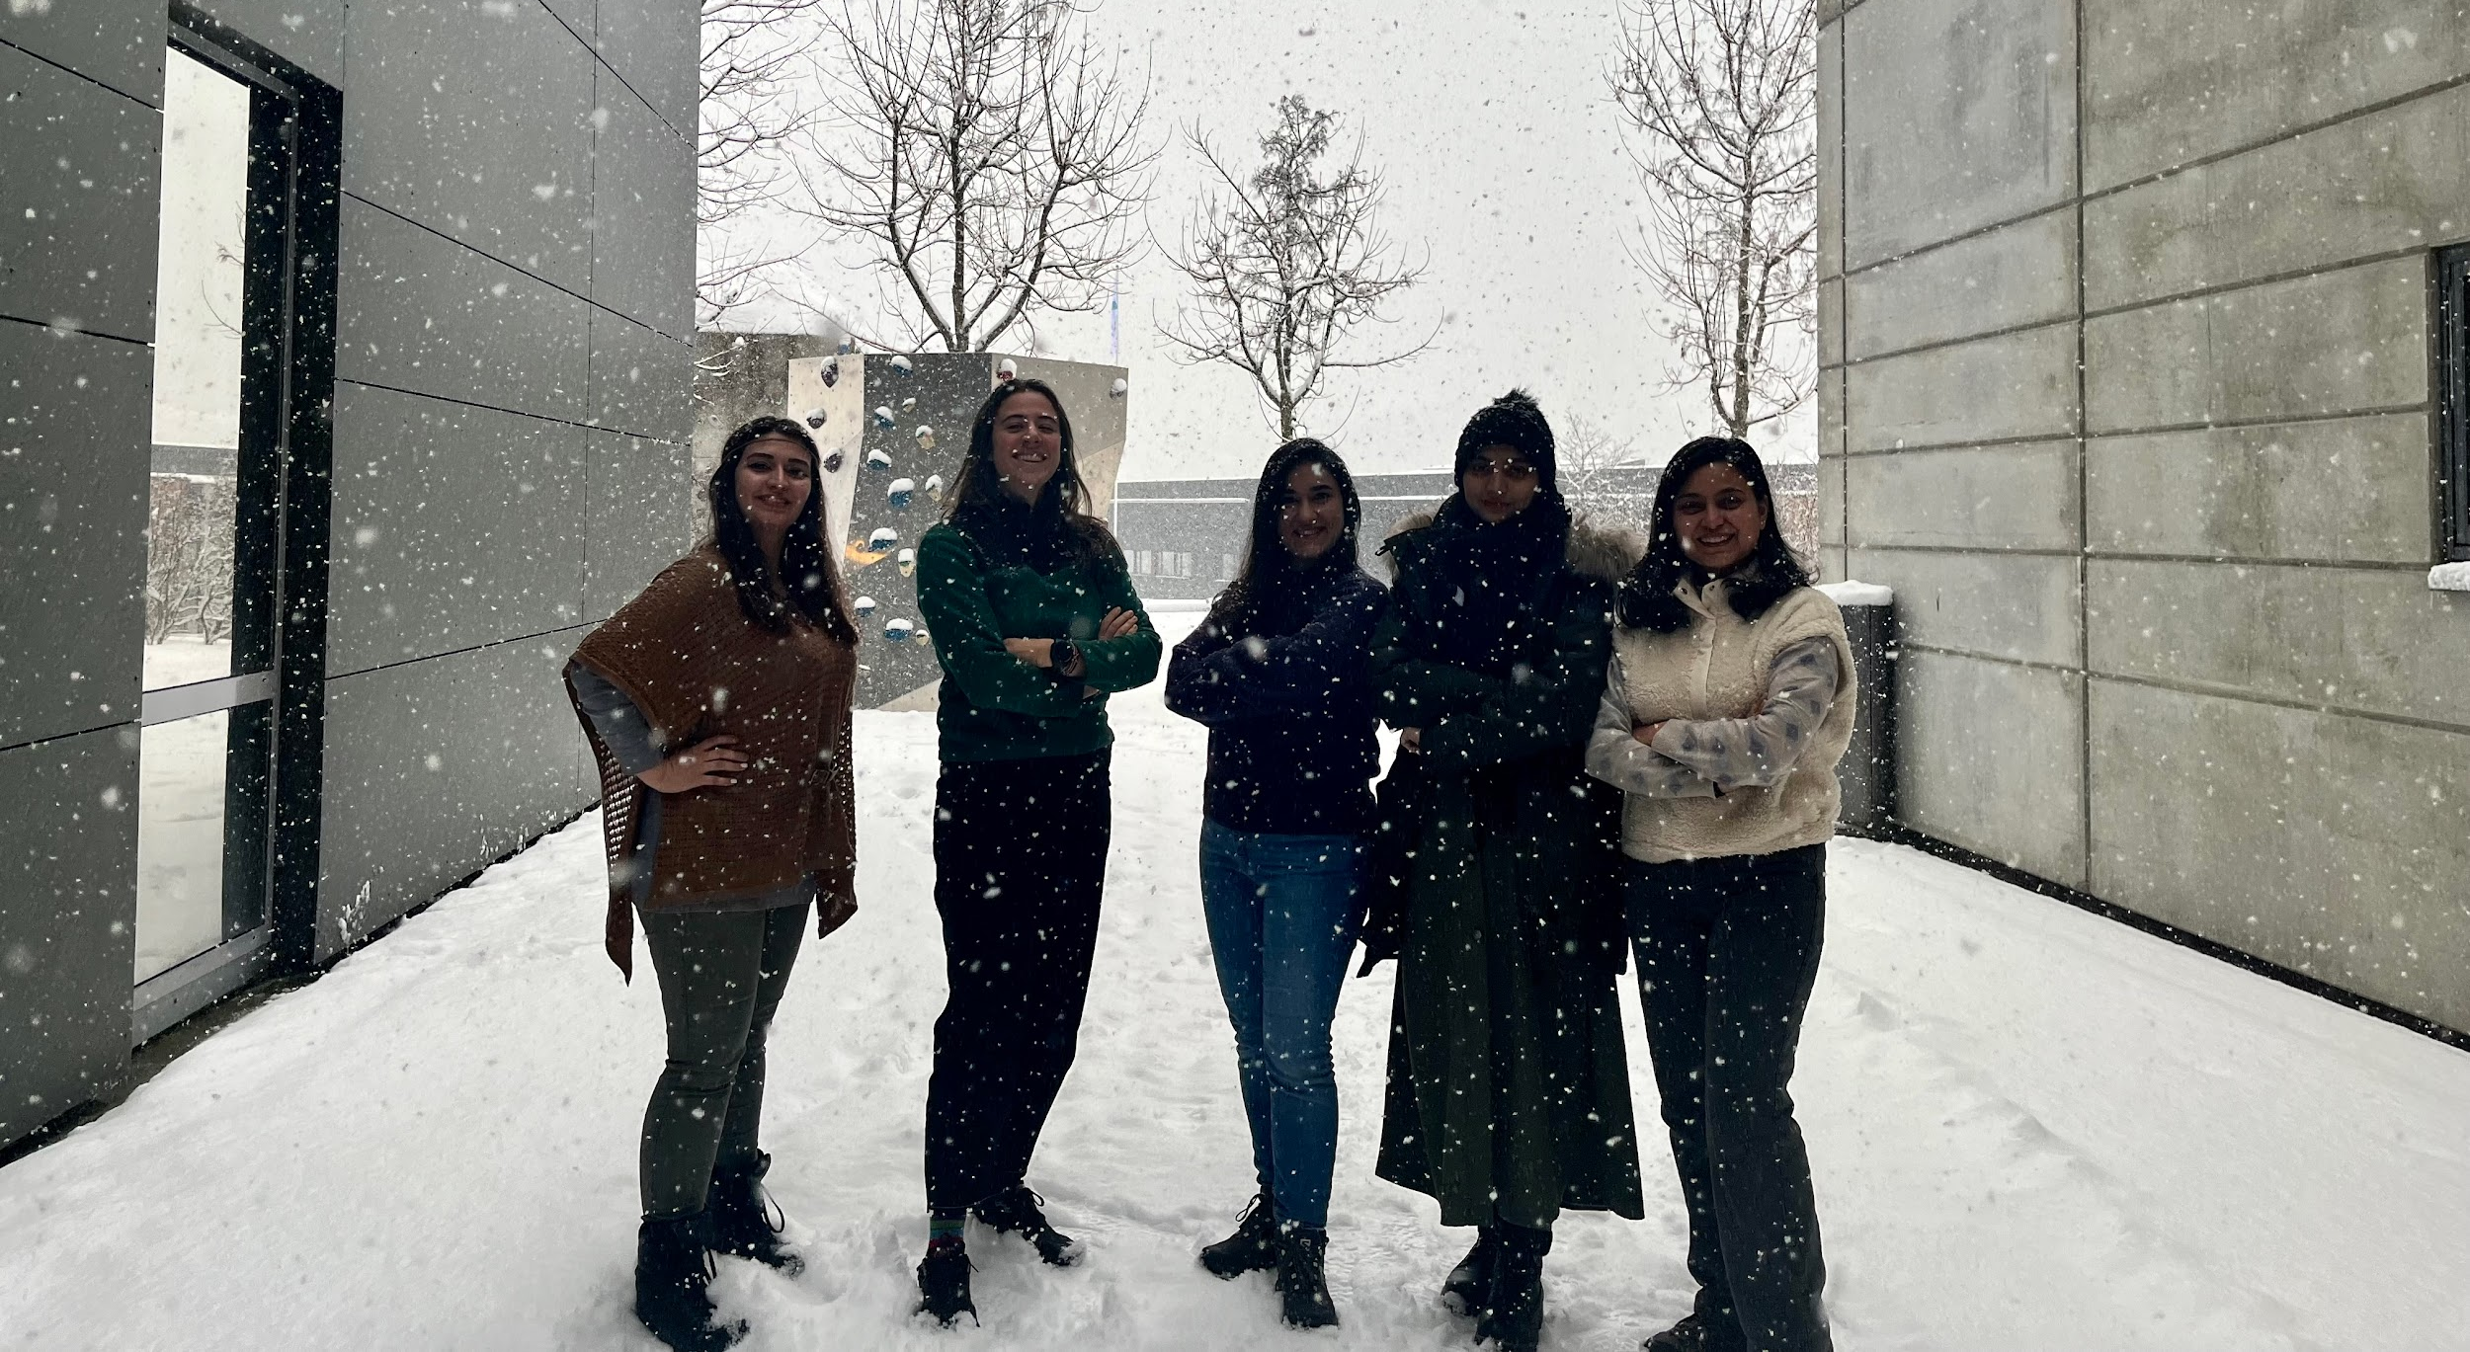
MEET THE E-VENGERS
DONYA ELENA SHAHRZAD KIRAN DIKSHYA

Slide 9
GOOD FOR YOU
GOOD FOR THE ENVIRONMENT
CHEAP
CONVENIENT
ACCESSIBLE
GREEN
AVOID TOXIC POLLUTION
KEEP IT CIRCULAR
SAVE LANDFILL WORKERS
CLEANER AIR AND SOILS

Slide 10
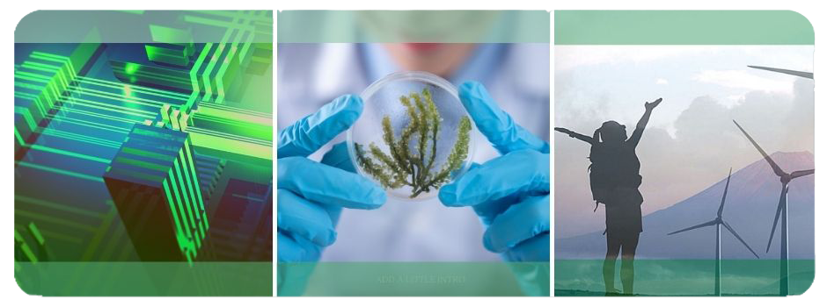
BE PART OF THE CIRCULAR REVOLUTION
HVL —> leader of the circular economy shift
—> Where nothing goes to waste

Slide 11
THANK YOU

