Slide 1
Fix It Yourself
Animali Teresa
Begum Forida
Giglio Giulia
Khoshnoodikhah Hadi
Waqas Muhammad
Notes:
Good afternoon, today we are going to offer you the solution to a problem that certainly all of us have experienced in our lives. We are Fix It Yourself.

Slide 2
Look at me! I am broken!!!
Oh no! How am I supposed to fix you?
Meet Alex
21 years old
student in Sogndal
problem: cannot use his broken lamp anymore
Notes:
This is Alex, he is a 21 years old student living alone for the first time in Sogndal. He is currently lives in the dark the whole day in his room ‘cause his lamp is broken! You all know that light is fundamental/necessary/vital!! He is environmentally conscious but like all of us wants to save his money. He doesn’t want to replace and neither can find a help to fix it.

Slide 3
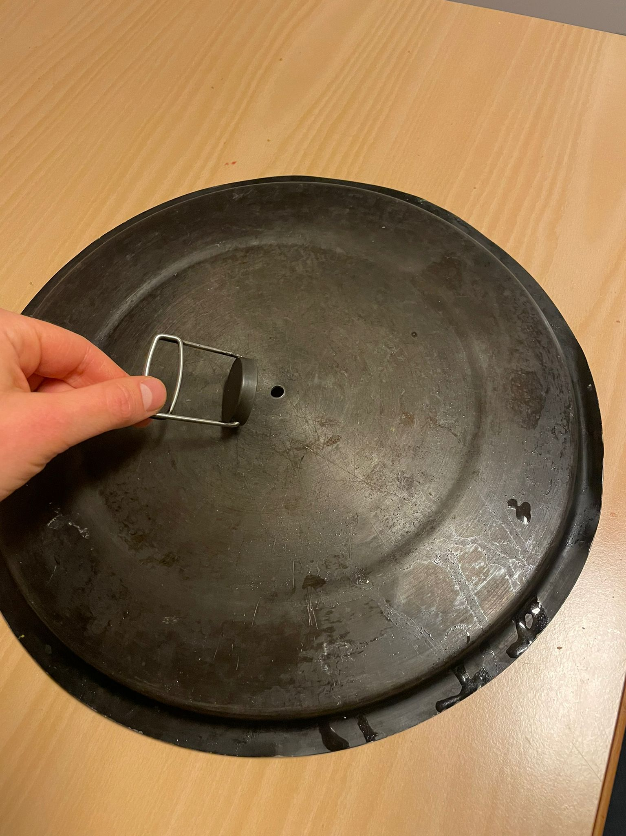
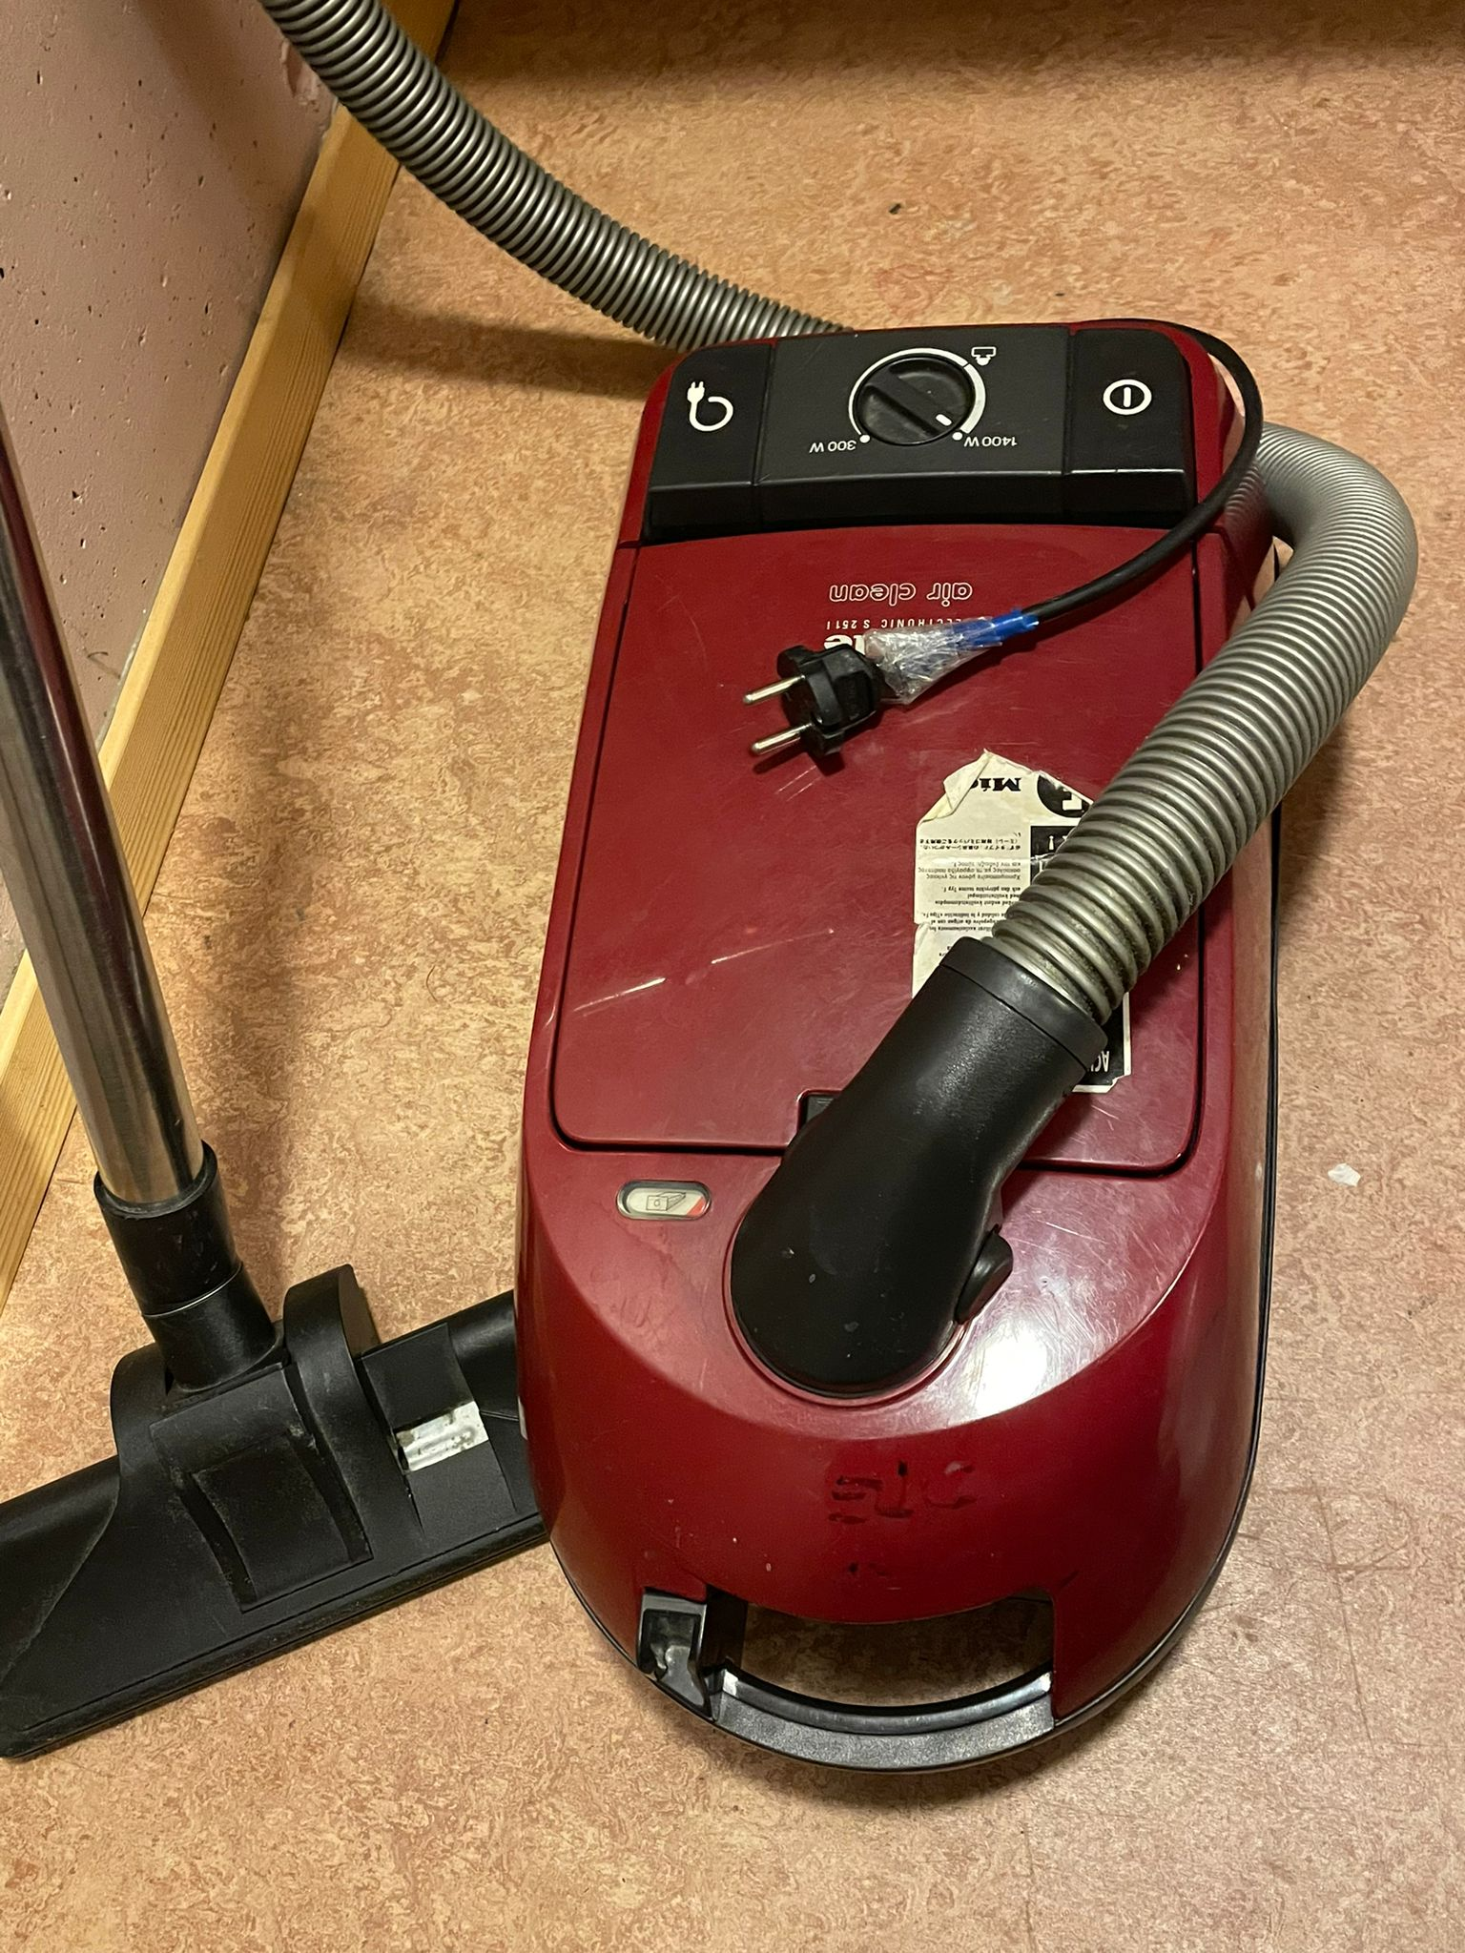
The problem
Broken items at home
Students living alone
Lack of skills
Solutions????
Pay a service-man X
Throw them away X
Replace them X
Notes:
As Alex, many of us has certainly experienced this problem. The lack of skills makes it even more difficult for students to repair items instead of buying new ones. We all agree that paying a service-man or throwing things away aren’t good solutions as well.

Slide 4
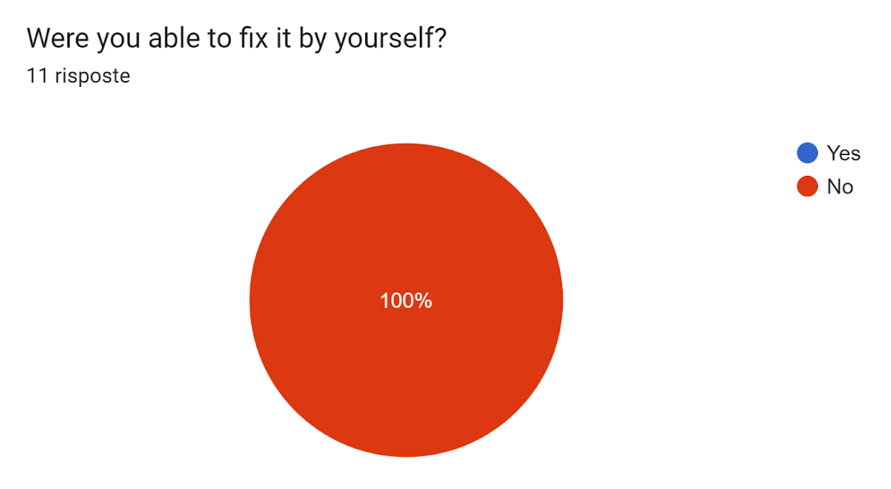
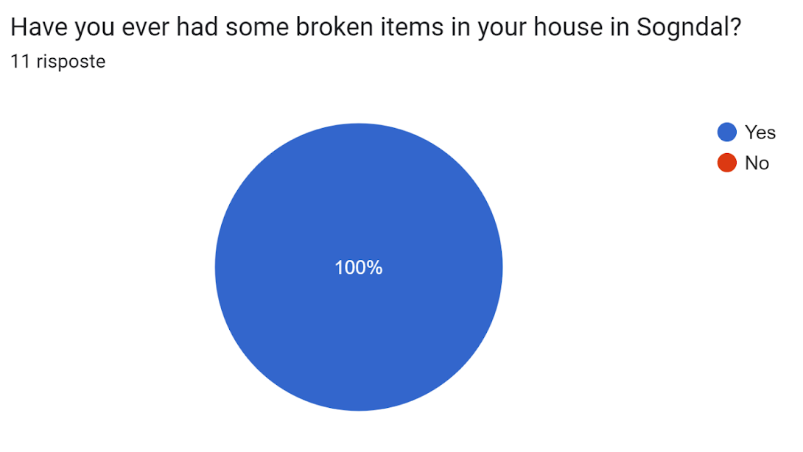
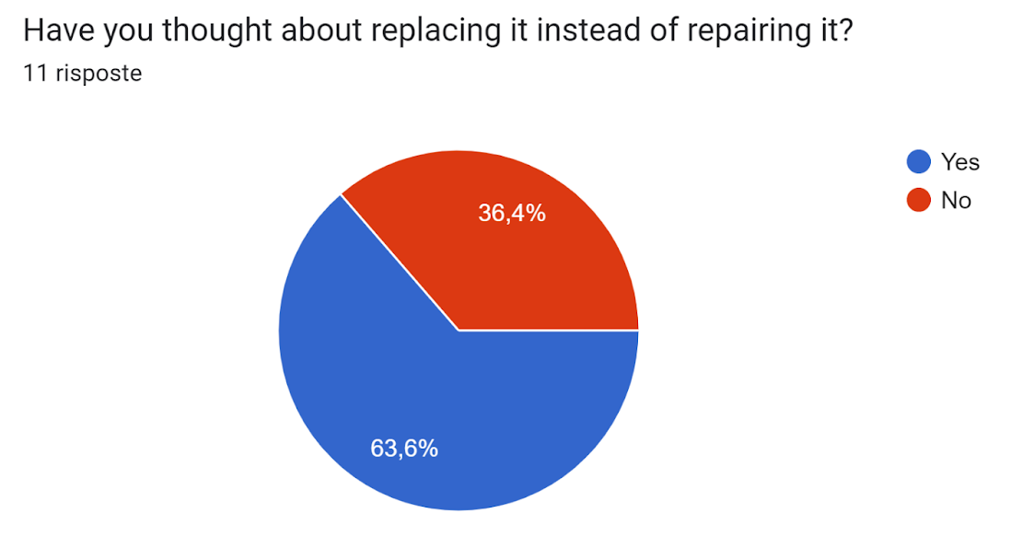
A simple survey among students
Notes:
We conducted a little survey which was responded by 11 students. We asked them different questions and found out these results: 100% of them reports at least one broken item at home. 100% of them were not able to fix them. Finally the majority of them (63,6%/ thought about replacing them. Based on this simple statistics we can see how the challenge we are tackling is common and feasible. Therefore we can guarantee that the solution we are offering will rise interest in many students.

Slide 5
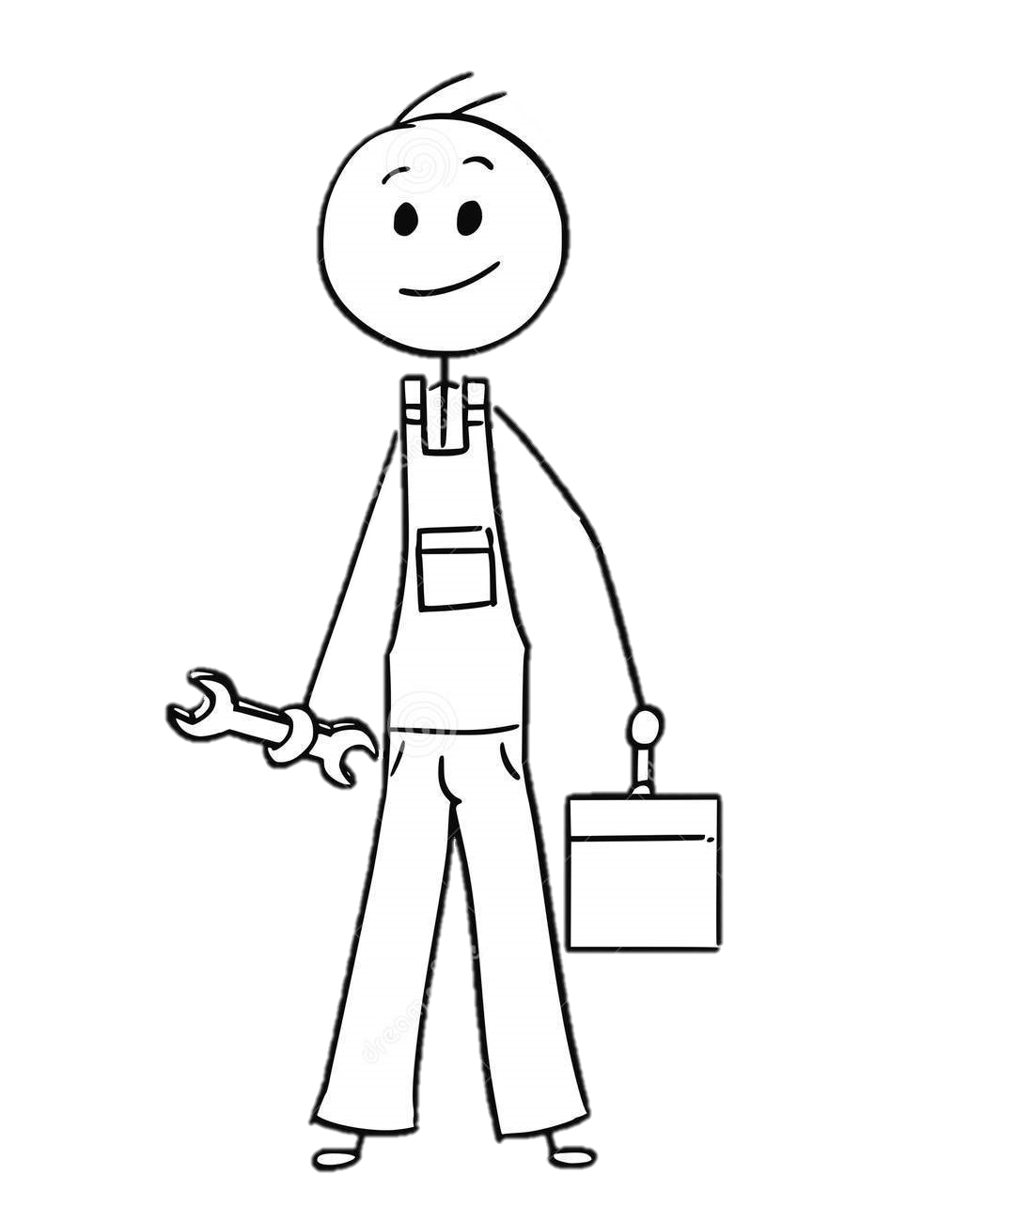
Our missions
MAKING ITEMS LIVE AS LONG AS POSSIBLE
EMPOWER OURSELVES
Notes:
That is where our idea came from. Our slogan «Long Live the Things» perfectly explains our mission: making items live as long as possible in order to avoid unnecessary consumption and waste and create a network of knowledge and skills to empower ourselves.

Slide 6
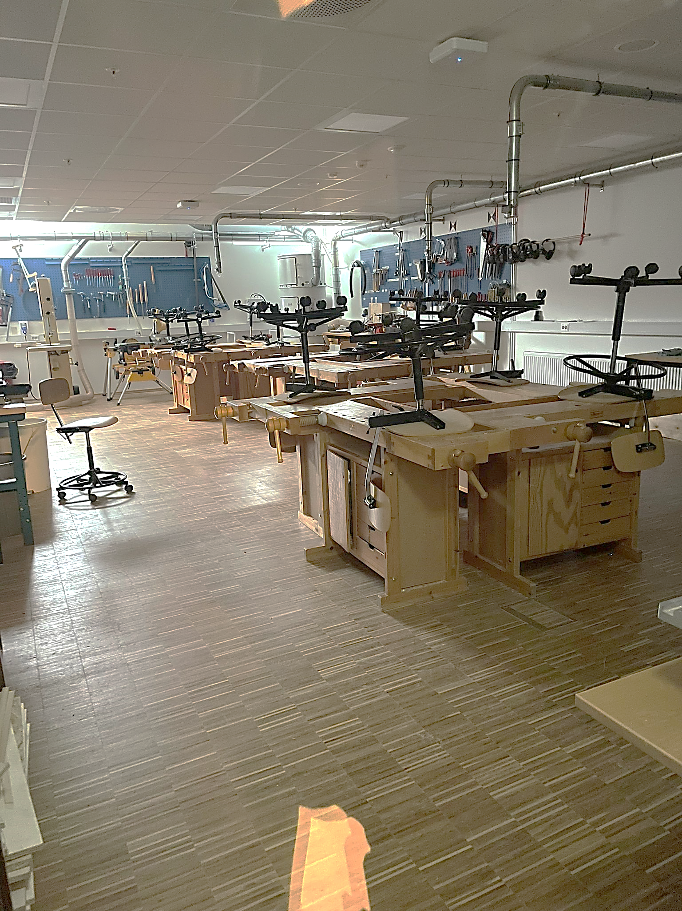
Where? When? How?
U010 EITRE - Bragebygget
Weekly meetings: Thursday 16-20
Workshops on the 25° of every month
Practical tips and info on our Facebook page
Notes:
The FIY project will be organized as an open hub where everybody can come and bring their broken items matching with someone that shares their knowledge/skills. It will take place here at HVL Campus, U010 Eitre, Bragebygget. The room will be available every Thursday 16-20 starting from the end of March. Furthermore, monthly workshops with local experts and handymen will be organized in order to bring everybody on the same page. You can also find us on Facebook with our practical tips and daily info.

Slide 7
Our Timeline
ACTIVITIES | WEEKS
 | 1 | 2 | 3 | 4 | 5 | 6
Meeting and arranging with administration
Create network with local experts
Promoting the project
Launch
Notes:
Here you can find our timeline. We are going to start our project starting from next Thursday (the 16°) plan to meet and arrange with the university administration in 3 the following three weeks. We will create the network with local experts from week 2 until week 5 and promote the project in the fifth and sixth week. The launch will finally take place in the sixth week (23° March)

Slide 8
JOIN US!!
Follow us on facebook to keep updated
Join our weekly meetings and monthly workshops
If you have any skill or knowledge come and share them with the others!
From the 20° to the 22° of March you will find our stand in the canteen!
First meeting: 23° of March in U010 EITRE - Bragebygget
Notes:
Alex has finally got light in his room thanks to the help of FIY volunteers! Join us to have an happy ending with your broken items as Alex did!!

Slide 9
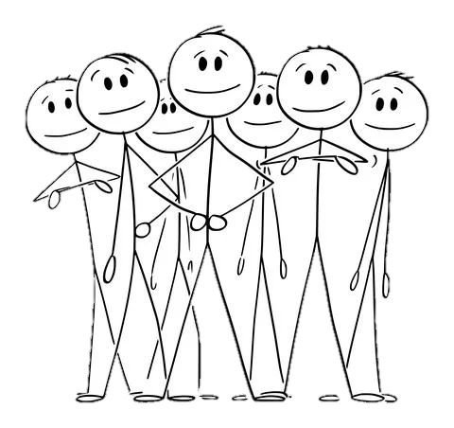
Budget
Voluntary project based at university
Main goal: NOT earning, BUT sharing
Tools available in the U010 EITRE - Bragebygget
Specific materials freely provided by our company partners
snacks for meetings and workshops are 300 kr per month
We are going to ask university department to fund our project

