Slide 1
FJELLVENN
An app for outdoor enthusiasts looking to reduce emissions

Slide 2
HAVE YOU EVER DRIVEN WITH EMPTY SEATS IN A CAR?

Slide 3
< 2 people in a car
In Europe, on average there are…

Slide 4
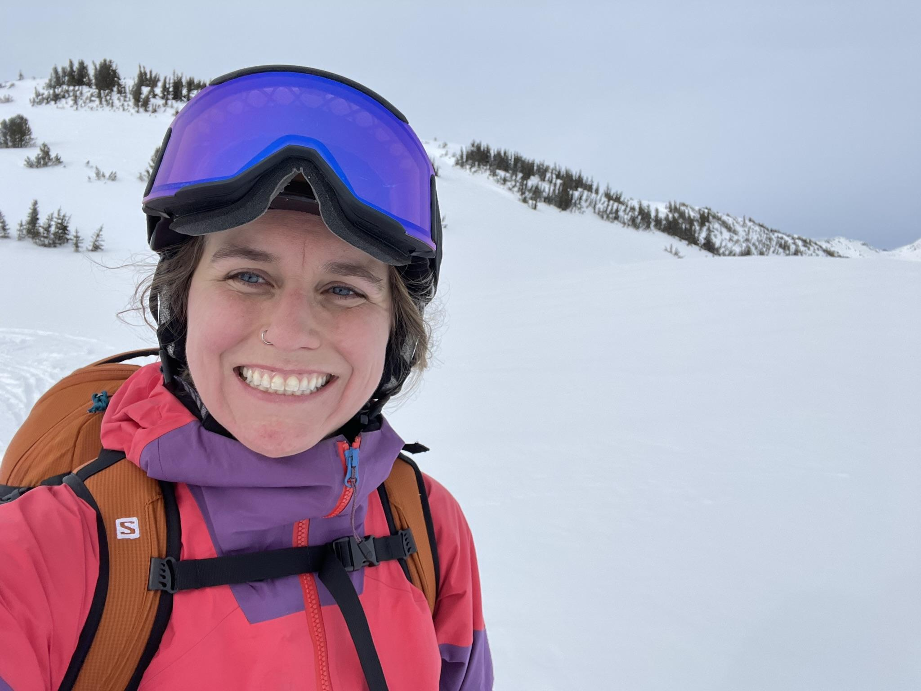
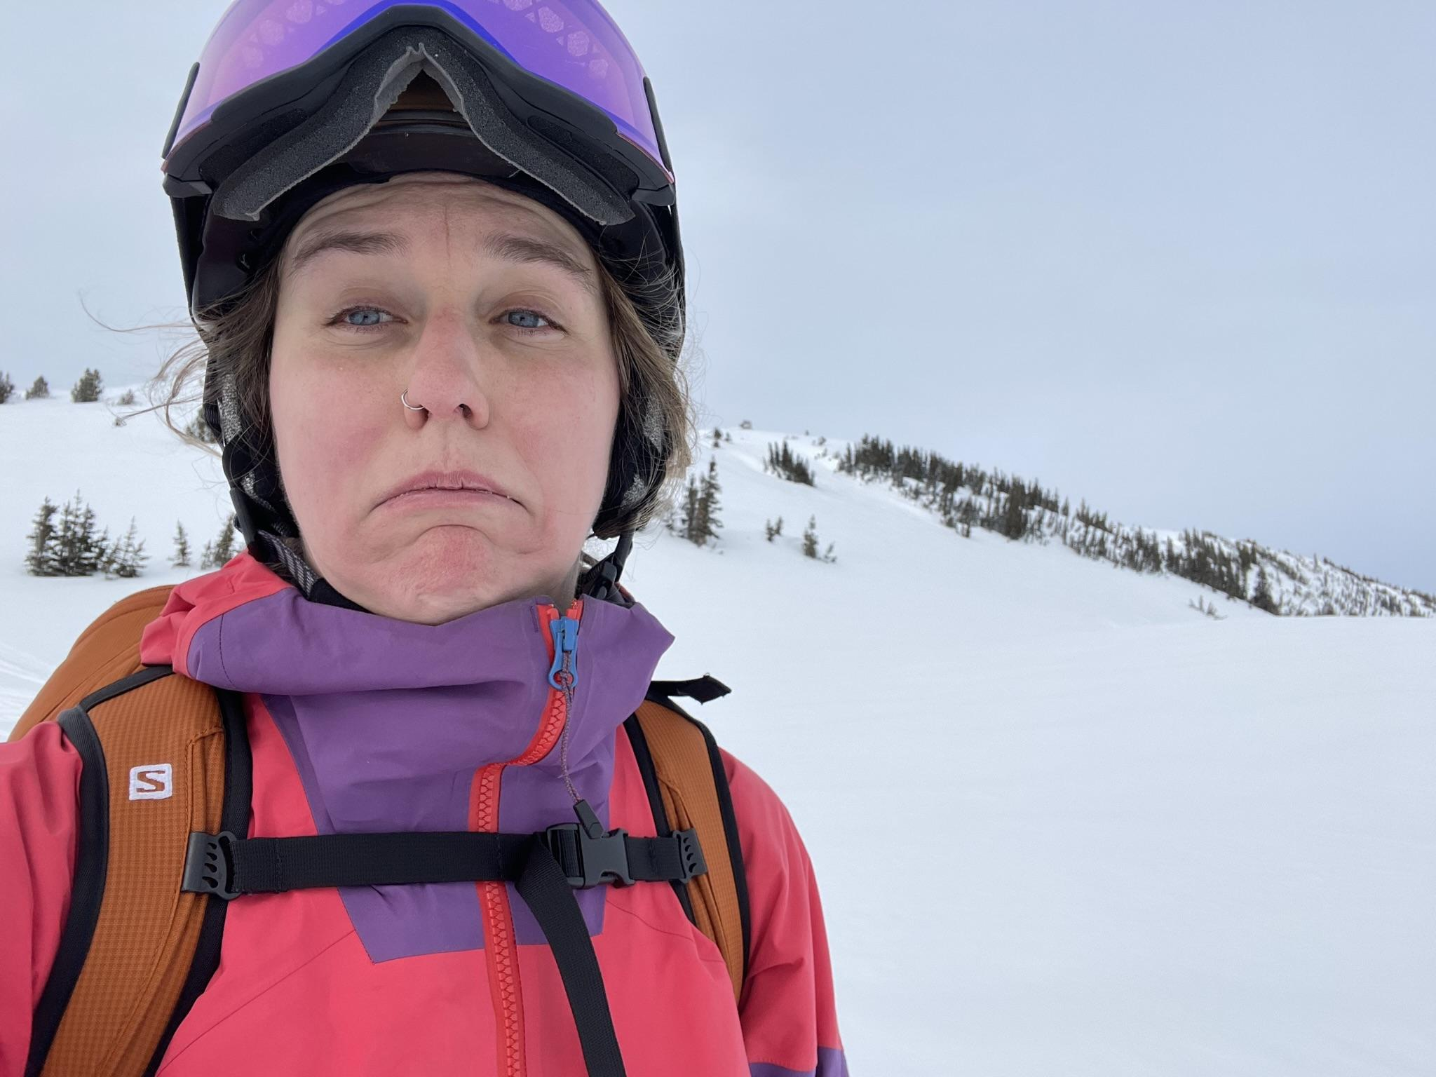
MEET PAULINA
International student who wants to go to the mountains but doesn’t own a car! She wants to buy a car to take her where she wants to go.

Slide 5
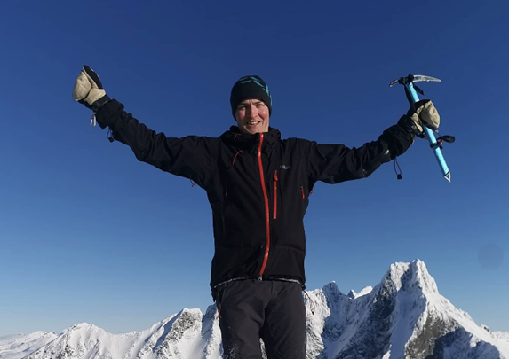
MEET HANS
Goes to mountains often BUT … Usually has empty seats in his car. He wants to be more sustainable but doesn’t know how!

Slide 6
FJELLVENN
A carpool app that connects people in Sogndal and encourages people going to the outdoors (hiking, skiing, climbing, kayaking) to share rides and reduce emissions!

Slide 7
OBJECTIVES
Lower
Emissions
Create Community
More Economic for Drivers
Reducing emissions with rideshare
Connecting people in the outdoors community
Encourage drivers to participate with added benefits (gas money, free parking)

Slide 8
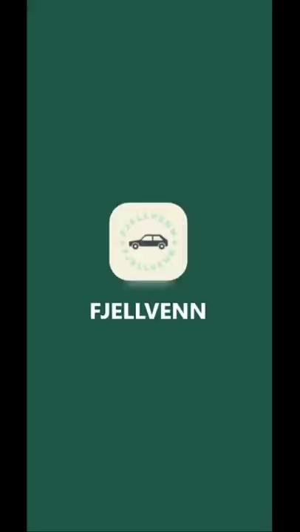

Slide 9
COMPETITORS
Offers carpooling but is not typically used in Sogndal
Offers carpooling but not widely used and doesn’t offer driver profiles

Slide 10
BUDGET
Item | Price
App Development | 200.000 NOK
Maintenance of the app | 20% off the app development each year
App Profits | 20 NOK per ride (5 rides per day = 40 000 a year) + advertisements (20 000)

Slide 11
TIMING
4 Weeks
1 - 4 Weeks
1-4 Weeks
Total of 3 months
App development/Testing phase
Advertising and marketing strategy.
Revising and
App support
Finished and working app

Slide 12
EXISTING PARTNERS

Slide 13
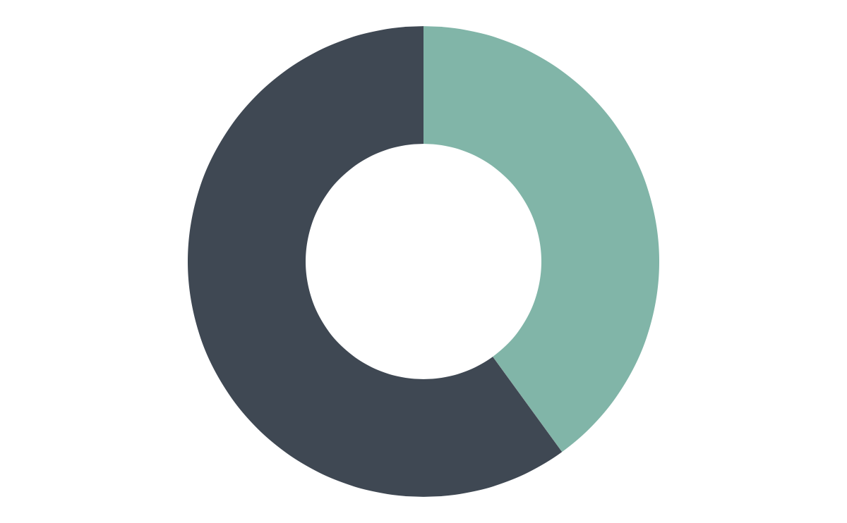
INVESTMENT
60%
40%
Existing Partners
Future Partners
Join us!

Slide 14
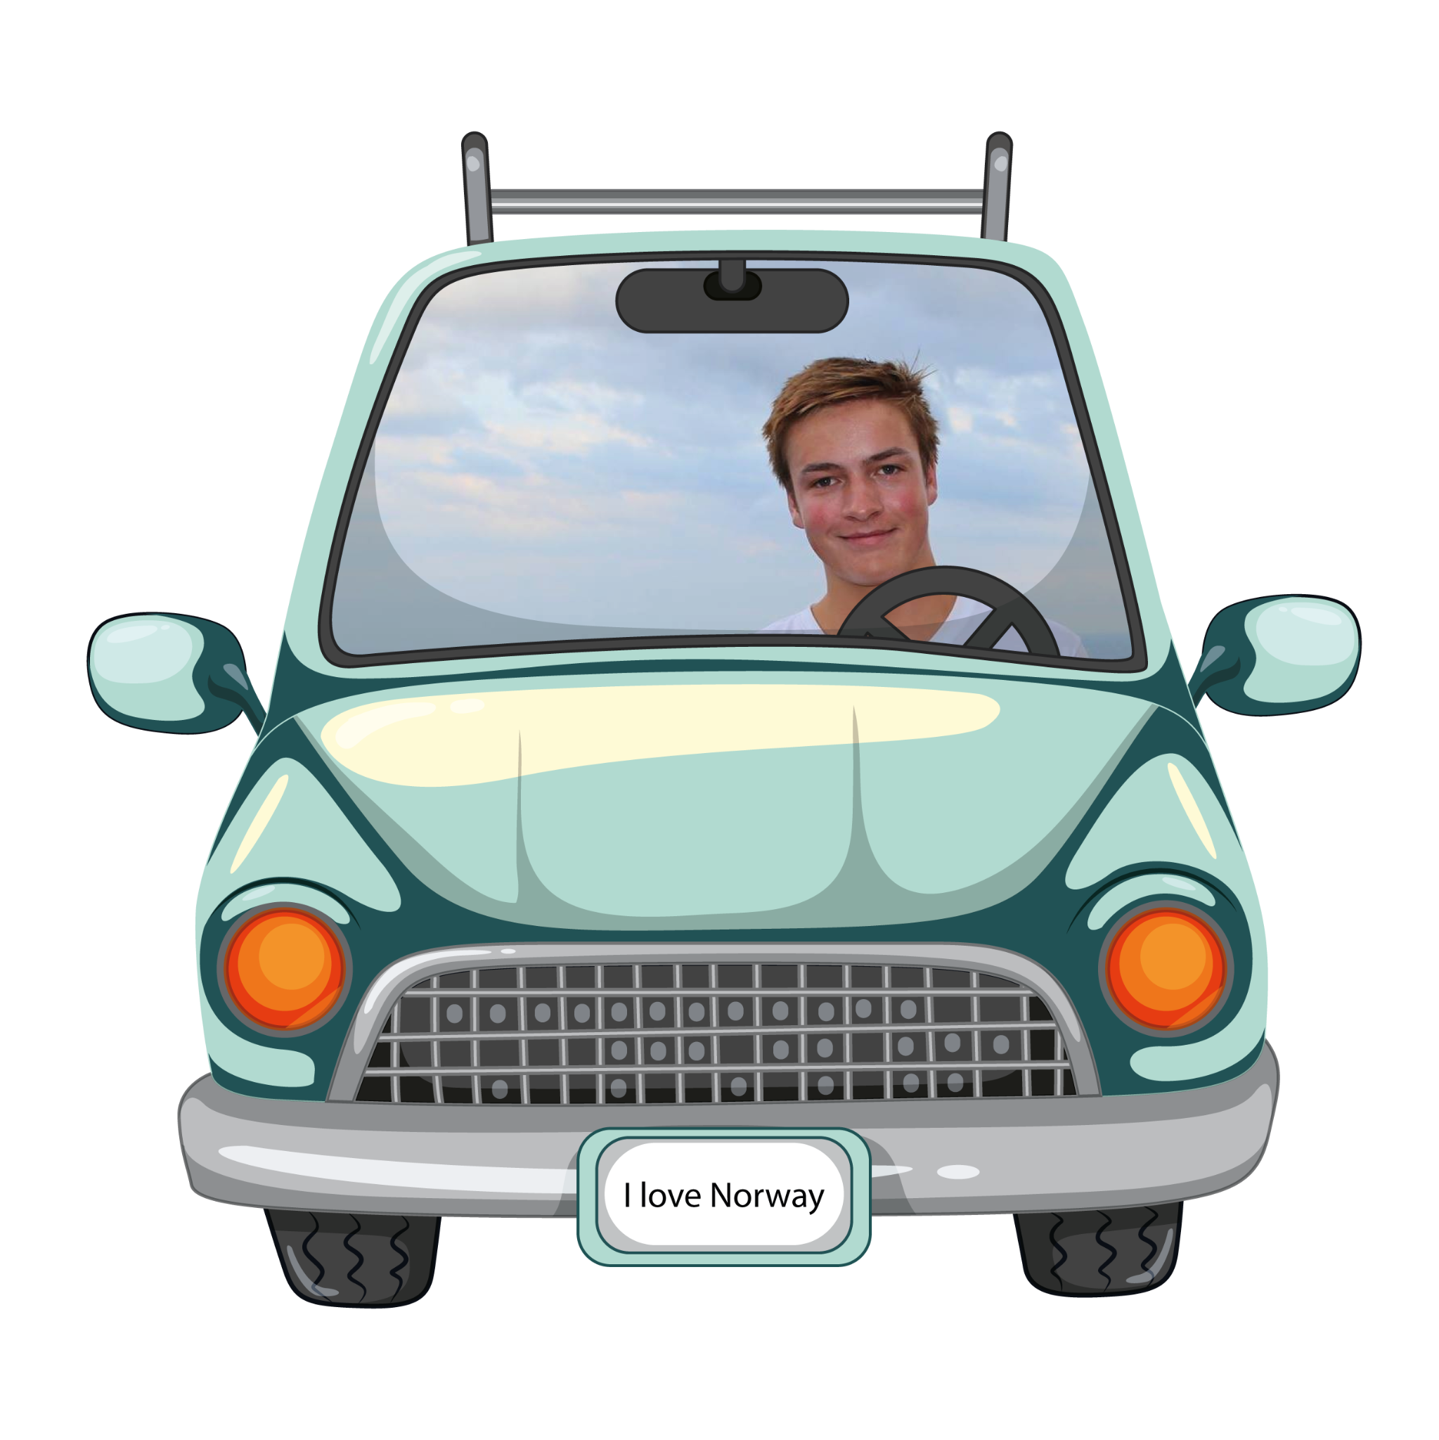
WITHOUT FJELLVENN

Slide 15
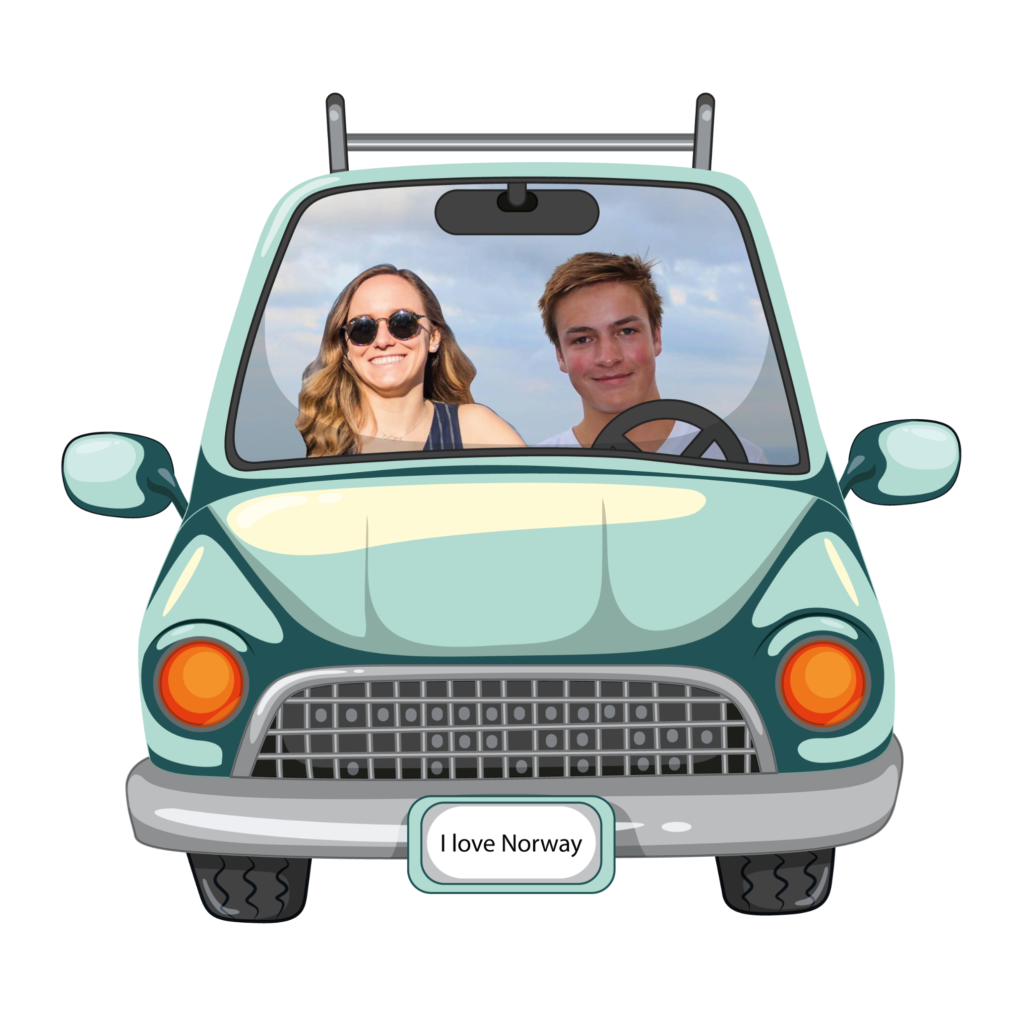
WITH FJELLVENN!

Slide 16
TAKK FOR TUREN!
Are you interested in investing in FJELLVENN?
hei@fjellvenn.no
+47 979 60 626
fjellvenn.no
Please keep this slide for attribution

