Slide 1


Slide 2
The Refinity mission
Eliminate the use of one-time plastic cups from concert venues.
(And save the whales)

Slide 3
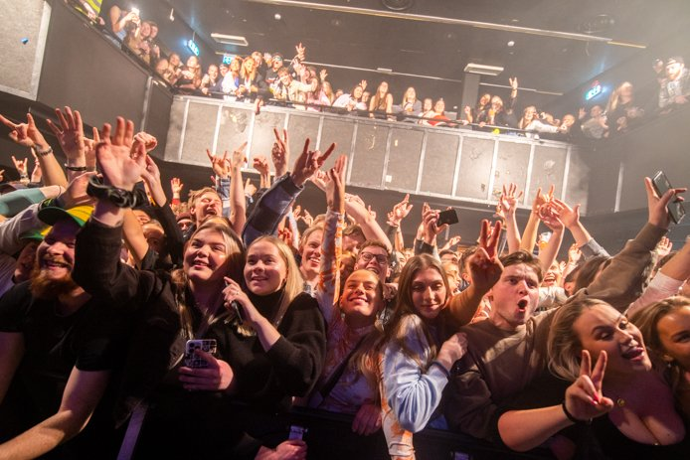

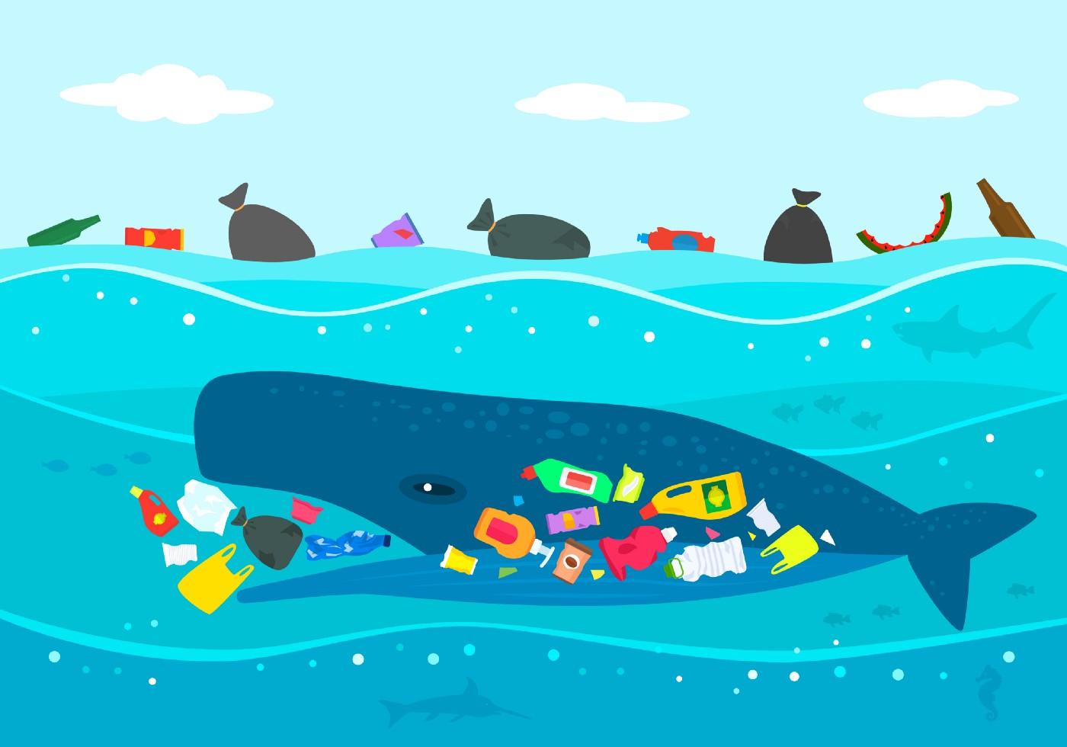
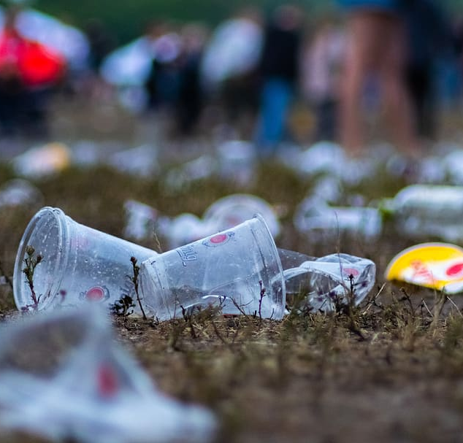

Slide 4

PRODUCT DESCRIPTION
REFINITY CUP
REFINITY COLLECTOR
Concert venues use one-time plastic cups
Due to safety concerns
Not sustainable – high plastic velocity.
CONCSIOUS STUDENT

Slide 5





Reusable – 5-year warranty.
Easy to wash in standard washing machines.
Light weight and sturdy.
The Refinity Bin creates easly asscesible on demand return points throughout the concert venue.
Using The Refinity Cup and Bins Eliminates the need for one-time plastic cups at concerts, while also fullfilling requirment for safety.

Slide 6

The Refinity cups are produced using recycled plastic.
pilot production capacity secured
Wholesale price of each cup estimated at NOK 10

Slide 7
The Refinity Plan

Slide 8
Case study – Current situation
Studenthuset Meieret [SM]
Concert venue for students in Sogndal
Approximately 10 – 20 concerts p.a.
Approximately 150-person capacity.
SM uses plastic cups during for safety reasons
Potential hazard from broken glass.
Potential hazard from glass being thrown at crowd/artists.
Assume, on average, that one plastic cup is used per attendee.
Total consumption p.a. = 3 000 one time plastic cups.

Slide 9


Action
Take responsibility into your own hands!
Party with a clear conscience!

