Slide 1
Nasim, Harry, Abhishesh, Fatemeh, Sarah

Slide 2
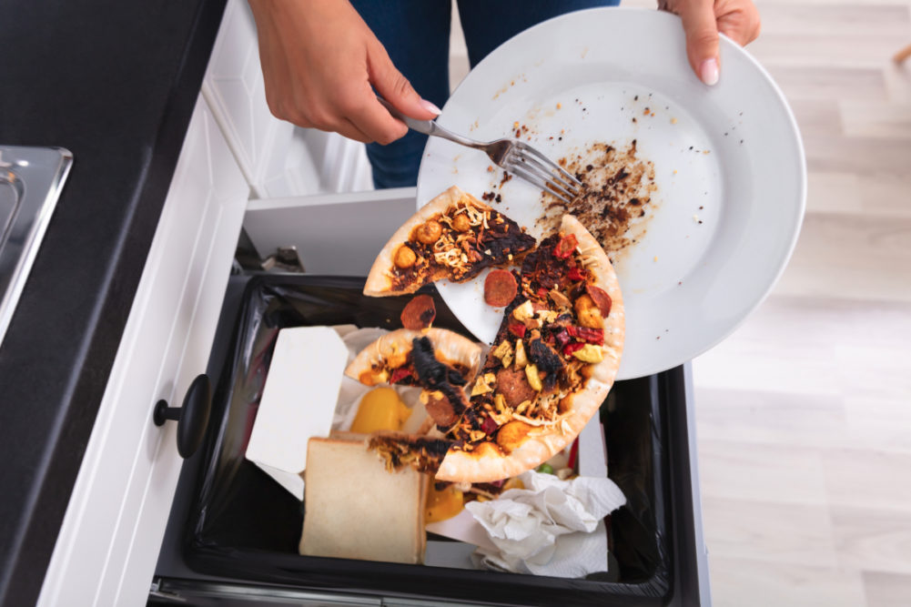
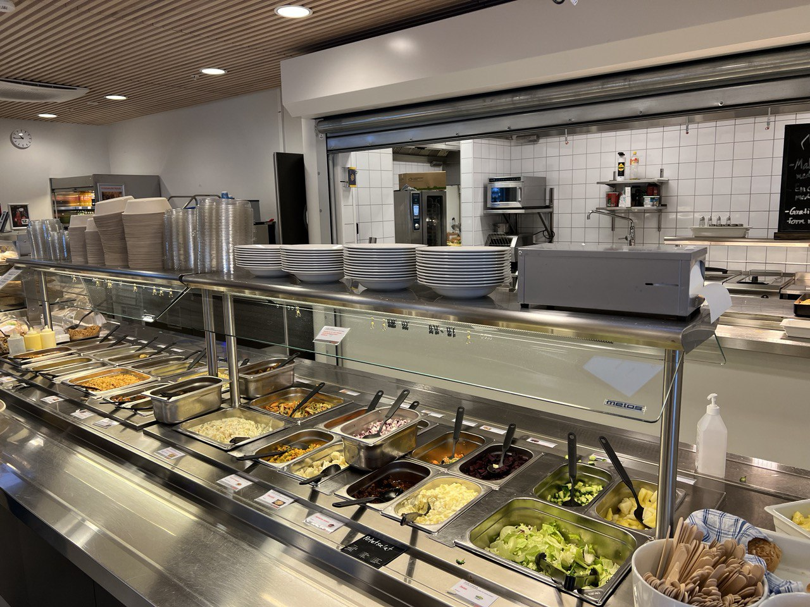
Problems

Slide 3
Meet FIVH
WWB+FIVH= Win-Win situation

Slide 4
Solutions
Segregate composting and non-composting food waste
Food waste will be collected from canteen and Samman cafe
Produce compost
Trasport to FIVH Garden
Grow vegetables
Fresh vegetable will sell to canteen with discount to be use

Slide 5
Expenditure and Income
Title​ | Pricing (Norwegian Kr)​ | Remarks​
Container ​ | Free​ | Reuse of plastic containers that are not in use (Volunteering ask with Students/Professors who have waste plastic containers)​
Worm (Red Wigglers)​ | 140​ | Best recommended by experts ​
Transport cart​ | 650​ | ​
Greenhouse ​ | 12000​ | 10sqm=Rs 12000 kr (Total FIVH Garden: 10sqm) ​
Vehicle for transportation​ | 1000​ | Only use Electric (1 time use in a month that is also in Rent)​
Packaging​ | Free​ | Encourage public to bring their own bags/ Not accepted plastics​
Maintenance​ | 1500​ | ​
Total​ | 15290​ | ​
Probable Income​
Tentative Food Waste Production in 3month​ | Tentative Compost Production (50% conversion)​ | Income after Selling the Compost (5kr/kg)​
2-3 Quintal​ | 1-1.5 Quintal ​ | 425-675 NKr​ (Estimated Income per month)/Vegetables will be quantify after the production only
15 KG of compost will be used in FIVH garden and rest will be sold to public, will try to expand FIVH Garden with communication to Sogndal Communa and HVL ​

Slide 6
Probable Collaborators
International collaborators
Local collaborator
National Collaborators

Slide 7
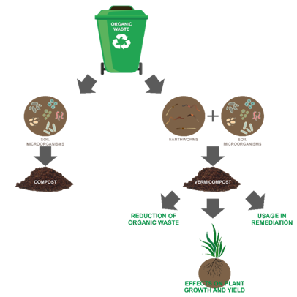
Current and Future Steps
Time Period | Activities
1st Month | Research for the Project
2nd Month | Discussion and negotiations with Collaborators/ Try to get the fund/ Discussion with Saman and Arrangement of Store sites, Equipment and other required Documents
2nd Month and Continue | Start to collect the waste from the Cafeteria and Canteen
4th Month | Producing the Compost
4th Month | Investigation from Ministry of Environment (Miljo Departmentet)
5th Month | If clear from MoE, starts to use in FIVH Garden and if not try to follow the regulation and get the perfect compost
6th Month | Selling Compost to Public and our partners
Future | Collaborating with Public and Restaurant in Sogndal

Slide 8
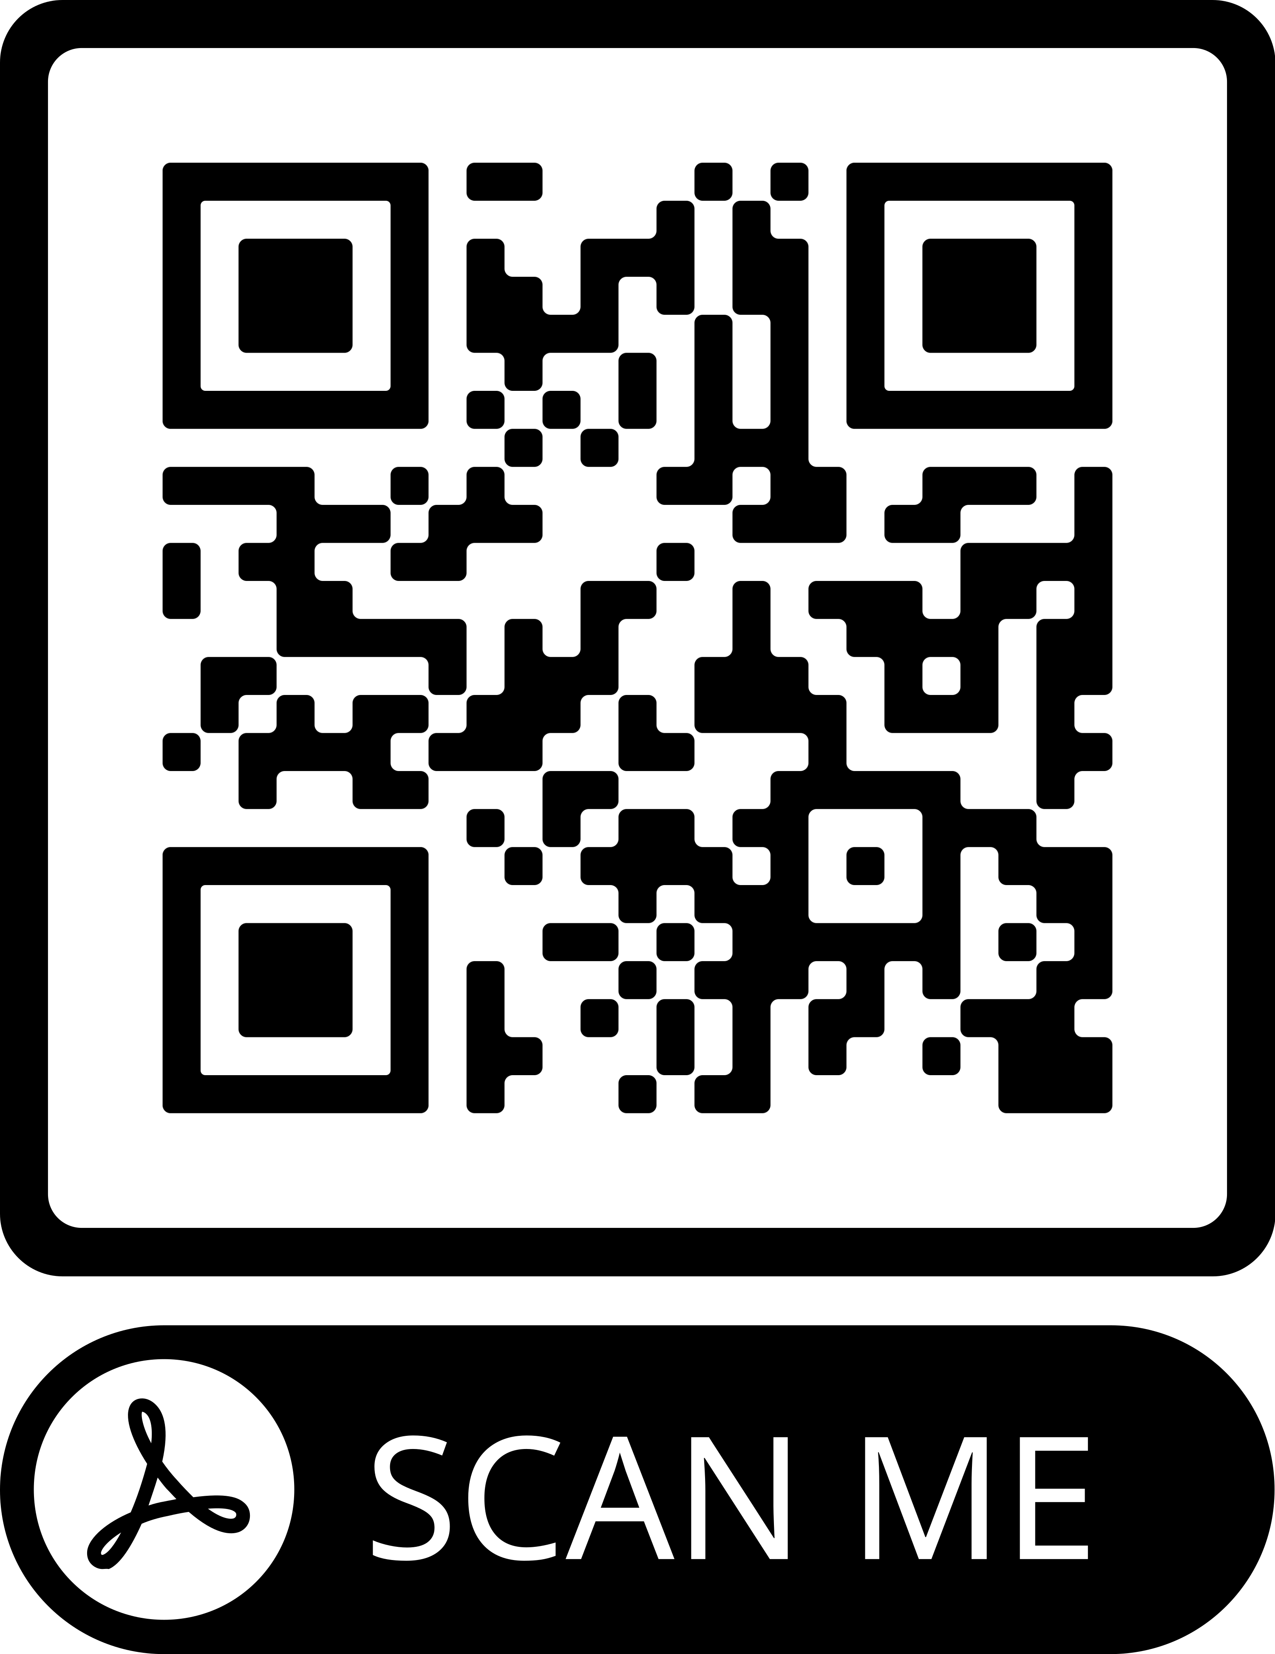
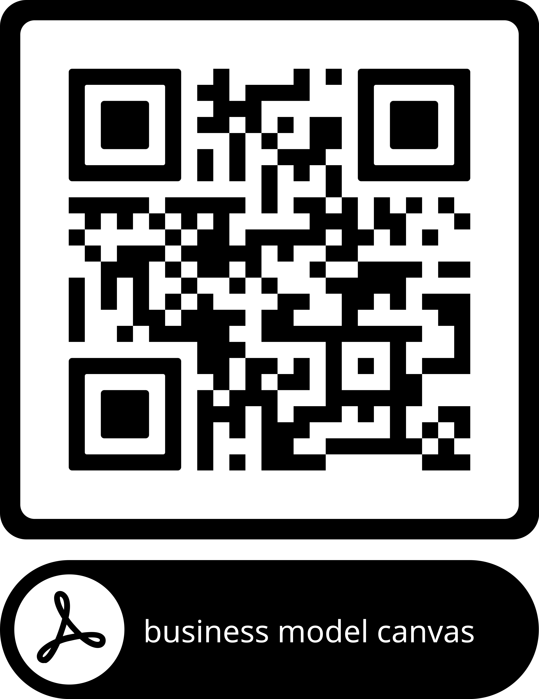
Education
Everyone can scan our QR code and access our booklet to get more information about compost. With our guidance, they can compost at home and use it for their garden
Our business model canvas

